Slide 1
Time and Space in Knowledge Graphs
Ernest Davis
Ontology Summit 2020
May 6, 2020

Slide 2
Time

Slide 3
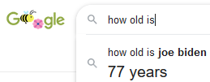
Who is older, Joe Biden or Mitch McConnell?

Slide 4
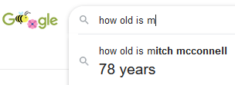
Who is older, Joe Biden or Mitch McConnell?

Slide 5
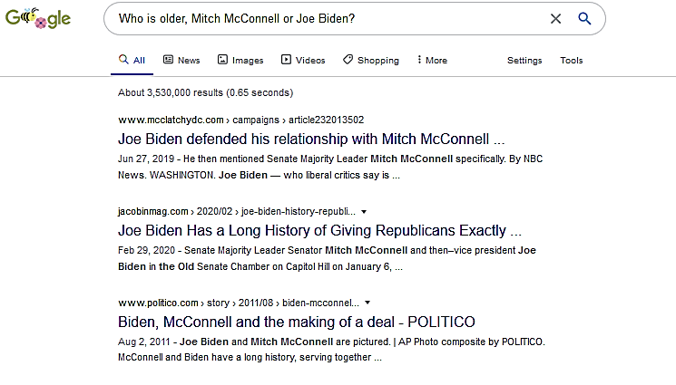
Who is older, Joe Biden or Mitch McConnell?

Slide 6
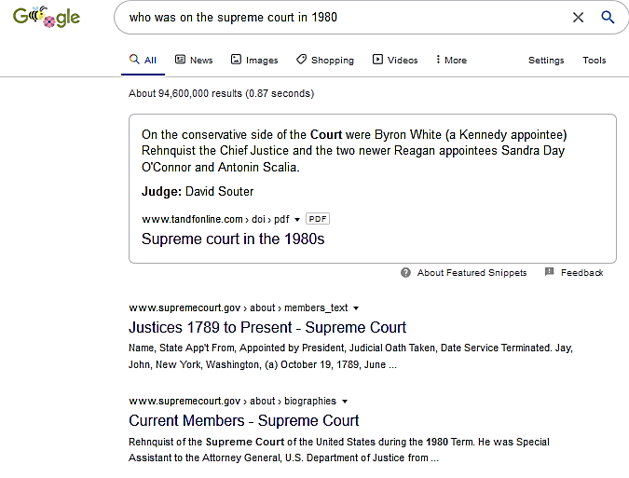
Who was on the Supreme Court in 1980?

Slide 7
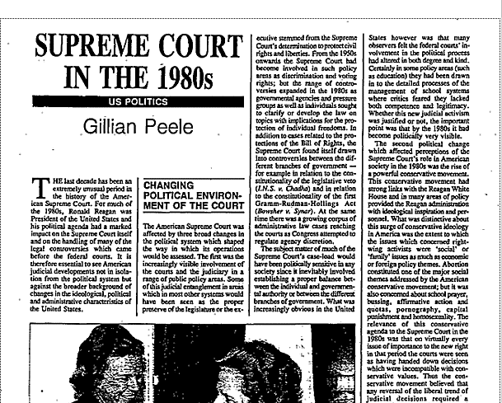
Who was on the Supreme Court in 1980?

Slide 8
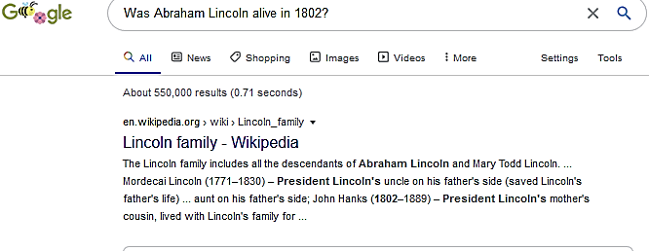
Was Abraham Lincoln alive in 1802?

Slide 9
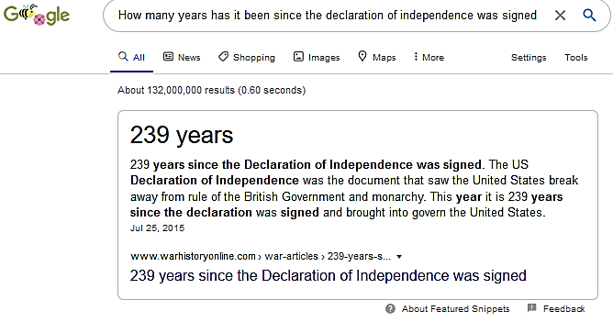
How many years since the declaration of independence was signed?

Slide 10
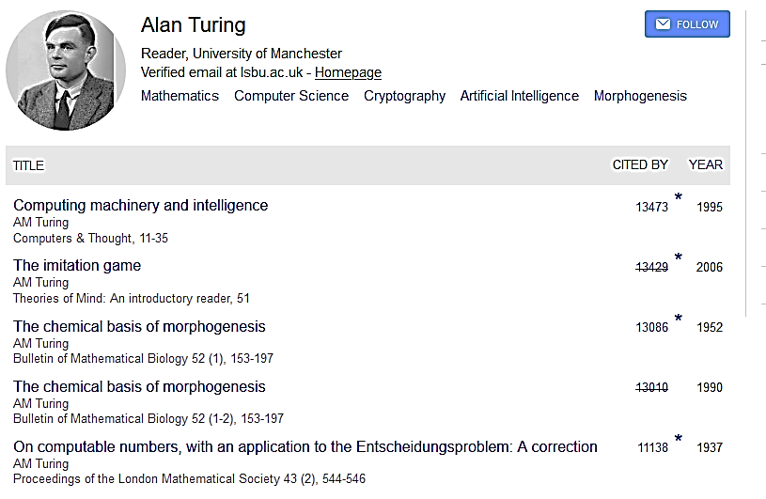
Temporal meta-data in Google Books and in Google Scholar are full of errors.

Slide 11
Applications of temporal reasoning
Text/video understanding
Narrative
  Medical records
Question answering
Scientific/technological
Information retrieval/QA –
The problem of outdated information.
Prediction
Scientific/technological/social
Planning
Robotic/Personal/Commercial/Software analysis
In any domain where things change, you have to deal with time. And, to deal with time flexibly and reliably, it’s best to have a systematic approach rather than a collection of ad hoc patches.

Slide 12
State of the art in knowledge graphs
(Generally speaking, and as far as I know)
Many relations that are in fact time-dependent are taken to be atemporal. E.g. the spatial extent of a country.
Time stamps, when they are there at all, are often “decorations” with little or no semantics.

Slide 13
Time: Issues to address: Outline
In increasing order of difficulty:
Well understood:
The basic model
Temporal representations
Temporal reasoning technology
Difficult:
Collecting temporal information from text
Indexical expressions in text (i.e. relative to the date of the text)
Domain inference

Slide 14
Basic model of time
The basic model of time is the simplest and most reliable in knowledge representation:
In simple narrative, time is an ordered line isomorphic to the real line.
Comparison, addition, and subtraction suffice for most purpose.
For counterfactuals and for planning, you additionally need branching time.
That’s it.

Slide 15
Temporal representation
Situation calculus (McCarthy, Hayes, Reiter): Branching, discrete.
Interval calculus (Allen): Linear. Order relations on intervals.
McDermott’s temporal logic: Branching, continuous.
Event calculus (Mueller): Interaction of events and states. Linear.
Modal temporal logic (Prior, Pnueli).
Dynamic modal logic (Pratt)
Different things are possible/convenient to represent.

Slide 16
SotA in temporal representation
Vagueness is an unsolved problem, as throughout KR, and in dealing with language this is a serious limitation.
But otherwise:
The purely temporal aspects of practically any situation can be represented.
The purely temporal aspects of most reasoning can be characterized and implemented efficiently.

Slide 17
Temporal reasoning technology
Basic time line reasoning – simple linear inequalities. Interval algebra.
High level planning.
Temporal data bases.
Program verification. In many ways, immensely powerful. Can deal with complexities such as:
  Subtle side-effect relations
  Conditionals and loops
  Asynchronous parallelism

Slide 18
Wide range of scales
A six-month trip involves actions of 1/10 of a second. Ratio: 1.5*10⁸
It may involve reasoning about distances ranging from 1 mm to 10,000 km. Ratio: 10¹⁰
This becomes an issue for a number of different kinds of algorithms and representations.

Slide 19
Extracting temporal information from text
Time relations between generic/repeated/ongoing/hypothetical events are difficult to characterize and left implicit.
“Afraid of Covid-19, parents are postponing well-child checkups, including shots, putting millions of children at risk of exposure to preventable deadly diseases.” NY Times, April 23, 2020
Events are stated out of order.
“Tony managed to pour the wine, though he had to take out the cork with a knife, because he couldn’t find the corkscrew.”

Slide 20
Indexical expressions in text
The majority of time references are indexical.
“Last week”, “At 2:00 today”, “Next Tuesday”, past vs. present vs. future.
Indexicals in conversation, or in the question of a Q/A system almost always refer to the current moment. That should be easy.
Indexicals in a text or a recording generally refer to the time of writing/utterance. But there are exceptions, e.g. within quotations.
Placing in an absolute time line requires finding the date of the text/utterance.
This can range from trivial (if dated) to extremely difficult (if not).

Slide 21
Extracting temporal relation from video
If video time = real time, then trivial.
Else (finding the time relation between two consecutive scenes in a film) extremely difficult in general.

Slide 22
Domain-specific inference
Older(x,y) iff BirthOf(x) < BirthOf(y).
If Holds(t,Alive(x)) then BirthOf(x) ≤ t ≤ DeathOf(x)
The background knowledge in the wine-pouring examples and in the vaccination example are much harder to characterize.

Slide 23
Take away for Time
Extremely important problem in many AI situations.
Some aspects are straightforward, others are AI-complete.
A lot more could pretty easily be done with existing technology than is currently being done. A lot can be done with very short inference paths, either at query time or at fact addition time.
Obsolete and outdated information in knowledge sources is a serious issue.
In designing a knowledge graph, one should consider from the start what kind of temporal knowledge to include and how it can be used. Ignoring time and doing everything in the timeless present is often easy, but may not be wise.

Slide 24
Space

Slide 25
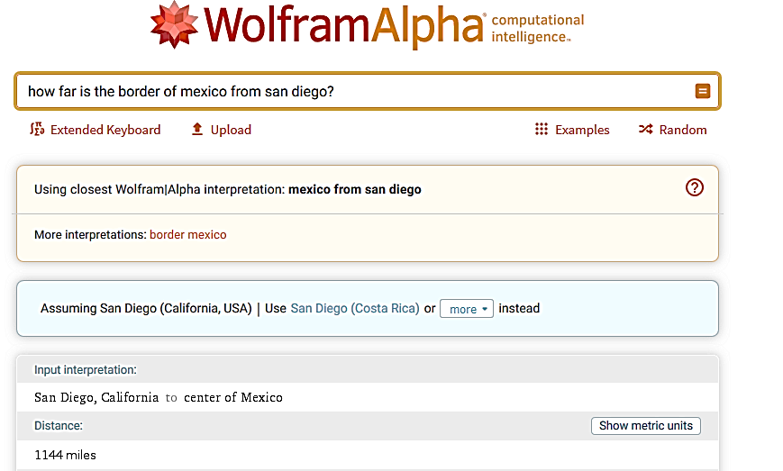
How far is the border of Mexico from San Diego?

Slide 26
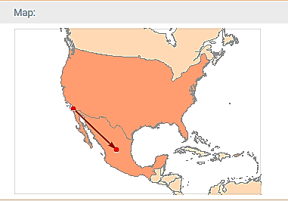
How far is the border of Mexico from San Diego?

Slide 27
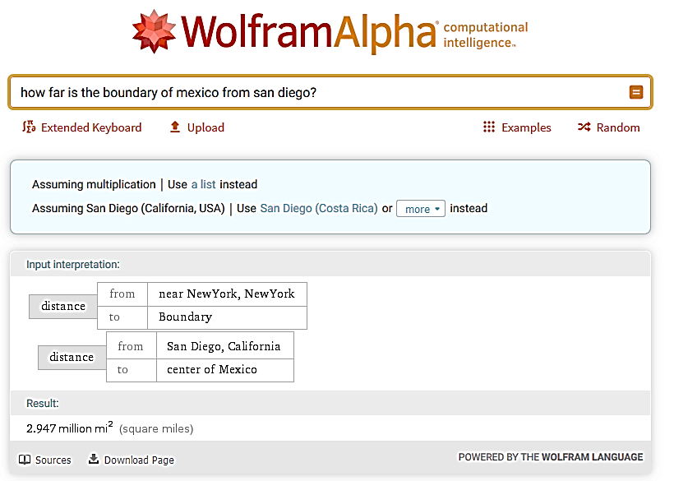
How far is the boundary of Mexico from San Diego?

Slide 28
Applications of spatial reasoning
Physical reasoning: Science and technology
  Prediction
  Explanation
  Design
  Planning
Robotics
Computer vision

Slide 29
Space: Issues to address: Outline
In increasing order of difficulty:
Well understood:
The basic model
Geographic information in knowledge bases
Spatial representations for exact information
Geometric calculations with exact information
Difficult:
Representation and reasoning with partial information
Extracting spatial information from data
Domain inference

Slide 30
Basic model of space
Three-dimensional Euclidean space. R³
A points is a point in R³
A region is a “well-behaved” set of points.
Other spatial entities are other kinds of sets of points, functions over points, etc.

Slide 31
Exact information: representation and computation
Point: Coordinates relative to a coordinate system
Regions: There are many representations:
Point cloud
Voxels
Constructive solid geometry
Mesh representation.
Etc. Depends on desirable features, computations to be performed, physical device.
Challenging algorithmic problems. Many algorithms, much software.

Slide 32
Geographic knowledge in knowledge bases
Location of the geographic center.
Bounding box. Extremes of latitude and longitude.
Specific measures e.g. area.
Containment relations. Bordering relations.
Maps as images.
Sufficient for some purposes (e.g. flight distance between cities).
Sophisticated systems like Wolfram Alpha certainly record more information, but are uneven in the degree that they use them.

Slide 33
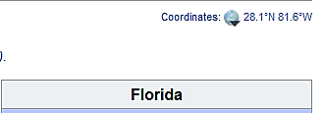
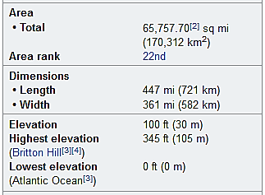

Florida geography in Wikipedia infobox

Slide 34
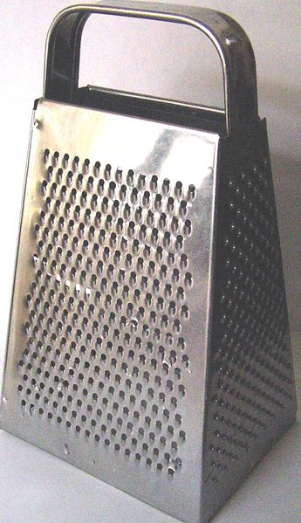
Incomplete or generic information
8’’ scale: Frustum of a pyramid.
3’’: Handle
1/4’’: Holes
1/8’’: Lip at hole
1/20’’: Sharp blade at lip
Topology: Holes go through grater connecting outside with cavity.
Repeated pattern of holes

Slide 35
Incomplete or generic information
If you turn a coffee cup upside down, the coffee will pour out.
A physics engine can do this (not as easily as you might suppose) if it has exact specifications of:
The shape of the cup
The turning motion
The amount of coffee in the cup
You want to use this inference in multiple directions: e.g. if you are holding a cup upside down then it is empty.

Slide 36
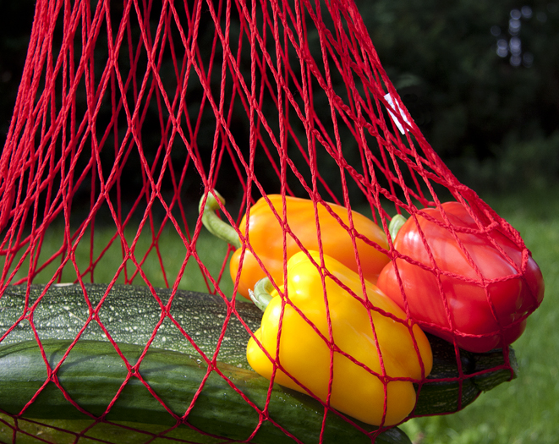
Incomplete or generic information
String bag is flexible though not elastic, so there is a lot of possible variation in overall shape.
Peppers will stay in the bag. Peas will fall through the holes. Elephants will not fit in the bag.
Regular structure of strings and knots.

Slide 37
Representation and reasoning:
A large gap between the theory that exists and the technology we need
There are systematic representations and reasoning techniques for specific qualitative spatial relations; e.g. part-whole relations; topological relations; direction between points in the plane; etc
But these are largely mathematics in (not very successful) search of applications.
There is no systematic representation for the significant qualitative features of the cheese grater or the string bag; let alone a reasoning mechanism for them. There are not even any good benchmark sets.

Slide 38
Extracting information from data
Natural language.
Notorious terrible for spatial information – especially shape, but also relative position. “A picture is worth 1000 words.”
Spatial pronouns are ambiguous.
  “coffee in the cup.”
  “milk in the coffee.”
  “a nail in the wall.”
  “bones in the foot.”
  “a car in the parking lot.”
  “a dent in the door.”
  “a bend in the road” …

Slide 39

Vision, images, video and measurement
Provide precise (often incomplete) information about specific situations, but not generic .
Extracting spatial relations is an understudied problem in vision.
Lots of vision systems identifies that as a man and can plausibly fill in his right side.
AFAIK, no current vision system infers that he is standing behind a barrier.

Slide 40
Domain inference
From the fact that a bottle is leaking
infer that it has a hole.
From the fact that a person walks from A to B in five minutes
infer that they are less than half a mile apart.
From the fact that a birthday present is in a small box
infer that it might be jewelry.

Slide 41
Takeaways for Space
Often an important question in applications.
When precise information is available and pertinent (often for geographic information; sometimes otherwise), there is a range of options. Consider with some care.
Keep an eye out for situations where incomplete information is significant. Do not simply recast them in terms of complete information. I would be interested to hear about them.

Slide 42
Thank you!

Slide 43
COMET (Yejin Choi and colleagues at Allen Institute for AI)
Input: PersonX ate a hot dog:
Sample outputs:
Because PersonX wanted to be full.
Before, PersonX needed to buy a hot dog.
PersonX is seen as hungry.
PersonX is seen as satiated.
As a result PersonX wants to drink water.
As a result, others feel full.
https://mosaickg.apps.allenai.org/comet_atomic

