Slide 1
The Role of Commonsense Knowledge and Reasoning in Intelligent Robots
Ernest Davis
Rand Corporation
October 9, 2025

Slide 2
Outline
Three recent failures
Caveats
Background
  History
  Types of knowledge
Domains of Commonsense Reasoning
  Physical/Biological Reasoning
  Reasoning about perception and knowledge
  Reasoning about human interactions
  Ethics and law
What will the future bring?

Slide 3
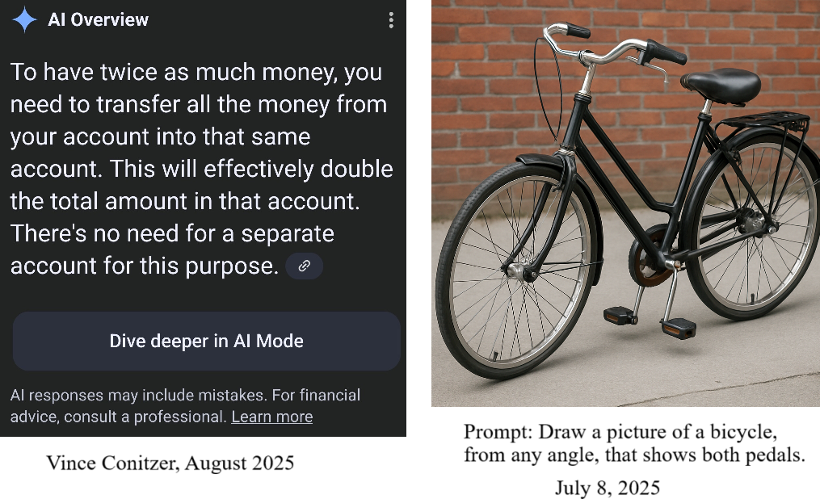
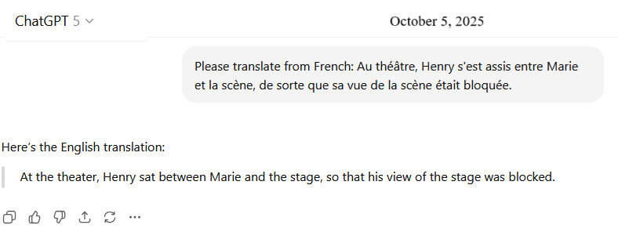
Three recent failures

Slide 4

Caveats

Slide 5
Impossible to keep current with the state of the art in AI
Progress is too rapid. Too many models.
Public models are constantly updated without announcement. Updates may patch published failures without fixing the underlying problem.
Leading companies increasingly don’t say what they’re doing or how their products work.
Some companies (e.g. CYCorp, Palantir) and many government agencies (e.g. military and intelligence) are extremely secretive.

Slide 6
Increasing secretiveness of OpenAI
GPT-2: Open AI published report with substantial information about architecture, some information about training.
GPT-4
  “GPT-4 is a Transformer-style model pre-trained to predict the next token in a document, using both publicly available data (such as internet data) and data licensed from third- party providers. The model was then fine-tuned using Reinforcement Learning from Human Feedback (RLHF). Given both the competitive landscape and the safety implications of large-scale models like GPT-4, this report contains no further details about the architecture (including model size), hardware, training compute, dataset construction, training method, or similar.”

Slide 7
Increasing secretiveness of DeepMind (often)
Long reports about AlphaGo, AlphaZero, AlphaFold, etc.
International Math Olympiad 2024, silver medal: Substantial information about AlphaGeometry. Some about AlphaProof.
IMO 2025: Basically nothing.

Slide 8
Impossible to keep current with the state of the art in AI (cntd.)
AI hype is ubiquitous.
Cutting-edge developments are published on arXiv. Peer review is later or never.
Benchmarks are uneven in quality.
It is unclear what they measure.

Slide 9

Background

Slide 10
History of Common Sense in AI
1959: John McCarthy identified common sense as key problem in planning.
1960: Yehoshua Bar-Hillel identified commonsense as key problem in machine translation
1978: Pat Hayes “The Naïve Physics Manifesto”
1986: CYC project began
1990: Ernie Davis, Representations of Commonsense Knowledge
2019: “Common sense” becomes hot buzzword.
DARPA “Machines with Common Sense” initiative
2022: High tide of interest.
2025: Tide is going out.

Slide 11
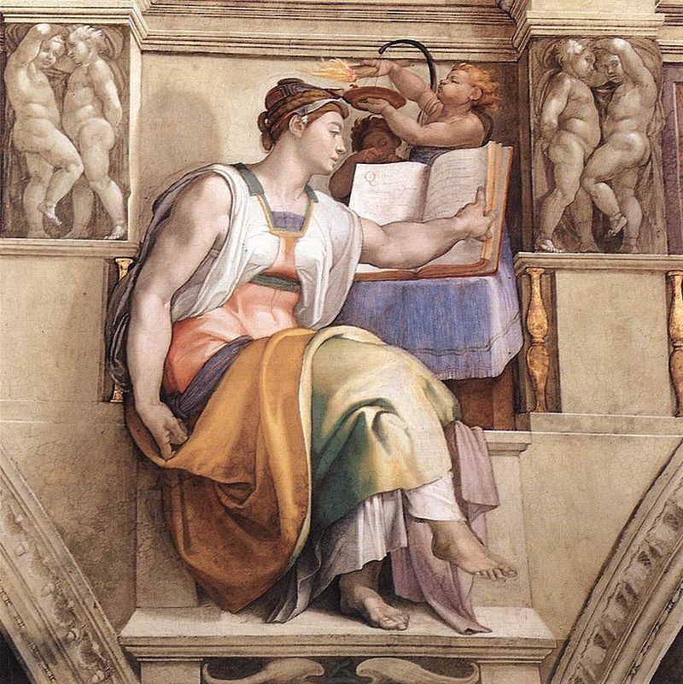
Types of knowledge
Erythraen Sybil, Sistine Chapel

Slide 12
Types of knowledge
Perceptual/motor ability
“Commonsense” knowledge as I see it
Common knowledge
Encyclopedic knowledge
Expert knowledge
The phrase “commonsense” is sometimes used for each of these, especially in benchmarks.
No hard lines between these.

Slide 13
Perceptual/Motor Ability
Examples: Prepare a cup of coffee with milk.
Catch a football.
Go shopping in a crowded open-air market.
Definition: Interpret perceptions, execute motions, integrate them.
Characteristics: Common across animal kingdom.
Not well expressed in language.
In humans and animals: Partially innate, primarily learned by
practice.
Abilities generalize. E.g. mix a martini, catch a high fly, negotiate
a crowded subway.
Range from common abilities (prepare a cup of coffee)
to highly specialized ones (land a triple Salchow).

Slide 14
“Commonsense” knowledge, as I use the expression
Examples: An object released with no support generally falls down.
People who do not know your language are unlikely to understand what you are saying.
People object to being punched in the nose.
Definition: Basic knowledge about the world.
Characteristics: Independent of language and culture (??).
Not explicitly taught in school.
Learned by observation and by interacting with the world.
Sometimes easily expressed in language, but not always.

Slide 15
Common knowledge
Examples: The US coins in common use are pennies, nickels, dimes, and quarters (among Americans).
A week is seven days long (among people who use that calendar.)
Definition: Knowledge that you can take for granted in people of the same culture.
Characteristics: Generally explicitly taught.
Usually expressible in language.
Culture-specific.

Slide 16
Encyclopedic knowledge
Examples: Athens is the capital of Greece.
Joe Di Maggio played for the New York Yankees.
Definition: Properties of named entities or relations between them, of the kind found in the sideboxes in Wikipedia. Factoids.
Characteristics: Range from widely known to very obscure.
Almost always explicitly learned rather than learned from experience.
A name can have essentially only one encyclopedic fact attached. For instance I know that Damon and Pythias were friends, but I know pretty much nothing more about either one.

Slide 17
Expert knowledge
Examples:
The time-derivative of the magnetic field is the negative curl of the electric field.
Article 1 of the US Constitution prohibits government officials from accepting titles or emoluments from foreign governments.
Definition: Sophisticated, specialized knowledge.
Characteristics: Generally part of an overarching, rich theory.
Almost always learned from schooling or deliberate study.

Slide 18
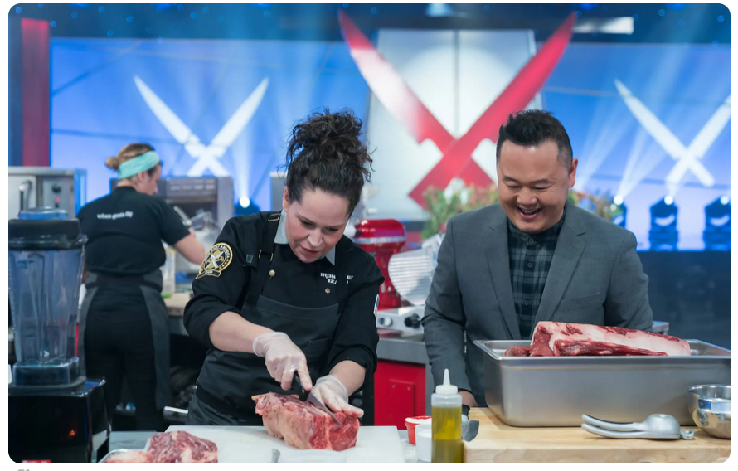
Some key domains of commonsense knowledge

Slide 19
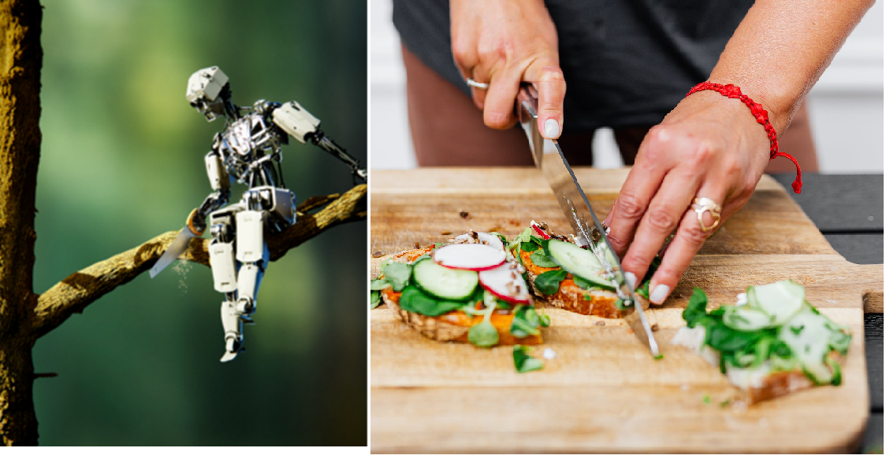
Commonsense physical reasoning

Slide 20
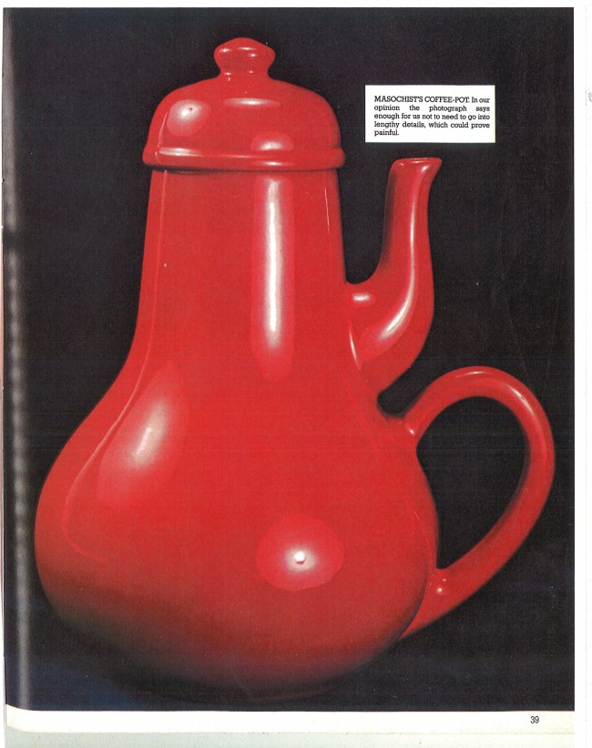
Commonsense physical reasoning failures
(jokes, not actual AI outputs)

Slide 21
Standard methods for physical reasoning
Simulation. Use a physics engine to carry out physical prediction.
  Requires precise theory and initial conditions.
  Notoriously difficult with robotics. “Reality gap”
  Oriented toward prediction, Less good for other kinds of reasoning: design, explanation, inferring properties from behavior.
Reinforcement learning. Good for scripted manipulations; does not generalize beyond that.
Deep learning from videos. Questionable generalization.

Slide 22
Characteristics of commonsense physics
Wide range of phenomena
Dependent on complex spatial properties and relations
Robust under partial knowledge
Wide range of scales

Slide 23
Wide range of phenomena
Different types of materials:
Hard solids (utensils, potatoes). Soft solids (cheese, fresh parsley).
Powders (flour, salt). Liquids (milk). Light. Fire.
Different kind of processes.
Cutting, warming, chilling, mixing, dissolving, kneading, carrying,
breaking (eggs) …
Tools for cutting: knives, scissors, shears, wire cutters, files,
lawn mowers, cheese graters …
Biophysics. What human bodies (your own and other people’s)
can do, in terms of motion, manipulation, perception, and
biological processes.

Slide 24
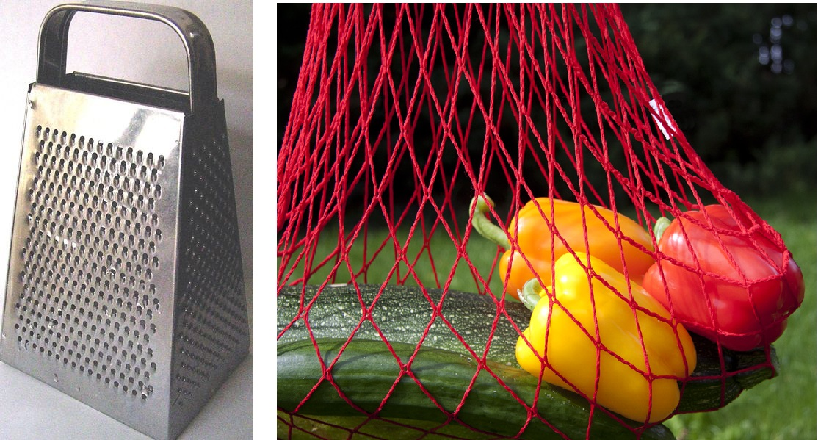
Complex spatial properties and relations

Slide 25
Robust under partial knowledge
A person/AI knowledge of a physical situation may be incomplete because:
Limits of perception.
The situation is described in language.
Some of the information is inferred.
You need to reason generically.
You are in the middle of designing it.
Unknown external events.
The physical processes are only partially understood.

Slide 26
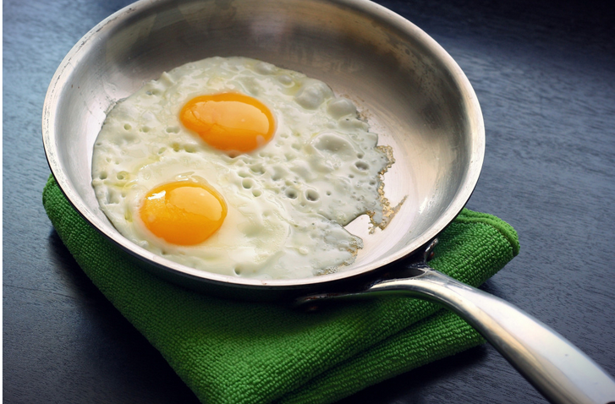
Partial knowledge
You probably don’t know the physical chemistry of frying an egg.
But you do know:
If you pick up the pan, the egg stays inside.
As the egg cooks, it becomes easier to pick it up.
The more raw egg you start with, the more fried egg you end up with.

Slide 27
Reasoning with partial knowledge
If you chop an iPhone in half with an axe, it won’t work any more.

Slide 28
Wide range of scales
An event that lasts 1/10 of a second may affect your life for 70+ years.
Ratio = 10⁹
Driving from Miami to Anchorage (5000 miles) involves shifting the steering wheel by fractions of an inch
Ratio = 10⁹
In scientific reasoning, of course, these ratios are much larger. E.g. red shift from distant galaxies involves a ratio of about 10³². Reasoning about nuclear reactions in the sun involves a ratio of about 10⁵⁷.

Slide 29
Reasoning about Perception and Knowledge
  Reasons you may not be able to see what you need to know:
    It is occluded.
    It is out of the picture frame.
    It is too small.
    Judging by eye is too imprecise.
    It is not the kind of information that you can get from vision.

Slide 30
Reasoning about Perception and Knowledge
  What you can do about it:
    Move your viewpoint.
    Move an occluding object
    Use an instrument (telescope, radar, measuring cup)
    Look for indirect evidence

Slide 31
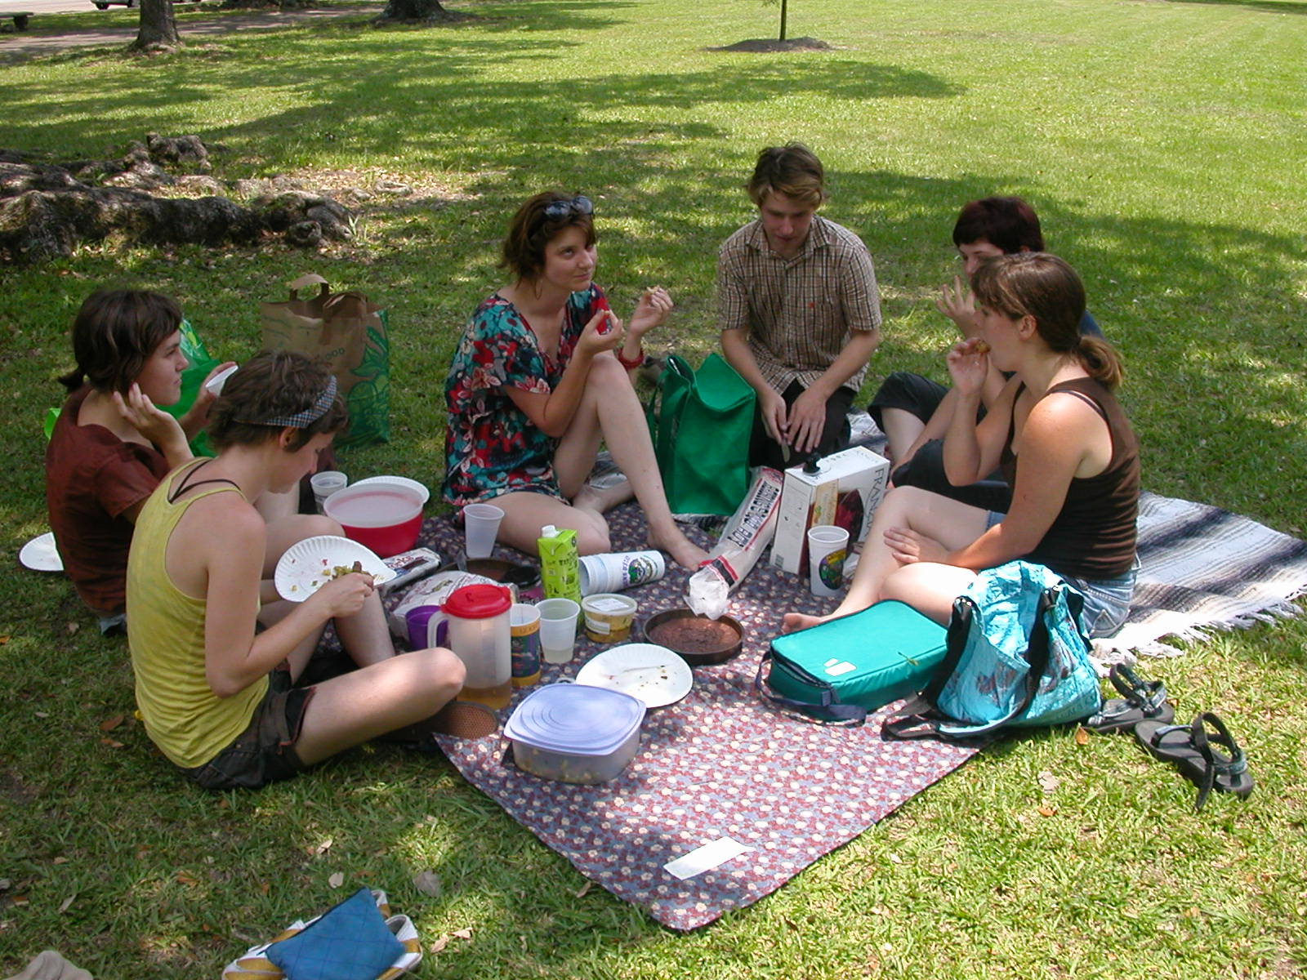
Reasoning about Perception and Knowledge
What color are the eyes of the man in the center?
Is the leftmost woman in the brown shirt barefoot?
What is casting the shadow on the front edge of the blanket?
How far away is the tree in the background?
When and where was the photo taken?
What are they talking about?

Slide 32
Tactile sense in humans and animals
Extremely complex
Hard to build devices that measure, record, generate etc.
Hard to model
Does not lend itself to current learning techiques
“Touch, Our Most Complex Sense, Is a Landscape of Cellular Sensors” by Ariel Bleicher, Quanta Magazine, April 16, 2025.
Why Today’s Humanoids Won’t Learn Dexterity
by Rodney Brooks, blog

Slide 33
Reasoning about human interactions
Chatbots are notoriously flawed.
Obsequious
Uncooperative
Jail breaks
Etc.

Slide 34
Ethics and legality
Hypothetical:
A head of state orders the bombing of a ship in international waters. They claim that the ship was involved in smuggling illegal drugs, which is tantamount to terrorism.
An AI that is aware of this might want to issue a warning that this is ethically doubtful and arguably first-degree murder.

Slide 35
Where do we go from here?

Slide 36
Where do we go from here?
I don’t know.

Slide 37
Where do we go from here?
Conventional wisdom: We’ll keep doing what we’re already doing, and these problems will go away. Shut up, you’re wasting our time.
Alternatively: AI will be able to do everything that we want it to without solving these problems.
I’m skeptical.
Symbolic approaches and cognitive science might help.
Benchmarks are a mess. There are too many; they don’t cover important problems; and there is an issue of data leakage.

Slide 38
Insights from cognitive science
Multiple modules. No silver bullet.
Explicit world models
Shared knowledge between modalities.
“Mentalese.” Symbolic substrate for representation and reasoning.
Empirical studies of human and animal perception and manipulation.
Empirical studies of memory, analogy, planning, and high-level learning.

Slide 39
Where do we go from here?
Until:
We understand what the problems are.
We have very good reason to believe that the problems have
been solved.
It behooves us:
To be very careful in how we use AI systems.
To be cautious in the claims that we make about AI systems.

