Slide 1
Commonsense Physical Reasoning in Humans and Machines
Mécanismes de l’intuition mathématique chez les êtres humains et les
machines
Collège de France
Ernest Davis
January 13, 2023

Slide 2
What the talk is about
People (and animals) interact in many different ways with an immensely complex physical world.
Computer systems (artificial intelligence) for many applications will have to do likewise.
How?
How do human beings (or animals) carry out commonsense physical reasoning?
How can you build an artificial intelligence program with commonsense physical reasoning?

Slide 3
Outline of talk
What do I mean by “commonsense” physical reasoning?
Why is it important?
Characteristics of commonsense physical reasoning
A few notable experimental results in people
Approaches
Challenges and directions

Slide 4
What do I mean by “commonsense”?
Learned by experience. Not formally taught in school.
Mostly learned young (by 7 or so).
Common. X can assume that Y knows it, and so he doesn’t have to explain it to Y.

Slide 5
Why is commonsense physical reasoning important?
It is a component of many other intelligent tasks:
Action
Vision
Planning
Design
Language
Learning
Science

Slide 6
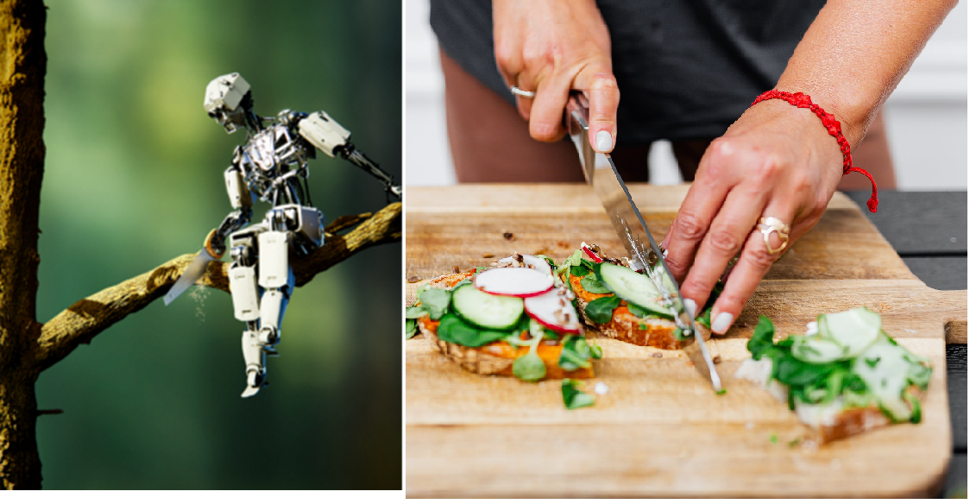
Commonsense physical reasoning is part of:
Acting, Planning, Vision

Slide 7
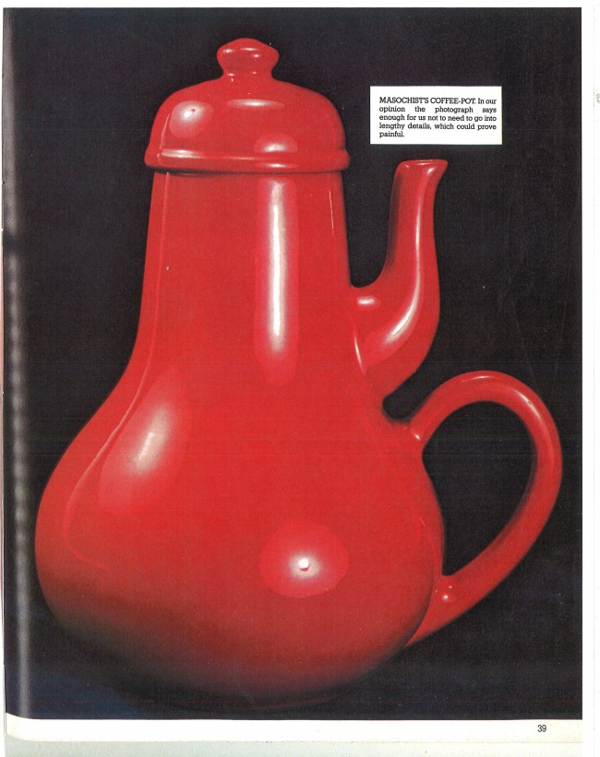
Design
From Jacques Carelman,
Objets Introuvables

Slide 8
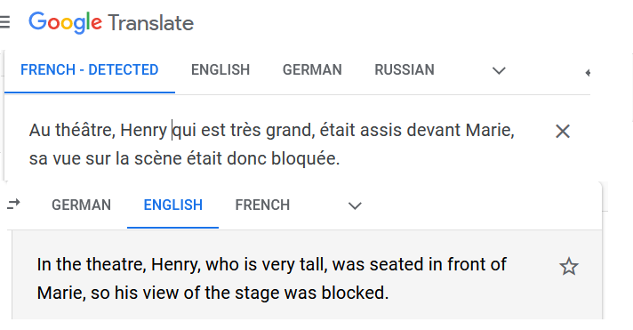
Commonsense physical reasoning is a part of:
Language use and comprehension

Slide 9

Commonsense physical reasoning is a part of:
Learning, Science
“Subpopulations of a species can become isolated if the water level of a lake falls, dividing it into two lakes.”

Slide 10
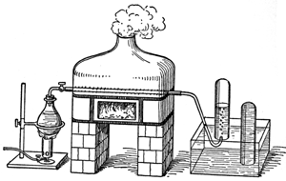
Chemical reaction
Passing steam over heated iron filings, the iron rusts, and you generate hydrogen.
2Fe + 3H₂O → Fe₂O₃ + 3H₂
Faraday, The Natural History of a Candle

Slide 11
Characteristics of commonsense physics
Wide range of phenomena
Dependent on complex spatial properties and relations
Robust under partial knowledge
Wide range of scales

Slide 12
Wide range of phenomena
Different types of materials:
Hard solids (utensils, potatoes). Soft solids (cheese, fresh parsley).
Powders (flour, salt). Liquids (milk). Light. Fire.
Different kind of processes.
Cutting, warming, chilling, mixing, dissolving, kneading, carrying,
breaking (eggs) …
Tools for cutting: knives, scissors, shears, wire cutters, files,
lawn mowers, cheese graters …
Biophysics. What human bodies (your own and other people’s)
can do, in terms of motion, manipulation, perception, and
biological processes.

Slide 13
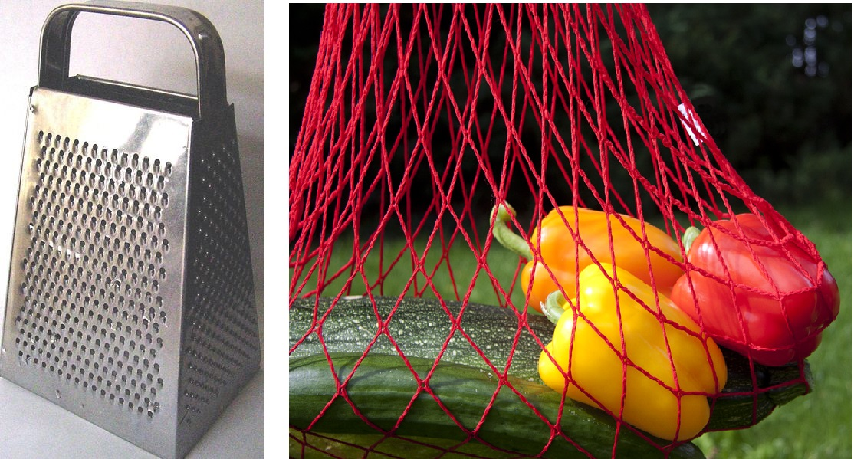
Complex spatial properties and relations

Slide 14
Robust under partial knowledge
A person/AI knowledge of a physical situation may be incomplete because:
Limits of perception.
The situation is described in language.
Some of the information is inferred.
You need to reason generically.
You are in the middle of designing it.
Unknown external events.
The physical processes are only partially understood.

Slide 15
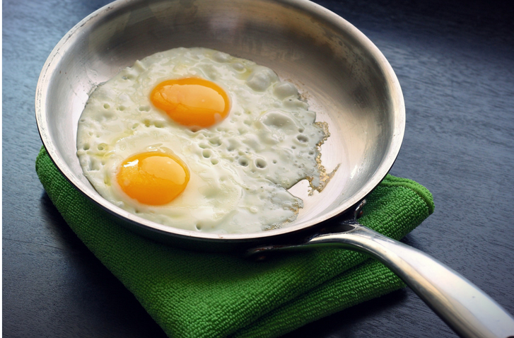
Partial knowledge
You probably don’t know the physical chemistry of frying an egg.
But you do know:
If you pick up the pan, the egg stays inside.
As the egg cooks, it becomes easier to pick it up.
The more raw egg you start with, the more fried egg you end up with.

Slide 16
Reasoning with partial knowledge
If you chop an iPhone in half with an axe, it won’t work any more.

Slide 17
Wide range of scales
An event that lasts 1/10 of a second may affect your life for 70+ years.
Ratio = 10⁹
Driving from Paris to Delhi (6000 km) involves shifting the steering wheel by centimeters.
Ratio = 6⋅10⁸
In scientific reasoning, of course, these ratios are much larger.

Slide 18
A few notable experimental results in human physical reasoning
Physical reasoning in infants
Erroneous predictions
Cutting pendulums, revisited
Visualization

Slide 19
Pre-verbal infant understanding
An infant looks at a situation set up by the experimenter.
If what they see surprises them, then they will stare longer than if it is what they expect.
Violations of physical law surprise them.
Infants 2.5-5 months are surprised when an object is hidden in one place and reappears in another, when an object disappears from behind a screen, when object goes through an obstacle behind a screen, etc.
Lin, Stavans,and Baillargeon, “Infants’ Physical Reasoning and the cognitive architecture that supports it.”

Slide 20
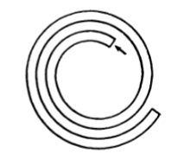
Erroneous predictions
The diagram shows a thin curved metal tube. In the diagram you are looking down on the tube. In other words, the tube is lying flat. A metal ball is put into the end of
the tube indicated by the arrow and is shot out of the other end of the tube at high speed. Draw the path the ball would follow.
Michael McCloskey, Naïve theories of motion

Slide 21
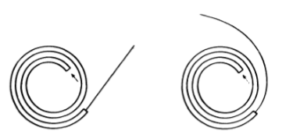
Erroneous predictions
The diagram shows a thin curved metal tube. In the diagram you are looking down on the tube. In other words, the tube is lying flat. A metal ball is put into the end of
the tube indicated by the arrow and is shot out of the other end of the tube at high speed. Draw the path the ball would follow.

Slide 22
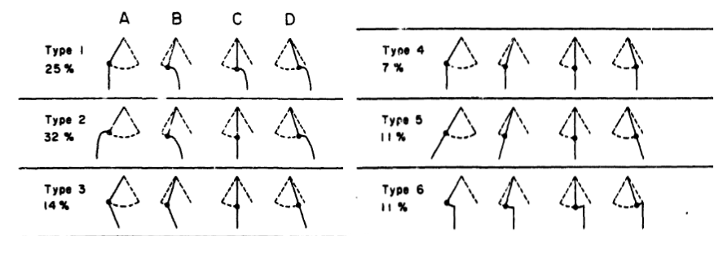
Erroneous predictions
Suppose you have a swinging pendulum and you cut the string at some point in its motion. Draw the trajectory of the bob.

Slide 23
Follow-up to the pendulum experiment
If you ask subjects to place a bucket to catch the bob, then they do much better.
Smith, K., Battaglia, P., & Vul, E. (2018). Different physical intuitions exist between tasks, not domains.

Slide 24
Erroneous prediction: Anecdote
I regularly scuba dive, and on one weekend trip two friends and I decided to do a night dive. We needed our weight belts, which were on a boat in the harbor, so I offered to fetch them. I swam the few meters to the boat in my dry suit, clipped my own weight belt around my waist, held one weight belt in each hand, slipped overboard, and headed back to the ladder. To my surprise, I immediately sank to the bottom of the harbor.
-- Rebecca Lawson, Mirrors, mirrors on the wall. . . the ubiquitous multiple reflection error

Slide 25
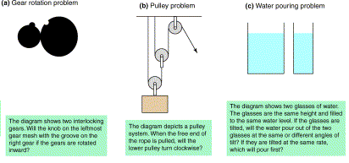
Visualization
Hegarty, M. (2004). Mechanical reasoning by mental simulation.

Slide 26
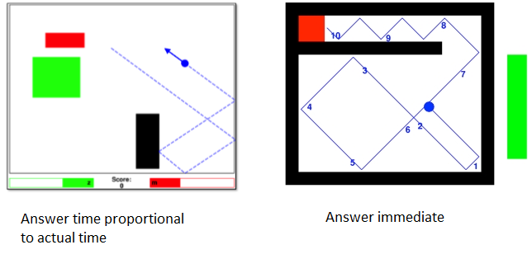
Visualization vs. Qualitative Reasoning
Subjects were shown a video of the ball moving (blue lines not there).
Which would the ball reach first: The red area or the green area?
Smith, K. A., Dechter, E., Tenenbaum, J. B., & Vul, E. (2013). Physical predictions over time.

Slide 27
Approaches to commonsense physical reasoning in cognitive psychology and AI
  Physics engine / simulation
  Symbolic reasoning
  Machine learning / pattern learning
    Reinforcement learning
    Deep learning
    Language models

Slide 28
Simulation / physics engine
“Video game physics engine in the head”
Basic idea:
You know the state of the world at some starting time.
Use the laws of physics to predict how the world will change over a tiny time period (fraction of a second). Compute the next state.
Iterate.
You generate a “mental movie” of what is going to occur.

Slide 29
Probabilistic version (Monte Carlo)
Either the starting state, or the laws of physics, or both are probabilistic.
You run multiple simulations, making random choices.
Do statistics over the outcomes
Extensively used in computer software. Proposed in cognitive theories.

Slide 30
Two versions of cognitive theory
Construct an actual “mental movie” that you can view in mind’s eye.
Vs.
The simulation is not accessible to introspection. Its outcome is used subconsciously in carrying out tasks.

Slide 31
Strengths of the simulation theory
Very general approach in principle for prediction
Huge mathematical (back to 1700s) and computer (back to 1940s) theory. Exceptionally well understood.
Lots of powerful software, both for scientific computing and for video games
Some experimental evidence of various kinds and degrees of cogency.

Slide 32
Weaknesses of simulation theory
Requires complete specification of starting state (or well-defined probabilistic distribution).
Requires physical theory stated as a differential or difference equation.
Fundamentally for prediction, only indirectly for other tasks.

Slide 33
Weaknesses of simulation theory (cntd).
Physics engines are hard to construct:
  Video games rarely have a physics for doors.
  In scientific computing, constructing a model requires immense expertise and labor.
  Building a useful simulator for a robot/human being is exceptionally hard: “The reality gap”.
In scientific computing, expertise is also needed to
  Choose the appropriate model
  Formulate the problem
  Interpret the output.

Slide 34

Weaknesses of simulation theory (cntd).
Unnecessary precision
demanded in input
and produced in output.
The cyclist is carrying a
half-filled, closed water bottle
on a bumpy road.
Predict: The water stays in
the bottle.

Slide 35
Symbolic reasoning:
Qualitative reasoning
Characterize the state of a system in terms of one-dimensional parameters.
Characterize dynamics in terms of sign relations: “If X goes up, then Y goes down.”
Often works well for systems with few degrees of freedom. E.g. swinging pendulum.
Some successful practical applications.
Doesn’t work well for geometry

Slide 36
Knowledge-based methods:
Logical analysis
∀ _{t:Time; o:Object} FeasiblePlace(o,Place(t,o)).
Every object always occupies a feasible place.
∀ _{p,q:Object; t:Time} p ≠ q ⇒
DR(Place(t,p), Place(t,q)).
Any two objects are spatially disjoint.
∀ _{o:Object} Continuous(HPlace(o))
An object moves continuously

Slide 37
Problem statement for water bottle
Given:
RigidObject(Bottle). RigidObject(Cap). Stuff(Water).
Holds(Ta,ClosedContainer(Place(Bottle) ∪ Place(Cap), Water))
Throughout(Ta,Tb,Sealed(Bottle,Cap))
Infer:
Holds(Tb,ClosedContainer(Place(Bottle) ∪ Place(Cap), Water))

Slide 38
Strengths of symbolic approach
Incomplete information and physical theories
Not inherently geared toward prediction
Can incorporate non-physical information
Deals with range of scales.

Slide 39
Weaknesses of symbolic reasoning
Extremely hard to formulate adequate theories.
Extreme degree of fussy logical precision required.
Hard to be confident (impossible to be sure) that no absurd inferences can be derived.
No generally adequate inference engines exist
Very few practical applications so far.
Questionable how plausible as a cognitive theory.

Slide 40
Current methods of machine learning
Reinforcement learning
Deep learning – neural network learning
Large language models
Some form of learning theory must be right. Much of commonsense physical knowledge is learned by babies/children. Whatever is innate was learned by evolution.

Slide 41
Reinforcement learning
A creature / a real robot / a simulated robot learns by trial and error what actions work to achieve specified goals in a given situation.
As a cognitive theory, this was behaviorism (B.F. Skinner).
Strength: Practical successes in some forms of AI, both robotics and game playing. AlphaGo etc. use forms of RL.
Weakness: Limited to learning relation of action to goals. Does not learn domain theory. Very limited as cognitive theory.

Slide 42
Deep learning
A very general model of learning to carry out intelligent tasks.
Trained from large to enormous data corpora.
Remotely similar to neuronal activity in the brain.
To some extent, extracts abstract features
Enormously successful in AI. A major component of almost every practical application in AI in the last decade.
  Completely dominant in vision and natural language
  Combined with reinforcement learning in robotics and games playing

Slide 43
Limitations of Deep Learning
Hard to incorporate domain knowledge.
Focuses on unimportant feature; e.g. texture rather than shape in computer vision.
Fails to generalize. A self-driving car trained in one city may not work in another.
Opaque. Results cannot be explained.
Cannot be debugged. All you can do is change the training set or the architecture.

Slide 44
As applied to physical reasoning
Important successes in highly specific scientific problems. E.g. AlphaFold as applied to protein folding.
Limited success as applied to robotics.
Little success as applied to commonsense physical reasoning. Little reason to think that it finds the “right” generalization or abstract categories.

Slide 45
Large Language Models – GPT3, ChatGPT, etc.
Deep learning models specifically for language. Trained from huge text corpora on task of predicting the next word.
Output is often breathtakingly impressive
Output is sometimes hilariously off-base.
Subject to hallucinations (invents facts, because they sound good). “Stochastic parrots”.
Commonsense reasoning, particularly spatial and physical, is a particular weak point. No inherent model of space, and looking at text is not a good way to learn about space.

Slide 46
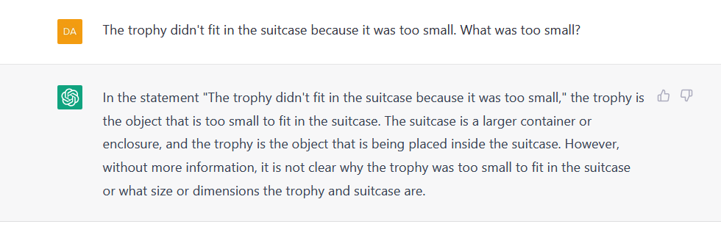
ChatGPT

Slide 47
ChatGPT

Slide 48
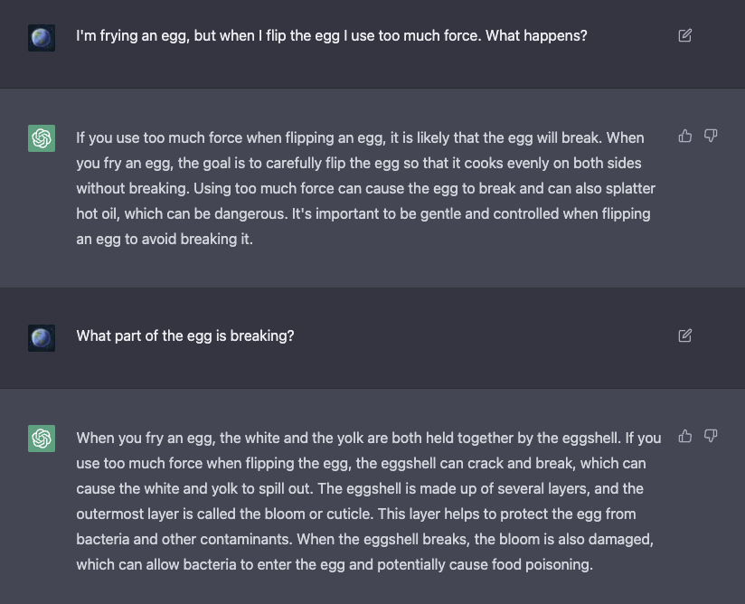

Slide 50
Overall
Multiple cognitive processes
Learned manipulation strategies
Visualization
Direct perception
Corpus-based learning
Language based method
Analogy
Abstract reasoning

Slide 51
Overall
Multiple cognitive processes
Learned manipulation strategies
Visualization
Direct perception
Corpus-based learning
Language-based methods
Analogy
Knowledge-based/abstract reasoning
We do not have adequate theories of any of these.
We have no idea how to integrate them.
Multimodal learning may advance things somewhat but probably won’t give a complete solution.

Slide 52
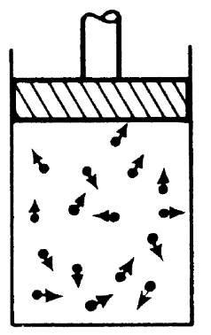
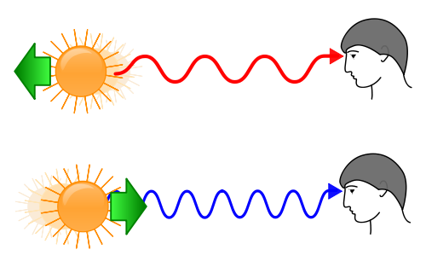
One possible point of leverage
Diagrams that have only a vague qualitative resemblance to the actual situation can be very useful aids to understanding.
Feynman, Lectures on Physics “Red shift and blue shift” Wikipedia

Slide 53
Thank you!

