Slide 1
The Logical Depth of Reasoning About Other Minds:
A Pep Talk
Ernest Davis
New York University
ACS 2017

Slide 2
Claim
Reasoning about other minds, in understanding text or video, requires constructing representations and using knowledge of considerable logical depth.

Slide 3
Examples
The Godfather: Horse’s head scene
Bergen, Louder than Words, Clever Bears
Winnie the Pooh: Plan to Capture Baby Roo
The Miracle Worker: Water scene
Sense and Sensibility: Chap. 35
Duck Soup: Mirror scene
Then I’ll talk about the state of the art.

Slide 4
The Godfather
Horse’s head scene
The viewer understands that:
Hagen has arranged for the horse to be decapitated and the head to be placed in the bed.
Hagen is communicating to Woltz:
  That he can kill Woltz
  That he will kill Woltz if Woltz does not hire Fontane.
Woltz understand the communication when he sees the head.
Hagen knows that Woltz will understand.

Slide 5
Question answering
What is the horse’s head doing in the bed?
Who killed the horse?
Does Woltz know who killed the horse?
Does Woltz expect to find a horse’s head in the bed?
Why didn’t Hagen just kill Woltz?

Slide 6
Alternate scenes:
Woltz wakes up and finds
A dead fish in his bed.
A threatening phone message from Hagen
The horse, alive and well, in the bedroom
Hagen wakes up and finds a dead fish in his bed.
Woltz and Hagen wake up together in bed.

Slide 7
Bergen, Louder than Words
  Sailors who encountered polar bears in the nineteenth century reported seeing polar bears do something quite clever to increase their chances of [eating a seal]. According to these early reports, as the bear sneaks upon its prey, it sometimes covers its muzzle with its paw, which allows it to go more or less undetected. Apparently, the polar bear hides its nose.

Slide 8
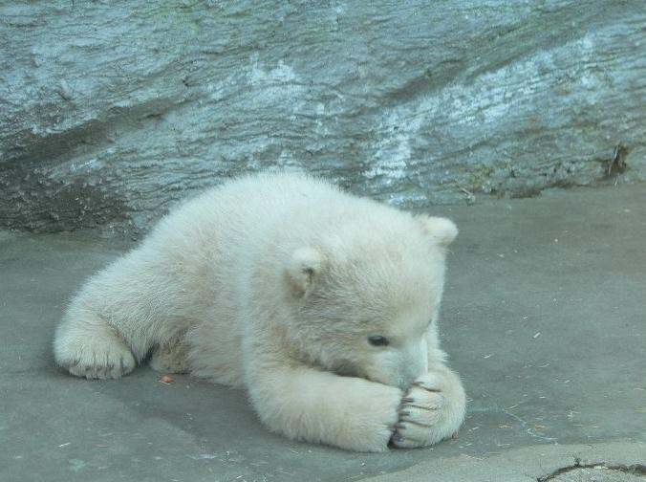
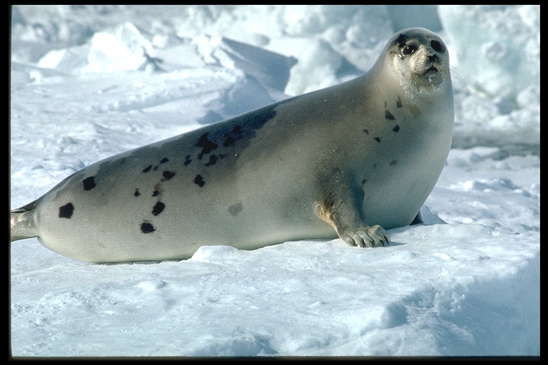

Slide 9
The bear believes that
if it approaches the seal with nose uncovered
the seal may see its black nose
so the seal is likely to know it is coming
and the seal will flee
and the bear will not be able to catch it
whereas …
3 epistemic operators, a hypothetical, six causal relations, two implications, three negations, and three occurrences of “will be able”

Slide 10
PLAN TO CAPTURE BABY ROO
General Remarks. Kanga runs faster than any of Us, even Me.
More General Remarks. Kanga never takes her eye off Baby Roo, except when he’s safely buttoned in her pocket.
Therefore. If we are to capture Baby Roo, we must get a Long Start because Kanga runs faster than any of Us, even Me (see 1.)

Slide 11
PLAN TO CAPTURE BABY ROO
A Thought. If Roo had jumped out of Kanga’s pocket and Piglet had jumped in, Kanga wouldn’t know the difference, because Piglet is a Very Small Animal.
Like Roo.
But Kanga would have to be looking the other way first, so as not to see Piglet jumping in.
See 2.

Slide 12
PLAN TO CAPTURE BABY ROO
Another thought. But if Pooh were talking to her very excitedly, she might look the other way for a moment.
And then I could run away with Roo.
Quickly
And Kanga wouldn’t discover the difference until Afterwards.

Slide 13
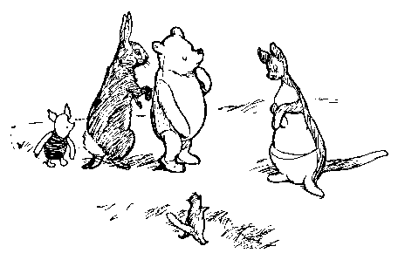

Slide 14
PLAN TO CAPTURE BABY ROO
Rabbit, Pooh, and Piglet are forming a joint plan
to distract Kanga’s attention
so that they can substitute Piglet for Roo
so that Kanga will not notice that Roo
is gone
so that Rabbit can run off with Roo.

Slide 15
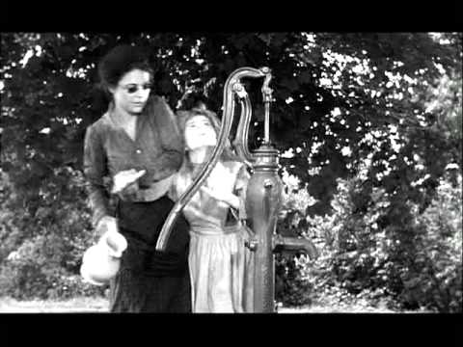
The Miracle Worker

Slide 16
The Miracle Worker
Helen Keller realizes that the pattern her teacher is pressing on her hand means water.
She generalizes that other things have other corresponding patterns.
She demands to know the patterns for pump, ground, father, mother, and teacher by running to them. Sullivan teaches them as she asks.

Slide 17
The Miracle Worker
The viewer needs to reason about
Language
Meaning
Understanding
Perception
Learning
at a quite abstract level.

Slide 18
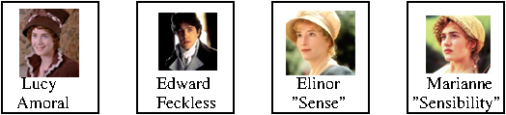
Jane Austen
Sense and Sensibility, Chap 35

Slide 19
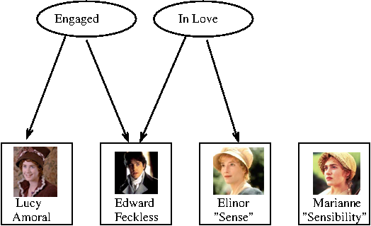
Jane Austen
Sense and Sensibility, Chap 35

Slide 20
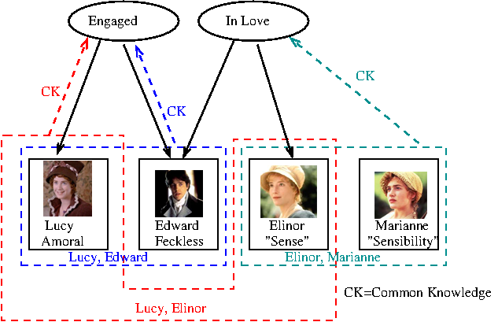
Jane Austen
Sense and Sensibility, Chap 35

Slide 21
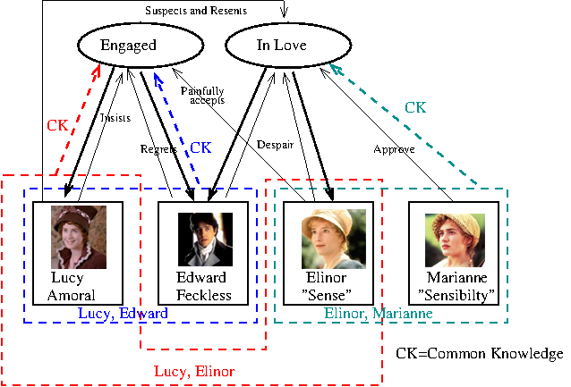
Jane Austen
Sense and Sensibility, Chap 35

Slide 22
"What can bring her [Lucy] here so often?" said Marianne, on her leaving them. "Could not she see that we wanted her gone!—how teazing to Edward!"
"Why so?—we were all his friends, and Lucy has been the longest known to him of any. It is but natural that he should like to see her as well as ourselves."
Marianne looked at her steadily, and said, "You know, Elinor, that this is a kind of talking which I cannot bear.”

Slide 23
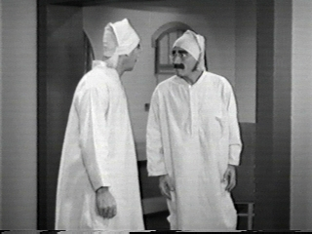
Duck Soup

Slide 24
Duck Soup
The user needs to understand
Perception
False belief
Deception
Unmasking deception
The user must understand that this is impossible.

Slide 25
State of the art as regards examples
Substantial parts of the specific content can be represented. By no means all.
Closest to a full representation: Polar bear (simple goal structure). Furthest: Sense and Sensibility
Representation for background knowledge is much more sketchy.
Collecting the background knowledge is even less advanced.

Slide 26
State of the art as regards domain
Well understood:
Idealized theories of knowledge, perception, communication, including dynamic theories.
Plans
Somewhat understood:
Beliefs, desires, intentions

Slide 27
State of the art as regards domain
Challenging
Realistic representations of cognitive processes (reasoning, learning etc..)
Typical assumptions about people (what can you expect different kinds of people to know)
Social interactions at all levels

Slide 28
Take away
These, or simpler situations, are good problems to work on.
(No more muddy children, cheating husbands, Mr. P and Mr. S etc.)
Sentence2vec is not going to cut it. The structure and interactions are richer than that.

