Slide 1
Physical Reasoning in an Open World
Zhuoran (Jennifer) Zeng and Ernest Davis
Advances in Cognitive Systems
November 17, 2021

Slide 2
Closed world physical reasoning
Most physical reasoning – in scientific computation, AI, and cognitive psychology experiments and models – operate in a closed world.
The problem statement fully specifies [up to some level of description]
the initial situation
the dynamic theory
the exogenous events/boundary conditions.
In particular, simulation/physics engines assume a closed world.

Slide 3
Open world reasoning is important
You pack clothes in a duffel bag, you lock the zipper, you check it onto a flight to Chicago. The duffel bag is lost. Three days later, it turns up at the Dallas airport, scuffed up, but intact. If it’s still locked, you can be sure that the clothes are still inside.

Slide 4
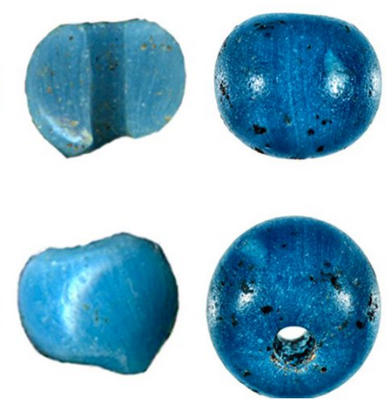
Open world reasoning
Beads and twine are found at an archaeological site in Alaska
The beads were manufactured in Venice in the 1400s.
The twine was made from plant materials in Alaska, carbon-dated to the 1400s.
Infer that the beads were brought overland through Asia and across the Bering Strait.

Slide 5
Open vs. closed world is a matter of degree
Deterministic prediction
Probabilistic / adversarial prediction
Partially observable states
Qualitative envisioning
Inverse reasoning
Radically incomplete reasoning

Slide 6
Reasoning about containers
In a toy microworld of objects, containers, and lids,
given initial specifications:
Partial characterization of states at various times.
Partial enumeration of actions.
Constraints that specified actions do not occur.
Goal: Make sound inferences about later states.
Proof-of-concept implementation in Prolog.
Need work-arounds to get negation to play nicely with unbound variables.

Slide 7
Microworld
Sorts: Objects, Times, Locations, Actions.
Objects: closedContainer(O), openContainer(O), lid(O), containerWithLid(O), block(O).
Actions: load(OB,OC), unload(OB,OC), seal(OC,OL,O), unseal(O,OC,OL), carry(OB,LFROM,LTO), dump(OC).

Slide 8
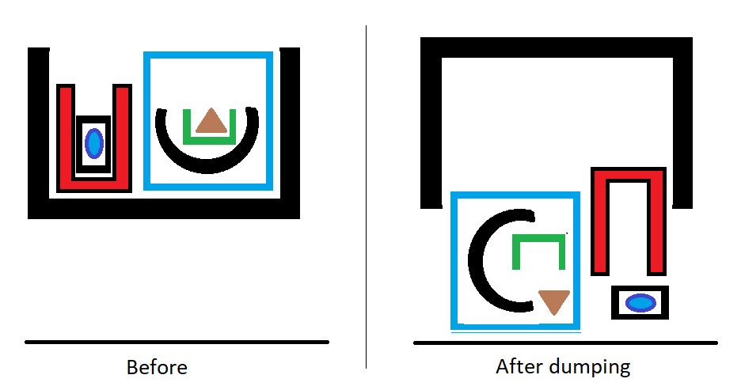
Dumping

Slide 9
Example
t0 < t1 < t2 < t3
[t0,t1] Load oa into open container oc.
[t1,t2] Seal oc with lid ol forming lidded container ocl.
Constraint: oc is not unsealed between t2 and Tt3.
Infer: oa is still inside ocl at t3.
Without the constraint, the inference is invalid.

Slide 10
Second Example
t0 < t1 < t2 < t3 < t4
[t0,t1] Object oa is loaded into open container ob.
[t1,t2] ob is loaded into open container oc.
[t3,t4] oc is carried to location l.
[t4,t5] oc is dumped.
Constraint: oc is neither unloaded nor dumped between t2 and t3
Infer: oa is at location l at time t5

Slide 11
Future work
Extend the kinds of information and the scope of forms of uncertainty.
Asynchronous events; partial ordering on timeline.
Indeterminate sets of objects
Spatial information.
Other physical domains.

