Slide 1
Artificial Intelligence and
Commonsense Reasoning
Ernest Davis
New York Amateur Computer Club
May 14, 2015

Slide 2

This is Anne and her babysitter.

Slide 3
This is Anne and her babysitter.
Which is which?

Slide 4
Commonsense Reasoning
Can you make a salad out of a polyester shirt?
If you stick a pin into a carrot, does it make a hole in the pin or in the carrot?
The answers are obvious, but no existing computer program can answer them.

Slide 5
The Godfather, Horse’s Head Scene
The viewer understands that
Tom Hagen has arranged for the horse to be killed and the head put in the bed.
Hagen is threatening Jack Woltz: “If I can kill the horse, I can kill you.”
Woltz understands the threat.
No AI program comes anywhere close to this level of understanding.

Slide 6
Commonsense Reasoning and AI
Considered a central problem in AI since 1950’s.
Little progress.
AI programs that have had any practical success have sidestepped the problem.

Slide 7
Outline
Why is commonsense important for AI?
  Natural language understanding
  Vision and video
  Robotics
  Understanding science
What can we do well?
Why is it hard?
What methods have been attempted, and what are their limits?
Where do we go from here?

Slide 8
Artificial intelligence: Getting computers/robots to carry out tasks that are easy for people and hard for computers.
Using language, vision, manipulation
Commonsense: What every child of 7 knows about the world.
Time, space, objects, animals, people individually and in groups.

Slide 9
Outline
Why is commonsense important for AI?
  Natural language understanding
  Vision and video
  Robotics
  Understanding science
What can we do well?
Why is it hard?
What methods have been attempted, and what are their limits?
Where do we go from here?

Slide 10
Ambiguity
The juiciest prize is to become the face of a luxury brand such as Dior or Burberry. To have any chance, a model must first have magazine shoots under her designer belt. This fact allows fashion magazines to pay peanuts, even for a cover-shoot.
"The beauty business", The Economist, Feb. 11, 2012.

Slide 11
Ambiguous words
The juiciest prize is to become the face of a luxury brand such as Dior or Burberry. To have any chance, a model must first have magazine shoots under her designer belt. This fact allows fashion magazines to pay peanuts, even for a cover-shoot.
Black – unambiguous.
Blue – most frequent meaning
Red – not most frequent meaning

Slide 12
Translate to German and back
The juiciest prize is to be the face of the luxury brand like Dior or Burberry. Ever have a chance to have a model first magazine shoots under her designer belt. This fact allowed to pay fashion magazines to peanuts, for a cover shoot.
(Google Translate, May 8, 2015).

Slide 13
Pronoun ambiguity
“Mary knocked on Jane’s door but she didn’t answer.”
“Mary knocked on Jane’s door but she didn’t get an answer.”
Winograd schema challenge: Proposed for “Turing test Olympics”

Slide 14
Natural language programs use patterns of words, not meaning
Translation: Find pairs of texts that are translations of one another (bitext), extract corresponding patterns.
Web search: Match words in or about document to words in query. Prefer pages with lots of links.
Watson (Jeopardy). Similar to web search, lots of special tricks for Jeopardy.
Siri: Similar to web search + voice interpretation. Tuned to questions that cell-phone users will ask.

Slide 15
Outline
Why is commonsense important for AI?
  Natural language understanding
  Vision and video
  Robotics
  Understanding science
What can we do well?
Why is it hard?
What methods have been attempted, and what are their limits?
Where do we go from here?

Slide 16
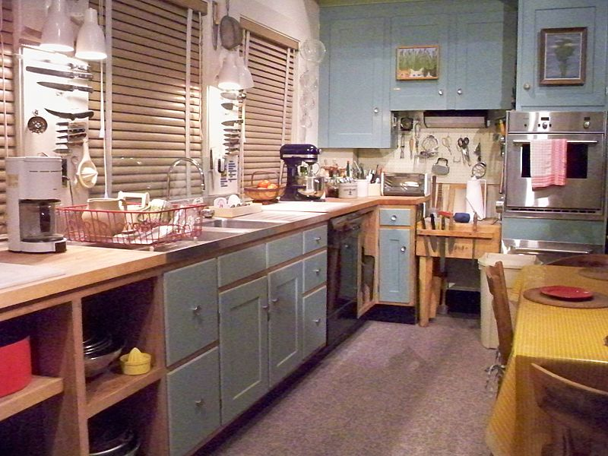
Julia Childs’ kitchen (Smithsonian)

Slide 17
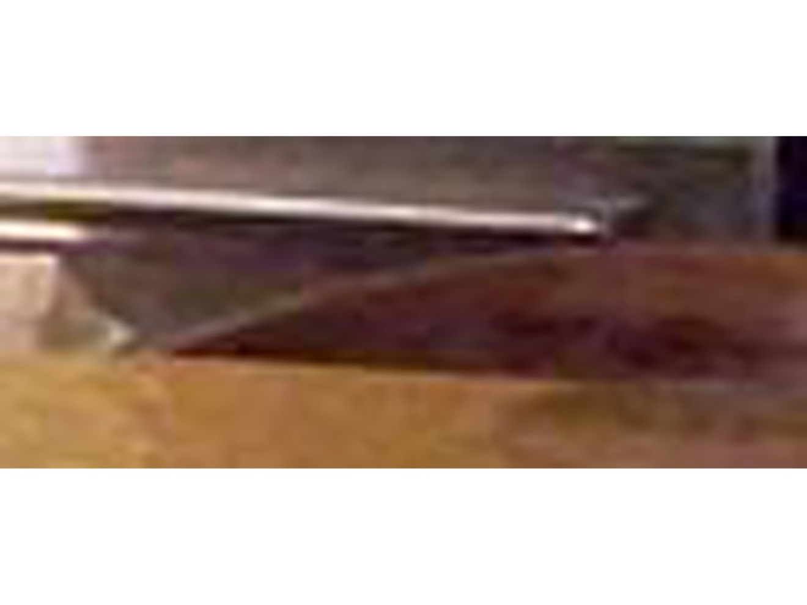
Chair at the far end of table

Slide 18
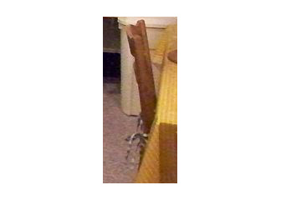
Chair at side of table

Slide 19
Unidentifiable in isolation
Chairs
Sink
Cushion strings
Inferred rather than seen
Table under cloth
Hot water tap
Drawers pull out; cabinets swing open.

Slide 20
Outline
Why is commonsense important for AI?
  Natural language understanding
  Vision and video
  Robotics
  Understanding science
What can we do well?
Why is it hard?
What methods have been attempted, and what are their limits?
Where do we go from here?

Slide 21
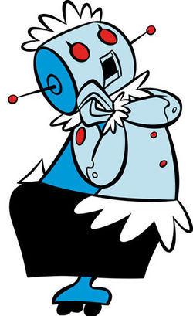
Rosie the Robot Maid (Jetsons)
If the cat is in your way when vacuuming, do not:
Vacuum it up
Run over it
Dust it and put it away
If you are serving drinks, do not use a glass that
is broken.
has a cockroach.
has soap in it.

Slide 22
Outline
Why is commonsense important for AI?
  Natural language understanding
  Vision and video
  Robotics
  Understanding science
What can we do well?
Why is it hard?
What methods have been attempted, and what are their limits?
Where do we go from here?

Slide 23
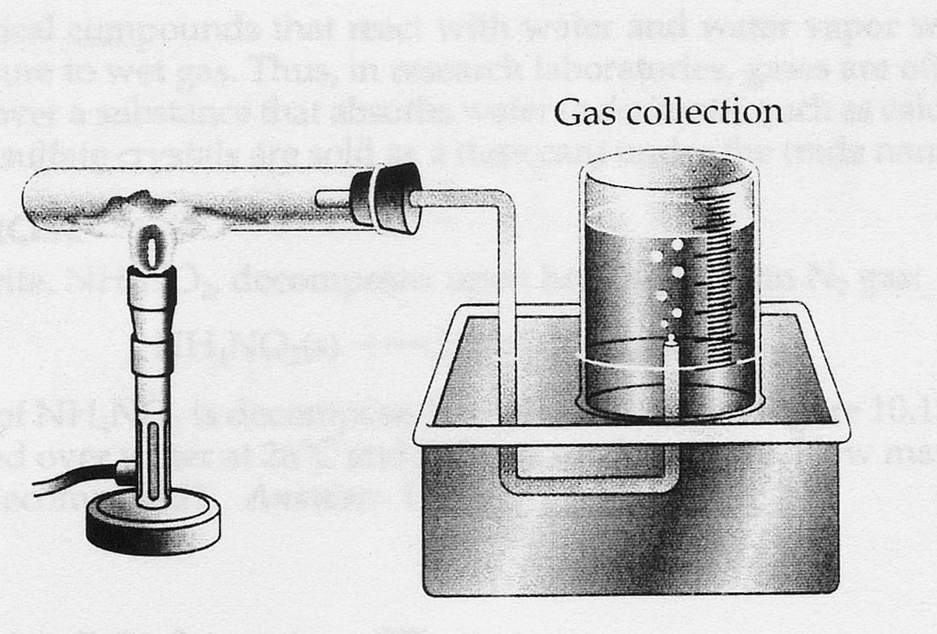
Chemistry experiment
What happens if: The end of the tube is outside the beaker? The beaker is right-side up? The beaker is made of stainless steel?

Slide 24
Outline
Why is commonsense important for AI?
  Natural language understanding
  Vision and video
  Robotics
  Understanding science
What can we do well?
Why is it hard?
What methods have been attempted, and what are their limits?
Where do we go from here?

Slide 25
Taxonomy
One category contains another.
Dogs are mammals.
Individual is an instance of a category.
Lassie is a dog.
Features of categories
Mammals are warm-blooded.
Inheritance
Infer that Lassie is warm-blooded.

Slide 26
Large taxonomies from web mining
Probase has 2.6 million categories, 92% accurate.
Basic trick: Hearst patterns.
If you see “countries such as Russia, China, and Japan”, infer that these are countries.
If you see “animals such as horse, dogs, and cats” infer that horses, dogs, and cats are animals.

Slide 27
Time
Representation and reasoning about time is well understood in principle.
Often ignored in practice.
A handful of additional specialized forms of commonsense reasoning are well understood.

Slide 28
Outline
Why is commonsense important for AI?
  Natural language understanding
  Vision and video
  Robotics
  Understanding science
What can we do well?
Why is it hard?
What methods have been attempted, and what are their limits?
Where do we go from here?

Slide 29
Why is automating commonsense hard?
Facts are not stated explicitly in text.
“If you stick a pin into a carrot, it leaves a hole.”
Facts have to be combined.
“Grown-ups are usually taller than children.”
“If X is a babysitter of Y, then Y is a child and X is older than Y.”

Slide 30
Why is it hard (continued)?
Logical complexity:
Hagen foresaw
that Woltz would realize
that Hagen arranged to kill the horse
in order to make it clear to Woltz
that Hagen could kill Woltz
if Woltz doesn’t do what Hagen wants.

Slide 31
Why is it hard (continued)
No standard theory of domains like folk psychology or folk sociology.
Lots of commonsense knowledge
Little value in automating a small part of commonsense knowledge. Incremental progress is not rewarded.

Slide 32
Outline
Why is commonsense important for AI?
  Natural language understanding
  Vision and video
  Robotics
  Understanding science
What can we do well?
Why is it hard?
What methods have been attempted, and what are their limits?
Where do we go from here?

Slide 33
Handcrafted knowledge bases
Mathematical/logical theories. Careful analysis of limited domains.
Informal technique (1970s: Schank, Minsky). Based loosely on cognitive theories.
Large manually constructed knowledge bases.
CYC (1985-present) has 500,000 concepts and 5 million facts (in one version).

Slide 34
Web mining
Probase: Taxonomy with 2 million category.
NELL (Never-ending Language Learner)
Some facts from NELL:
regional_officer is a kind of office held by a politician
mount_hollywood is a mountain
supply_chain_tools is a tool
john_newton is a U.S. politician

Slide 35
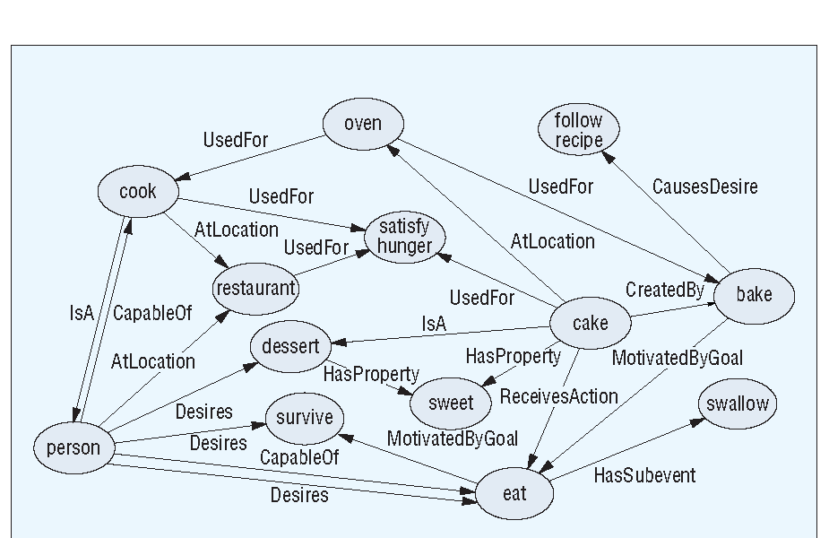
Crowdsourcing
Concept Net

Slide 36
 | Logic | Informal | Large | Web mining | Crowd source
Scope | Narrow | Medium | Broad | Broad | Broad
Basic domains | Strong | Weak | Medium | Weak | Weak
Experts needed? | Yes | Yes | Yes | No | No
Application oriented | Medium | Highly | Highly | Medium | Highly
Types of Reasoning | Medium | Many | Medium | Limited | Limited
Plausible Reasoning | Substantial | Medium | Substantial | Little | Little
Cognitive | Little | Strong | Little | Little | Some

Slide 37
Outline
Why is commonsense important for AI?
  Natural language understanding
  Vision and video
  Robotics
  Understanding science
What can we do well?
Why is it hard?
What methods have been attempted, and what are their limits?
Where do we go from here?

Slide 38
Going forward
No silver bullet.
Integrate successful theories (e.g. time) into practice.
Deeper analysis of meaning in natural language tools.
Case studies of commonsense reasoning in natural tasks.
Patience.

