Slide 1
Reasoning about Containers
Ernest Davis
Joint work with
Gary Marcus and Noah Frazier-Logue
Northwestern University
January 11, 2017

Slide 2
Radically Incomplete Information
People are very good at doing useful commonsense, physical reasoning with very incomplete information. E.g. partial knowledge of
Shape, spatial relations, exogenous motion
Material properties
Relevant laws of physics
Weak closed world assumptions

Slide 3
Containers
Containers — bags, bottles, boxes, cups, etc. are
Universally known and learned very young
Ubiquitous in everyday and sophisticated reasoning
Fertile domain for radically incomplete reasoning

Slide 4
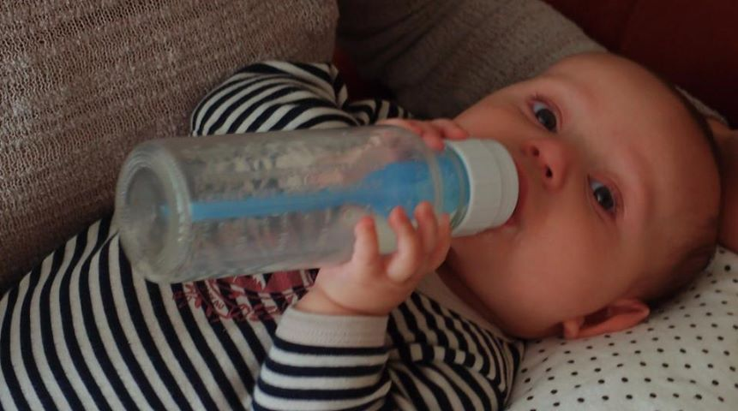
Infant learning about containers

Slide 5
Part of Common Sense Reasoning Enterprise
Represent knowledge of commonsense domains and automate commonsense reasoning
Potential applications to natural language interpretation, automated planning, vision, expert systems, automated tutoring, etc.

Slide 6
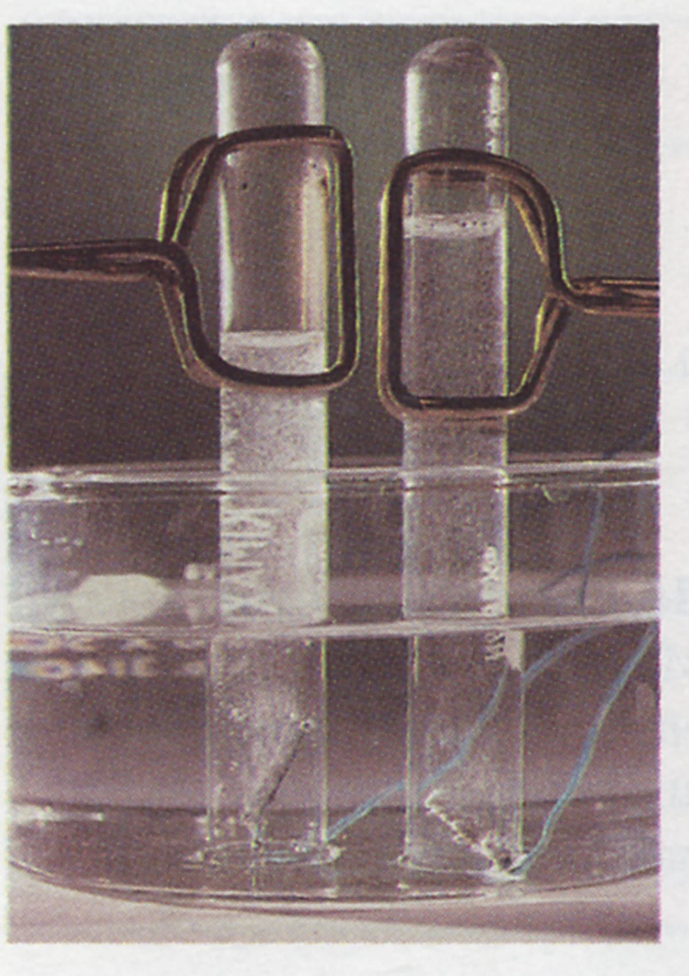
Commonsense and Science
How experiment – manipulation and perception at the human level –
relate to the underlying scientific theory.

Slide 7
Understanding variants
What would happen if:
There were no test tubes?
The test tubes were right side up?
The test tubes were slanted?
The test tubes were initially full of air?
One of the electrodes was outside the tube?
Both electrodes were in the same tube?

Slide 8

Containers in Biology
Biological containers: Cell membrane, skin, lungs …
A lake dries up, isolating subpopulations of a species, causing speciation. The lake-bed is initially one container, then two containers.

Slide 9
Outline: Knowledge-based theory
Related Work
Methodology
Three related studies and sample inferences
Microworld
Theory features
Ontology
Examples of axioms and problem statements
Proofs and automated verification

Slide 10
Related Work
Pat Hayes: “Naïve Physics Manifesto”, “Ontology for Liquids”
Alan Bundy, first-order physical theories.
AI Solid Objects: Forbus, Faltings, Nielssen, Joskowicz, Shrobe & Davis, Gelsey.
AI Liquids: Gardin & Meltzer, Collins, Kim
Logical formalizations of commonsense: McCarthy, Reiter, Levesque, early McDermott
Sci. Computing, Graphics, Robotics
Axiomatization of physics. Hilbert’s 6th problem.

Slide 11
Methodology
(Pat Hayes, Naïve Physics Manifesto, 1979)
Collect some interesting, natural examples of inferences.
Formulate a microworld
Formulate a language and a set of axioms:
  Symbols can be defined in the microworld.
  Axioms are true in the microworld.
  Axioms justify the inferences
  Axioms are easily stated in first-order logic.

Slide 12
Not everyone is a fan
David Waltz (1995):
“It was widely believed that logic could successfully model images and scenes, even though the baroque improbability of that effort should have long been clear to everyone who read Pat Hayes’ Naïve Physics Manifesto.”

Slide 13
3 Studies
How does a box work?
“How does a box work?”
  Container and contents are rigid objects
  Agent is abstract.
  Quasi-static dynamics with abstract, exogenous actions
  Sample inference: You can load a collection of small objects into a box, and then move everything in the box.

Slide 14
Liquids
Containers are rigid. Contents are liquid
Static and quasi-static theory of liquid motion
Abstract agent manipulating containers
Inferences:
  You can pour liquid from a pitcher to a pail by lifting the pitcher and pouring it.
  If you drop enough small rocks into a pail of water, you can make it overflow.

Slide 15
Radically incomplete knowledge
Containers may be flexible. Contents may be amorphous.
Very weak theory of stability.
Agent is an object. Very weak theory of manipulation.
Inferences:
  An object will stay inside a closed container.
  An object that comes out of an open container must go through an opening.
  The agent can load a small object into a near-empty open container.
  If an object inside a lidded box changes position and the box didn’t move, then the agent moved the lid.

Slide 16
Microworld
Time is branching and continuous.
Branching corresponds to choice of actions.
Space is three-dimensional Euclidean space.
A Region is a bounded, topologically regular, interior-connected, subset of space.
A History (Hayes) is a function from time to regions.

Slide 17
Physics
At a given time, an object occupies a feasible region. (What is feasible depends on characteristics of the object)
Objects and liquids move continuously.
Objects do not overlap.
Liquids do not overlap objects.
Liquids are incompressible.

Slide 18
Dynamics
An object is either fixed, grasped, stably supported, or falling.
Liquids are stably supported (cupped) or pouring.
Quasi-static theory: motion originates either in falling or manipulation and propagates by contact.
An isolated system is free from outside influences, including the agent.
An isolated system will attain a stable state.

Slide 19
Action
Theory 1: Abstracts away agent. The agent can move solid objects using telekinesis.
Theory 2: The agent is an object. He can directly move objects that he is grasping. He must be in contact in order to grasp.
Specific forms of manipulation are axiomatized e.g. loading a small object into an open box.

Slide 20
Closed Container
Topological definition
Region A is a cavity in region B iff A is an interior-connected component of the complement of B.
Region C is contained in region B iff there region A such that C ⊆ A and A is a cavity of C.

Slide 21
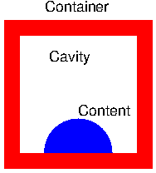
Closed container

Slide 22
Box/Cup
Region R is boxed in state S iff
the interior of R is connected;
the top of R is a horizontal surface;
no solid object is in the interior of R;
every boundary point of R below its top is a boundary point of some solid object

Slide 23
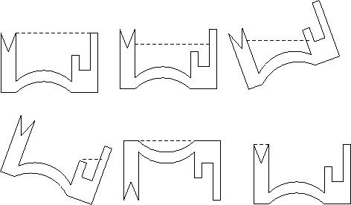
Boxed regions

Slide 24
Theory features
Incomplete.
Frame axioms are given explicitly.
Multiple levels of specificity.
  General: Two solid objects do not overlap.
  More specific: If an object is dropped inside an upright container, it remains in the container.
  Very specific: If an agent puts a small object into a container by reaching into the container, but the agent does not have to entirely enter the container, then the agent can withdraw from the container.

Slide 25
Ontology
Instant of time
Region of space
History: Region-valued fluent
Object
Set of objects
Event/Action

Slide 26
Examples of axioms
∀ _{t:Time; o:Object} FeasiblePlace(o,Place(t,o)).
Every object always occupies a feasible place.
∀ _{p,q:Object; t:Time} p ≠ q ⇒
DR(Place(t,p), Place(t,q)).
Any two objects are spatially disjoint.
∀ _{o:Object} Continuous(HPlace(o))
An object moves continuously

Slide 27
Another axiom
∀ _{ta,tb:Time; s:ObjectSet;}
[CausallyIsolated(ta,tb,s) ⋀
[∀ _{o:Object} Element(o,s) ⟹ Stable(ta,o)]] ⟹
[∀ _{o:Object t:Time} Element(o,s) ⋀ ta ≤ t ≤ tb ⟹
Place(t,o) = Place(ta,o) ⋀ Stable(t,o)]
Frame axiom: If set s is causally isolated over an interval and all objects are stable at the start, then all objects remain in the same place

Slide 28
One more axiom
∀ _{ta:Time} ∃ _{tb:Time}
ta < tb ⋀ Occurs(ta,tb,StandStill) ⋀
AllStable(tb).
At any time ta, the agent has the option of standing still until everything attains a stable state.

Slide 29
Problem statement
Given:
RigidObject(Ob).
CContained(Ta,Ox,Singleton(Ob)).
Lt(Ta,Tb).
Ob ≠ Ox.
Infer: CContained(Tb,Ox,Singleton(Ob)).

Slide 30
Toward automated reasoning
Detailed proofs for sample inferences in boxes and liquids papers.
Natural deduction proofs of 5 example inferences in the radically incomplete theory.
All five inferences has been verified by SPASS.

Slide 31
Summary: What have we accomplished?
Parts of a theory of containers.
Conceptual framework for theories of radically incomplete reasoning.
Alternative to simulation: proof of concept

Slide 32
Thank you!

