Slide 1
Modeling, visualizing, and annotating immunoreceptor signaling systems
Lily Chylek
Cornell University & Los Alamos National Laboratory

Slide 2
Outline
Methods for model visualization
Extended contact map and model guide
Applications: large-scale models of immunoreceptor signaling

Slide 3
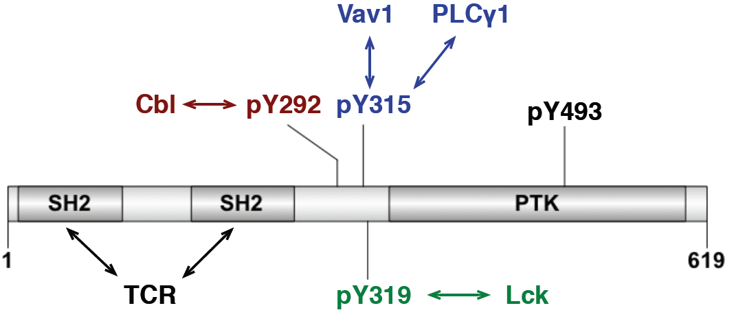
Signaling proteins
Multiple components mediate interactions with other proteins.
Interactions regulated by post-translational modifications at multiple sites.
Combinatorial complexity: many possible binding and modification states.
ZAP-70

Slide 4
Features of early events in immunoreceptor signaling
Multi-subunit receptors (e.g., FcεRI, TCR) interact with ligands
Phosphorylation of tyrosine residues in ITAM motifs
Binding of SH2 domains to receptor
Regulation of kinases by phosphorylation of specific residues
Rule-based modeling offers a viable approach to modeling these (and other) cell signaling systems.

Slide 5
Rule-based modeling
Prospects:
A great deal of information is available about a number of signal transduction systems.
This information can be used to specify rules.
Algorithms and software tools are available that allow us to simulate large-scale rule-based models.
Challenges:
How can we communicate the content of a large model?
Can we associate each rule with its biological basis?

Slide 6
Rule-based modeling
Rec(a) + Lig(l,l) <-> Rec(a!1).Lig(l!1,l) kp1, km1Rec(a) + Lig(l,l!1) <-> Rec(a!2).Lig(l!2,l!1) kp2,km2
Rec(b∼Y) + Lyn(U,SH2) <-> Rec(b∼Y!1).Lyn(U!1,SH2) kpL, kmL
Lig(l!1,l!2).Lyn(U!3,SH2).Rec(a!2,b Y!3).Rec(a!1,b∼Y) -> Lig(l!1,l!2).Lyn(U!3,SH2).Rec(a!2,b Y!3).Rec(a!1,b∼pY) pLb
Lig(l!1,l!2).Lyn(U,SH2!3).Rec(a!2,b pY!3).Rec(a!1,b∼Y) -> Lig(l!1,l!2).Lyn(U,SH2!3).Rec(a!2,b pY!3).Rec(a!1,b∼pY) pLbs
Lig(l!1,l!2).Lyn(U!3,SH2).Rec(a!2,b Y!3).Rec(a!1,g∼Y) -> Lig(l!1,l!2).Lyn(U!3,SH2).Rec(a!2,b Y!3).Rec(a!1,g∼pY) pLg
Lig(l!1,l!2).Lyn(U,SH2!3).Rec(a!2,b pY!3).Rec(a!1,g∼Y) -> Lig(l!1,l!2).Lyn(U,SH2!3).Rec(a!2,b pY!3).Rec(a!1,g∼pY) pLgs
Rec(b∼pY) + Lyn(U,SH2) <-> Rec(b∼pY!1).Lyn(U,SH2!1) kpLs, kmLsRec(g∼pY) + Syk(tSH2) <-> Rec(g∼pY!1).Syk(tSH2!1) kpS, kmS
Lig(l!1,l!2).Lyn(U!3,SH2).Rec(a!2,b∼Y!3).Rec(a!1,g pY!4).Syk(tSH2!4,l∼Y) -> Lig(l!1,l!2).Lyn(U!3,SH2).Rec(a!2,b∼Y!3).Rec(a!1,g pY!4).Syk(tSH2!4,l∼pY) pLS
Prospects:
A great deal of information is available about a number of signal transduction systems.
This information can be used to specify rules.
Algorithms and software tools are available that allow us to simulate large-scale rule-based models.
Challenges:
How can we communicate the content of a large model?
Can we associate each rule with its biological basis?

Slide 7
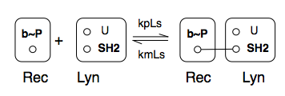
Method 1: Individual rules
How are components transformed by a rule?
Advantage
Rules are easily visualized.
Problem
Locally comprehensible, globally incomprehensible.

Slide 8
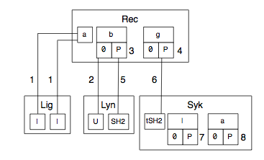
Method 2: Contact map
How do molecules bind?
Advantages
All molecules, components, states, and binding interactions are presented.
Can be generated automatically (GetBonNie, RuleBender, Rulebase/Kappa).
Problems
Lacks clear representation of enzyme-substrate relationships.
Does not always show accurate substructure.

Slide 9
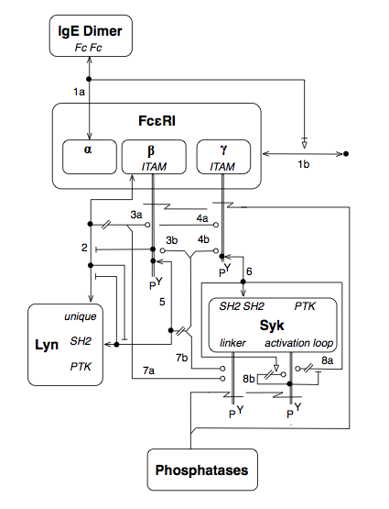
Method 3: Molecular interaction map
How do molecules interact, and how do interactions affect each other?
Advantage
Catalytic interactions are distinguishable from binding interactions.
Each molecule is shown only once.
Problem
Too much information (context). Maps become cluttered for complex networks.

Slide 10
What do we need from a diagram?
A comprehensive representation of molecules and interactions in a model.
Understandable, not overloaded with information.
Connections to rules and biological knowledge.

Slide 11
Outline
Methods for model visualization
Extended contact map and model guide
Applications: large-scale models of immunoreceptor signaling

Slide 12
Extended contact map
What is the big picture of molecules and interactions in a model?

Slide 13
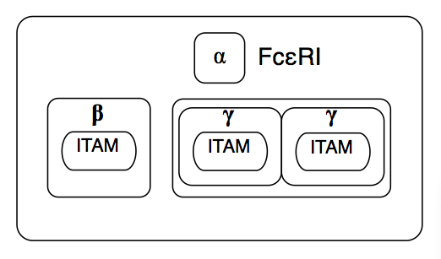
Extended contact map
Multiple levels of nesting to show protein substructure.

Slide 14
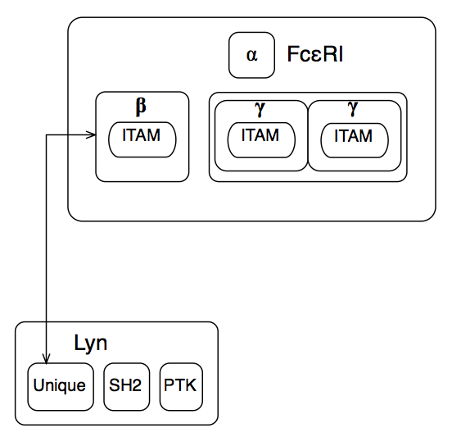
Extended contact map
Multiple levels of nesting to show protein substructure.
Distinguish different types of interactions (binding vs. catalysis).

Slide 15
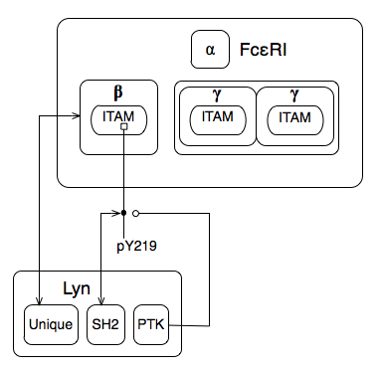
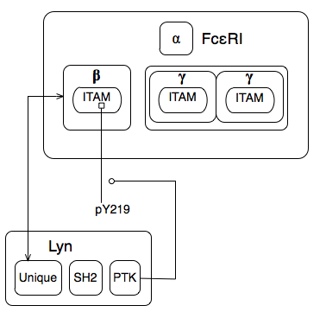
Extended contact map
Multiple levels of nesting to show protein substructure.
Distinguish different types of interactions (binding vs. catalysis).

Slide 16
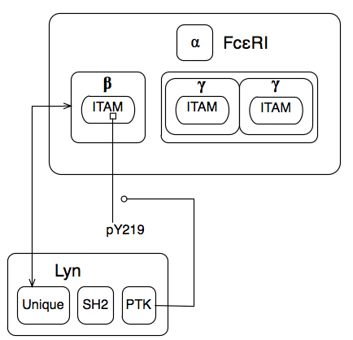
Extended contact map
Multiple levels of nesting to show protein substructure.
Distinguish different types of interactions (binding vs. catalysis).
Show sites of post-translational modification.

Slide 17
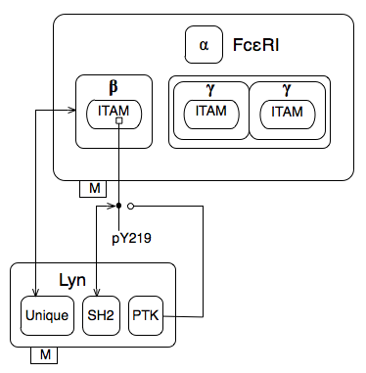
Extended contact map
Use tags to show locations of molecules.

Slide 18
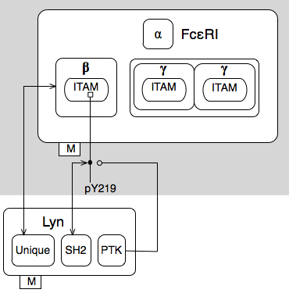
Extended contact map
Use tags to show locations of molecules.
Use shading to indicate hierarchy of molecules in signaling.

Slide 19
Extended contact map
Use tags to show locations of molecules.
Use shading to indicate hierarchy of molecules in signaling.
Connect interactions to rules, where context is accounted for.

Slide 20
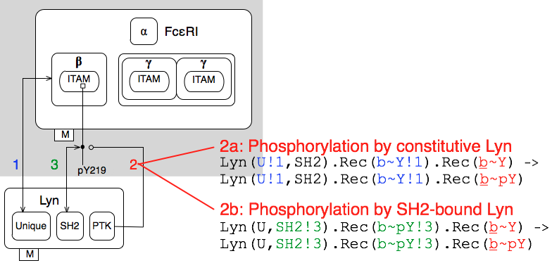
Extended contact map
Use tags to show locations of molecules.
Use shading to indicate hierarchy of molecules in signaling.
Connect interaction to rule(s), where context is accounted for.

Slide 21
Annotation: Model guide
8
8

Slide 22
Can we model and visualize other common processes in cell signaling?

Slide 23
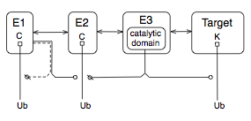
Ubiquitination cascade
E1 catalyzes transfer of ubiquitin from itself to E2.
E3 catalyzes transfer of ubiquitin from E2 to target protein.

Slide 24
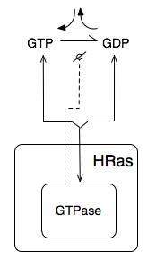
HRas
HRas is a GTPase.

Slide 25
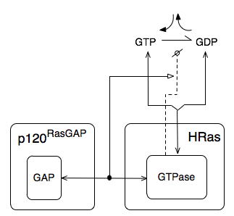
HRas
HRas is a GTPase, stimulated by RasGAP.

Slide 26
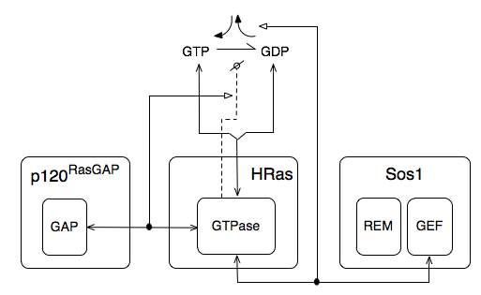
HRas
HRas is a GTPase, stimulated by RasGAP.
Nucleotide exchange stimulated by Sos1.

Slide 27
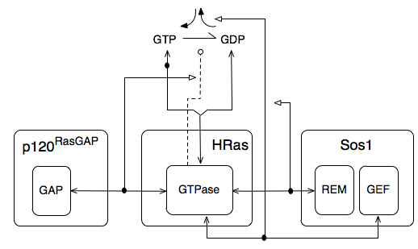
HRas
HRas is a GTPase, stimulated by RasGAP.
Nucleotide exchange stimulated by Sos1.
Sos1 allosterically activated by binding HRas.

Slide 28
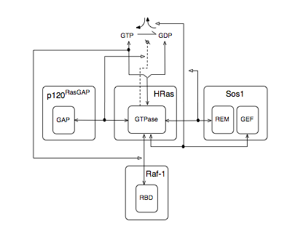
HRas
HRas is a GTPase, stimulated by RasGAP.
Nucleotide exchange stimulated by Sos1.
Sos1 allosterically activated by binding HRas.
Raf-1 binds GTP-bound HRas.

Slide 29
Outline
Methods for model visualization
Extended contact map and model guide
Applications: large-scale models of immunoreceptor signaling

Slide 30
Conclusions
As we formulate larger models, it will be necessary to have a consistent means of model visualization and annotation.
An extended contact map and model guide annotate a signal-transduction system in a form that is both visual and executable.
http://bionetgen.org/index.php/Extended_Contact_Maps

Slide 31
Thanks!
Bill Hlavacek
Bin Hu
Michael Blinov
Thierry Emonet
Jim Faeder
Byron Goldstein
Ryan Gutenkunst
Jason Haugh
Tomasz Lipniacki
Richard Posner
Jin Yang

