Slide 1
Fitting & Matching
Lectures 7 & 8 – Prof. Fergus
Slides from: S. Lazebnik, S. Seitz, M. Pollefeys, A. Effros.

Slide 2
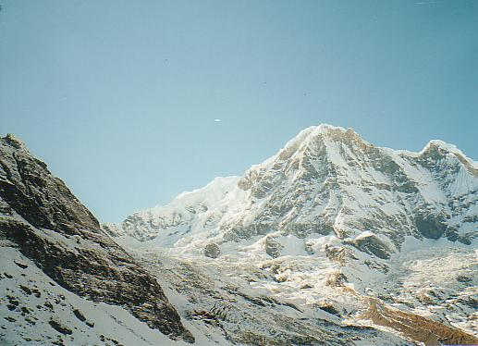
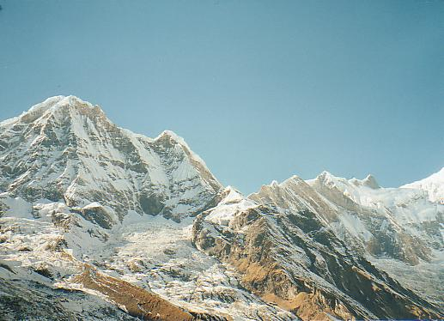
How do we build panorama?
We need to match (align) images

Slide 3
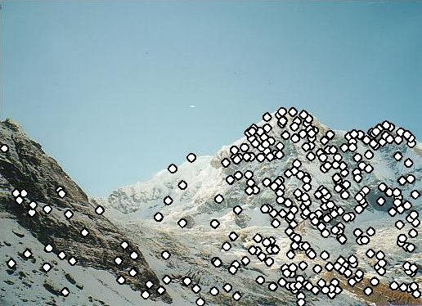
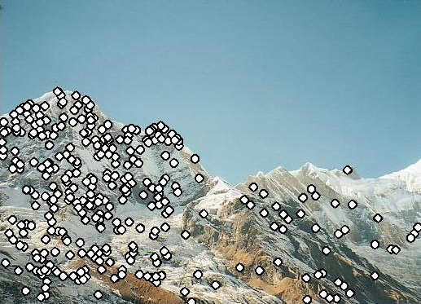
Matching with Features
Detect feature points in both images

Slide 4
Matching with Features
Detect feature points in both images
Find corresponding pairs

Slide 5
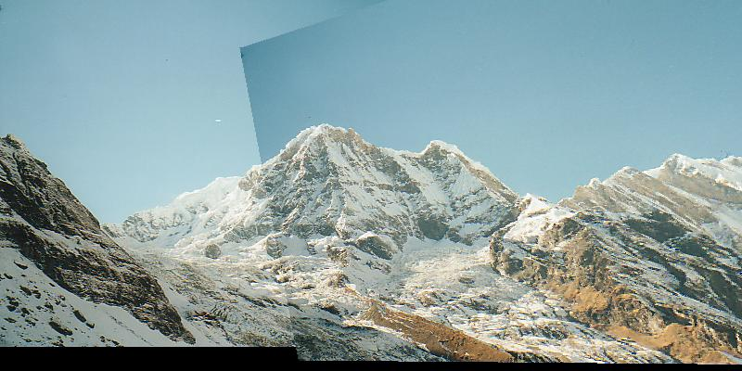
Matching with Features
Detect feature points in both images
Find corresponding pairs
Use these pairs to align images

Slide 6
Matching with Features
Detect feature points in both images
Find corresponding pairs
Use these pairs to align images
Previous lecture

Slide 7
Overview
Fitting techniques
Least Squares
Total Least Squares
RANSAC
Hough Voting
Alignment as a fitting problem

Slide 8
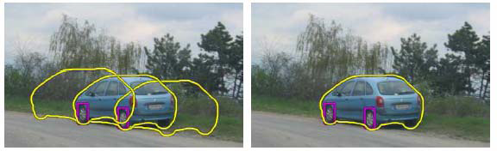
Fitting
Choose a parametric model to represent a set of features
simple model: lines
simple model: circles
complicated model: car
Source: K. Grauman

Slide 9
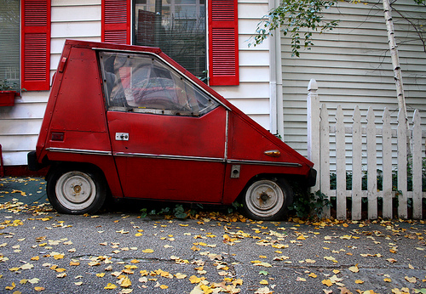
Fitting: Issues
Case study: Line detection
Noise in the measured feature locations
Extraneous data: clutter (outliers), multiple lines
Missing data: occlusions
Slide: S. Lazebnik

Slide 10
Fitting: Issues
If we know which points belong to the line, how do we find the “optimal” line parameters?
Least squares
What if there are outliers?
Robust fitting, RANSAC
What if there are many lines?
Voting methods: RANSAC, Hough transform
What if we’re not even sure it’s a line?
Model selection
Slide: S. Lazebnik

Slide 11
Overview
Fitting techniques
Least Squares
Total Least Squares
RANSAC
Hough Voting
Alignment as a fitting problem

Slide 12
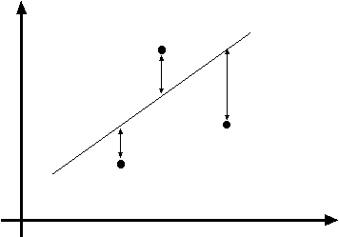
Least squares line fitting
Data: (x₁, y₁), …, (x_{n}, y_{n})
Line equation: y_{i} = m x_{i} + b
Find (m, b) to minimize
y=mx+b
(x_{i}, y_{i})
Slide: S. Lazebnik

Slide 13
Least squares line fitting
Data: (x₁, y₁), …, (x_{n}, y_{n})
Line equation: y_{i} = m x_{i} + b
Find (m, b) to minimize
y=mx+b
(x_{i}, y_{i})
Normal equations: least squares solution to XB=Y
Slide: S. Lazebnik

Slide 14
Matlab Demo
%%%% let's make some points
n = 10;
true_grad = 2;
true_intercept = 3;
noise_level = 0.04;
x = rand(1,n);
y = true_grad*x + true_intercept + randn(1,n)*noise_level;
figure; plot(x,y,'rx');
hold on;
%%% make matrix for linear system
X = [x(:) ones(n,1)];
%%% Solve system of equations
p = inv(X'*X)*X'*y(:); % Pseudo-inverse
p = pinv(X) * y(:); % Pseduo-inverse
p = X \ y(:); % Matlab's \ operator
est_grad = p(1);
est_intercept = p(2);
plot(x,est_grad*x+est_intercept,'b-');
fprintf('True gradient: %f, estimated gradient: %f\n',true_grad,est_grad);
fprintf('True intercept: %f, estimated intercept: %f\n',true_intercept,est_intercept);

Slide 15
Problem with “vertical” least squares
Not rotation-invariant
Fails completely for vertical lines
Slide: S. Lazebnik

Slide 16
Overview
Fitting techniques
Least Squares
Total Least Squares
RANSAC
Hough Voting
Alignment as a fitting problem

Slide 17
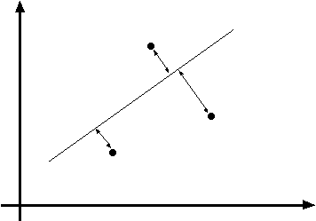
Total least squares
Distance between point (x_{i}, y_{i}) and line ax+by=d (a²+b²=1): |ax_{i} + by_{i} – d|
ax+by=d
Unit normal: N=(a, b)
(x_{i}, y_{i})
Slide: S. Lazebnik

Slide 18
Total least squares
Distance between point (x_{i}, y_{i}) and line ax+by=d (a²+b²=1): |ax_{i} + by_{i} – d|
Find (a, b, d) to minimize the sum of squared perpendicular distances
ax+by=d
Unit normal: N=(a, b)
(x_{i}, y_{i})

Slide 19
Total least squares
Distance between point (x_{i}, y_{i}) and line ax+by=d (a²+b²=1): |ax_{i} + by_{i} – d|
Find (a, b, d) to minimize the sum of squared perpendicular distances
ax+by=d
Unit normal: N=(a, b)
(x_{i}, y_{i})
Solution to (U^{T}U)N = 0, subject to ||N||² = 1: eigenvector of U^{T}U associated with the smallest eigenvalue (least squares solution to homogeneous linear system UN = 0)
Slide: S. Lazebnik

Slide 20
Total least squares
second moment matrix
Slide: S. Lazebnik

Slide 21
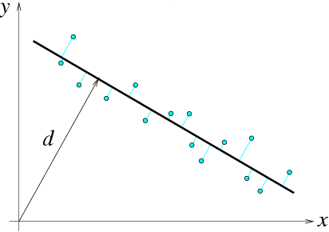
Total least squares
second moment matrix
N = (a, b)
Slide: S. Lazebnik

Slide 22
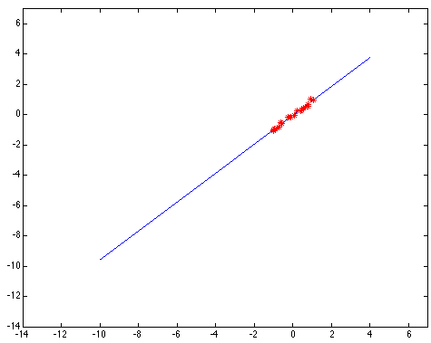
Least squares: Robustness to noise
Least squares fit to the red points:
Slide: S. Lazebnik

Slide 23
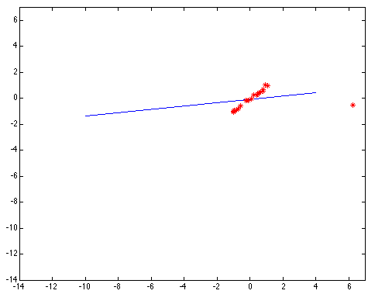
Least squares: Robustness to noise
Least squares fit with an outlier:
Problem: squared error heavily penalizes outliers
Slide: S. Lazebnik

Slide 24
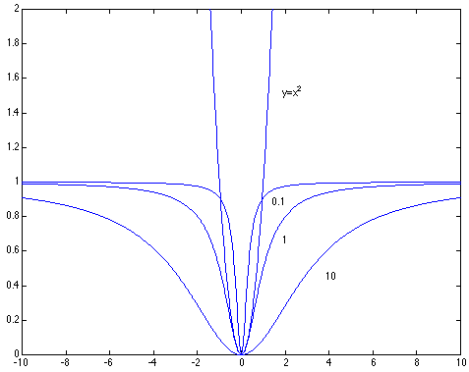

Robust estimators
General approach: minimize r_{i} (x_{i}, θ) – residual of ith point w.r.t. model parameters θ ρ – robust function with scale parameter σ
The robust function ρ behaves like squared distance for small values of the residual u but saturates for larger values of u
Slide: S. Lazebnik

Slide 25

Choosing the scale: Just right
The effect of the outlier is minimized
Slide: S. Lazebnik
Notes:
Fit to earlier data with an appropriate choice of s

Slide 26
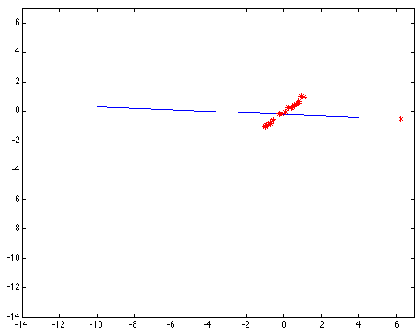
Choosing the scale: Too small
The error value is almost the same for every point and the fit is very poor
Slide: S. Lazebnik

Slide 27

Choosing the scale: Too large
Behaves much the same as least squares

Slide 28
Overview
Fitting techniques
Least Squares
Total Least Squares
RANSAC
Hough Voting
Alignment as a fitting problem

Slide 29
RANSAC
Robust fitting can deal with a few outliers – what if we have very many?
Random sample consensus (RANSAC): Very general framework for model fitting in the presence of outliers
Outline
Choose a small subset of points uniformly at random
Fit a model to that subset
Find all remaining points that are “close” to the model and reject the rest as outliers
Do this many times and choose the best model
M. A. Fischler, R. C. Bolles. Random Sample Consensus: A Paradigm for Model Fitting with Applications to Image Analysis and Automated Cartography. Comm. of the ACM, Vol 24, pp 381-395, 1981.
Slide: S. Lazebnik
Notes:
This algorithm contains concepts that are hugely useful; in my experience, everyone with some
experience of applied problems who doesn’t yet know RANSAC is almost immediately able to use it to simplify some problem they’ve seen.

Slide 30
RANSAC for line fitting
Repeat N times:
Draw s points uniformly at random
Fit line to these s points
Find inliers to this line among the remaining points (i.e., points whose distance from the line is less than t)
If there are d or more inliers, accept the line and refit using all inliers
Source: M. Pollefeys

Slide 31
Choosing the parameters
Initial number of points s
Typically minimum number needed to fit the model
Distance threshold t
Choose t so probability for inlier is p (e.g. 0.95)
Zero-mean Gaussian noise with std. dev. σ: t²=3.84σ²
Number of samples N
Choose N so that, with probability p, at least one random sample is free from outliers (e.g. p=0.99) (outlier ratio: e)
Source: M. Pollefeys

Slide 32
Choosing the parameters
Initial number of points s
Typically minimum number needed to fit the model
Distance threshold t
Choose t so probability for inlier is p (e.g. 0.95)
Zero-mean Gaussian noise with std. dev. σ: t²=3.84σ²
Number of samples N
Choose N so that, with probability p, at least one random sample is free from outliers (e.g. p=0.99) (outlier ratio: e)
 | proportion of outliers e
s | 5% | 10% | 20% | 25% | 30% | 40% | 50%
2 | 2 | 3 | 5 | 6 | 7 | 11 | 17
3 | 3 | 4 | 7 | 9 | 11 | 19 | 35
4 | 3 | 5 | 9 | 13 | 17 | 34 | 72
5 | 4 | 6 | 12 | 17 | 26 | 57 | 146
6 | 4 | 7 | 16 | 24 | 37 | 97 | 293
7 | 4 | 8 | 20 | 33 | 54 | 163 | 588
8 | 5 | 9 | 26 | 44 | 78 | 272 | 1177
Source: M. Pollefeys

Slide 33
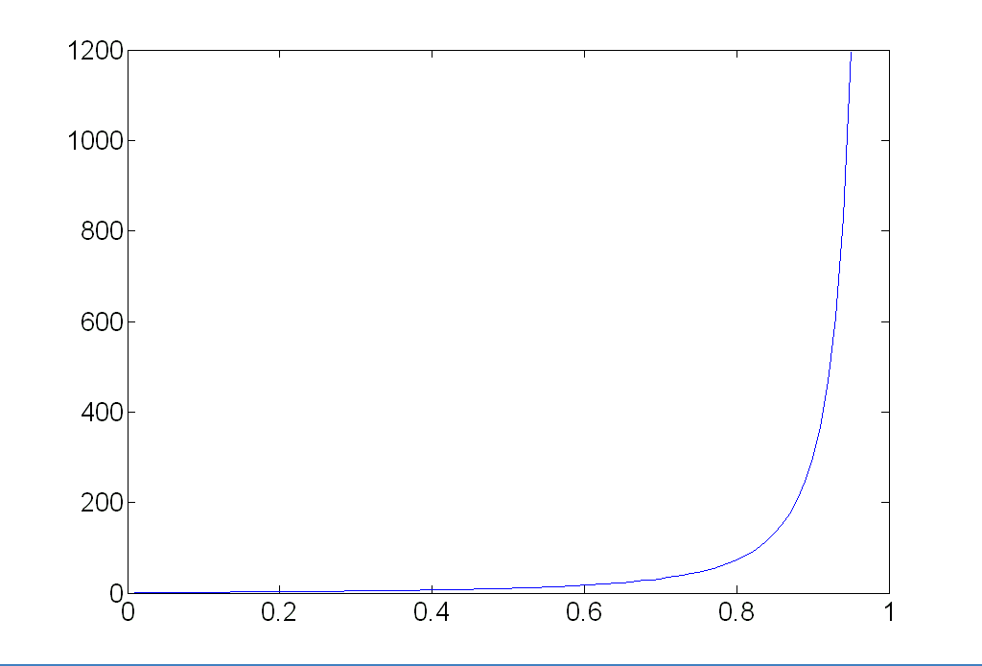
Choosing the parameters
Initial number of points s
Typically minimum number needed to fit the model
Distance threshold t
Choose t so probability for inlier is p (e.g. 0.95)
Zero-mean Gaussian noise with std. dev. σ: t²=3.84σ²
Number of samples N
Choose N so that, with probability p, at least one random sample is free from outliers (e.g. p=0.99) (outlier ratio: e)
Source: M. Pollefeys

Slide 34
Choosing the parameters
Initial number of points s
Typically minimum number needed to fit the model
Distance threshold t
Choose t so probability for inlier is p (e.g. 0.95)
Zero-mean Gaussian noise with std. dev. σ: t²=3.84σ²
Number of samples N
Choose N so that, with probability p, at least one random sample is free from outliers (e.g. p=0.99) (outlier ratio: e)
Consensus set size d
Should match expected inlier ratio
Source: M. Pollefeys

Slide 35
Adaptively determining the number of samples
Inlier ratio e is often unknown a priori, so pick worst case, e.g. 50%, and adapt if more inliers are found, e.g. 80% would yield e=0.2
Adaptive procedure:
N=∞, sample_count =0
While N >sample_count
Choose a sample and count the number of inliers
Set e = 1 – (number of inliers)/(total number of points)
Recompute N from e:
Increment the sample_count by 1
Source: M. Pollefeys

Slide 36
RANSAC pros and cons
Pros
Simple and general
Applicable to many different problems
Often works well in practice
Cons
Lots of parameters to tune
Can’t always get a good initialization of the model based on the minimum number of samples
Sometimes too many iterations are required
Can fail for extremely low inlier ratios
We can often do better than brute-force sampling
Source: M. Pollefeys

Slide 37
Voting schemes
Let each feature vote for all the models that are compatible with it
Hopefully the noise features will not vote consistently for any single model
Missing data doesn’t matter as long as there are enough features remaining to agree on a good model

Slide 38
Overview
Fitting techniques
Least Squares
Total Least Squares
RANSAC
Hough Voting
Alignment as a fitting problem

Slide 39
Hough transform
An early type of voting scheme
General outline:
Discretize parameter space into bins
For each feature point in the image, put a vote in every bin in the parameter space that could have generated this point
Find bins that have the most votes
Image space
Hough parameter space
P.V.C. Hough, Machine Analysis of Bubble Chamber Pictures, Proc. Int. Conf. High Energy Accelerators and Instrumentation, 1959

Slide 40
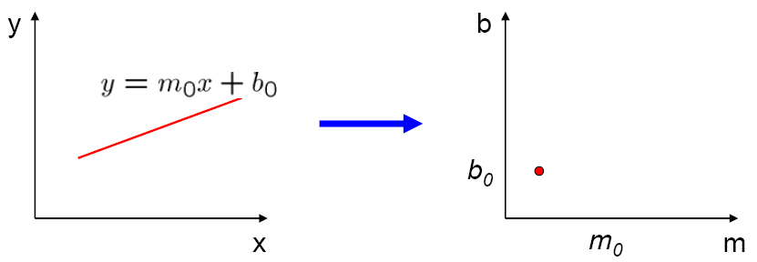
Parameter space representation
A line in the image corresponds to a point in Hough space
Image space
Hough parameter space
Source: S. Seitz

Slide 41
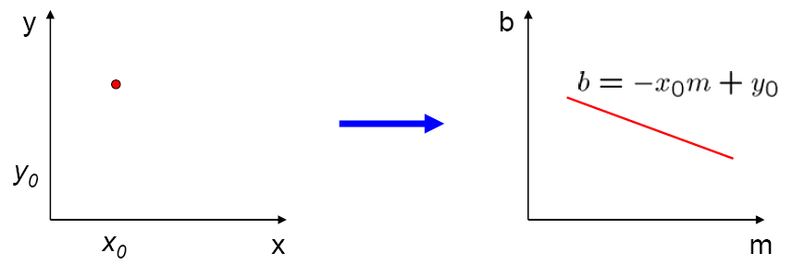
Parameter space representation
What does a point (x₀, y₀) in the image space map to in the Hough space?
Image space
Hough parameter space
Source: S. Seitz

Slide 42
Parameter space representation
What does a point (x₀, y₀) in the image space map to in the Hough space?
Answer: the solutions of b = –x₀m + y₀
This is a line in Hough space
Image space
Hough parameter space
Source: S. Seitz

Slide 43
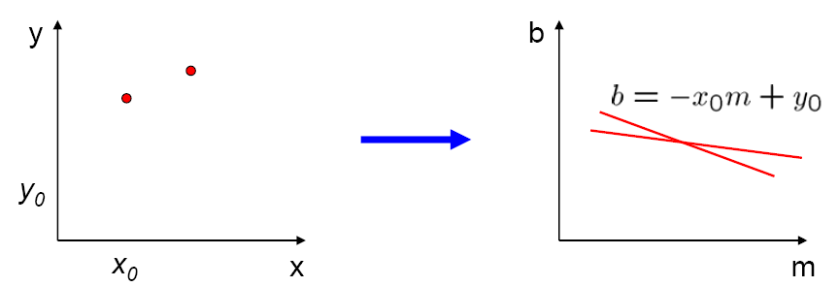
Parameter space representation
Where is the line that contains both (x₀, y₀) and (x₁, y₁)?
Image space
Hough parameter space
(x₁, y₁)
(x₀, y₀)
b = –x₁m + y₁
Source: S. Seitz

Slide 44
Parameter space representation
Where is the line that contains both (x₀, y₀) and (x₁, y₁)?
It is the intersection of the lines b = –x₀m + y₀ and b = –x₁m + y₁
Image space
Hough parameter space
(x₁, y₁)
(x₀, y₀)
b = –x₁m + y₁
Source: S. Seitz

Slide 45
Parameter space representation
Problems with the (m,b) space:
Unbounded parameter domain
Vertical lines require infinite m

Slide 46
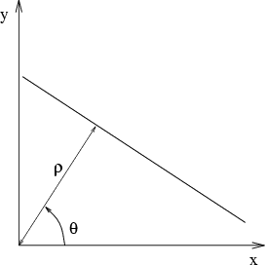
Parameter space representation
Problems with the (m,b) space:
Unbounded parameter domain
Vertical lines require infinite m
Alternative: polar representation
Each point will add a sinusoid in the (θ,ρ) parameter space

Slide 47
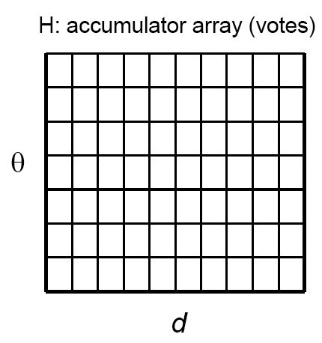
Algorithm outline
Initialize accumulator H to all zeros
For each edge point (x,y) in the image For θ = 0 to 180 ρ = x cos θ + y sin θ H(θ, ρ) = H(θ, ρ) + 1 end end
Find the value(s) of (θ, ρ) where H(θ, ρ) is a local maximum
The detected line in the image is given by ρ = x cos θ + y sin θ
ρ
θ

Slide 48
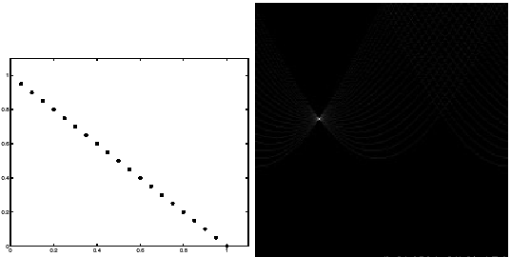
Basic illustration
features
votes
Notes:
Figure 15.1, top half. Note that most points in the vote array are very dark, because they
get only one vote.

Slide 49
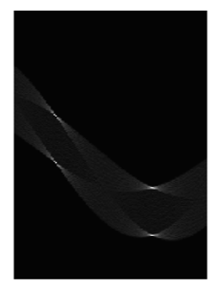
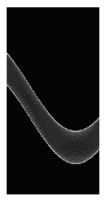
Other shapes
Square
Circle

Slide 50
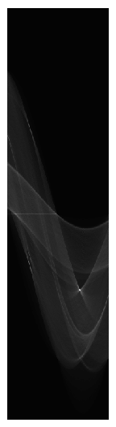
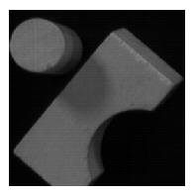
Several lines

Slide 51
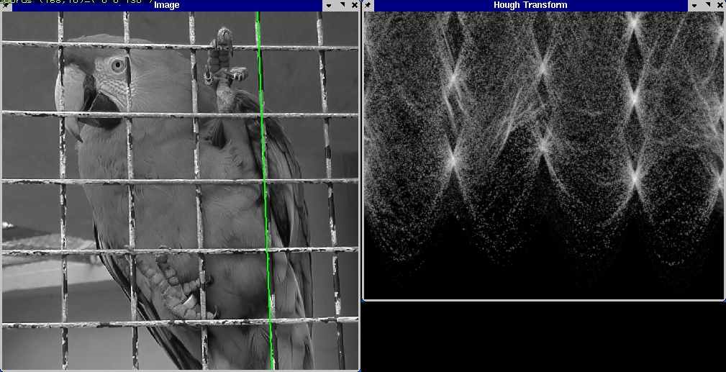
A more complicated image
http://ostatic.com/files/images/ss_hough.jpg

Slide 52
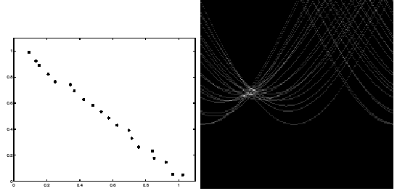
Effect of noise
features
votes
Notes:
This is 15.1 lower half

Slide 53
Effect of noise
features
votes
Peak gets fuzzy and hard to locate
Notes:
This is 15.1 lower half

Slide 54
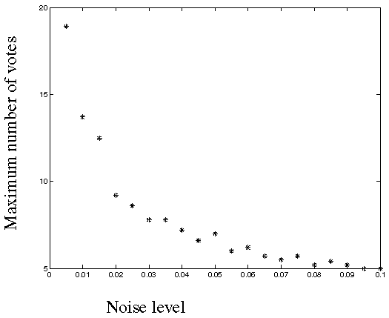
Effect of noise
Number of votes for a line of 20 points with increasing noise:
Notes:
This is the number of votes that the real line of 20 points gets with increasing noise (figure15.3)

Slide 55
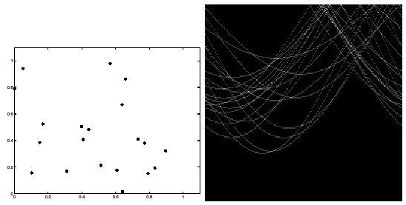
Random points
features
votes
Uniform noise can lead to spurious peaks in the array
Notes:
15.2; main point is that lots of noise can lead to large peaks in the array

Slide 56
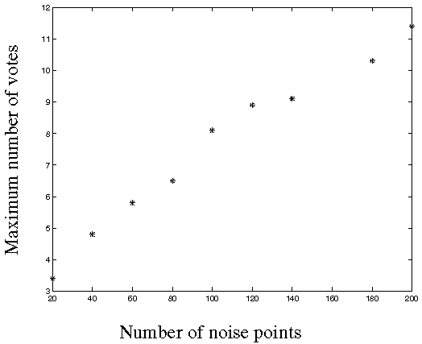
Random points
As the level of uniform noise increases, the maximum number of votes increases too:
Notes:
Figure 15.4; as the noise increases in a picture without a line, the number of points in the max cell goes
up, too

Slide 57
Dealing with noise
Choose a good grid / discretization
Too coarse: large votes obtained when too many different lines correspond to a single bucket
Too fine: miss lines because some points that are not exactly collinear cast votes for different buckets
Increment neighboring bins (smoothing in accumulator array)
Try to get rid of irrelevant features
Take only edge points with significant gradient magnitude

Slide 58
Hough transform for circles
How many dimensions will the parameter space have?
Given an oriented edge point, what are all possible bins that it can vote for?

Slide 59
Hough transform for circles
image space
Hough parameter space
r
y
(x,y)
x
x
y

Slide 60
Generalized Hough transform
We want to find a shape defined by its boundary points and a reference point
a
D. Ballard, Generalizing the Hough Transform to Detect Arbitrary Shapes, Pattern Recognition 13(2), 1981, pp. 111-122.

Slide 61
Generalized Hough transform
We want to find a shape defined by its boundary points and a reference point
For every boundary point p, we can compute the displacement vector r = a – p as a function of gradient orientation θ
a
θ
r(θ)
p
D. Ballard, Generalizing the Hough Transform to Detect Arbitrary Shapes, Pattern Recognition 13(2), 1981, pp. 111-122.

Slide 62
Generalized Hough transform
For model shape: construct a table indexed by θ storing displacement vectors r as function of gradient direction
Detection: For each edge point p with gradient orientation θ:
Retrieve all r indexed with θ
For each r(θ), put a vote in the Hough space at p + r(θ)
Peak in this Hough space is reference point with most supporting edges
Assumption: translation is the only transformation here, i.e., orientation and scale are fixed
Source: K. Grauman

Slide 63
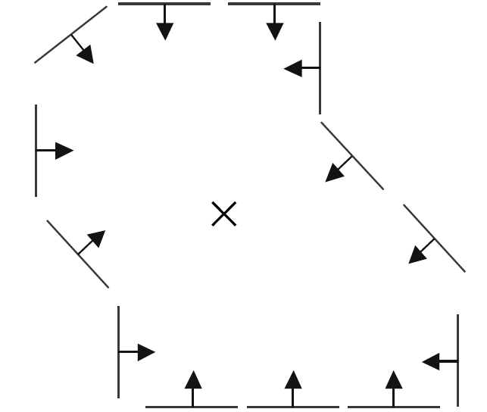
Example
model shape

Slide 64
Example
displacement vectors for model points

Slide 65
Example
range of voting locations for test point

Slide 66
Example
range of voting locations for test point

Slide 67
Example
votes for points with θ =

Slide 68
Example
displacement vectors for model points

Slide 69
Example
range of voting locations for test point

Slide 70
Example
votes for points with θ =

Slide 71

Application in recognition
Instead of indexing displacements by gradient orientation, index by “visual codeword”
visual codeword with displacement vectors
training image
B. Leibe, A. Leonardis, and B. Schiele, Combined Object Categorization and Segmentation with an Implicit Shape Model, ECCV Workshop on Statistical Learning in Computer Vision 2004

Slide 72
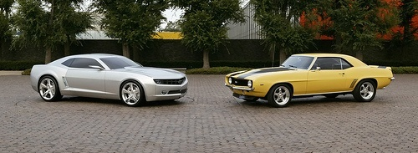
Application in recognition
Instead of indexing displacements by gradient orientation, index by “visual codeword”
test image
B. Leibe, A. Leonardis, and B. Schiele, Combined Object Categorization and Segmentation with an Implicit Shape Model, ECCV Workshop on Statistical Learning in Computer Vision 2004

Slide 73
Overview
Fitting techniques
Least Squares
Total Least Squares
RANSAC
Hough Voting
Alignment as a fitting problem

Slide 74
Image alignment
Two broad approaches:
Direct (pixel-based) alignment
Search for alignment where most pixels agree
Feature-based alignment
Search for alignment where extracted features agree
Can be verified using pixel-based alignment
Source: S. Lazebnik

Slide 75
Alignment as fitting
Previously: fitting a model to features in one image
M
x_{i}
Find model M that minimizes
Source: S. Lazebnik

Slide 76
Alignment as fitting
Previously: fitting a model to features in one image
Alignment: fitting a model to a transformation between pairs of features (matches) in two images
M
x_{i}
Find model M that minimizes
x_{i}
x_{i}
Find transformation T that minimizes
'
T
Source: S. Lazebnik

Slide 77
2D transformation models
Similarity (translation, scale, rotation)
Affine
Projective (homography)
Source: S. Lazebnik

Slide 78
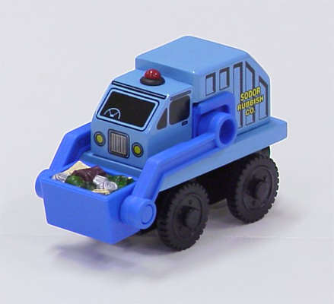
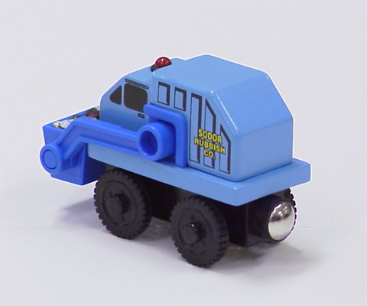
Let’s start with affine transformations
Simple fitting procedure (linear least squares)
Approximates viewpoint changes for roughly planar objects and roughly orthographic cameras
Can be used to initialize fitting for more complex models
Source: S. Lazebnik

Slide 79
Fitting an affine transformation
Assume we know the correspondences, how do we get the transformation?
Source: S. Lazebnik

Slide 80
Fitting an affine transformation
Linear system with six unknowns
Each match gives us two linearly independent equations: need at least three to solve for the transformation parameters
Source: S. Lazebnik

Slide 81
Feature-based alignment outline

Slide 82
Feature-based alignment outline
Extract features

Slide 83
Feature-based alignment outline
Extract features
Compute putative matches

Slide 84
Feature-based alignment outline
Extract features
Compute putative matches
Loop:
Hypothesize transformation T

Slide 85
Feature-based alignment outline
Extract features
Compute putative matches
Loop:
Hypothesize transformation T
Verify transformation (search for other matches consistent with T)

Slide 86
Feature-based alignment outline
Extract features
Compute putative matches
Loop:
Hypothesize transformation T
Verify transformation (search for other matches consistent with T)

Slide 87
Dealing with outliers
The set of putative matches contains a very high percentage of outliers
Geometric fitting strategies:
RANSAC
Hough transform

Slide 88
RANSAC
RANSAC loop:
Randomly select a seed group of matches
Compute transformation from seed group
Find inliers to this transformation
If the number of inliers is sufficiently large, re-compute least-squares estimate of transformation on all of the inliers
Keep the transformation with the largest number of inliers

Slide 89
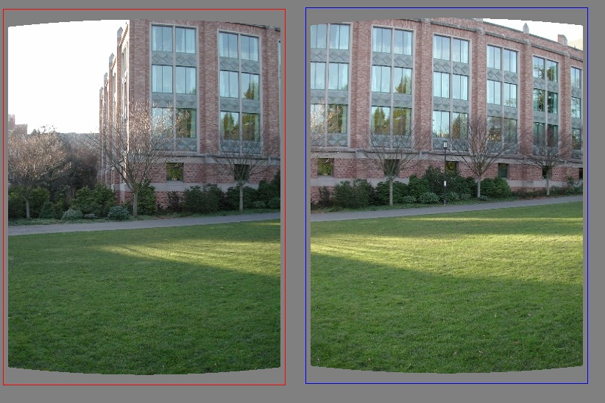
RANSAC example: Translation
Putative matches
Source: A. Efros

Slide 90
RANSAC example: Translation
Select one match, count inliers
Source: A. Efros

Slide 91
RANSAC example: Translation
Select one match, count inliers
Source: A. Efros

Slide 92
RANSAC example: Translation
Select translation with the most inliers
Source: A. Efros

Slide 93
Motion estimation techniques
Feature-based methods
Extract visual features (corners, textured areas) and track them over multiple frames
Sparse motion fields, but more robust tracking
Suitable when image motion is large (10s of pixels)
Direct methods
Directly recover image motion at each pixel from spatio-temporal image brightness variations
Dense motion fields, but sensitive to appearance variations
Suitable for video and when image motion is small

Slide 94
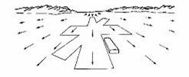
Optical flow
Combination of slides from Rick Szeliski, Steve Seitz, Alyosha Efros and Bill Freeman and Fredo Durand

Slide 95
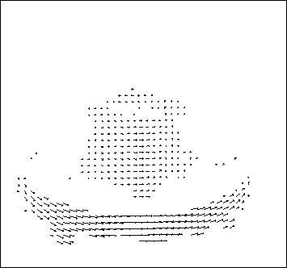
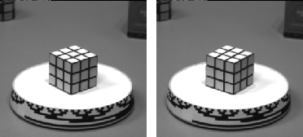
Motion estimation: Optical flow
Will start by estimating motion of each pixel separately
Then will consider motion of entire image

Slide 96
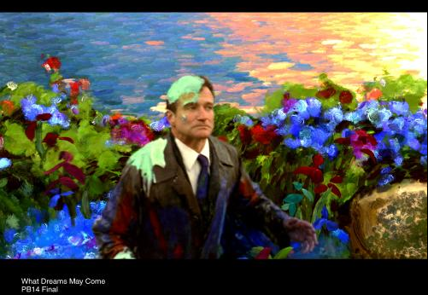
Why estimate motion?
Lots of uses
Track object behavior
Correct for camera jitter (stabilization)
Align images (mosaics)
3D shape reconstruction
Special effects

Slide 97


Problem definition: optical flow
How to estimate pixel motion from image H to image I?
Solve pixel correspondence problem
given a pixel in H, look for nearby pixels of the same color in I
Key assumptions
color constancy: a point in H looks the same in I
For grayscale images, this is brightness constancy
small motion: points do not move very far
This is called the optical flow problem

Slide 98


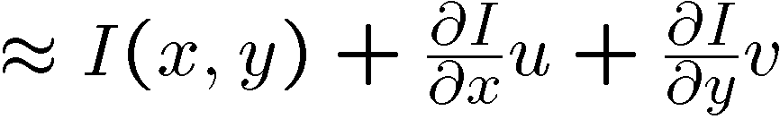
Optical flow constraints (grayscale images)
Let’s look at these constraints more closely
brightness constancy: Q: what’s the equation?
H(x,y)=I(x+u, y+v)
small motion: (u and v are less than 1 pixel)
suppose we take the Taylor series expansion of I:
Notes:
A: H(x,y) = I(x+u, y+v)

Slide 99



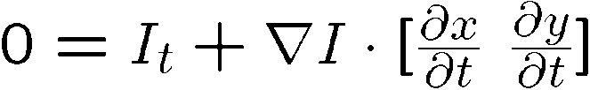
Optical flow equation
Combining these two equations
In the limit as u and v go to zero, this becomes exact

Slide 100

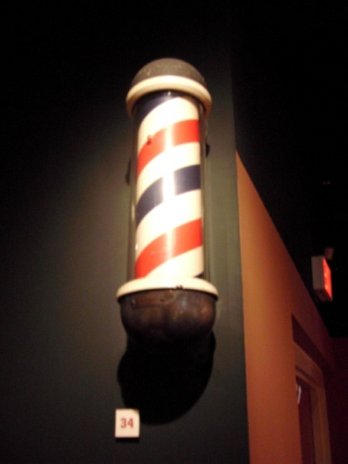
Optical flow equation
Q: how many unknowns and equations per pixel?
2 unknowns, one equation
Intuitively, what does this constraint mean?
The component of the flow in the gradient direction is determined
The component of the flow parallel to an edge is unknown
This explains the Barber Pole illusion
http://www.sandlotscience.com/Ambiguous/Barberpole_Illusion.htm
http://www.liv.ac.uk/~marcob/Trieste/barberpole.html
http://en.wikipedia.org/wiki/Barber's_pole
Notes:
A: u and v are unknown, 1 equation

Slide 101
Aperture problem

Slide 102
Aperture problem

Slide 103
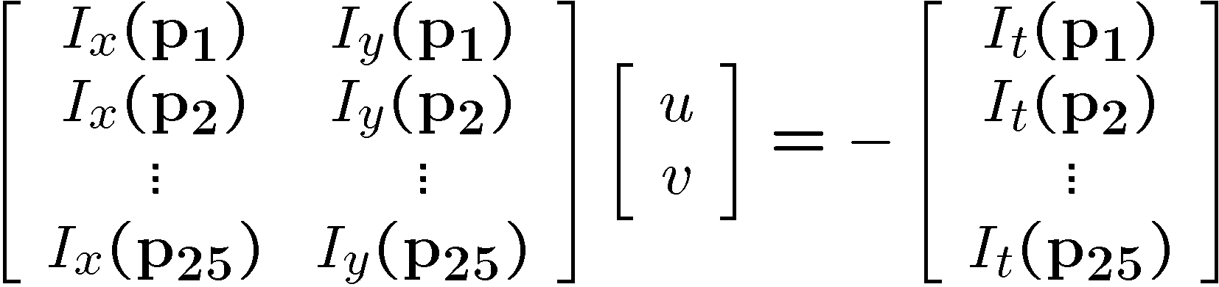


Solving the aperture problem
How to get more equations for a pixel?
Basic idea: impose additional constraints
most common is to assume that the flow field is smooth locally
one method: pretend the pixel’s neighbors have the same (u,v)
If we use a 5x5 window, that gives us 25 equations per pixel!

Slide 104
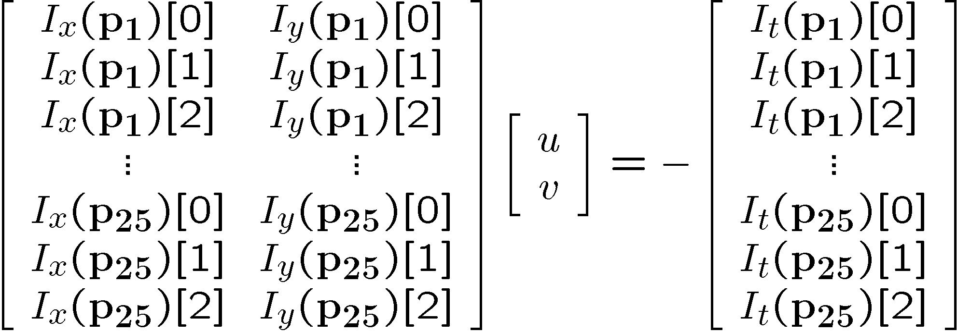


RGB version
How to get more equations for a pixel?
Basic idea: impose additional constraints
most common is to assume that the flow field is smooth locally
one method: pretend the pixel’s neighbors have the same (u,v)
If we use a 5x5 window, that gives us 25*3 equations per pixel!
Note that RGB is not enough to disambiguate because R, G & B are correlated Just provides better gradient

Slide 105






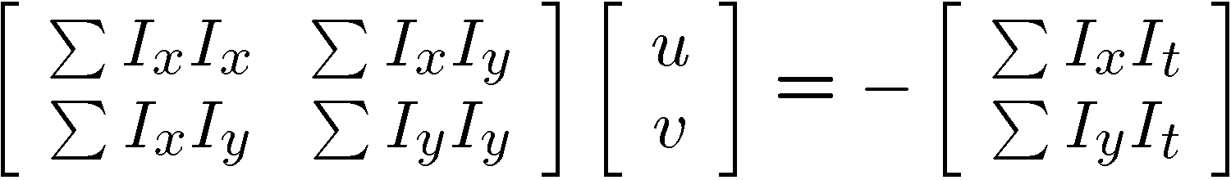


Lukas-Kanade flow
Prob: we have more equations than unknowns
Solution: solve least squares problem
minimum least squares solution given by solution (in d) of:
The summations are over all pixels in the K x K window
This technique was first proposed by Lukas & Kanade (1981)

Slide 106
Aperture Problem and Normal Flow
The gradient constraint:
Defines a line in the (u,v) space
v
Normal Flow:
u

Slide 107
Combining Local Constraints
v
u
etc.

Slide 108
Conditions for solvability
Optimal (u, v) satisfies Lucas-Kanade equation
When is This Solvable?
A^{T}A should be invertible
A^{T}A should not be too small due to noise
eigenvalues λ₁ and λ₂ of A^{T}A should not be too small
A^{T}A should be well-conditioned
λ₁/ λ₂ should not be too large (λ₁ = larger eigenvalue)
A^{T}A is solvable when there is no aperture problem

Slide 109
Eigenvectors of A^{T}A
Recall the Harris corner detector: M = A^{T}A is the second moment matrix
The eigenvectors and eigenvalues of M relate to edge direction and magnitude
The eigenvector associated with the larger eigenvalue points in the direction of fastest intensity change
The other eigenvector is orthogonal to it
Notes:
Suppose M = vv^T . What are the eigenvectors and eigenvalues? Start by considering Mv

Slide 110
Interpreting the eigenvalues
Classification of image points using eigenvalues of the second moment matrix:
λ₂
“Edge” λ₂ >> λ₁
“Corner” λ₁ and λ₂ are large, λ₁ ~ λ₂
λ₁ and λ₂ are small
“Flat” region
“Edge” λ₁ >> λ₂
λ₁

Slide 111
Local Patch Analysis

Slide 112
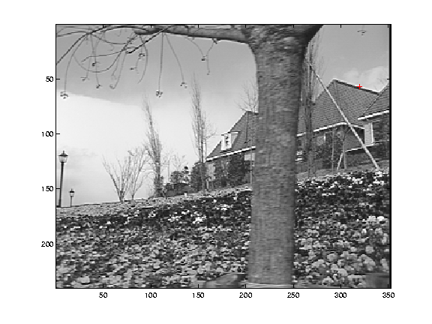
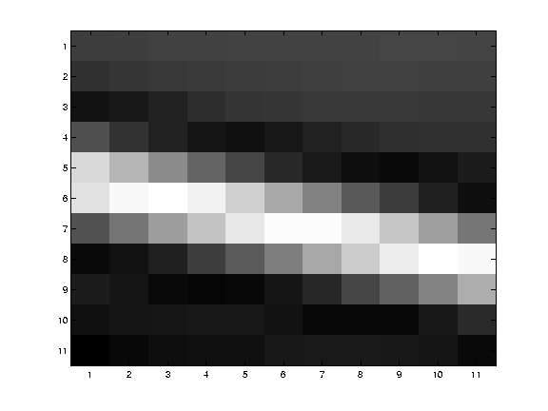
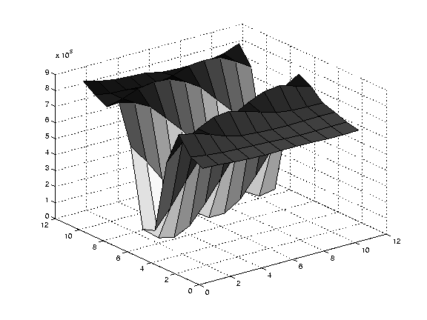
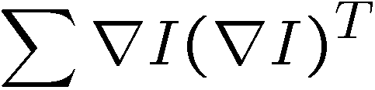
Edge
large gradients, all the same
large λ₁, small λ₂

Slide 113
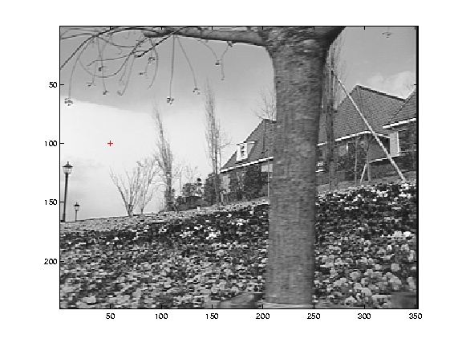


Low texture region
gradients have small magnitude
small λ₁, small λ₂

Slide 114



High textured region
gradients are different, large magnitudes
large λ₁, large λ₂

Slide 115
Observation
This is a two image problem BUT
Can measure sensitivity by just looking at one of the images!
This tells us which pixels are easy to track, which are hard
very useful later on when we do feature tracking...

Slide 116




Motion models
Translation
Affine
Perspective
3D rotation
2 unknowns
6 unknowns
8 unknowns
3 unknowns

Slide 117
Affine motion
Substituting into the brightness constancy equation:

Slide 118
Affine motion
Substituting into the brightness constancy equation:
Each pixel provides 1 linear constraint in 6 unknowns
Least squares minimization:

Slide 119
Errors in Lukas-Kanade
What are the potential causes of errors in this procedure?
Suppose A^{T}A is easily invertible
Suppose there is not much noise in the image
When our assumptions are violated
Brightness constancy is not satisfied
The motion is not small
A point does not move like its neighbors
window size is too large
what is the ideal window size?

Slide 120
Iterative Refinement
Iterative Lukas-Kanade Algorithm
Estimate velocity at each pixel by solving Lucas-Kanade equations
Warp H towards I using the estimated flow field
- use image warping techniques
Repeat until convergence

Slide 121






Optical Flow: Iterative Estimation
estimate update
Initial guess:
Estimate:
x₀
x
(using d for displacement here instead of u)

Slide 122




Optical Flow: Iterative Estimation
estimate update
Initial guess:
Estimate:
x₀
x

Slide 123




Optical Flow: Iterative Estimation
estimate update
Initial guess:
Estimate:
Initial guess:
Estimate:
x₀
x

Slide 124


Optical Flow: Iterative Estimation
x₀
x

Slide 125
Optical Flow: Iterative Estimation
Some Implementation Issues:
Warping is not easy (ensure that errors in warping are smaller than the estimate refinement)
Warp one image, take derivatives of the other so you don’t need to re-compute the gradient after each iteration.
Often useful to low-pass filter the images before motion estimation (for better derivative estimation, and linear approximations to image intensity)

Slide 126

Revisiting the small motion assumption
Is this motion small enough?
Probably not—it’s much larger than one pixel (2nd order terms dominate)
How might we solve this problem?

Slide 127



Optical Flow: Aliasing
Temporal aliasing causes ambiguities in optical flow because images can have many pixels with the same intensity.
I.e., how do we know which ‘correspondence’ is correct?
actual shift
estimated shift
nearest match is correct (no aliasing)
nearest match is incorrect (aliasing)
To overcome aliasing: coarse-to-fine estimation.

Slide 128




Reduce the resolution!

Slide 129
Coarse-to-fine optical flow estimation
u=1.25 pixels
u=2.5 pixels
u=5 pixels
image H
u=10 pixels
image I
image H
image I
Gaussian pyramid of image H
Gaussian pyramid of image I

Slide 130
Coarse-to-fine optical flow estimation
run iterative L-K
warp & upsample
run iterative L-K
.
.
.
image J
image I
image H
image I
Gaussian pyramid of image H
Gaussian pyramid of image I

Slide 131
Recap: Classes of Techniques
Feature-based methods (e.g. SIFT+Ransac+regression)
Extract visual features (corners, textured areas) and track them over multiple frames
Sparse motion fields, but possibly robust tracking
Suitable especially when image motion is large (10-s of pixels)
Direct-methods (e.g. optical flow)
Directly recover image motion from spatio-temporal image brightness variations
Global motion parameters directly recovered without an intermediate feature motion calculation
Dense motion fields, but more sensitive to appearance variations
Suitable for video and when image motion is small (< 10 pixels)

