Slide 1
Fitting & Matching Region Representation Image Alignment, Optical Flow
Lectures 5 & 6 – Prof. Fergus
Slides from: S. Lazebnik, S. Seitz, M. Pollefeys, A. Effros.

Slide 2
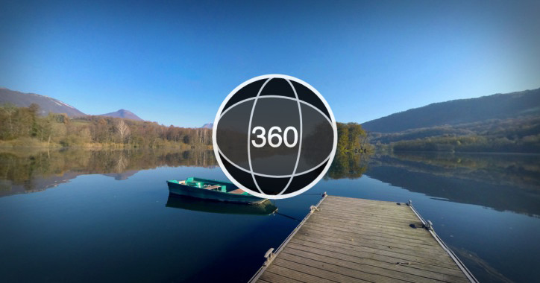
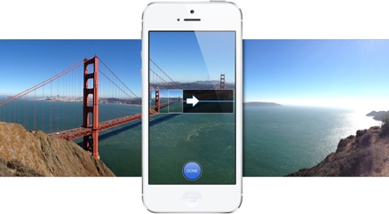
Panoramas
Facebook 360 photos

Slide 3
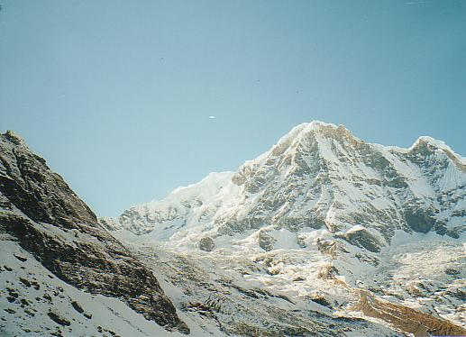
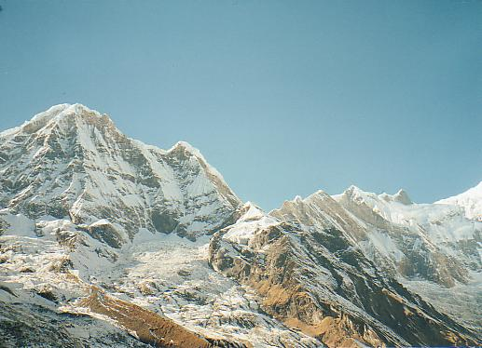
How do we build panorama?
We need to match (align) images

Slide 4
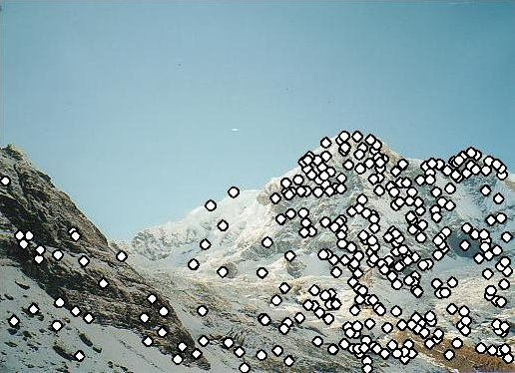
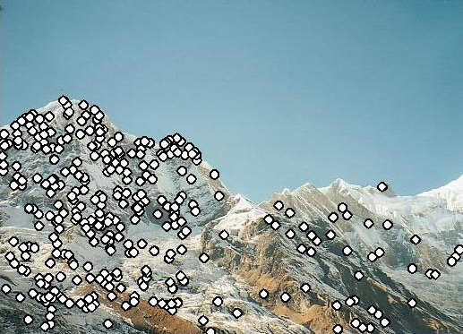
Matching with Features
Detect feature points in both images

Slide 5
Matching with Features
Detect feature points in both images
Find corresponding pairs

Slide 6
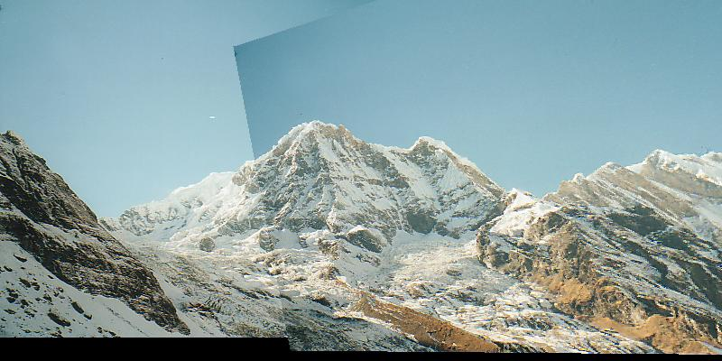
Matching with Features
Detect feature points in both images
Find corresponding pairs
Use these pairs to align images

Slide 7
Matching with Features
Detect feature points in both images
Find corresponding pairs
Use these pairs to align images

Slide 8
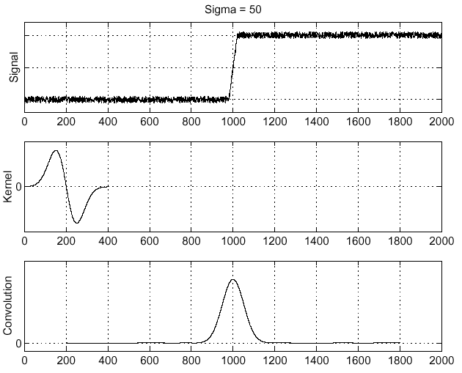
Recall: Edge detection
Edge
f
Derivative of Gaussian
Edge = maximum of derivative
Source: S. Seitz

Slide 9
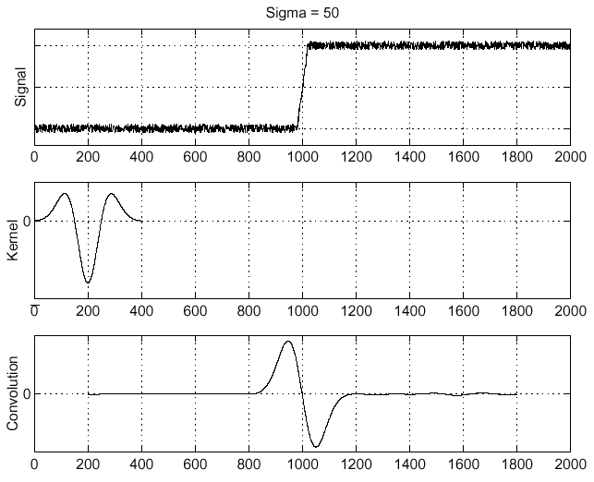
Edge detection, Take 2
f
Edge
Second derivative of Gaussian (Laplacian)
Edge = zero crossing of second derivative
Source: S. Seitz

Slide 10
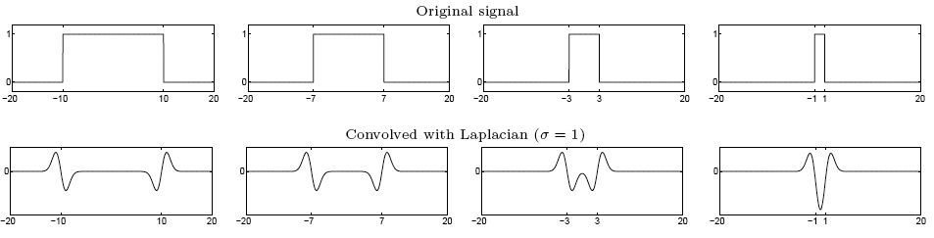
From edges to blobs
Edge = ripple
Blob = superposition of two ripples
maximum
Spatial selection: the magnitude of the Laplacian response will achieve a maximum at the center of the blob, provided the scale of the Laplacian is “matched” to the scale of the blob

Slide 11
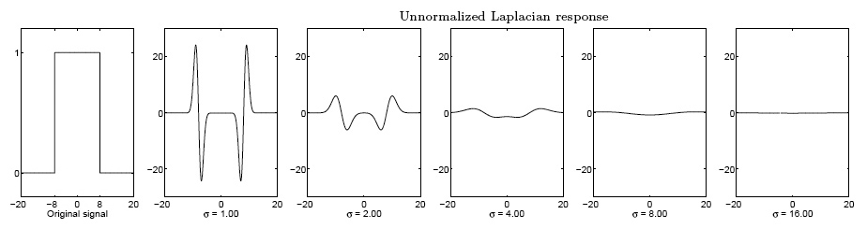
Scale selection
We want to find the characteristic scale of the blob by convolving it with Laplacians at several scales and looking for the maximum response
However, Laplacian response decays as scale increases:
original signal (radius=8)
increasing σ
Why does this happen?

Slide 12
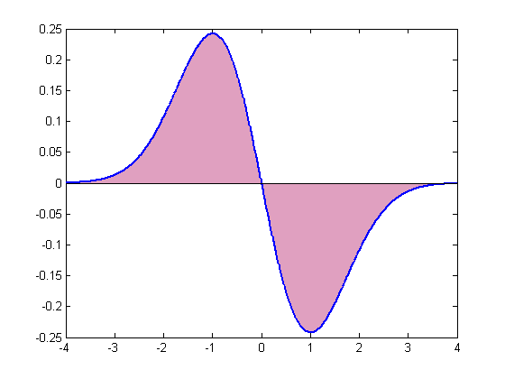
Scale normalization
The response of a derivative of Gaussian filter to a perfect step edge decreases as σ increases
Notes:
The area under the first derivative of Gaussian from –infinity to 0 is equal to the value of the Gaussian at zero

Slide 13
Scale normalization
The response of a derivative of Gaussian filter to a perfect step edge decreases as σ increases
To keep response the same (scale-invariant), must multiply Gaussian derivative by σ
Laplacian is the second Gaussian derivative, so it must be multiplied by σ²

Slide 14
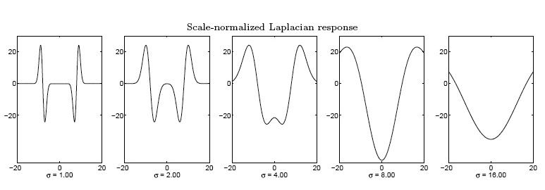
Effect of scale normalization
Original signal
Unnormalized Laplacian response
Scale-normalized Laplacian response
maximum

Slide 15
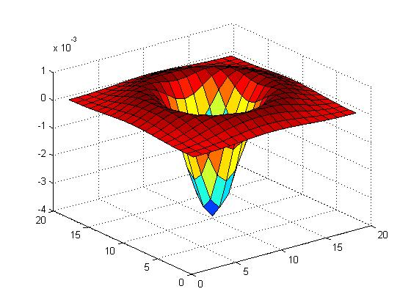

Blob detection in 2D
Laplacian of Gaussian: Circularly symmetric operator for blob detection in 2D

Slide 16
Blob detection in 2D
Laplacian of Gaussian: Circularly symmetric operator for blob detection in 2D
Scale-normalized:

Slide 17
Scale selection
At what scale does the Laplacian achieve a maximum response to a binary circle of radius r?
r
image
Laplacian

Slide 18
Scale selection
At what scale does the Laplacian achieve a maximum response to a binary circle of radius r?
To get maximum response, the zeros of the Laplacian have to be aligned with the circle
Zeros of Laplacian is given by (up to scale):
Therefore, the maximum response occurs at
r
circle
image
Laplacian

Slide 19
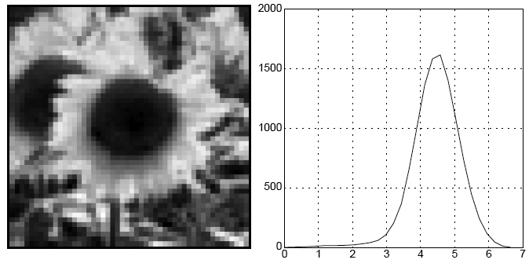
Characteristic scale
We define the characteristic scale of a blob as the scale that produces peak of Laplacian response in the blob center
characteristic scale
T. Lindeberg (1998). "Feature detection with automatic scale selection." International Journal of Computer Vision 30 (2): pp 77--116.

Slide 20
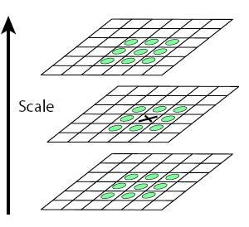
Scale-space blob detector
Convolve image with scale-normalized Laplacian at several scales
Find maxima of squared Laplacian response in scale-space

Slide 21
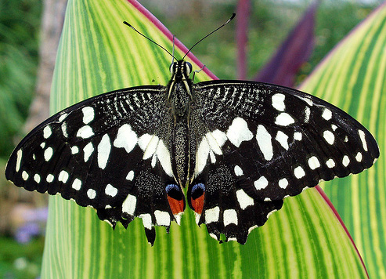
Scale-space blob detector: Example

Slide 22
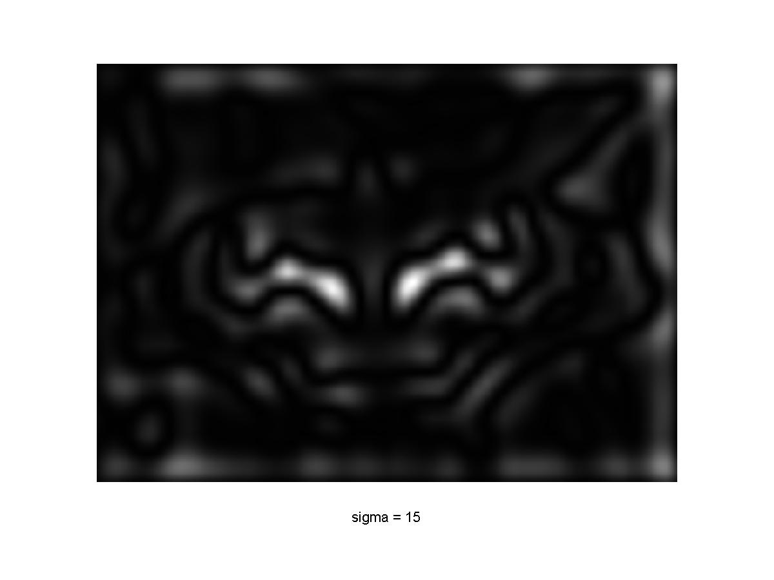
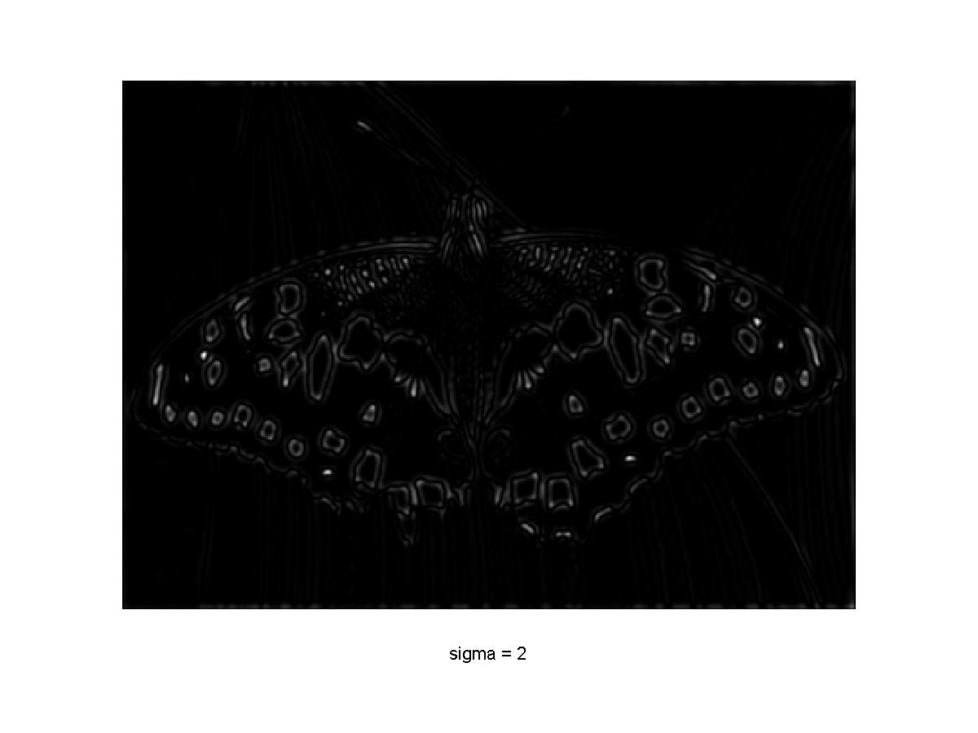
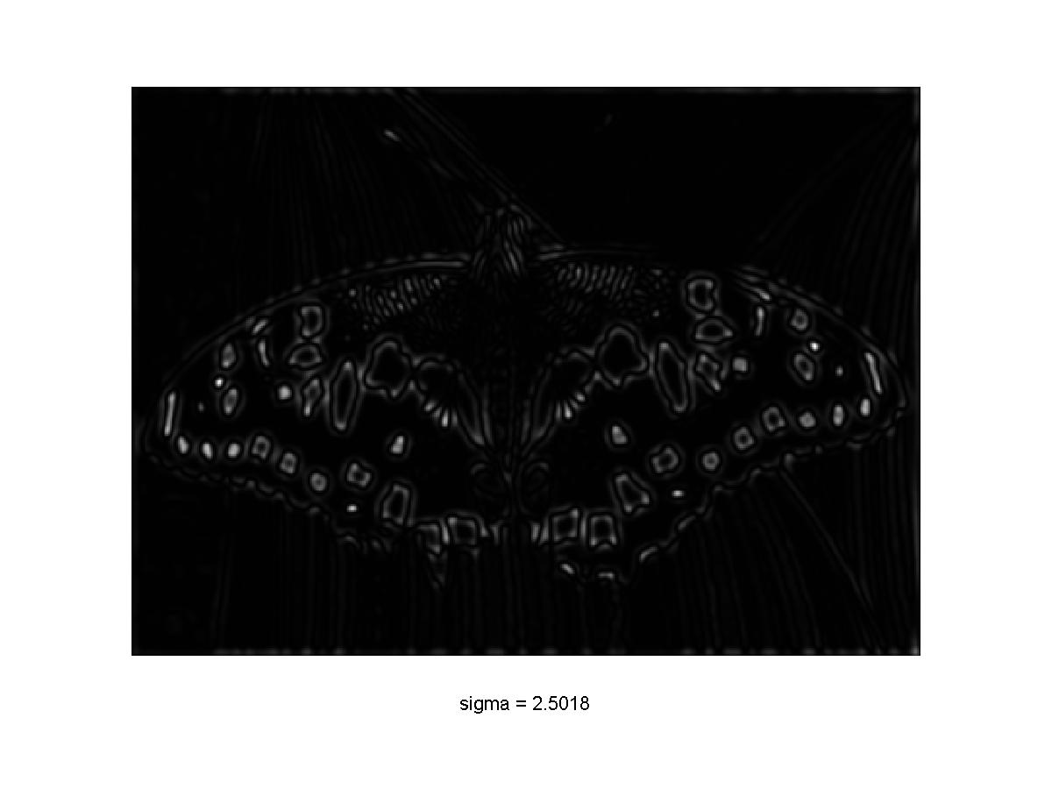
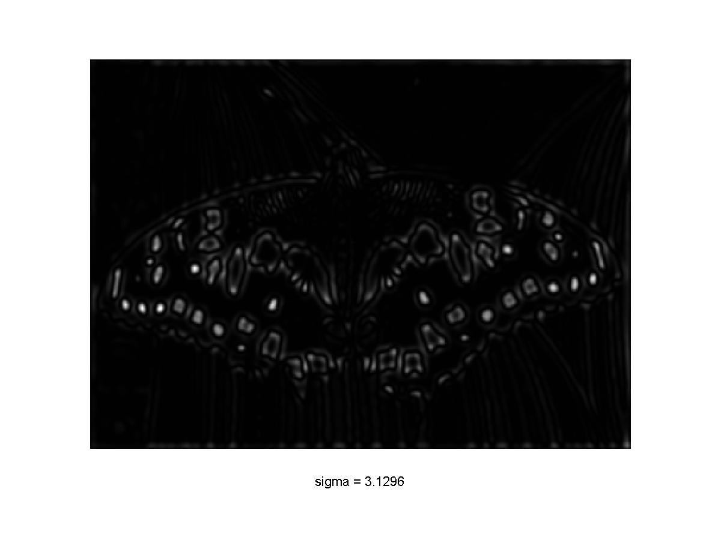
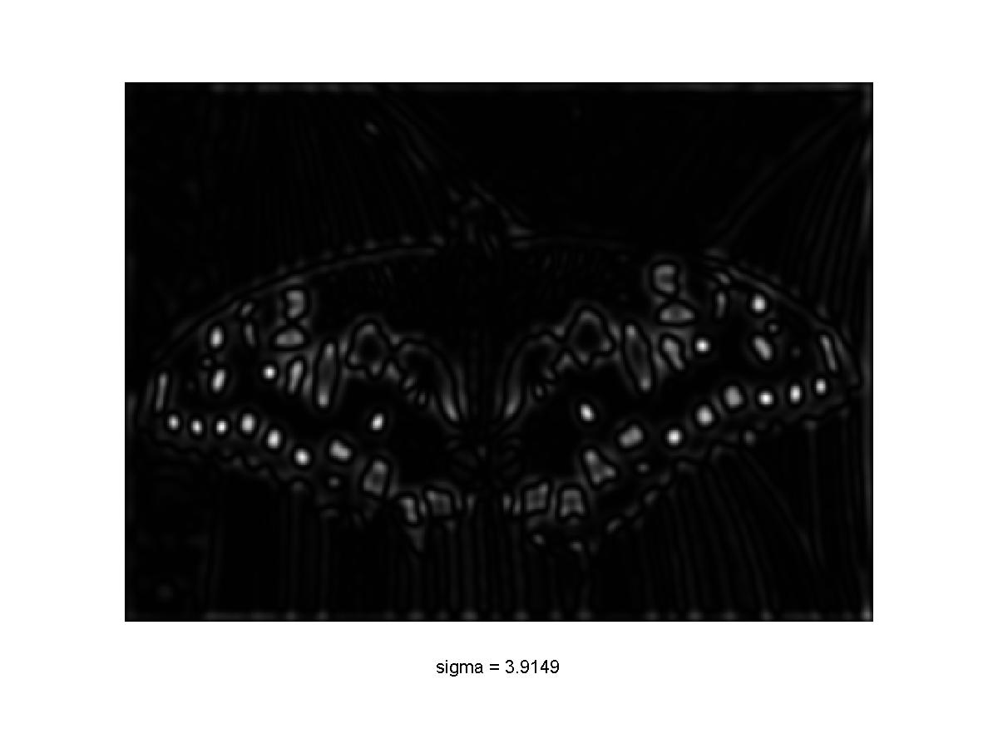
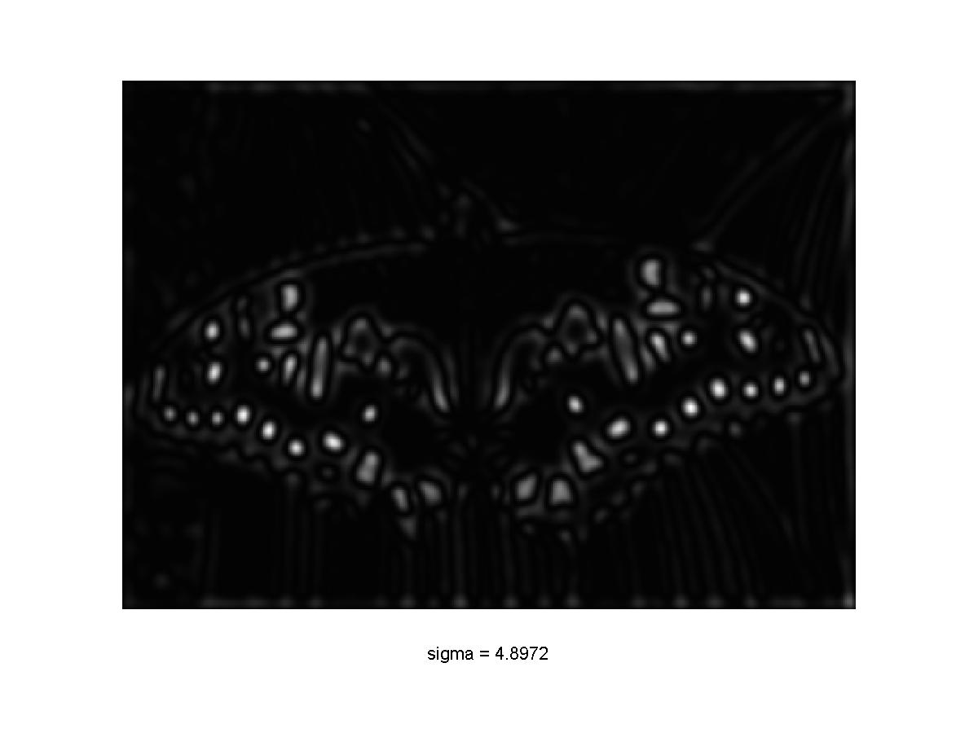

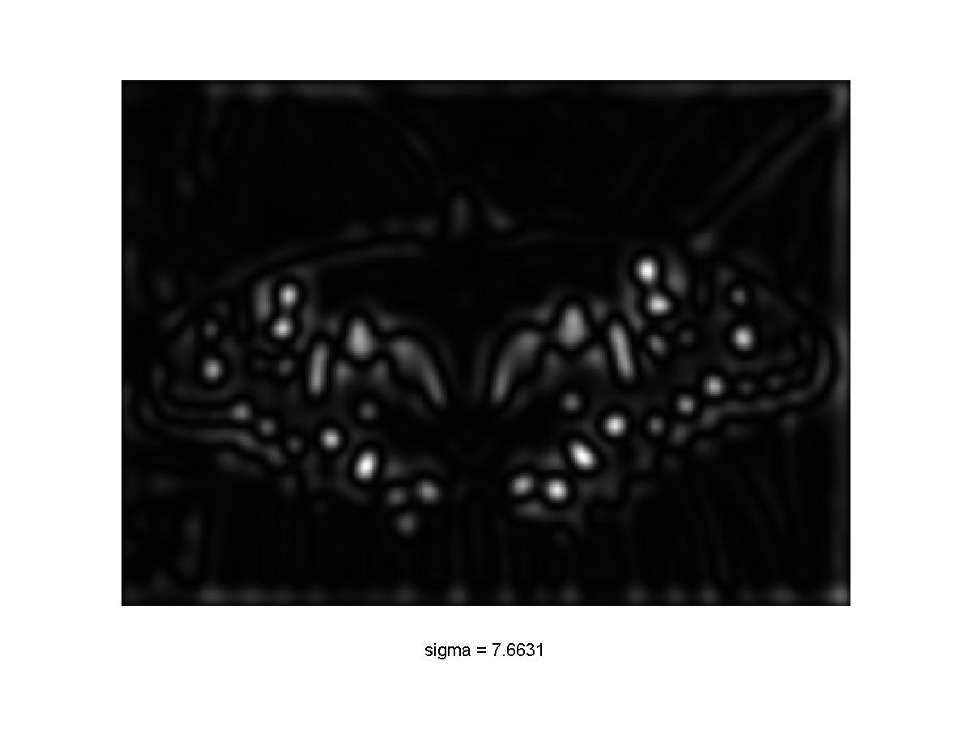
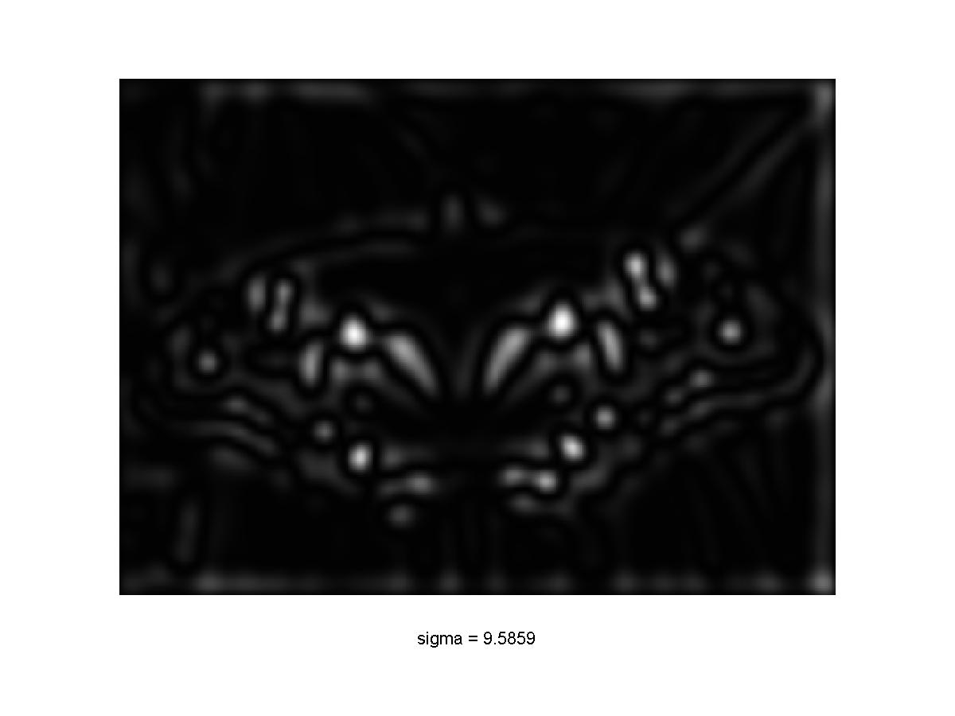
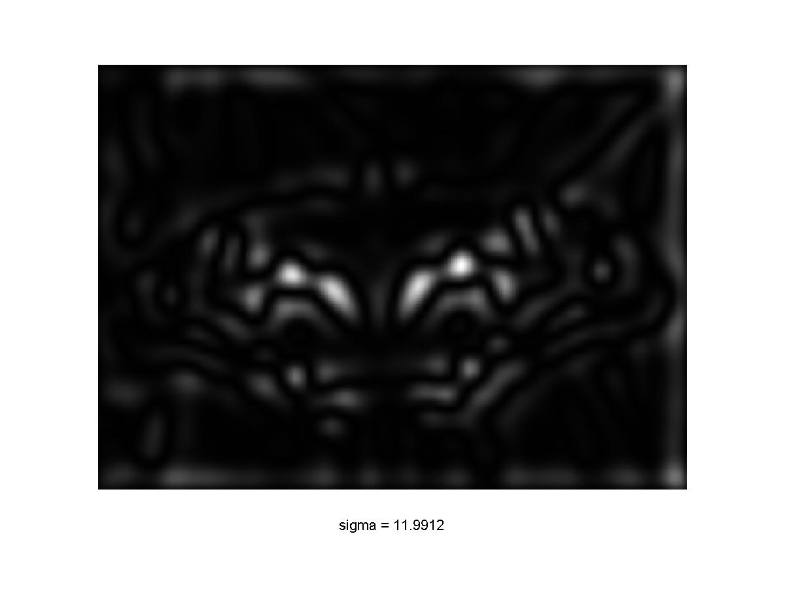
Scale-space blob detector: Example

Slide 23
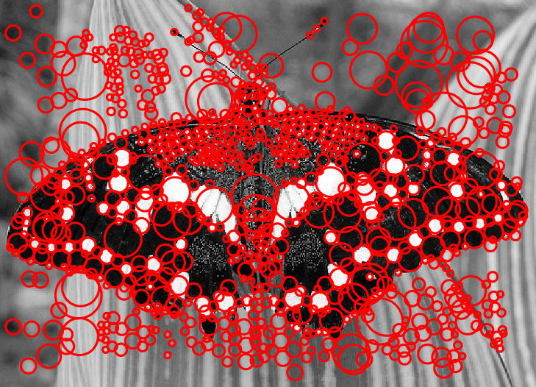
Scale-space blob detector: Example

Slide 24
Matching with Features
Detect feature points in both images
Find corresponding pairs
Use these pairs to align images

Slide 25
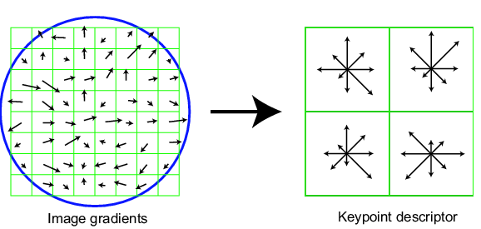
Scale Invariant Feature Transform
David Lowe IJCV 2004
Basic idea:
Take 16x16 square window around detected feature
Compute edge orientation (angle of the gradient - 90°) for each pixel
Throw out weak edges (threshold gradient magnitude)
Create histogram of surviving edge orientations
0
2π
angle histogram
Adapted from slide by David Lowe
Former NYU faculty & Prof. Ken Perlin’s advisor

Slide 26
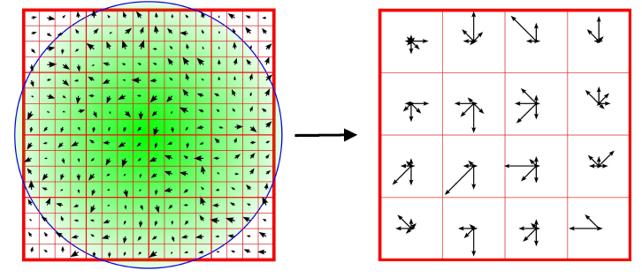
Orientation Histogram
4x4 spatial bins (16 bins total)
Gaussian center-weighting
8-bin orientation histogram per bin
8 x 16 = 128 dimensions total
Normalized to unit norm

Slide 27
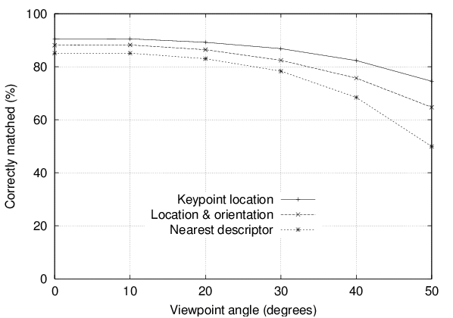
Feature stability to affine change
Match features after random change in image scale & orientation, with 2% image noise, and affine distortion
Find nearest neighbor in database of 30,000 features

Slide 28
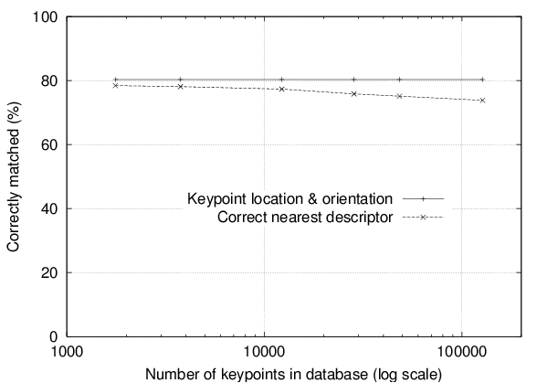
Distinctiveness of features
Vary size of database of features, with 30 degree affine change, 2% image noise
Measure % correct for single nearest neighbor match

Slide 29
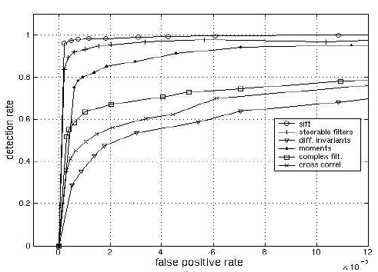
SIFT – Scale Invariant Feature Transform¹
Empirically found² to show very good performance, invariant to image rotation, scale, intensity change, and to moderate affine transformations
Scale = 2.5 Rotation = 45⁰
¹ D.Lowe. “Distinctive Image Features from Scale-Invariant Keypoints”. Accepted to IJCV 2004 ² K.Mikolajczyk, C.Schmid. “A Performance Evaluation of Local Descriptors”. CVPR 2003

Slide 30
SIFT invariances
Spatial binning gives tolerance to small shifts in location and scale
Explicit orientation normalization
Photometric normalization by making all vectors unit norm
Orientation histogram gives robustness to small local deformations

Slide 31
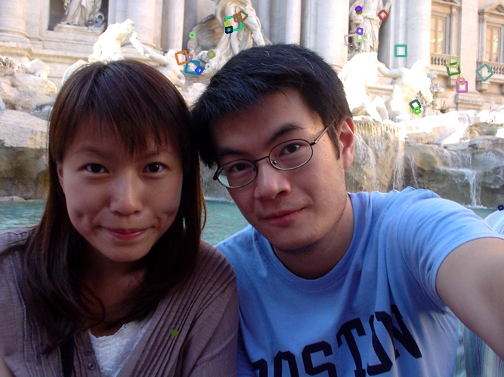
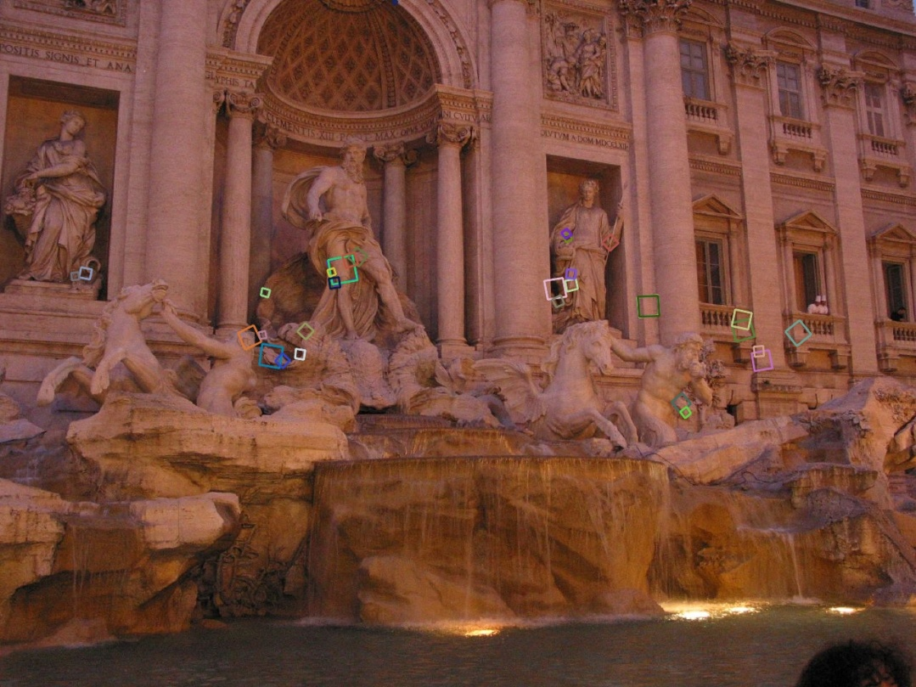
Summary of SIFT
Extraordinarily robust matching technique
Can handle changes in viewpoint
Up to about 60 degree out of plane rotation
Can handle significant changes in illumination
Sometimes even day vs. night (below)
Fast and efficient—can run in real time
Lots of code available
http://people.csail.mit.edu/albert/ladypack/wiki/index.php/Known_implementations_of_SIFT

Slide 32
Matching with Features
Detect feature points in both images
Find corresponding pairs
Use these pairs to align images

Slide 33
Overview
Fitting techniques
Least Squares
Total Least Squares
RANSAC
Hough Voting
Alignment as a fitting problem

Slide 34
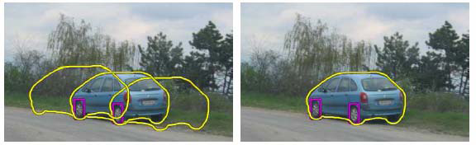
Fitting
Choose a parametric model to represent a set of features
simple model: lines
simple model: circles
complicated model: car
Source: K. Grauman

Slide 35
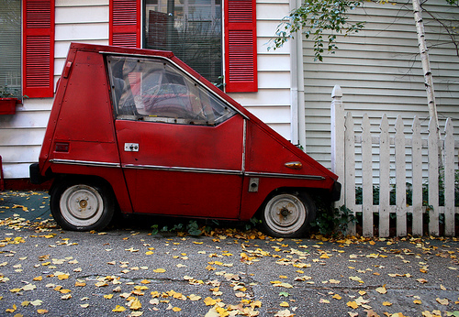
Fitting: Issues
Case study: Line detection
Noise in the measured feature locations
Extraneous data: clutter (outliers), multiple lines
Missing data: occlusions
Slide: S. Lazebnik

Slide 36
Fitting: Issues
If we know which points belong to the line, how do we find the “optimal” line parameters?
Least squares
What if there are outliers?
Robust fitting, RANSAC
What if there are many lines?
Voting methods: RANSAC, Hough transform
What if we’re not even sure it’s a line?
Model selection
Slide: S. Lazebnik

Slide 37
Overview
Fitting techniques
Least Squares
Total Least Squares
RANSAC
Hough Voting
Alignment as a fitting problem

Slide 38
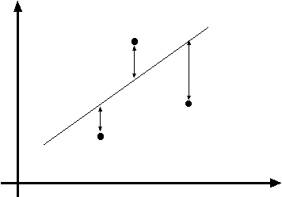
Least squares line fitting
Data: (x₁, y₁), …, (x_{n}, y_{n})
Line equation: y_{i} = m x_{i} + b
Find (m, b) to minimize
y=mx+b
(x_{i}, y_{i})
Slide: S. Lazebnik

Slide 39
Least squares line fitting
Data: (x₁, y₁), …, (x_{n}, y_{n})
Line equation: y_{i} = m x_{i} + b
Find (m, b) to minimize
y=mx+b
(x_{i}, y_{i})
Normal equations: least squares solution to XB=Y
Slide: S. Lazebnik

Slide 40
Matlab Demo
%%%% let's make some points
n = 10;
true_grad = 2;
true_intercept = 3;
noise_level = 0.04;
x = rand(1,n);
y = true_grad*x + true_intercept + randn(1,n)*noise_level;
figure; plot(x,y,'rx');
hold on;
%%% make matrix for linear system
X = [x(:) ones(n,1)];
%%% Solve system of equations
p = inv(X'*X)*X'*y(:); % Pseudo-inverse
p = pinv(X) * y(:); % Pseduo-inverse
p = X \ y(:); % Matlab's \ operator
est_grad = p(1);
est_intercept = p(2);
plot(x,est_grad*x+est_intercept,'b-');
fprintf('True gradient: %f, estimated gradient: %f\n',true_grad,est_grad);
fprintf('True intercept: %f, estimated intercept: %f\n',true_intercept,est_intercept);

Slide 41
Problem with “vertical” least squares
Not rotation-invariant
Fails completely for vertical lines
Slide: S. Lazebnik

Slide 42
Overview
Fitting techniques
Least Squares
Total Least Squares
RANSAC
Hough Voting
Alignment as a fitting problem

Slide 43
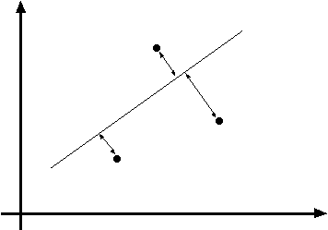
Total least squares
Distance between point (x_{i}, y_{i}) and line ax+by=d (a²+b²=1): |ax_{i} + by_{i} – d|
ax+by=d
Unit normal: N=(a, b)
(x_{i}, y_{i})
Slide: S. Lazebnik

Slide 44
Total least squares
Distance between point (x_{i}, y_{i}) and line ax+by=d (a²+b²=1): |ax_{i} + by_{i} – d|
Find (a, b, d) to minimize the sum of squared perpendicular distances
ax+by=d
Unit normal: N=(a, b)
(x_{i}, y_{i})

Slide 45
Total least squares
Distance between point (x_{i}, y_{i}) and line ax+by=d (a²+b²=1): |ax_{i} + by_{i} – d|
Find (a, b, d) to minimize the sum of squared perpendicular distances
ax+by=d
Unit normal: N=(a, b)
(x_{i}, y_{i})
Solution to (U^{T}U)N = 0, subject to ||N||² = 1: eigenvector of U^{T}U associated with the smallest eigenvalue (least squares solution to homogeneous linear system UN = 0)
Slide: S. Lazebnik

Slide 46
Total least squares
second moment matrix
Slide: S. Lazebnik

Slide 47
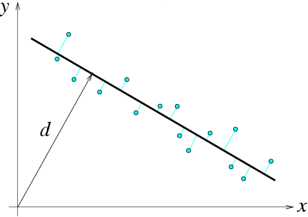
Total least squares
second moment matrix
N = (a, b)
Slide: S. Lazebnik

Slide 48
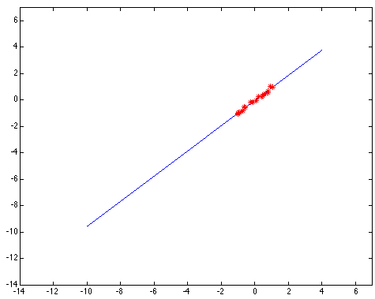
Least squares: Robustness to noise
Least squares fit to the red points:
Slide: S. Lazebnik

Slide 49
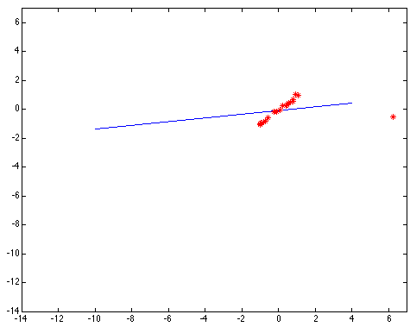
Least squares: Robustness to noise
Least squares fit with an outlier:
Problem: squared error heavily penalizes outliers
Slide: S. Lazebnik

Slide 50
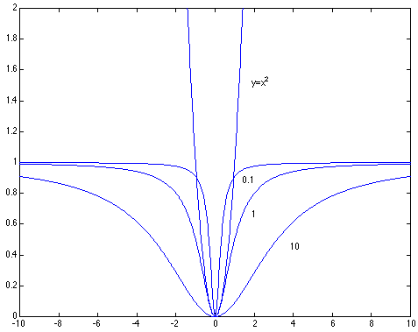

Robust estimators
General approach: minimize r_{i} (x_{i}, θ) – residual of ith point w.r.t. model parameters θ ρ – robust function with scale parameter σ
The robust function ρ behaves like squared distance for small values of the residual u but saturates for larger values of u
Slide: S. Lazebnik

Slide 51

Choosing the scale: Just right
The effect of the outlier is minimized
Slide: S. Lazebnik
Notes:
Fit to earlier data with an appropriate choice of s

Slide 52
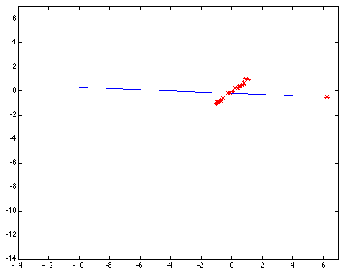
Choosing the scale: Too small
The error value is almost the same for every point and the fit is very poor
Slide: S. Lazebnik

Slide 53

Choosing the scale: Too large
Behaves much the same as least squares

Slide 54
Overview
Fitting techniques
Least Squares
Total Least Squares
RANSAC
Hough Voting
Alignment as a fitting problem

Slide 55
RANSAC
Robust fitting can deal with a few outliers – what if we have very many?
Random sample consensus (RANSAC): Very general framework for model fitting in the presence of outliers
Outline
Choose a small subset of points uniformly at random
Fit a model to that subset
Find all remaining points that are “close” to the model and reject the rest as outliers
Do this many times and choose the best model
M. A. Fischler, R. C. Bolles. Random Sample Consensus: A Paradigm for Model Fitting with Applications to Image Analysis and Automated Cartography. Comm. of the ACM, Vol 24, pp 381-395, 1981.
Slide: S. Lazebnik
Notes:
This algorithm contains concepts that are hugely useful; in my experience, everyone with some
experience of applied problems who doesn’t yet know RANSAC is almost immediately able to use it to simplify some problem they’ve seen.

Slide 56
RANSAC for line fitting
Repeat N times:
Draw s points uniformly at random
Fit line to these s points
Find inliers to this line among the remaining points (i.e., points whose distance from the line is less than t)
If there are d or more inliers, accept the line and refit using all inliers
Source: M. Pollefeys

Slide 57
Choosing the parameters
Initial number of points s
Typically minimum number needed to fit the model
Distance threshold t
Choose t so probability for inlier is p (e.g. 0.95)
Zero-mean Gaussian noise with std. dev. σ: t²=3.84σ²
Number of samples N
Choose N so that, with probability p, at least one random sample is free from outliers (e.g. p=0.99) (outlier ratio: e)
Source: M. Pollefeys

Slide 58
Choosing the parameters
Initial number of points s
Typically minimum number needed to fit the model
Distance threshold t
Choose t so probability for inlier is p (e.g. 0.95)
Zero-mean Gaussian noise with std. dev. σ: t²=3.84σ²
Number of samples N
Choose N so that, with probability p, at least one random sample is free from outliers (e.g. p=0.99) (outlier ratio: e)
 | proportion of outliers e
s | 5% | 10% | 20% | 25% | 30% | 40% | 50%
2 | 2 | 3 | 5 | 6 | 7 | 11 | 17
3 | 3 | 4 | 7 | 9 | 11 | 19 | 35
4 | 3 | 5 | 9 | 13 | 17 | 34 | 72
5 | 4 | 6 | 12 | 17 | 26 | 57 | 146
6 | 4 | 7 | 16 | 24 | 37 | 97 | 293
7 | 4 | 8 | 20 | 33 | 54 | 163 | 588
8 | 5 | 9 | 26 | 44 | 78 | 272 | 1177
Source: M. Pollefeys

Slide 59
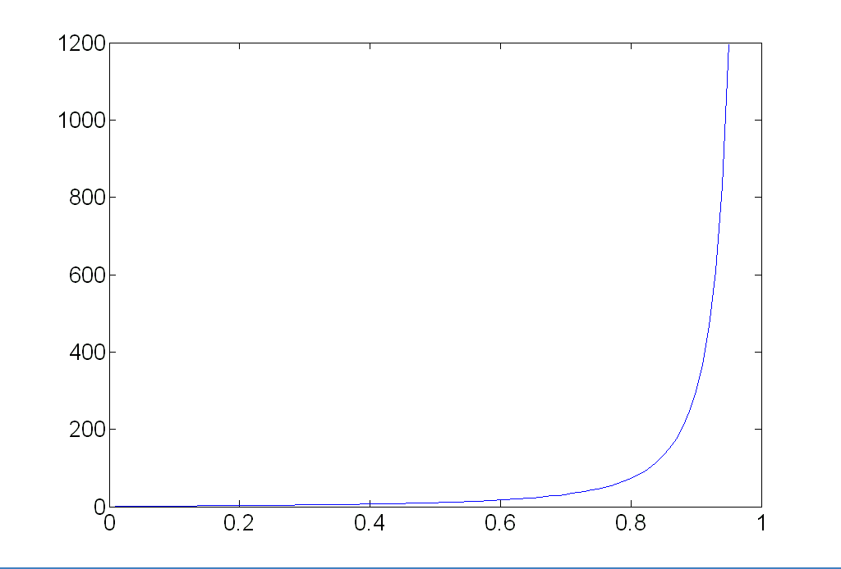
Choosing the parameters
Initial number of points s
Typically minimum number needed to fit the model
Distance threshold t
Choose t so probability for inlier is p (e.g. 0.95)
Zero-mean Gaussian noise with std. dev. σ: t²=3.84σ²
Number of samples N
Choose N so that, with probability p, at least one random sample is free from outliers (e.g. p=0.99) (outlier ratio: e)
Source: M. Pollefeys

Slide 60
Choosing the parameters
Initial number of points s
Typically minimum number needed to fit the model
Distance threshold t
Choose t so probability for inlier is p (e.g. 0.95)
Zero-mean Gaussian noise with std. dev. σ: t²=3.84σ²
Number of samples N
Choose N so that, with probability p, at least one random sample is free from outliers (e.g. p=0.99) (outlier ratio: e)
Consensus set size d
Should match expected inlier ratio
Source: M. Pollefeys

Slide 61
Adaptively determining the number of samples
Inlier ratio e is often unknown a priori, so pick worst case, e.g. 50%, and adapt if more inliers are found, e.g. 80% would yield e=0.2
Adaptive procedure:
N=∞, sample_count =0
While N >sample_count
Choose a sample and count the number of inliers
Set e = 1 – (number of inliers)/(total number of points)
Recompute N from e:
Increment the sample_count by 1
Source: M. Pollefeys

Slide 62
RANSAC pros and cons
Pros
Simple and general
Applicable to many different problems
Often works well in practice
Cons
Lots of parameters to tune
Can’t always get a good initialization of the model based on the minimum number of samples
Sometimes too many iterations are required
Can fail for extremely low inlier ratios
We can often do better than brute-force sampling
Source: M. Pollefeys

Slide 63
Voting schemes
Let each feature vote for all the models that are compatible with it
Hopefully the noise features will not vote consistently for any single model
Missing data doesn’t matter as long as there are enough features remaining to agree on a good model

Slide 64
Overview
Fitting techniques
Least Squares
Total Least Squares
RANSAC
Hough Voting
Alignment as a fitting problem

Slide 65
Hough transform
An early type of voting scheme
General outline:
Discretize parameter space into bins
For each feature point in the image, put a vote in every bin in the parameter space that could have generated this point
Find bins that have the most votes
Image space
Hough parameter space
P.V.C. Hough, Machine Analysis of Bubble Chamber Pictures, Proc. Int. Conf. High Energy Accelerators and Instrumentation, 1959

Slide 66
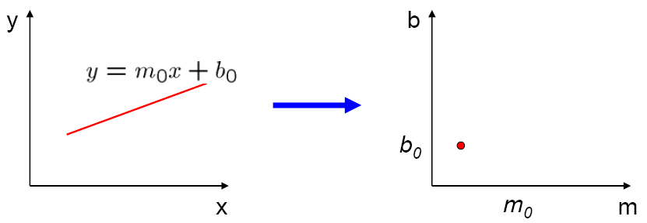
Parameter space representation
A line in the image corresponds to a point in Hough space
Image space
Hough parameter space
Source: S. Seitz

Slide 67
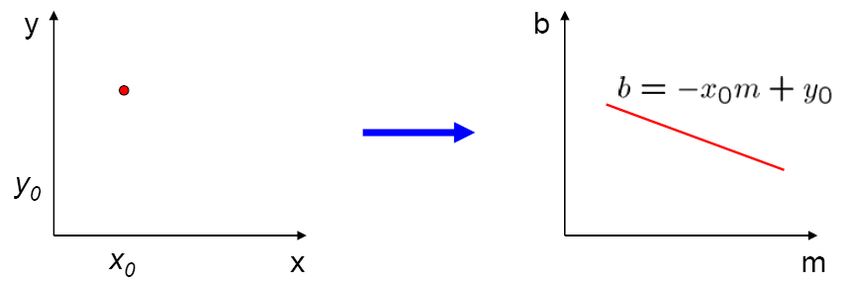
Parameter space representation
What does a point (x₀, y₀) in the image space map to in the Hough space?
Image space
Hough parameter space
Source: S. Seitz

Slide 68
Parameter space representation
What does a point (x₀, y₀) in the image space map to in the Hough space?
Answer: the solutions of b = –x₀m + y₀
This is a line in Hough space
Image space
Hough parameter space
Source: S. Seitz

Slide 69
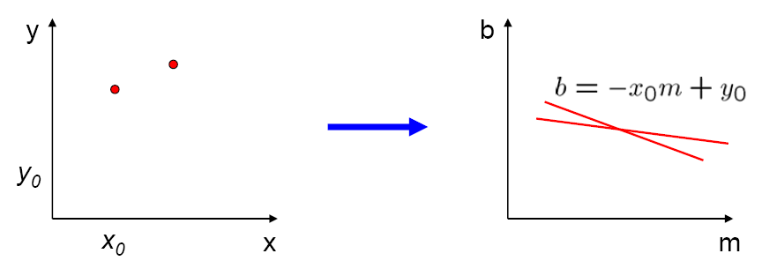
Parameter space representation
Where is the line that contains both (x₀, y₀) and (x₁, y₁)?
Image space
Hough parameter space
(x₁, y₁)
(x₀, y₀)
b = –x₁m + y₁
Source: S. Seitz

Slide 70
Parameter space representation
Where is the line that contains both (x₀, y₀) and (x₁, y₁)?
It is the intersection of the lines b = –x₀m + y₀ and b = –x₁m + y₁
Image space
Hough parameter space
(x₁, y₁)
(x₀, y₀)
b = –x₁m + y₁
Source: S. Seitz

Slide 71
Parameter space representation
Problems with the (m,b) space:
Unbounded parameter domain
Vertical lines require infinite m

Slide 72
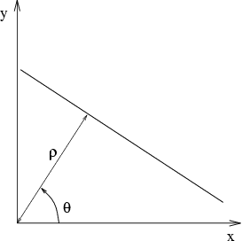
Parameter space representation
Problems with the (m,b) space:
Unbounded parameter domain
Vertical lines require infinite m
Alternative: polar representation
Each point will add a sinusoid in the (θ,ρ) parameter space

Slide 73
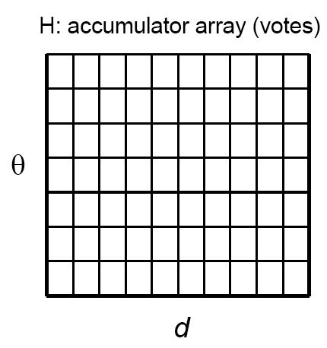
Algorithm outline
Initialize accumulator H to all zeros
For each edge point (x,y) in the image For θ = 0 to 180 ρ = x cos θ + y sin θ H(θ, ρ) = H(θ, ρ) + 1 end end
Find the value(s) of (θ, ρ) where H(θ, ρ) is a local maximum
The detected line in the image is given by ρ = x cos θ + y sin θ
ρ
θ

Slide 74
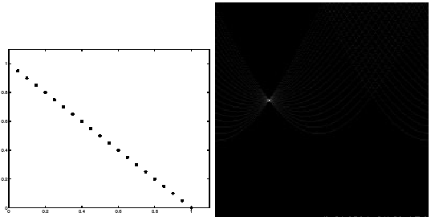
Basic illustration
features
votes
Notes:
Figure 15.1, top half. Note that most points in the vote array are very dark, because they
get only one vote.

Slide 75


Other shapes
Square
Circle

Slide 76


Several lines

Slide 77

A more complicated image
http://ostatic.com/files/images/ss_hough.jpg

Slide 78

Effect of noise
features
votes
Notes:
This is 15.1 lower half

Slide 79
Effect of noise
features
votes
Peak gets fuzzy and hard to locate
Notes:
This is 15.1 lower half

Slide 80

Effect of noise
Number of votes for a line of 20 points with increasing noise:
Notes:
This is the number of votes that the real line of 20 points gets with increasing noise (figure15.3)

Slide 81

Random points
features
votes
Uniform noise can lead to spurious peaks in the array
Notes:
15.2; main point is that lots of noise can lead to large peaks in the array

Slide 82

Random points
As the level of uniform noise increases, the maximum number of votes increases too:
Notes:
Figure 15.4; as the noise increases in a picture without a line, the number of points in the max cell goes
up, too

Slide 83
Dealing with noise
Choose a good grid / discretization
Too coarse: large votes obtained when too many different lines correspond to a single bucket
Too fine: miss lines because some points that are not exactly collinear cast votes for different buckets
Increment neighboring bins (smoothing in accumulator array)
Try to get rid of irrelevant features
Take only edge points with significant gradient magnitude

Slide 84
Hough transform for circles
How many dimensions will the parameter space have?
Given an oriented edge point, what are all possible bins that it can vote for?

Slide 85
Hough transform for circles
image space
Hough parameter space
r
y
(x,y)
x
x
y

Slide 86
Generalized Hough transform
We want to find a shape defined by its boundary points and a reference point
a
D. Ballard, Generalizing the Hough Transform to Detect Arbitrary Shapes, Pattern Recognition 13(2), 1981, pp. 111-122.

Slide 87
Generalized Hough transform
We want to find a shape defined by its boundary points and a reference point
For every boundary point p, we can compute the displacement vector r = a – p as a function of gradient orientation θ
a
θ
r(θ)
p
D. Ballard, Generalizing the Hough Transform to Detect Arbitrary Shapes, Pattern Recognition 13(2), 1981, pp. 111-122.

Slide 88
Generalized Hough transform
For model shape: construct a table indexed by θ storing displacement vectors r as function of gradient direction
Detection: For each edge point p with gradient orientation θ:
Retrieve all r indexed with θ
For each r(θ), put a vote in the Hough space at p + r(θ)
Peak in this Hough space is reference point with most supporting edges
Assumption: translation is the only transformation here, i.e., orientation and scale are fixed
Source: K. Grauman

Slide 89
Overview
Fitting techniques
Least Squares
Total Least Squares
RANSAC
Hough Voting
Alignment as a fitting problem

Slide 90
Image alignment
Two broad approaches:
Direct (pixel-based) alignment
Search for alignment where most pixels agree
Feature-based alignment
Search for alignment where extracted features agree
Can be verified using pixel-based alignment
Source: S. Lazebnik

Slide 91
Alignment as fitting
Previously: fitting a model to features in one image
M
x_{i}
Find model M that minimizes
Source: S. Lazebnik

Slide 92
Alignment as fitting
Previously: fitting a model to features in one image
Alignment: fitting a model to a transformation between pairs of features (matches) in two images
M
x_{i}
Find model M that minimizes
x_{i}
x_{i}
Find transformation T that minimizes
'
T
Source: S. Lazebnik

Slide 93
2D transformation models
Similarity (translation, scale, rotation)
Affine
Projective (homography)
Source: S. Lazebnik

Slide 94


Let’s start with affine transformations
Simple fitting procedure (linear least squares)
Approximates viewpoint changes for roughly planar objects and roughly orthographic cameras
Can be used to initialize fitting for more complex models
Source: S. Lazebnik

Slide 95
Fitting an affine transformation
Assume we know the correspondences, how do we get the transformation?
Source: S. Lazebnik

Slide 96
Fitting an affine transformation
Linear system with six unknowns
Each match gives us two linearly independent equations: need at least three to solve for the transformation parameters
Source: S. Lazebnik

Slide 97
Feature-based alignment outline

Slide 98
Feature-based alignment outline
Extract features

Slide 99
Feature-based alignment outline
Extract features
Compute putative matches

Slide 100
Feature-based alignment outline
Extract features
Compute putative matches
Loop:
Hypothesize transformation T

Slide 101
Feature-based alignment outline
Extract features
Compute putative matches
Loop:
Hypothesize transformation T
Verify transformation (search for other matches consistent with T)

Slide 102
Feature-based alignment outline
Extract features
Compute putative matches
Loop:
Hypothesize transformation T
Verify transformation (search for other matches consistent with T)

Slide 103
Dealing with outliers
The set of putative matches contains a very high percentage of outliers
Geometric fitting strategies:
RANSAC
Hough transform

Slide 104
RANSAC
RANSAC loop:
Randomly select a seed group of matches
Compute transformation from seed group
Find inliers to this transformation
If the number of inliers is sufficiently large, re-compute least-squares estimate of transformation on all of the inliers
Keep the transformation with the largest number of inliers

Slide 105

RANSAC example: Translation
Putative matches
Source: A. Efros

Slide 106
RANSAC example: Translation
Select one match, count inliers
Source: A. Efros

Slide 107
RANSAC example: Translation
Select one match, count inliers
Source: A. Efros

Slide 108
RANSAC example: Translation
Select translation with the most inliers
Source: A. Efros

Slide 109
Motion estimation techniques
Feature-based methods
Extract visual features (corners, textured areas) and track them over multiple frames
Sparse motion fields, but more robust tracking
Suitable when image motion is large (10s of pixels)
Direct methods
Directly recover image motion at each pixel from spatio-temporal image brightness variations
Dense motion fields, but sensitive to appearance variations
Suitable for video and when image motion is small

Slide 110

Optical flow
Combination of slides from Rick Szeliski, Steve Seitz, Alyosha Efros and Bill Freeman and Fredo Durand

Slide 111


Motion estimation: Optical flow
Will start by estimating motion of each pixel separately
Then will consider motion of entire image

Slide 112

Why estimate motion?
Lots of uses
Track object behavior
Correct for camera jitter (stabilization)
Align images (mosaics)
3D shape reconstruction
Special effects

Slide 113


Problem definition: optical flow
How to estimate pixel motion from image H to image I?
Solve pixel correspondence problem
given a pixel in H, look for nearby pixels of the same color in I
Key assumptions
color constancy: a point in H looks the same in I
For grayscale images, this is brightness constancy
small motion: points do not move very far
This is called the optical flow problem

Slide 114



Optical flow constraints (grayscale images)
Let’s look at these constraints more closely
brightness constancy: Q: what’s the equation?
H(x,y)=I(x+u, y+v)
small motion: (u and v are less than 1 pixel)
suppose we take the Taylor series expansion of I:
Notes:
A: H(x,y) = I(x+u, y+v)

Slide 115




Optical flow equation
Combining these two equations
In the limit as u and v go to zero, this becomes exact

Slide 116


Optical flow equation
Q: how many unknowns and equations per pixel?
2 unknowns, one equation
Intuitively, what does this constraint mean?
The component of the flow in the gradient direction is determined
The component of the flow parallel to an edge is unknown
This explains the Barber Pole illusion
http://www.sandlotscience.com/Ambiguous/Barberpole_Illusion.htm
http://www.liv.ac.uk/~marcob/Trieste/barberpole.html
http://en.wikipedia.org/wiki/Barber's_pole
Notes:
A: u and v are unknown, 1 equation

Slide 117
Aperture problem

Slide 118
Aperture problem

Slide 119



Solving the aperture problem
How to get more equations for a pixel?
Basic idea: impose additional constraints
most common is to assume that the flow field is smooth locally
one method: pretend the pixel’s neighbors have the same (u,v)
If we use a 5x5 window, that gives us 25 equations per pixel!

Slide 120



RGB version
How to get more equations for a pixel?
Basic idea: impose additional constraints
most common is to assume that the flow field is smooth locally
one method: pretend the pixel’s neighbors have the same (u,v)
If we use a 5x5 window, that gives us 25*3 equations per pixel!
Note that RGB is not enough to disambiguate because R, G & B are correlated Just provides better gradient

Slide 121









Lukas-Kanade flow
Prob: we have more equations than unknowns
Solution: solve least squares problem
minimum least squares solution given by solution (in d) of:
The summations are over all pixels in the K x K window
This technique was first proposed by Lukas & Kanade (1981)

Slide 122
Aperture Problem and Normal Flow
The gradient constraint:
Defines a line in the (u,v) space
v
Normal Flow:
u

Slide 123
Combining Local Constraints
v
u
etc.

Slide 124
Conditions for solvability
Optimal (u, v) satisfies Lucas-Kanade equation
When is This Solvable?
A^{T}A should be invertible
A^{T}A should not be too small due to noise
eigenvalues λ₁ and λ₂ of A^{T}A should not be too small
A^{T}A should be well-conditioned
λ₁/ λ₂ should not be too large (λ₁ = larger eigenvalue)
A^{T}A is solvable when there is no aperture problem

Slide 125
Eigenvectors of A^{T}A
Recall the Harris corner detector: M = A^{T}A is the second moment matrix
The eigenvectors and eigenvalues of M relate to edge direction and magnitude
The eigenvector associated with the larger eigenvalue points in the direction of fastest intensity change
The other eigenvector is orthogonal to it
Notes:
Suppose M = vv^T . What are the eigenvectors and eigenvalues? Start by considering Mv

Slide 126
Interpreting the eigenvalues
Classification of image points using eigenvalues of the second moment matrix:
λ₂
“Edge” λ₂ >> λ₁
“Corner” λ₁ and λ₂ are large, λ₁ ~ λ₂
λ₁ and λ₂ are small
“Flat” region
“Edge” λ₁ >> λ₂
λ₁

Slide 127
Local Patch Analysis

Slide 128




Edge
large gradients, all the same
large λ₁, small λ₂

Slide 129



Low texture region
gradients have small magnitude
small λ₁, small λ₂

Slide 130



High textured region
gradients are different, large magnitudes
large λ₁, large λ₂

Slide 131
Observation
This is a two image problem BUT
Can measure sensitivity by just looking at one of the images!
This tells us which pixels are easy to track, which are hard
very useful later on when we do feature tracking...

Slide 132




Motion models
Translation
Affine
Perspective
3D rotation
2 unknowns
6 unknowns
8 unknowns
3 unknowns

Slide 133
Affine motion
Substituting into the brightness constancy equation:

Slide 134
Affine motion
Substituting into the brightness constancy equation:
Each pixel provides 1 linear constraint in 6 unknowns
Least squares minimization:

Slide 135
Errors in Lukas-Kanade
What are the potential causes of errors in this procedure?
Suppose A^{T}A is easily invertible
Suppose there is not much noise in the image
When our assumptions are violated
Brightness constancy is not satisfied
The motion is not small
A point does not move like its neighbors
window size is too large
what is the ideal window size?

Slide 136
Iterative Refinement
Iterative Lukas-Kanade Algorithm
Estimate velocity at each pixel by solving Lucas-Kanade equations
Warp H towards I using the estimated flow field
- use image warping techniques
Repeat until convergence

Slide 137






Optical Flow: Iterative Estimation
estimate update
Initial guess:
Estimate:
x₀
x
(using d for displacement here instead of u)

Slide 138




Optical Flow: Iterative Estimation
estimate update
Initial guess:
Estimate:
x₀
x

Slide 139




Optical Flow: Iterative Estimation
estimate update
Initial guess:
Estimate:
Initial guess:
Estimate:
x₀
x

Slide 140


Optical Flow: Iterative Estimation
x₀
x

Slide 141
Optical Flow: Iterative Estimation
Some Implementation Issues:
Warping is not easy (ensure that errors in warping are smaller than the estimate refinement)
Warp one image, take derivatives of the other so you don’t need to re-compute the gradient after each iteration.
Often useful to low-pass filter the images before motion estimation (for better derivative estimation, and linear approximations to image intensity)

Slide 142

Revisiting the small motion assumption
Is this motion small enough?
Probably not—it’s much larger than one pixel (2nd order terms dominate)
How might we solve this problem?

Slide 143



Optical Flow: Aliasing
Temporal aliasing causes ambiguities in optical flow because images can have many pixels with the same intensity.
I.e., how do we know which ‘correspondence’ is correct?
actual shift
estimated shift
nearest match is correct (no aliasing)
nearest match is incorrect (aliasing)
To overcome aliasing: coarse-to-fine estimation.

Slide 144




Reduce the resolution!

Slide 145
Coarse-to-fine optical flow estimation
u=1.25 pixels
u=2.5 pixels
u=5 pixels
image H
u=10 pixels
image I
image H
image I
Gaussian pyramid of image H
Gaussian pyramid of image I

Slide 146
Coarse-to-fine optical flow estimation
run iterative L-K
warp & upsample
run iterative L-K
.
.
.
image J
image I
image H
image I
Gaussian pyramid of image H
Gaussian pyramid of image I

Slide 147
Recap: Classes of Techniques
Feature-based methods (e.g. SIFT+Ransac+regression)
Extract visual features (corners, textured areas) and track them over multiple frames
Sparse motion fields, but possibly robust tracking
Suitable especially when image motion is large (10-s of pixels)
Direct-methods (e.g. optical flow)
Directly recover image motion from spatio-temporal image brightness variations
Global motion parameters directly recovered without an intermediate feature motion calculation
Dense motion fields, but more sensitive to appearance variations
Suitable for video and when image motion is small (< 10 pixels)

