Slide 1

Machine Learning: Effective, Low Bandwidth, Energy-efficient, Accurate
Yao Wang: High performance, low bandwidth video understanding on the road.
Siddharth Garg: Low energy machine learning for applications like speech recognition
Dennis Shasha/Elza Erkip: Make better decisions by sometimes refusing to predict.
Notes:
Great interest in accelerating deep learning training/inference in hardware. Goal: higher efficiency; perf/Watt compared to CPU/GPU. Systolic array archs., first proposed in the 80s for fast and efficient matrix mults making a comeback; example Google TPU uses a systolic array with ~65000 multiply-and-accumulate untis. 30x-100x more TOPS/Watt than GPU (although some GPU vendors have predictably pushed back)…At any rate, great interest in industry/academia on hardware for ML, >60 startups

Slide 2
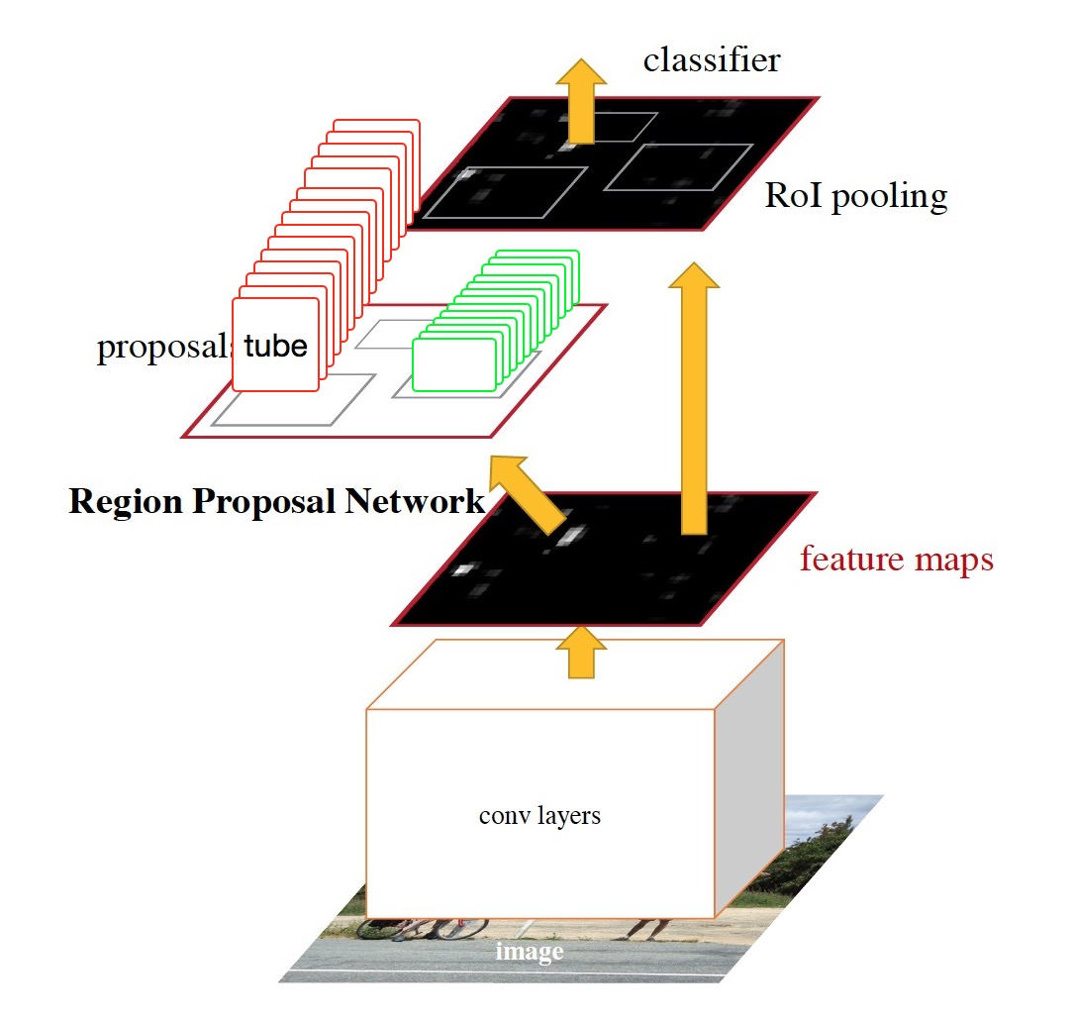
Simultaneous Detection and Tracking of Moving Objects in Video
Detect a tube in a video segment by extending prior work for detecting a region in an image
Use 3D and 2D convolution for feature extraction (C3D and VGG)
Generate tube proposals (bounding tubes of various sizes and orientations)
Refine proposals and classify each detected tube (car, van, bus, pedestrian, …)
Application for vehicle detection and tracking
Chenge Li, Gregory Dobler, Xin Feng, Yao Wang, "TrackNet: Simultaneous Detection and Tracking and its Application in Traffic Video Analysis”, https://arxiv.org/abs/1902.01466

Slide 3
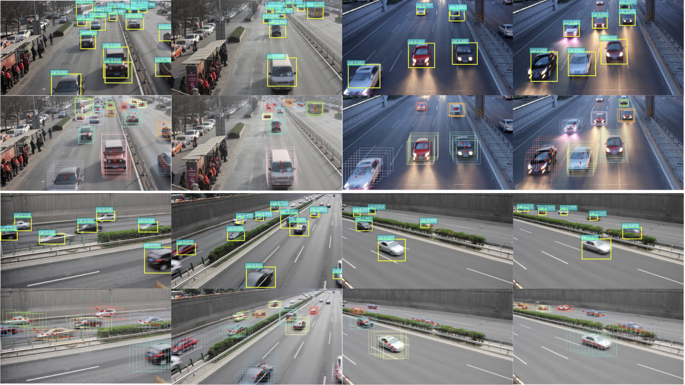

Slide 4
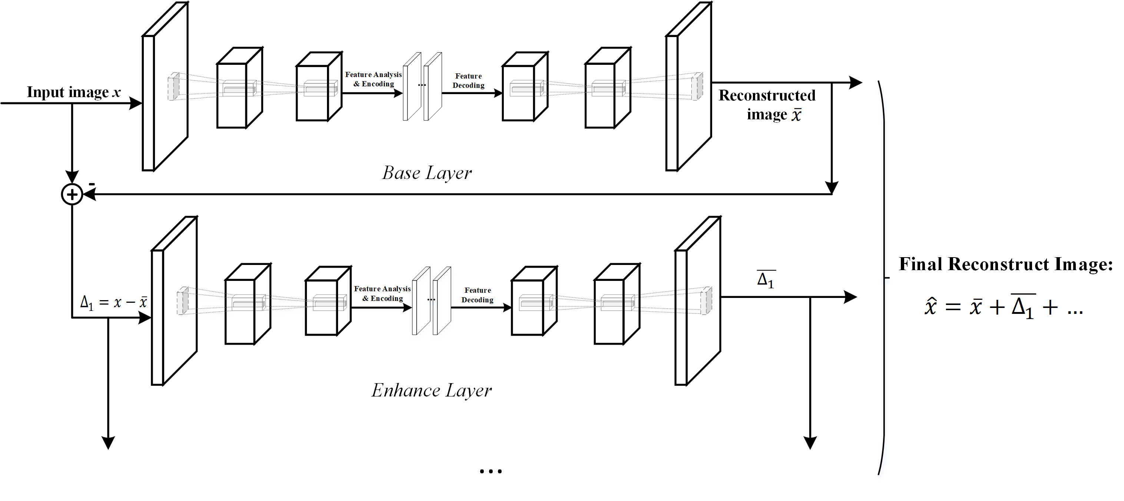
Scalable Image Compression Using Stacked Auto Encoders
Chuanmin Jia, Zhaoyi Liu, Yao Wang, Siwei Ma, Wen Gao, Layered Image Compression using Scalable Auto-encoder”, IEEE 2nd International Conference on Multimedia Information Processing and Retrieval (MIPR’2019), Mar. 2019. Best Student Paper Award.

Slide 5
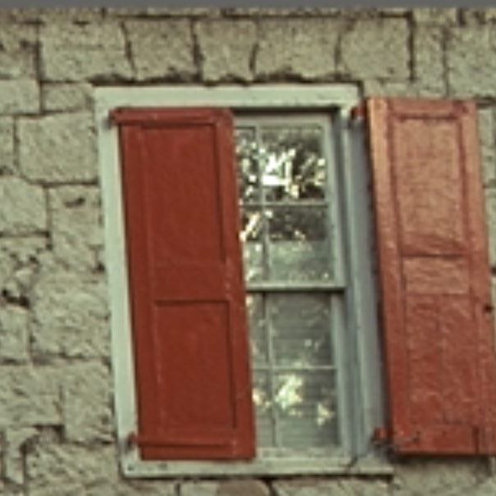
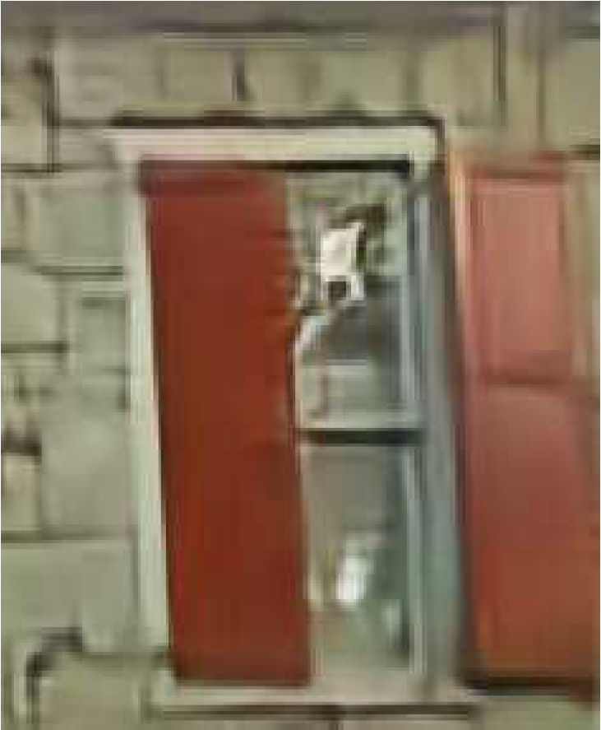
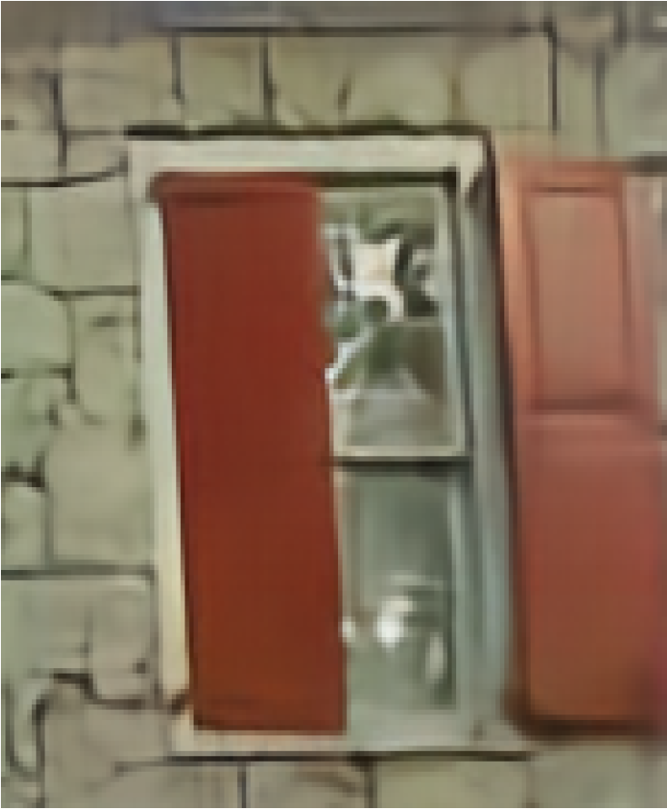
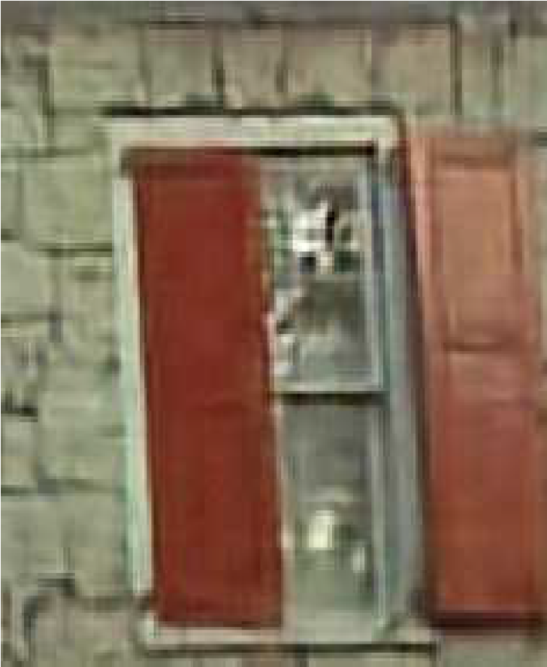
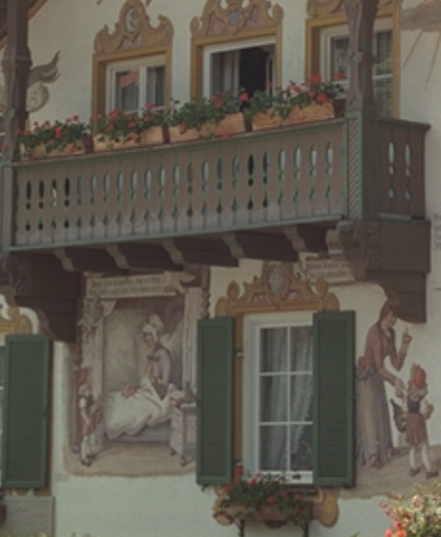
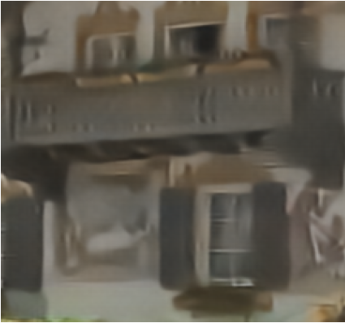
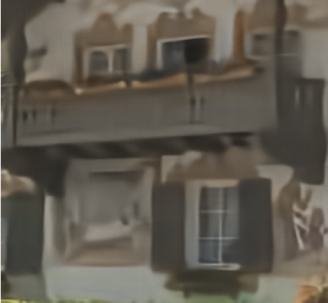
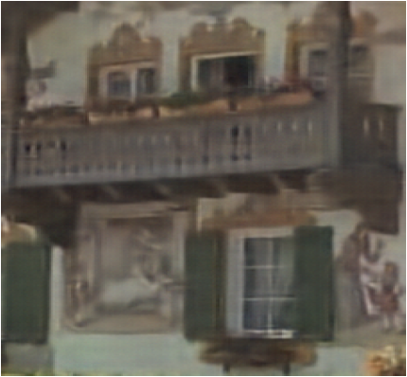
Ours: 0.1305 bpp
Original
ICLR 2017: 0.1455 bpp
ICLR 2018: 0.1782 bpp,
Original
ICLR 2017: 0.1370 bpp
ICLR 2017: 0.1387 bpp
ICLR 2017: 0.1130 bpp

Slide 6
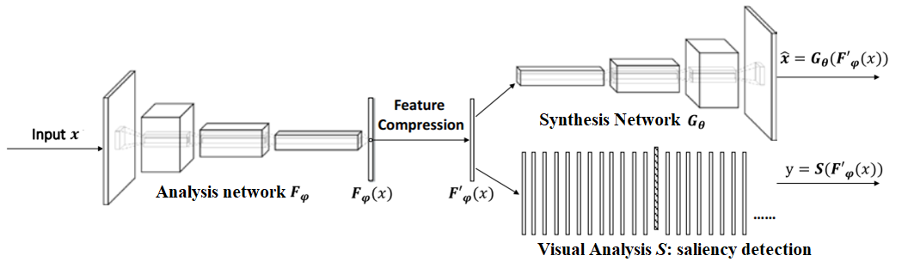
Learning for compression and analytics simultaneously
Encoder generates features effective for both compression and analytics
Camera site can perform compression and analytics using the same features.
Receiver can use decoded features directly for visual analytics
Using “saliency detection” as surrogates for visual analytics task

Slide 7
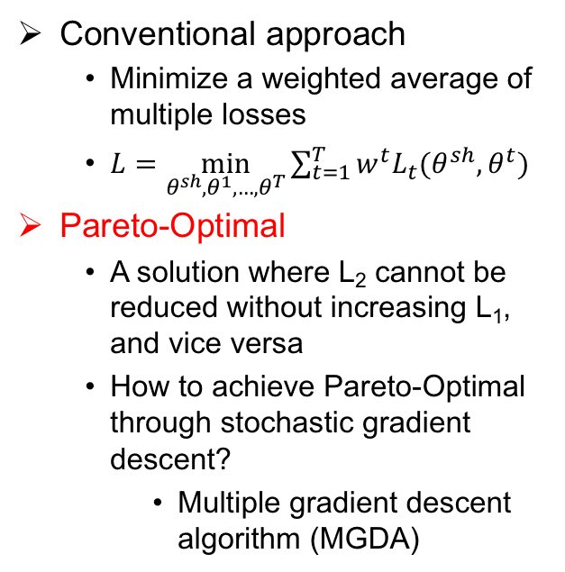
Multiple Objective Optimization
Conventional approach
Minimize a weighted average of multiple losses
$L=\min_{θ^{sh},θ^{1},…,θ^{T}}{\sum_{t=1}^{T}{w^{t}L_{t}(θ^{sh},θ^{t})}}$
Pareto-Optimal
A solution where L₂ cannot be reduced without increasing L₁, and vice versa
How to achieve Pareto-Optimal through stochastic gradient descent?
Multiple gradient descent algorithm (MGDA)
Alp Aygar, Chuanmin Jia, Yao Wang, “Pareto Optimal Learning for Image Compression and Saliency Detection”.

Slide 8
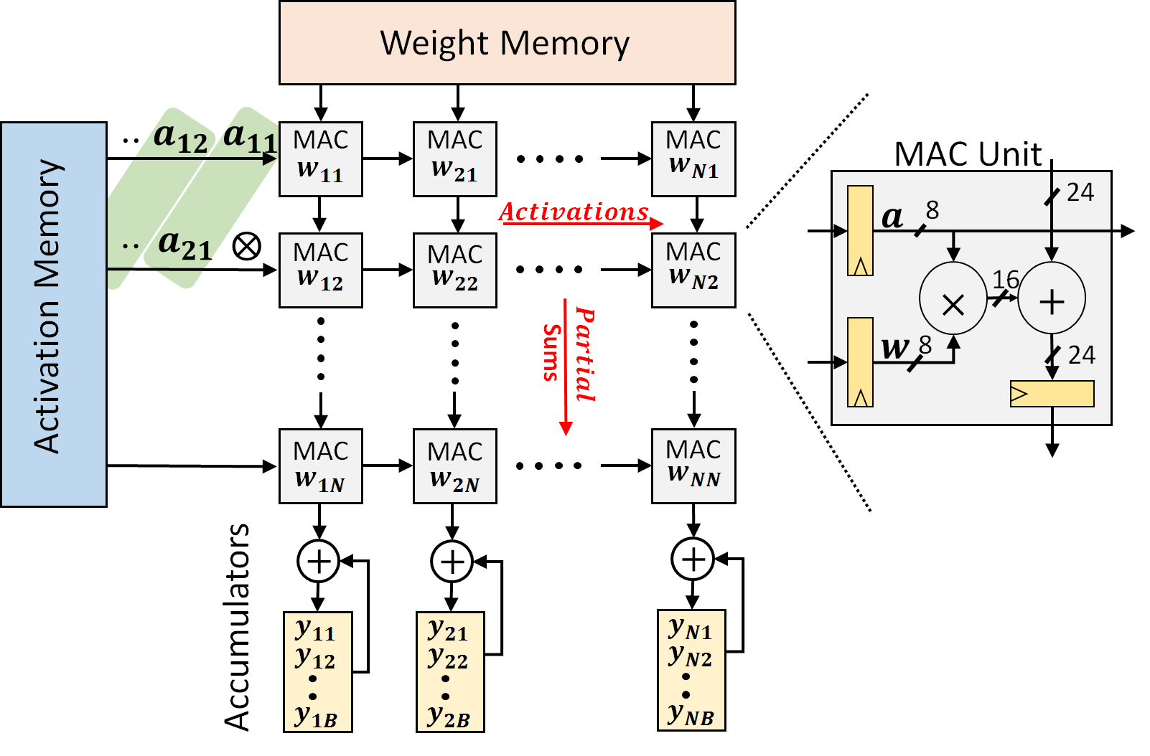
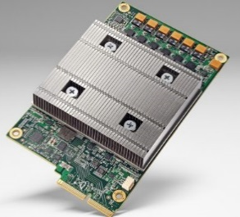
Hardware Acceleration for Deep Learning
Systolic Array
accelerates matrix mults and convolutions
2-D grid of MAC units
nearest neighbor communication
amortizes memory access cost
30x-100x greater TOPs/Watt vs. GPU
Google TPU
[1] N. Jouppi et al., “In-datacenter performance analysis of a tensor processing unit”, ISCA’17.
Notes:
Great interest in accelerating deep learning training/inference in hardware. Goal: higher efficiency; perf/Watt compared to CPU/GPU. Systolic array archs., first proposed in the 80s for fast and efficient matrix mults making a comeback; example Google TPU uses a systolic array with ~65000 multiply-and-accumulate untis. 30x-100x more TOPS/Watt than GPU (although some GPU vendors have predictably pushed back)…At any rate, great interest in industry/academia on hardware for ML, >60 startups

Slide 9

Energy Efficient TPU Design
$$Energy∝{VDD}^{2}$$
[Zhang et al., DAC’18]
How can we architect an error resilient TPU?
Timing Errors (TE)
⤓ VDD
Reduce Energy without hurting performance
Notes:
Can we make the TPU more energy efficient by reducing its power consumpition without impacting performance. One way to do so is undervolting a chip; this results in quadratic reduction in energy/power. In return, the logic runs slower and sometimes incurs timing faults (or timing errors); i.e., the outputs of some MAC operations might be incorrect. There is a belief that deep nets are resilient to fault computations: can we just ignore these errors? No. Turns out that does not work because timing errors frequently corrupt MSBs of the MAC output.

Slide 10
Architecting Error Resilience
Steal a cycle from the next MAC
Add error detection flip-flops
a31
a21
a11
W11
W12
W13
Δ + w11 a11
…
a32
a22
a12
W21
W22
W23
w11a11+ 0
a33
a23
a13
W31
W32
W33
y₁₁ = w31a13 + 0 +w11a11
Timing errors result in dropped MAC operations
Notes:
Instead we propose ThunderVolt. Basic idea, when a timing error occurs, “drop” the subsequent MAC op and steal its clock to complete the erroneous MAC op correctly. Equivalent to setting weights of MAC ops that follow an erroneous MAC to zero. Why would we expect this to work? DNNs are trained to begin with using dropout/dropconnect where weights are randomly set to zero. Better to drop a12*w12 rather than sacrificing the entire correct column computation up to then (especially because the delta is large). Application like data centers. Speech recognition.

Slide 11
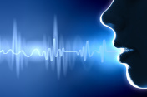
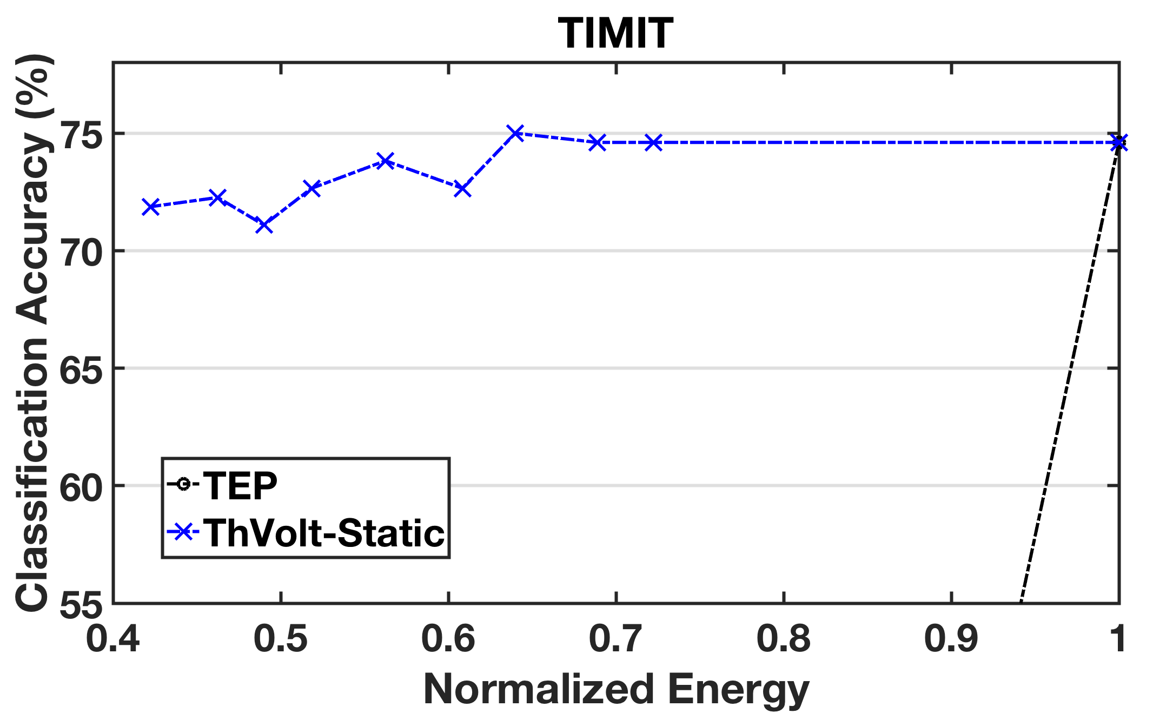
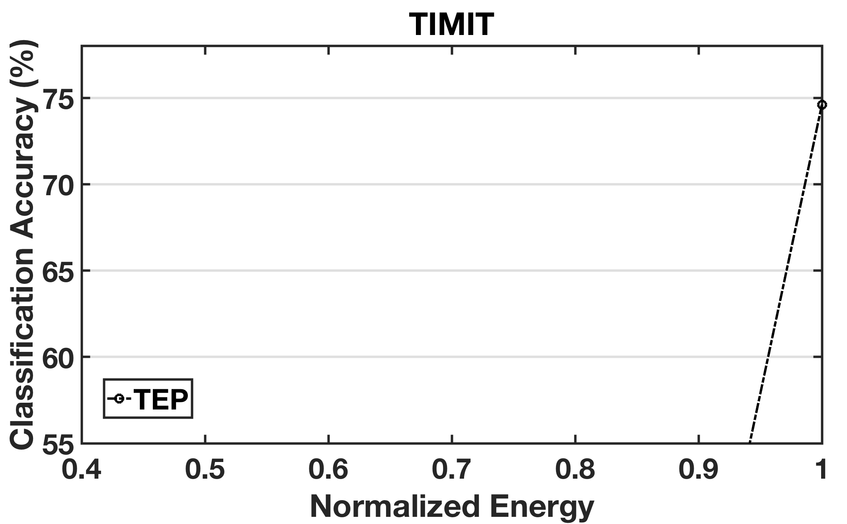
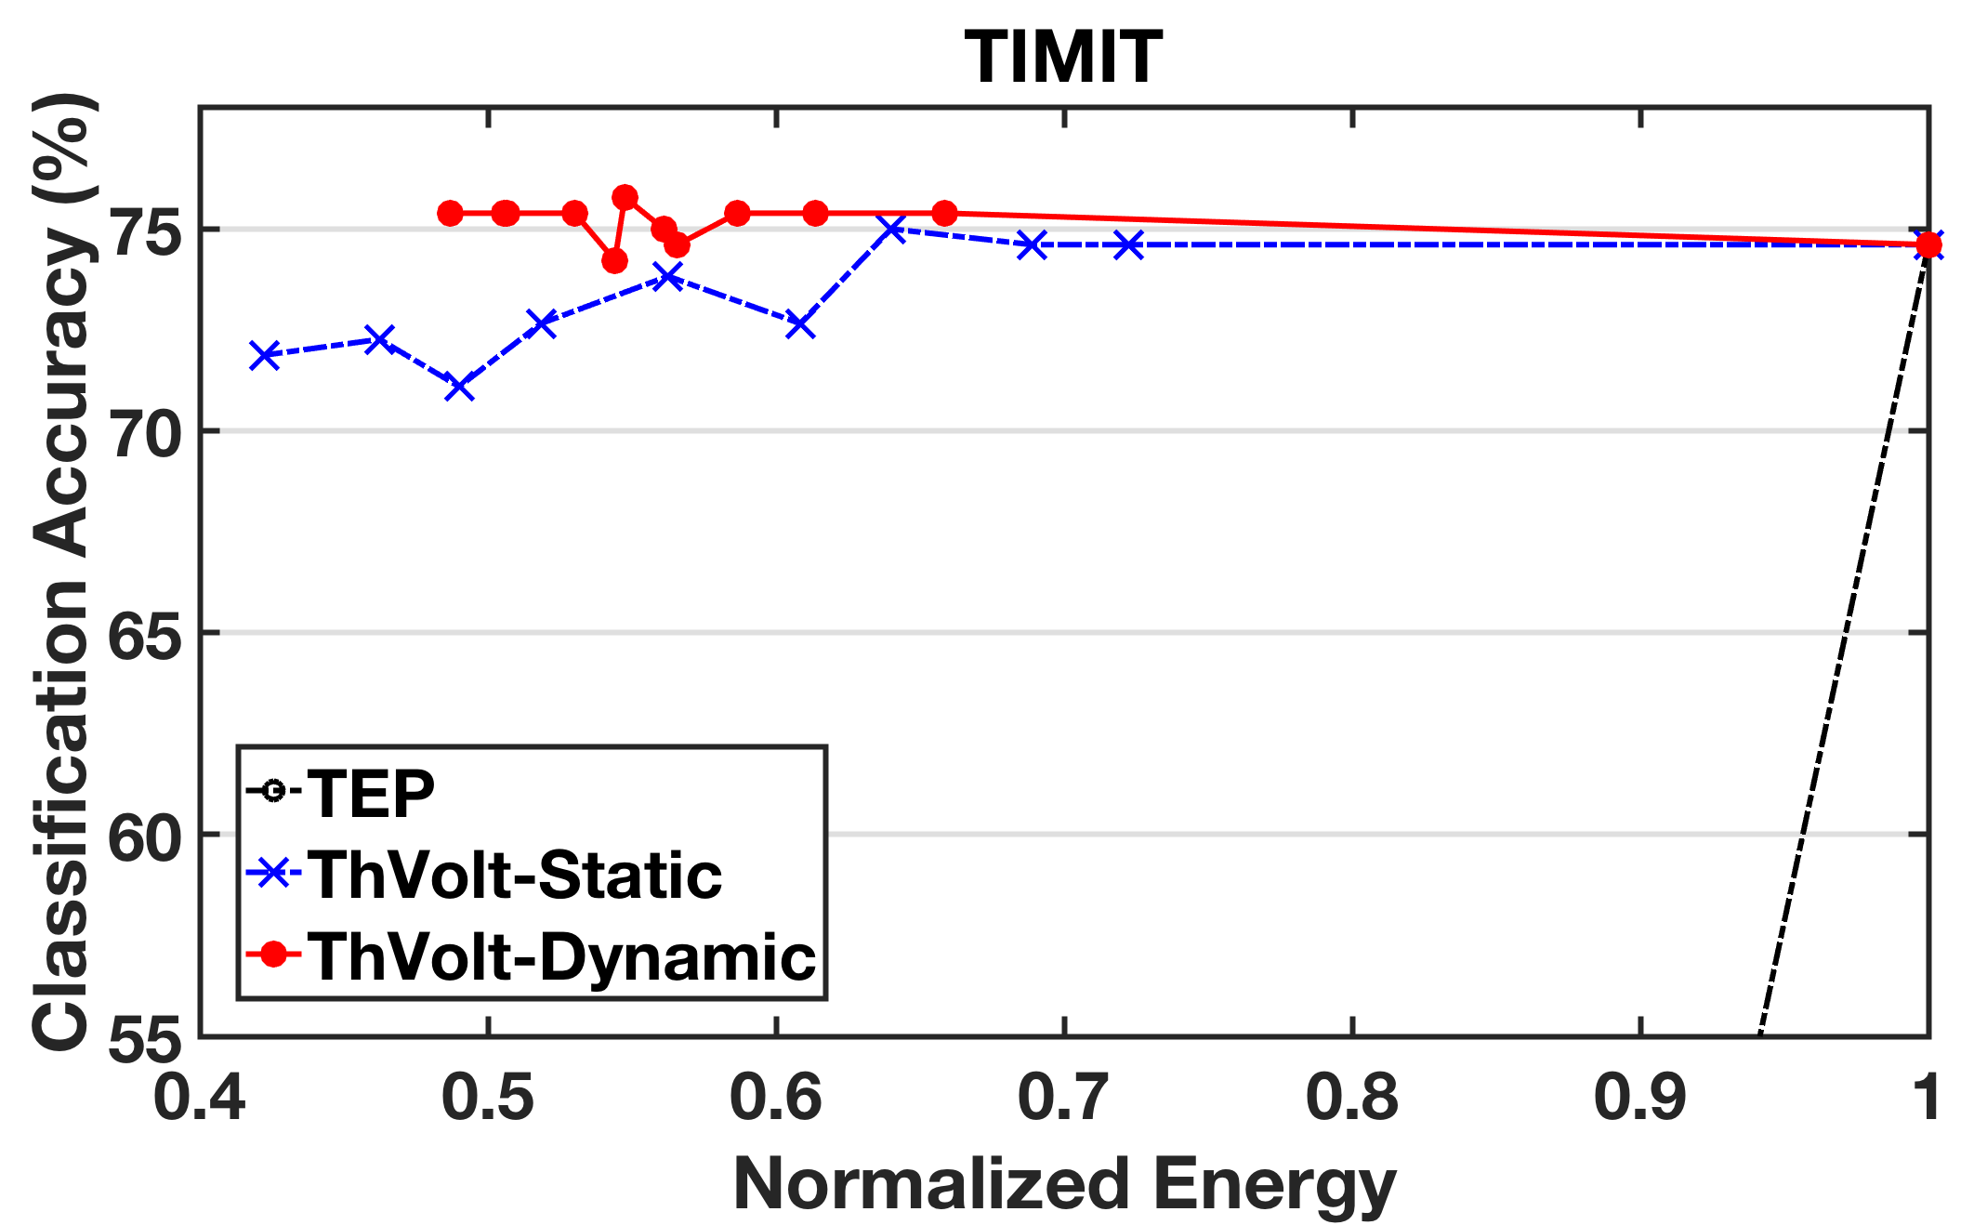
Speech Recognition Results
50% energy savings,
0.1 % accuracy loss

Slide 12
Reducing Errors by Refusing to Guess
Making a bad decision can be costly
e.g. an unnecessary medical operation, a bad decision in deployment of equipment
SafePredict takes any machine learning algorithm and reduces its error rate to any target value by introducing refusals.
Empirical validation on public datasets using meta-algorithm on top of scikit-learn
Notes:
Great interest in accelerating deep learning training/inference in hardware. Goal: higher efficiency; perf/Watt compared to CPU/GPU. Systolic array archs., first proposed in the 80s for fast and efficient matrix mults making a comeback; example Google TPU uses a systolic array with ~65000 multiply-and-accumulate untis. 30x-100x more TOPS/Watt than GPU (although some GPU vendors have predictably pushed back)…At any rate, great interest in industry/academia on hardware for ML, >60 startups

Slide 13
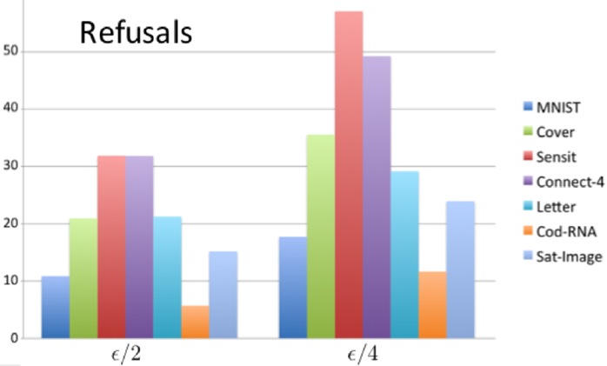
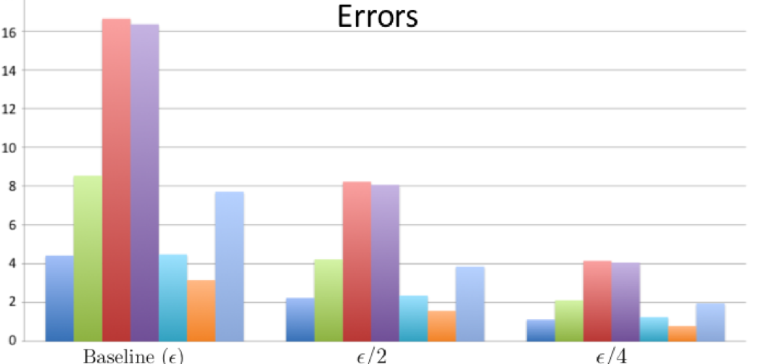
Empirical Results: Refusing Works
Can cut the error rate
in half by refusing 6 -32% of the time.
to a quarter by refusing 12-57% of the time.
Notes:
Great interest in accelerating deep learning training/inference in hardware. Goal: higher efficiency; perf/Watt compared to CPU/GPU. Systolic array archs., first proposed in the 80s for fast and efficient matrix mults making a comeback; example Google TPU uses a systolic array with ~65000 multiply-and-accumulate untis. 30x-100x more TOPS/Watt than GPU (although some GPU vendors have predictably pushed back)…At any rate, great interest in industry/academia on hardware for ML, >60 startups

