Slide 1
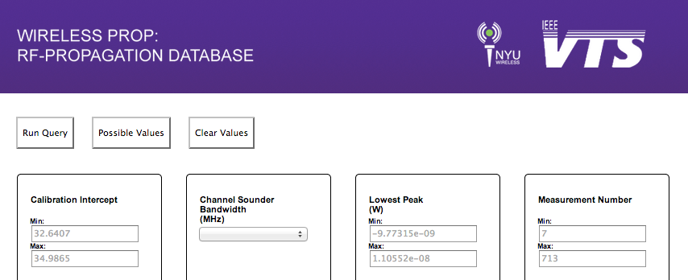
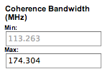
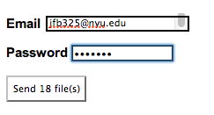
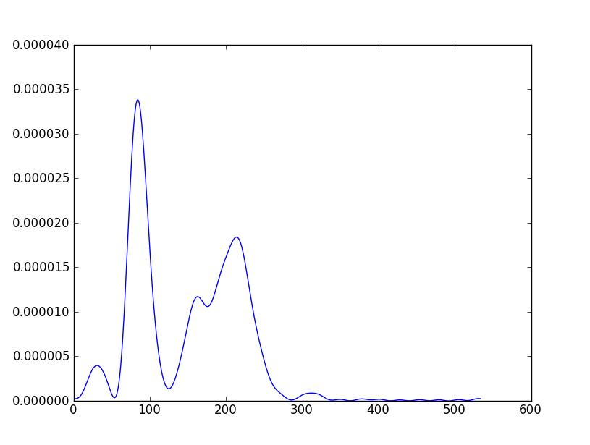
Choose Parameters
Authenticate
Receive Data

Slide 2
Current System
28.8GB of Data
37 Query Parameters
6000 Experiments (and counting)
Processing backend in Python
Database migrating to MySQL
Notes:
XXXXXXXXX

