Slide 1
More Reliable Machine Learning through Refusals
Dennis Shasha
New York University

Slide 2
Meta-Algorithm for Machine Learning
Making a bad decision can be costly
e.g. an unnecessary medical operation, a bad trade in finance.
Our framework takes any machine learning algorithm and reduces its error rate to any target value by refusing sometimes
Analogous to refusing to accept advice if you don’t trust advisor.
With Anil Mustafa, Elza Erkip, and David Ramirez

Slide 3
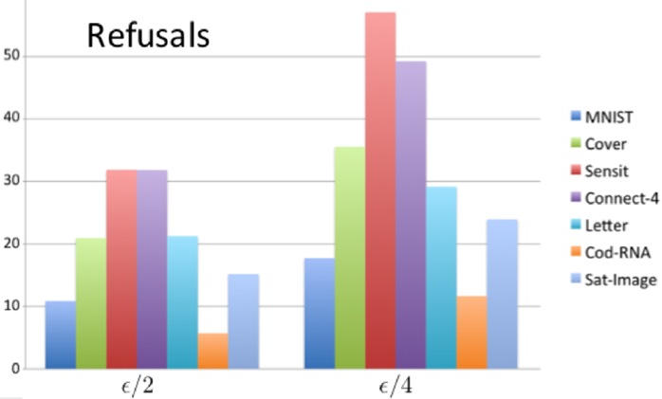
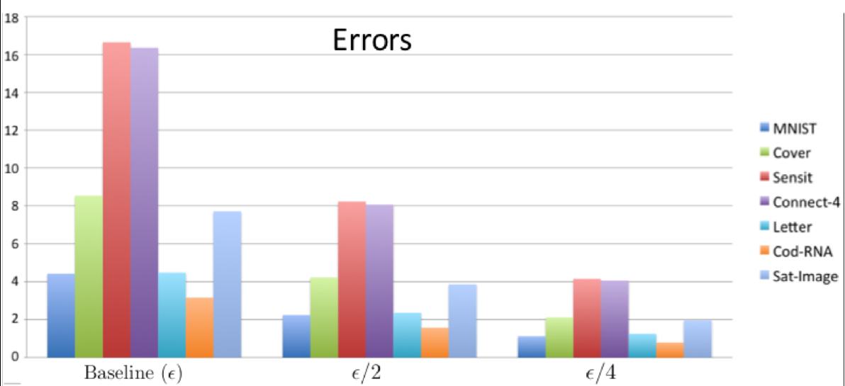
Overview of Results
Can cut the error rate
in half by refusing 6 -32% of the time.
to a quarter by refusing 12-57% of the time.

Slide 4
Guarantees
If the base predictor meets the error bound, then refuse at most constant number of times.
When i.i.d. can do better.
Algorithm is online, so applies to time series.
But… we ain’t rich yet☺

Slide 5
Other Work: Nearest Neighbor Search in Time Series
Given a database of time series, and a query time series which may be short or long, find nearest neighbor in the database.
Study to show when iSAX works well and when a sketch approach works well.

