Slide 1
Computational Reproducibility: why needed, first tools, open problems
Dennis Shasha
Joint work with:
Philippe Bonnet, Fernando Chirigati, Juliana Freire,
and Remi Rampin.
Earlier collaborators: Ioana Manolescu, Stefan Manigold, and Sigmod Reproducibility Committee

Slide 2
Why Do We Need Reproducibility?
Isaac Newton 1676: If I have seen further, it is by standing on the shoulders of giants.
Science builds on the results of others.
We want to trust those results.
In natural science, must describe protocol in detail (usually not enough, though close)

Slide 3
Computational Reproducibility
Nearly all papers in science and social science, draw conclusions based on a computational analysis of raw data.
Consider such a paper P.
Most basic: Is the code in P error-free?
Basic: how robust is the result in P to small changes in parameters/data?

Slide 4
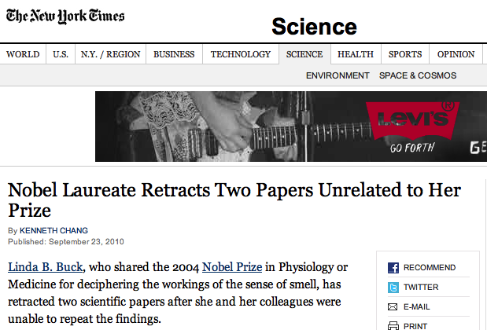
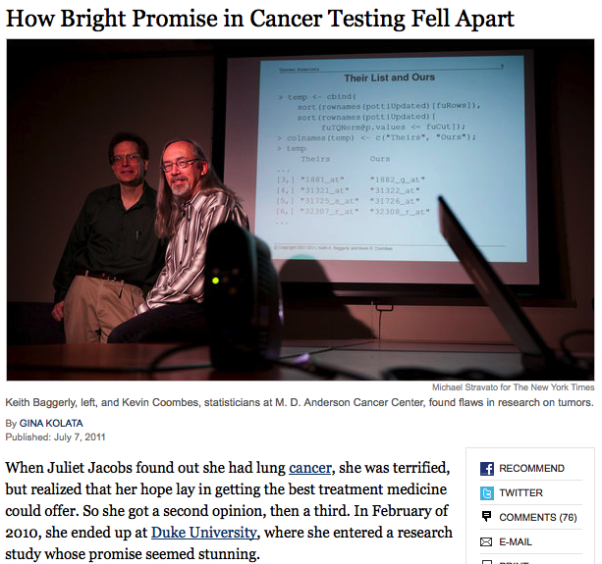
Most Basic Does Not Always Hold
Notes:
http://en.wikipedia.org/wiki/Scientific_misconduct
http://ori.dhhs.gov/misconduct/cases/

Slide 5
Science and Reproducibility
Reproducibility is the cornerstone of science
If we can’t trust other results, we have to start over from scratch.
Without reproducibility, people die!
John Wilbanks, AMPS Workshop on Reproducibility 2011
Notes:
If a result is not reproducible, it is questionable whether it is actually science
The lack of reproducibility can have dire consequences
http://www.nytimes.com/2011/07/08/health/research/08genes.html
http://en.wikipedia.org/wiki/Scientific_misconduct
http://ori.dhhs.gov/misconduct/cases/
Some seemed careless — moving a row or a column over by one in a giant spreadsheet — while others seemed inexplicable. The Duke team shrugged them off as “clerical errors.”
Nobel Laureate Retracts Two Papers, NYTimes 09/24/2010
But the research at Duke turned out to be wrong. Its gene-based tests proved worthless, and the research behind them was discredited.

Slide 6
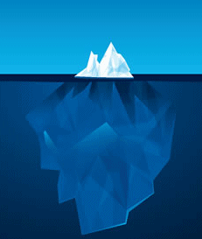









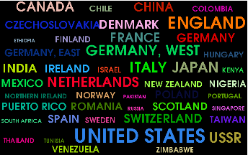
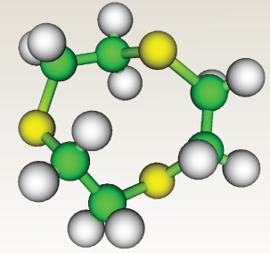
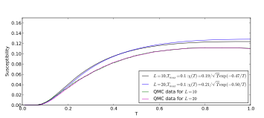
Computational Science and Reproducibility
Many disciplines have been transformed by computation: data and computing-intensive
  Computations can (often) be reproduced!
Authors are being encouraged (or required) to submit reproducible results
  ACM SIGMOD, VLDB, Journal of Biostatistics, Science, IEEE Transactions on Signal Processing, Freedom of Information Act and climate science
Notes:
Simulation, analysis and visualization
Journal of Biostatistics has a reproducibility editor
science now requires code since Feb 2011

Slide 7
Computational Science and Reproducibility
Publications are changing: need to provide a complete and trustworthy scientific record
  ETH’s ethics guidelines http://www.vpf.ethz.ch/services/researchethics/Broschure
  NSF data policies http://www.nsf.gov/nsb/committees/dp/principles.pdf
http://www.sciencemag.org/site/feature/contribinfo/prep/gen_info.xhtml
Notes:
Simulation, analysis and visualization
Journal of Biostatistics has a reproducibility editor
science now requires code since Feb 2011

Slide 8
Why Not Make Computational Experiments Reproducible?
Intellectual property concerns: patents/commercial prospects.
My view: this is often an excuse.
Secrecy is the last refuge of the lazy.
Corollary: If we could make reproducibility really easy, then more people would do it.

Slide 9
Philosophy
Wisdom is knowing what should be done.
See above.
Now it’s time for how!

Slide 10
Reproducibility – what does it mean?
Computational reproducibility:
Experiment at time t, done on system s and data d can be performed
at time t’ on system s’ on data d to get the same result.
The experiment can also be performed on data d’ with “consistent” results.
Much higher standard than natural science.
Notes:
In natural science, It’s routine for results to fail to be reproducible across labs: biological variation.
It’s Science, but Not Necessarily Right, people can solve more complex problems
Free online availability substantially increases a paper's impact S. Lawrence, Nature 2001

Slide 11

Too many dependencies!
Data
Provenance
Workflow
Environment
From pixshark.com
Notes:
Data: data used by the experiment (input files, parameters, etc)
Workflow: all the processes and activities involved in the experiment (source code, binaries, software, etc)
Environment: information about platform (library dependencies, OS information, hardware information, etc)
Therefore, we need to capture the provenance of the experiment: record of every step taken by the experiment, including all the files and dependencies it made use to derive the output data.
Two main issues: identifying all the dependencies, and compiling and installing all the required software.
Experiment may have many library dependencies and files to keep track, which can be a daunting task – where (and which) are all the data and libraries ?
For authors, it is hard to track and find all the dependencies (software and data) and the exact configuration used. They even need to remember how all the libraries used were compiled and installed!
For reviewers (users), it is hard to install all the required software! How to compile ? Which dependencies to install?
Dependency hell problem – it is hard for researchers to identify all the packages needed for their experiments, and it is hard for a user that will reproduce the experiment to install all the required software!

Slide 12

Too many different platforms!
From intelerad-insider.com
Notes:
Libraries that work in one OS do not work in another – authors may try making their experiment to work in other OS, which may be a daunting task!
Reviewers (users) may try installing dependencies in another OS to use it, but it may be also a daunting task.
All these tasks involving many dependencies and different operating systems are time-consuming and error-prone (too much work), and people claim that they do not have enough time !

Slide 13

Too much to do, too little time!
“authors have complained that the process requires too much work for the benefit derived”
Bonnet et al., SIGMOD Record 2011
“Insufficient time is the main reason why scientists do not make their data and experiment available and reproducible.”
Carol Tenopir, Beyond the PDF 2 Conference
“77% claim that they do not have time to document and clean up the code.”
Victoria Stodden, Survey of the Machine Learning Community – NIPS 2010
“It would require huge amount of effort to make our code work with the latest versions of these tools.”
Collberg et al., Repeatability and Benefaction in Computer Systems Research, University of Arizona TR 14-04
From galleryhip.com
Notes:
Needless to say, tracking dependencies and files, making sure the experiment works in different platforms, etc. are not an issue if you think about reproducibility since the beginning of your project – no time need to be dedicated for those things later. This is what happens when you actually perform reproducible research, and you plan for reproducibility, and you can make use of a plethora of different tools for that.

Slide 14
Planning for Reproducibility
Scientific Workflow Systems (VisTrails, Taverna, Kepler, …)
Virtual Machines and Containers (VirtualBox, Vagrant, Docker, …)
Configuration Management Tools (Chef, Puppet, …)
… and many others !
But what about reproducibility after the fact?
Remember that most people have no time
i.e., would rather do something else…
Notes:
Many tools available when you plan for reproducibility.
But what happens when you do not plan for reproducibility, but after publishing your paper, you want to publish your experiment as well (“reproducibility after the fact”)?
(and let’s face it, this is the most common scenario nowadays… few people actually plan for reproducibility!)
Then it is, again, too time-consuming to port the experiment to any of these tools !

Slide 15
What Do We Want from a Reproducibility Tool?
Scientists develop the experiment without caring about reproducibility. (I’d rather be doing X (you fill in X).)
After software is developed, run the experiment in the context of some tool.
Tool collects all dependencies about the experiment and packs into a virtual machine that then can be unpacked anywhere.

Slide 16

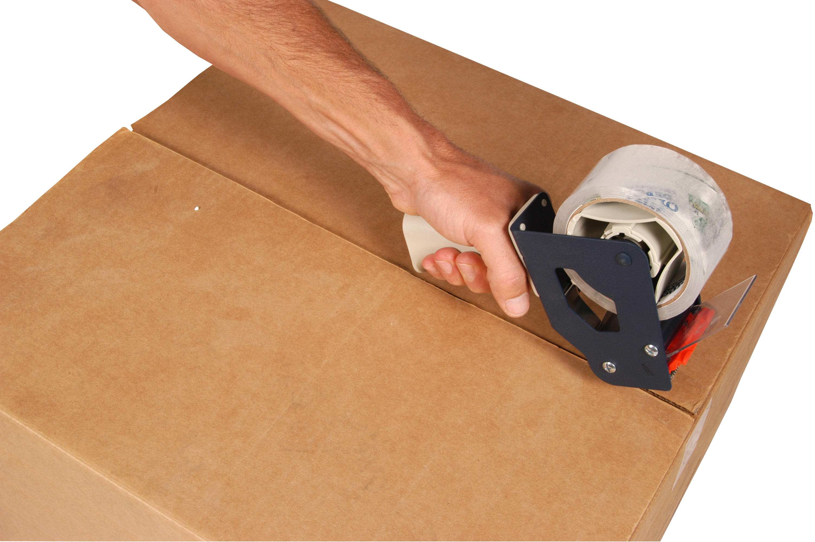
Ideal packaging tool
Packing Step
Unpacking Step
From reputablemoving.com
From wykop.pl

Slide 17
Approach We Focus On: ReproZip
Automatically and systematically captures the provenance of an existing experiment, including binaries, data, and dependencies
Creates a self-contained reproducible package from captured provenance
Extracts package in another environment, independent of the operating system
Provides interfaces for replicating and varying the original configuration of the experiment

Slide 18
How does ReproZip work?

Slide 19
Packing Experiments
Execute
Capture Provenance
Experiment Reprozip
Process p’
Package
Command line
arguments
Working Directories
Input files
Output files
Vistrail Workflows
(dataflow visualization tool)

Slide 20


Packing Experiments
Authors
Computational Environment E (Linux)
Experiment

Slide 21
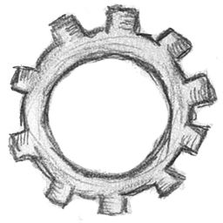
Packing Experiments
Authors
Computational Environment E (Linux)
Executing
Experiment
reprozip

Slide 22
Packing Experiments
Authors
Computational Environment E (Linux)
Capturing
Provenance
Executing
Experiment Provenance
Experiment
reprozip
ptrace + SQLite
Data
Input files, output files, parameters, …
Workflow
Executable programs and steps
Environment
Environment variables, dependencies, …
Notes:
We use some heuristics for detecting files:
Input Files: files that are read but that do not belong to any software package + files mentioned in command line
Log Files: files that are read and written afterwards (logs, database files, etc.)
Output files: files that are only written
If an input file was hardcoded, we can also identify it.
If E is Debian-based, we use the package manager to automatically identify the software packages being used in the experiment (including the version).
The author can then excluded it from the package, if necessary, and the reviewer can request ReproZip to install it when unpacking. However, note that if a different version is installed for some reason, the experiment may not be reproducible anymore.

Slide 23

Packing Experiments
Authors
Computational Environment E (Linux)
Capturing
Provenance
Executing
Experiment Provenance
Experiment
reprozip
ptrace + SQLite
Data
Input files, output files, parameters, …
Workflow
Executable programs and steps
Creating
Configuration
Environment
Environment variables, dependencies, …
Configuration
File

Slide 24

Packing Experiments
Authors
Computational Environment E (Linux)
Capturing
Provenance
Executing
Experiment Provenance
Experiment
reprozip
ptrace + SQLite
Data
Input files, output files, parameters, …
Workflow
Executable programs and steps
Creating
Configuration
Environment
Configuring
Environment variables, dependencies, …
Reproducible
Package
Packing
Configuration
File
Notes:
All the files are packed in the same structure they are found in the original environment.

Slide 25
Packing Experiments
Authors
Computational Environment E (Linux)
Tracing the experiment
Gathering provenance
Capturing
Provenance
Executing
Experiment Provenance
Experiment
reprozip
ptrace + SQLite
Data
Creating the package
Configuring the package
Input files, output files, parameters, …
Workflow
Executable programs and steps
Creating
Configuration
Environment
Configuring
Environment variables, dependencies, …
Reproducible
Package
Packing
Configuration
File

Slide 26
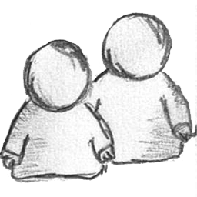
Unpacking Experiments
Reviewers
Readers
Computational Environment E’ (potentially different than E)
Reproducible
Package

Slide 27
Unpacking Experiments
Reviewers
Readers
Computational Environment E’ (potentially different than E)
Extracting
Reproducible
Package
reprounzip

Slide 28

Unpacking Experiments
Reviewers
Readers
Computational Environment E’ (potentially different than E)
unpacks and reproduces
from a single directory
(Linux)
directory
Extracting
Reproducible
Package
reprounzip
Notes:
The directory unpacker (reprounzip directory) allows users to unpack the entire experiment (including library dependencies) in a single directory, and to reproduce the experiment directly from that directory. It does so by automatically setting up environment variables (e.g.: PATH, HOME, and LD_LIBRARY_PATH) that point the experiment execution to the created directory, which has the same structure as in the packing environment.
This is unreliable if the application cannot be trusted, since it can point outside the unpacked directory.

Slide 29
Unpacking Experiments
Reviewers
Readers
Computational Environment E’ (potentially different than E)
unpacks and reproduces
from a single directory
(Linux)
directory
/
unpacks in a single directory
and builds a full system environment
(Linux)
chroot
Extracting
Reproducible
Package
reprounzip
Notes:
In the chroot unpacker (reprounzip chroot), similar to reprounzip directory, a directory is created from the experiment package; however, a full system environment is also built, which can then be run with chroot(2), a Linux mechanism that changes the root directory / for the experiment to the experiment directory. Therefore, this unpacker addresses the limitation of the directory unpacker and does not fail in the presence of hardcoded absolute paths. Note as well that it does not interfere with the current environment since the experiment is isolated in that single directory.
Although chroot offers pretty good isolation, it is not considered completely safe: it is possible for processes owned by root to “escape” to the outer system.

Slide 30

Unpacking Experiments
Reviewers
Readers
Computational Environment E’ (potentially different than E)
unpacks and reproduces
from a single directory
(Linux)
directory
/
unpacks in a single directory
and builds a full system environment
(Linux)
chroot
Extracting
Reproducible
Package
reprounzip
unpacks in a virtual machine
using Vagrant
(Linux, Mac OS X, Windows)
vagrant
Notes:
The vagrant unpacker (reprounzip vagrant) allows an experiment to be unpacked and reproduced using a virtual machine created through Vagrant. Therefore, the experiment can be reproduced in any environment supported by this tool, i.e., Linux, Mac OS X, and Windows.

Slide 31
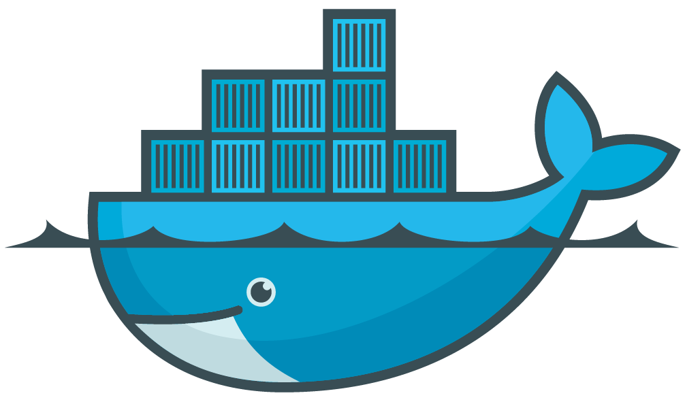
Unpacking Experiments
Reviewers
Readers
Computational Environment E’ (potentially different than E)
unpacks and reproduces
from a single directory
(Linux)
directory
/
unpacks in a single directory
and builds a full system environment
(Linux)
chroot
Extracting
Reproducible
Package
reprounzip
unpacks in a virtual machine
using Vagrant
(Linux, Mac OS X, Windows)
vagrant
unpacks in a Docker container
(Linux, Mac OS X, Windows)
docker
Notes:
ReproZip can also extract and reproduce experiments as Docker containers. The docker unpacker (reprounzip docker) is responsible for such integration.
Docker implements a high-level API to provide lightweight containers that run processes in isolation. A Docker container, as opposed to a traditional virtual machine, does not require or include a separate operating system. Instead, it relies on the kernel's functionality and uses resource isolation (CPU, memory, block I/O, network, etc.) and separate namespaces to isolate the application's view of the operating system.

Slide 32
Unpacking Experiments
Reviewers
Readers
Inspecting a reproducible package:
info, showfiles, graph
Running an unpacker:
setup, run, destroy, upload, download
Natively installing required software dependencies:
installpkgs
Generating a VisTrails workflow for the experiment:
Enabled by default for all unpackers
Notes:
info: general information about package (size, original OS, number of input and output files, command line, etc) and shows which unpackers are compatible with current OS
showfiles: details on input and output files
graph: creates a provenance graph showing the relationships between files, library dependencies, and binaries
setup: setup experiment using the desire unpacker
run: reproduce the experiment
destroy: turn off the unpacker; deletes the directory for reprounzip-directory, and deletes the vm for reprounzip-vagrant, for instance
upload and download: change input files and see output files, as I’ll show later
installpkgs: if version installed is different than original one, experiment may not be reproducible anymore
vistrails: for all unpackers

Slide 33
News!
ReproZip …
… has been adopted in the Bonneau Lab (NYU)
http://bonneaulab.bio.nyu.edu/
… will be used by the ACM SIGMOD 2015 Reproducibility Review
http://db-reproducibility.seas.harvard.edu/
… will be used by the Information Systems journal
http://www.journals.elsevier.com/information-systems/
Notes:
Bonneau lab – not only to share their experiment with others, but also to create snapshots of their experiments.

Slide 34
Wrap-Up: Main Features
Automatically captures experimental steps
Preserves experiment in a package (longevity)
Allows configuration of what should (not) be included in the package
Allows reproducibility of graphical tools
Allows experiment to be reproduced using the same configuration (replicability)
Allows users to change command line parameters and input files (modifiability)
Experiments can be ported from Linux to Mac OS X and Windows (portability)
Notes:
Longevity: not claiming data preservation, but it helps maintain an entire experiment so it can be reproduced long after if was created – library versions change, dependencies change, but the package remains the same

Slide 35
Wrap-Up: Limitations
Only packs experiments in Linux distributions (so far…)
Only detects software packages in Debian-based environments (so far…)
Does not guarantee reproducibility of distributed applications
Does not allow reproducibility of non-deterministic processes
Does not save state
Doing all this efficiently is an ongoing research effort
Notes:
Distributed applications: still an open research problem -- you can make these applications reproducible in your own environment, but making them available for others is harder.

Slide 36
In case you want to use it …
Website: http://vida-nyu.github.io/reprozip/
GitHub: https://github.com/ViDA-NYU/reprozip
Mailing lists: reprozip-users@vgc.poly.edu
reprozip-dev@vgc.poly.edu
Tutorial: http://cs.nyu.edu/courses/fall15/CSCI-GA.2434-001/IntroductiontoReprozip.pptx

Slide 37
Reproducibility and Software Management
Reproducibility tools can help with problems that have nothing to do with reviewing papers:
A project gets shelved for budget reasons and then gets revived.
Want last working copy and use it as a reference implementation and want to be able to cannibalize its parts.
Version control on entire environment.

Slide 38
Reproducibility and Upgrades
You have a working software system that uses package-version pairs P1.v1, P2.v2, … Pn.vn.
Original authors have long left.
You want to upgrade package P3 to as most recent a version as possible, then P6, then P1. The other packages may or may not be upgraded.
Liquidclimber framework…

Slide 39
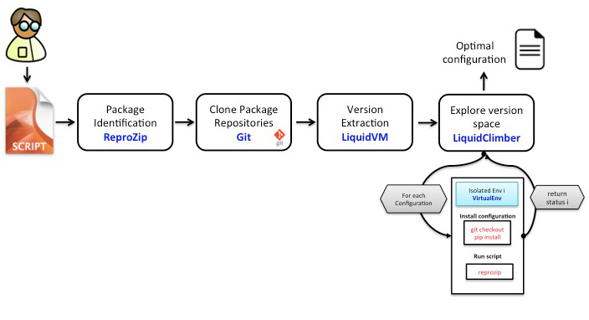

Thanks!
Questions?
Notes:
Take original computation: record with reprozip, capture package
dependencies, create "frozen" virtual machine.
Abstract from package-versions to just packages creating "liquid"
virtual machine.
Then based on an algorithm to efficiently explore version space,
upgrade the software package versions.

Slide 40
Research Question: cooperating VMs
Virtual machines protect an execution environment so that old software can run on new hardware/operating systems.
Requires isolation.
Sometimes want distribution and interoperation
How to do this lightly and efficiently?

Slide 41
Research Question: heterogeneous mash-ups
Given a repository of reproducible environments, can you extract interfaces that can then support scripts that call on multiple heterogeneous environments.
I want to use the 2012 version of this display software running on Mac OS 10 with the 2017 version of machine learning running on google Chrome X….

Slide 42
Other Challenges
Link to documents, so a change in data or method is immediately reflected in the document (iPython, Sweave, DEXY and others)
Ensuring longevity of archives.
Summary of tools:
http://repromatch.poly.edu/tools/#/tools/tool/pass

Slide 43
Summary
Reproducibility is necessary for good science.
Tools can make it reasonably painless.
These tools enable new applications.
There are practical important research directions to pursue given these new tools.

