Slide 1
High-Frequency Trading and its Strategies

Slide 2
Profit is Profit
High-frequency trading takes advantage of small shifts in market
Notes:
Strictly speaking, if the price of your commodity goes up, you can make a profit. In practice, this idea is, for the most part, impractical. Penny profits, while profits, are very small. Special techniques must be applied in order to take advantage of these small gains.

Slide 3
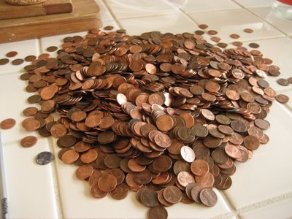
Do it Quickly, Do it Often
You will have an embarrassment of riches
Notes:
Despite such small profit-margins, if done many times a day, meaningful amounts of money can be made. High-frequency trading involves buying commodities and selling them mere milliseconds afterwards.

Slide 4
Strategies
Four categories
Market Making
Ticker Tape Trading
Event Arbitrage
High Frequency Statistical Arbitrage

Slide 5
Market Making
Inventory Models
Information Models
Notes:
In a Market Making strategy, the idea is to use observable quote data to make profits. Information models take into account incoming information that will affect prices. Inventory models take into account dealer book imbalances.
One general strategy for inventory models is to look for discrepancies in prices of the same security. A limit order to buy is placed just below the market place in the cheaper market while a limit order to sell just above market place is placed in the pricier market. While this may be a small profit, do keep in mind that this all happens in a matter of milliseconds many, many times over the course of a market day.

Slide 6
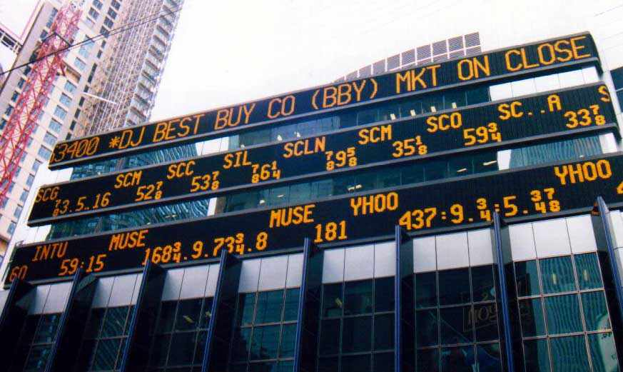
Ticker Tape Trading
Quotes reveal more than just prices
Get ticker tape readings frequently (though irregularly)
Notes:
Quotes are usually influenced by a dealer’s inventory. Bid and ask prices are raised or lowered to influence clients to (not) buy or sell.
By sampling prices at a high frequency (hopefully by now it is clear that this is the theme of this powerpoint), traders can gain an advantage over those who sample less frequently. For example, when a trader not applying ticker tape trading strategies merely samples prices at every minute, the trader will operate under the assumption that prices remain constant until the quotes arrive for the next minute. Even worse, the trader will assume that the prices are the same as two minutes ago if quotes for the current minute do not arrive. These assumptions can presumably be taken advantage of by more well-informed traders.

Slide 7
Event Arbitrage
Taking advantage of events (news announcements) that move that market
Notes:
Certain events such as the U.S. Federal Funds rate increasing can effect a rise in prices (in this case, an increase in the value of the US Dollar). These events will consistently increase prices and therefore can be taken advantage of. The trick is to start acting shortly before the event and to complete the action shortly after it has started. Again, speed is key.

Slide 8
High Frequency Statistical Arbitrage
Pray that a pattern is real
Notes:
Sift through a mountain of data and look for patterns. The pattern has to hold at least 90% of the time. Otherwise, you haven’t actually found a pattern.

Slide 9
Bibliography
High-frequency Trading : A Practical Guide to Algorithmic Strategies and Trading System by Irene Aldridge.

