Slide 1
Bounce Blockchain
Dennis Shasha
Computer Science Dept
New York University
shasha@courant.nyu.edu
January, 2019

Slide 2
Blockchain Semantics: Goals
Transactions (with whatever semantics) are in a pure sequence ordered at least approximately in time.
Anyone can walk the sequence through a chain of hashes.
Cannot be forked into several sequences such that none is a prefix sequence of another.

Slide 3
Blockchain In Practice
Proof-of-Work blockchains like BitCoin. i) Enormous electricity consumption (> 20 terawatt-hours per year) ii) Oligopoly of mining sites who could fork the blockchain, so not really secure.
Proof-of-stake: cheaper but vulnerable to collusion. Could be forked with enough resources.
Proof-of-location: cheaper, but depends on cell tower integrity.

Slide 4
Permissioned Blockchain
A host organization, e.g. IBM, collects transactions from participants and uses a set of trusted nodes to determine which transactions go to which blocks and the order of blocks.
Inexpensive and fast.
Very dependent on the security at the host organization.

Slide 5
Bounce Blockchain: the strawman implementation
Single completely reliable/ownerless satellite orders transactions and sends them back to earth.
Satellite is the arbiter of the blockchain and maintains the sequence.
No forking by construction.
Minimal electricity use.

Slide 6
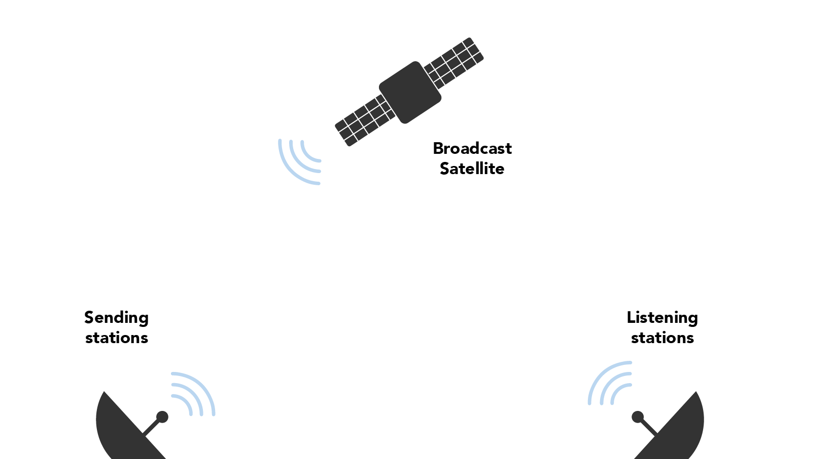
Strawman

Slide 7
Bounce Blockchain Strawman Issues
Satellite could be hacked.
Single satellite does not scale.
Single satellite is not fault tolerant.
Communications satellites cost > $100 million.

Slide 8
Bounce Blockchain Architecture
Cubesats each embedded with hardware security module.
Scalable, cheap (less than $0.01 per transaction)
Socio-technically safe (hardware security modules are highly vetted because all big companies use them).
Protocols can deal with fail-stop failures easily, even traitorous failures (if not too many).

Slide 9
More Reliable, Faster, Cheaper
Multiple Cubesats (10 centimeter cubes) with embedded Hardware Security Modules.
“Multiple” for redundancy to fail-stop failures and scalability.
Sending stations to deliver information to the Cubesats and Listening Stations to collect and re-distribute.

Slide 10
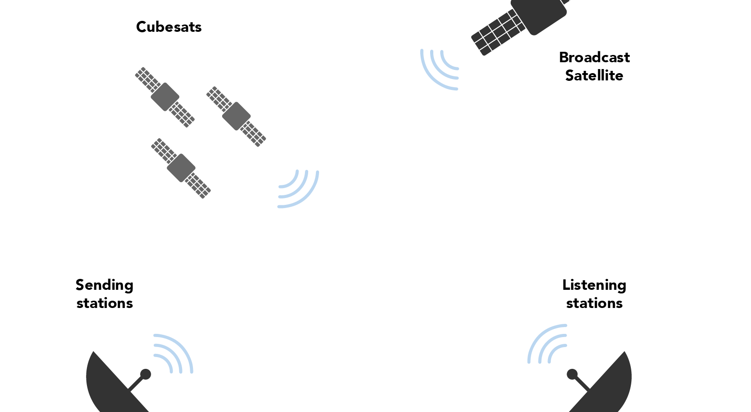
Cubesat/Sending/Listening

Slide 11
Lift-off Protocol
Cubesats with embedded Hardware Security Modules (HSMs) deployed en masse under supervision of security validation experts and broadcast on television (like a SpaceX liftoff).
HSMs generate private/public key pairs through physical process and are validated by sending stations and become common knowledge.
Socio-technical strategies to guarantee integrity of HSMs: NIST level 4 requires tamper resistance.

Slide 12
Many Cubesats are Scalable and Fault Tolerant
Cubesats organize the chain and broadcast signed messages to Listening Stations.
When fail-stop cubesats miss their time slice theyare spliced out.
If Hardware Security Modules can’t be spoofed or taken over, then this is all that’s needed.

Slide 13
Individualistic Cubesat Protocol
User send to some Sending Stations with payment.
Sending Station sends to one Cubesat.
Each Cubesat assembles its transactions into a block and sends to Listening Station during its time slice.
Listening Stations gossip about each block.

Slide 14
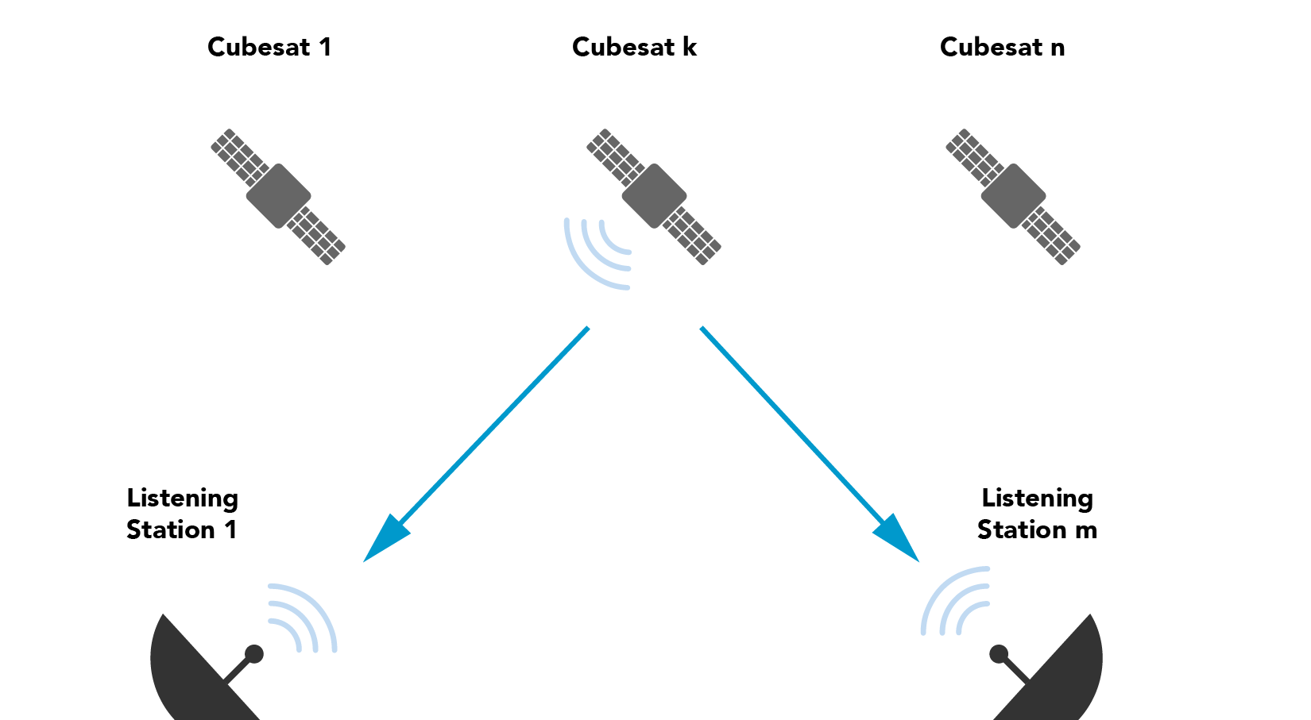
Individualistic Cubesat Protocol

Slide 15
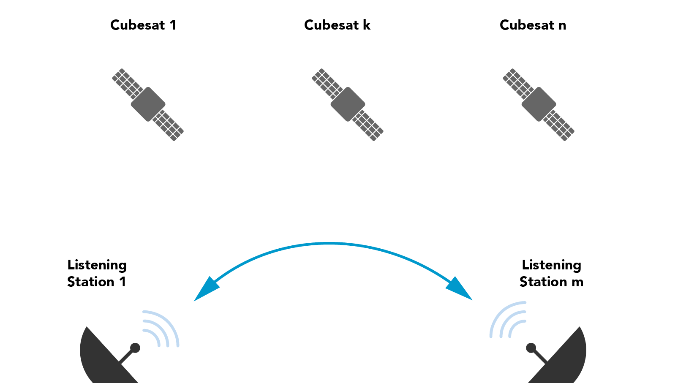
Individualistic Continued

Slide 16
Individualistic Cubesat Protocol part 2
If, for Cubesat c, a Listening Station L receives the same signed block b from a supermajority (more than 2/3) of the Listening Stations, then L commits.
Guarantees: 1) If all cubesats are fail-stop then no forking 2) If fewer than 1/3 of the Listening Stations are traitorous, then no forking.

Slide 17
Alternative
Guarded places on earth that organize the blocks.
Guards or owner can be bribed or overcome making likelihood of traitorous failure more likely.
Communication is not naturally broadcast.
Cubesats hard to destroy, much less capture.

Slide 18
Alternative
Current distributed Bitcoin protocol: A few data centers control more than half the hashing power, so could fork it if they wish.
Algorand: Modified proof of stake where stake is proportional to investment. Malevolent actor could buy up 1/3 of a coin to control the other 2/3.
By contrast, bounce blockchain has punctuated trust (lift-off).

Slide 19
Alternative
Use Intel trusted computing kernel SGX and run a random process to trip an alarm when done. Earliest machine to trip determines the next block.
There have already been attacks on SGX and with so much at stake, some hacker will figure out a way to hack the chip sitting in front of them.

Slide 20
Business Case
For 20 cubesats at 1 cent per transaction (vs. $6.00 for Bitcoin now), could handle 2000 transactions per second (vs. 20 per second for each of Bitcoin/Ethereum), yielding as much as $600 million per year.
Fully loaded cubesat including launch costs $100,000, so $2 million for 20 cubesats with lifetime of 20 years.
Engineering and communications cost say another $2 million per year (overestimate).

Slide 21
Upshots
Revenue/profit potential large.
Cost of blockchain vastly reduced, with new applications possible.
Practically speaking more secure
Impact is enormous both financially and ecologically.
Proposal: cubesat engineering company + our algorithms.

