Slide 1
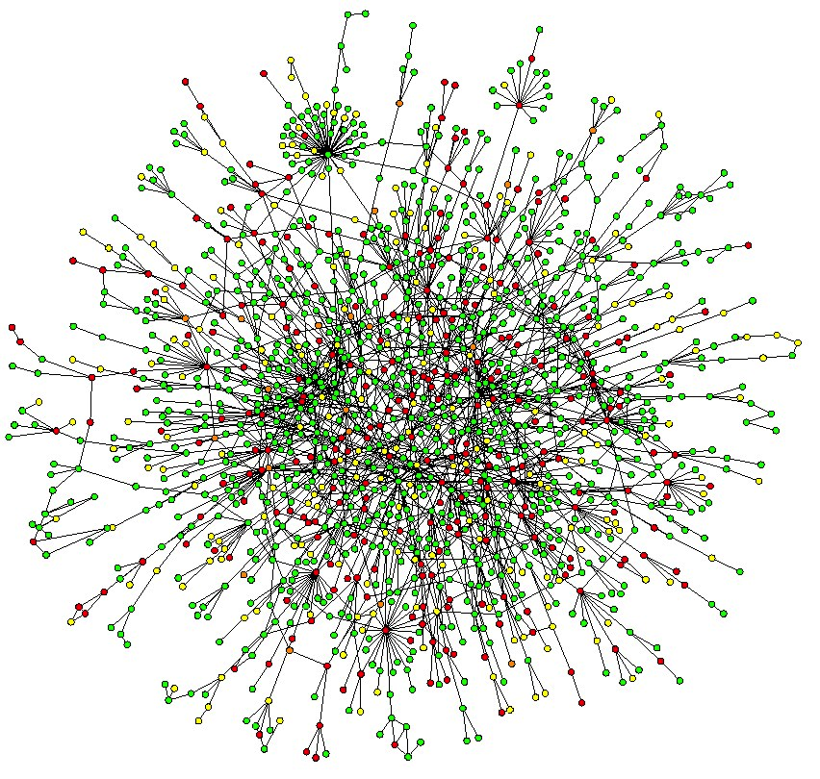
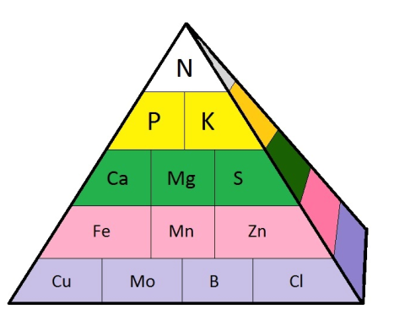
Learning using TF-families & The NPK Nutriome: a Transcriptomic Analysis
Jacopo Cirrone - Ph.D. Student

Slide 2
Outline
Learning using TF-Families (Network Inference from real biological data)
(Joint work with Dennis Shasha, Kranthi Varala, Ying Li, Gloria Coruzzi)
Problem & Motivation
The DFG Algorithm, Data Source, Universe
All TFs VS TF-families
Nitrogen Influence Network
The NPK Nutriome: a Transcriptomic Analysis
(Joint work with Joan, Dennis, Gloria, Manny)
Nonlinear correlation between traits and genes expression

Slide 3
Outline
Learning using TF-Families (Network Inference from real biological data)
(Joint work with Dennis Shasha, Kranthi Varala, Ying Li, Gloria Coruzzi)
Problem & Motivation
The DFG Algorithm, Data Source, Universe
All TFs VS TF-families
Nitrogen Influence Network
The NPK Nutriome: a Transcriptomic Analysis
(Joint work with Joan, Dennis, Gloria, Manny)
Nonlinear correlation between traits and genes expression

Slide 4
Motivation
B
A
A can cause some B to take on a high value
-where A and B are genes
Preventing B from taking such a value can be done by removing some B or by removing some A
Conversely, making B achieve a higher value can be done by adding more B or adding more A
Notes:
-- For example if we Infer this edge
-- How do we use this knowledge for instance if for example we want to prevent B from taking….
(would provide solutions such as suitable genetic modifications (ox or ko exps))

Slide 5
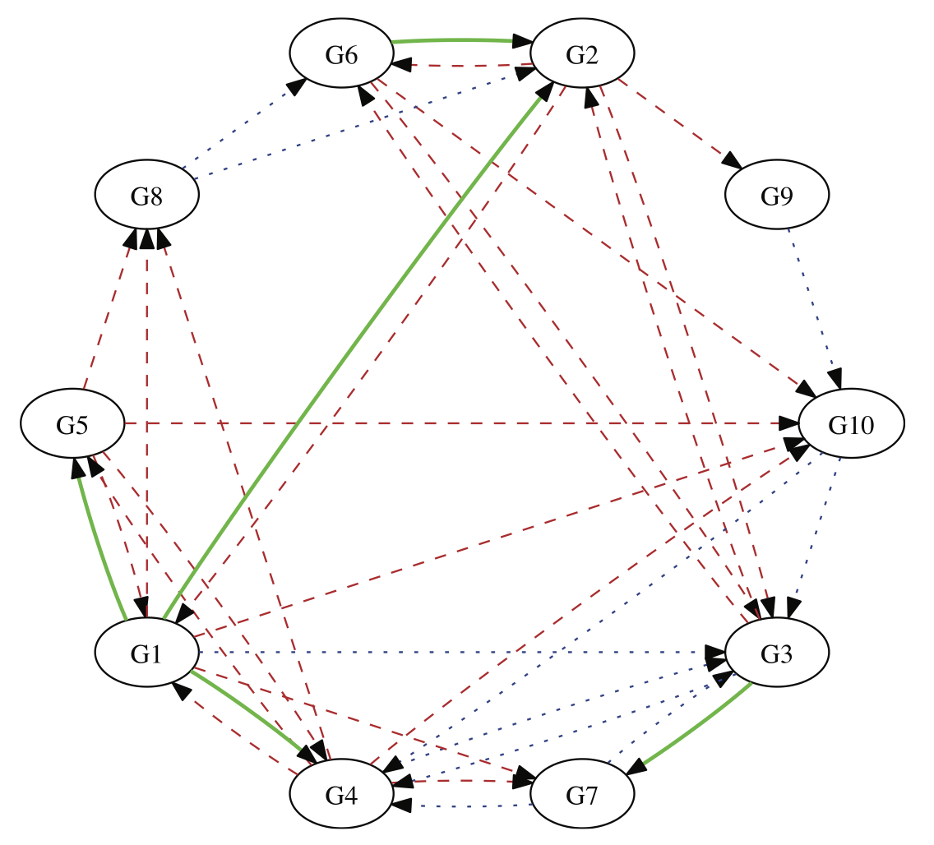
Goal: Causality
Notes:
Goal is causality and why we want to achive this goal, because: Inspite of amazing advances in the ability to generate huge amount of genomic and biological data. Nearly all biologic systems are under-determined with respect to the problem of regulatory network inference. So we know the part list, we know the genes, but we don’t know how they pieces fit together, how the genes are connected to each other.

Slide 6
Approach to finding such causal links:
B
A
Experiments that decrease (or over-express) the quantity of A or knock it out reveal the influence of A
Experiments over a spaced time course to enable inference of the form “the state of A at t may influence B at time t+1”
Notes:
So which are the approach to finding such causal links….
….Red highlights the approach to infer causality that will discuss today.

Slide 7
Outline
Learning using TF-Families (Network Inference from real biological data)
(Joint work with Dennis Shasha, Kranthi Varala, Ying Li, Gloria Coruzzi)
Problem & Motivation
The DFG Algorithm, Data Source, Universe
All TFs VS TF-families
Nitrogen Influence Network
The NPK Nutriome: a Transcriptomic Analysis
(Joint work with Joan, Dennis, Gloria, Manny)
Nonlinear correlation between traits and genes expression

Slide 8
Algorithm, Data Source, Universe
Machine learning algorithm:
Dynamic Factor Graph
Data source:
Time series of N-response in Shoots (Amy Dataset)
Shoot Universe: 2173 genes – 161 TFs
Coruzzi Lab

Slide 9
Dynamic Factor Graphs
Top contender in competitions such as
DREAM for network inference or CATS for time series prediction.Jacopo: I don’t’ think dfg has been used in DREAM.
Infers the topology of the networks as a ranked list of interactions (i.e. a matrix of edge scores)
TFs
S
C
O
R
E
S
G
E
N
E
S

Slide 10
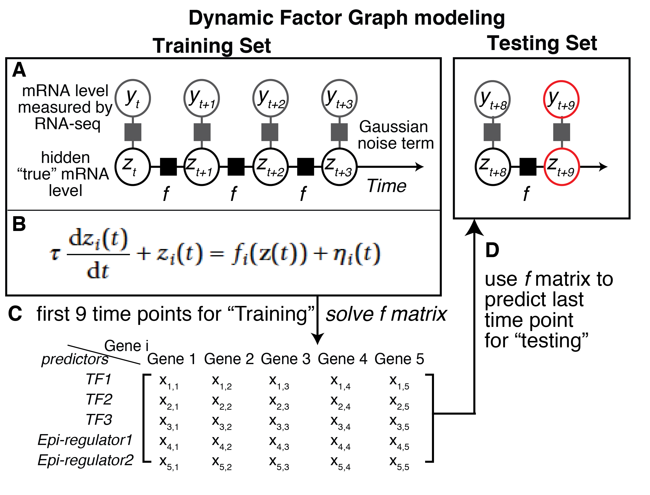
How DFG works for Gene Regulatory Networks?
TF4
TF5
Notes:
“It alternates between two steps: learning the function f mapping latent values of transcription factors at time t to changes to target genes (and transcription factors themselves) at time t + 1; and recomputing (inferring) the values of the latent variables. In the first step, learning the function f corresponds to finding parameters of F that minimize the prediction error and that involve few transcription factors, thanks to a sparsity constraint on F. In the second step, the sum of quadratic errors on functions f and g is minimized with respect to latent variables z(t) by gradient descent in the hidden variable space. The learning procedure is repeated (learning model parameters, inferring latent variables) on training data until F stabilizes (see Materials and methods). Using a bootstrapping approach based on random initia- lization of latent variables z(t), we further repeat the SSM iterative procedure 20 times(i.e. models) and take the final average network F”

Slide 11
Outline
Learning using TF-Families (Network Inference from real biological data)
(Joint work with Dennis Shasha, Kranthi Varala, Ying Li, Gloria Coruzzi)
Problem & Motivation
The DFG Algorithm, Data Source, Universe
All TFs vs TF-families
Nitrogen Influence Network
The NPK Nutriome: a Transcriptomic Analysis
(Joint work with Joan, Dennis, Gloria, Manny)
Nonlinear correlation between traits and genes expression

Slide 12
All TFs VS TF-families
Through our experiments we can show that using TF-families as predictors improves performance compared with using all TFs.
We have compared results of families as predictors with results using all TFs as predictors. And the latter outcomes are much worse.

Slide 13
Example
Run Dynamic Factor Graphs using 12 TFs of G2-family:
NAC-family has 73% of correct signs
Run Dynamic Factor Graphs using all TFs:
12 TFs of G2 family predicts 46% of NAC-family correct signs

Slide 14
Outline
Learning using TF-Families (Network Inference from real biological data)
(Joint work with Dennis Shasha, Kranthi Varala, Ying Li, Gloria Coruzzi)
Problem & Motivation
The DFG Algorithm, Data Source, Universe
All TFs VS TF-families
Nitrogen Influence Network
The NPK Nutriome: a Transcriptomic Analysis
(Joint work with Joan, Dennis, Gloria, Manny)
Nonlinear correlation between traits and genes expression

Slide 15
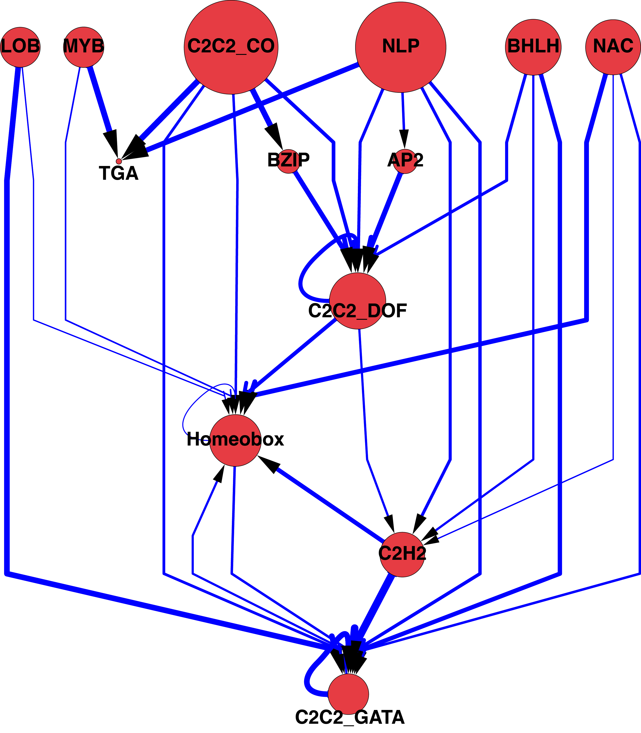
Nitrogen Influence Network
FDR has been used to determine which families influence which others
Notes:
Here is the TF family influence graph. It was updated to remove edges that did not pass a FDR cutoff of 10%. (FDR adjusted p-val <0.1). The size of the node indicates the sum of its influence over the other nodes which can be roughly translated as: a TF family that correctly predicts the expression of multiple TF families is larger than one that predicts a smaller number of TF families. Frankly, I am not sure if that is a better measure than simply the outdegree of the node.

Slide 16
FDR
Jacopo: In case you get questions, please explain how FDR is calculated and your interpretation of FDR.
Why is FDR appropriate?
P-value of family f1 to family f2 is computed by comparing the accuracy of the f1 to f2 results against …
Because there are many pairs of families, need multiple testing correction.
We use xyz method…

Slide 17
Outline
Learning using TF-Families (Network Inference from real biological data)
(Joint work with Dennis Shasha, Kranthi Varala, Ying Li, Gloria Coruzzi)
Problem & Motivation
The DFG Algorithm, Data Source, Universe
All TFs VS TF-families
Nitrogen Influence Network
The NPK Nutriome: a Transcriptomic Analysis
(Joint work with Joan, Dennis, Gloria, Manny)
Nonlinear correlation between traits and genes expression

Slide 18
Summary from Joan Presentation
24 conditions:
6 levels of nitrogen
4 permutations of PK
21 traits:
Biomass, RootLength, N, P, K etc
28712 genes
Root/Shoot
Avg of 3Reps

Slide 19
The NPK interplay affects plant biomass
HPHK
Crossing
point
LPHK
HPLK
LPLK
Biomass (g)
PK effect
0.1mM
0.5mM
2mM
5mM
10mM
20mM
40mM
60mM
80mM
[Nitrogen]
Low [N]
Medium [N]
High [N]

Slide 20
Filtering Steps
I Step) Removed genes with low expression
II Step) Removed genes that don’t change
Problem: there are still genes with very low expressions(for instance range ~[0,3]) – Manny is finding out a better way to complement this filtering strategy

Slide 21
Outline
Learning using TF-Families (Network Inference from real biological data)
(Joint work with Dennis Shasha, Kranthi Varala, Ying Li, Gloria Coruzzi)
Problem & Motivation
The DFG Algorithm, Data Source, Universe
All TFs VS TF-families
Nitrogen Influence Network
The NPK Nutriome: a Transcriptomic Analysis
(Joint work with Joan, Dennis, Gloria, Manny)
Nonlinear correlation between traits and genes expression

Slide 22
Our Basic Idea
We want to get genes that correlate with traits that we are interested in.
Let’s take a trait t such as biomass.
We correlate genes with trait t.
We find the p-value of the correlations.
This will give us the most important genes for biomass, nitrogen etc.

Slide 23
Variation
Look at Spearman correlation, able to find out linear and non linear correlations.
Main task for the biologists is to choose traits.
With our software we are able to take any trait and any subset of conditions and find correlations. Interesting subsets will fix P and K.

Slide 24
Implementation
1) Compute Spearman correlations
2) Apply FDR
3) Apply threshold (e.g. 0.05)
Do the 3 steps above separately for positive and negative correlations. And separately for root and shoot.

Slide 25
Global Correlation – Number of genes – FDR cutoff 0.1
 | Global
Root - Biomass | Pos: 0 Neg: 0
Root - Nitrogen | Pos: 374 Neg: 281
Shoot - Biomass | Pos: 47 Neg: 97
Shoot - Nitrogen | Pos: 1,666 Neg: 1,635
Root = ~15,408 (after filtering) Shoot=~17,451 (after filtering)
Notes:
We can consider those 47 as markers of the good biomass. These are genes that are low when biomass is low and high when biomass is high. On the other hand those 97 are genes that potentially we want to repress.

Slide 26
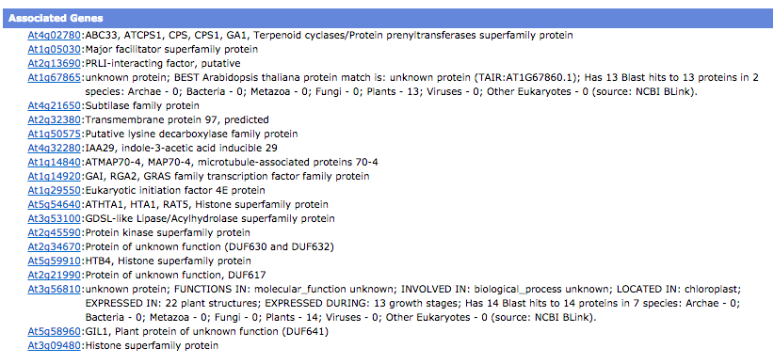
Genesect - Shoot Pos correlated genes w/ Biomass & Nitrogen (20 genes)
1 Transcription Factor

Slide 27
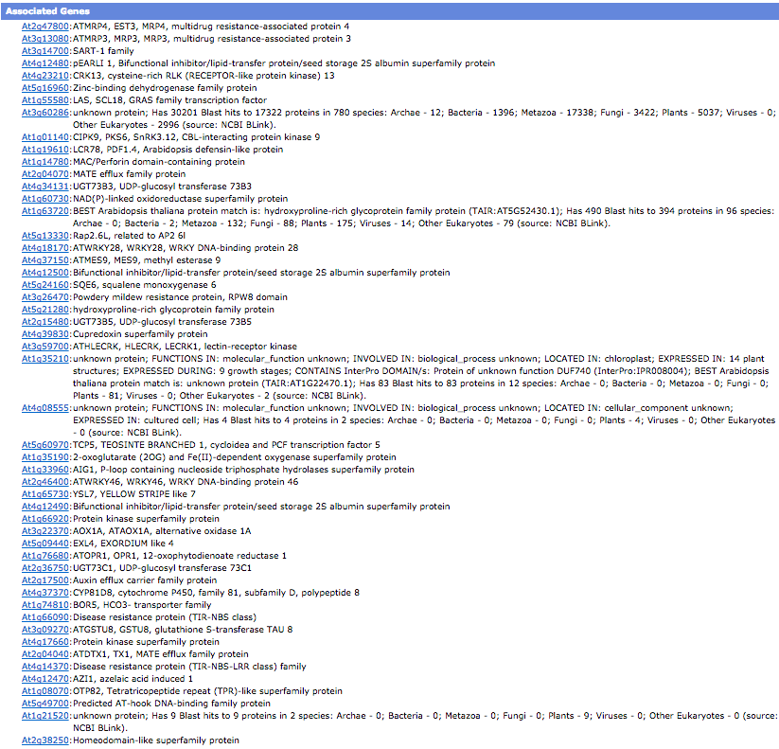
Genesect - Shoot Neg correlated genes w/ Biomass & Nitrogen (51 genes)
6 Transcription Factors

Slide 28
Plots
Shoot Pos Nitrogen: 1,666 genes
Shoot Neg Nitrogen 1,635 genes
Shoot Pos Biomass 47 genes
Shoot Neg Biomass 97 genes
Genesect Shoot Pos Biomass/Nitrog 20 genes
Genesect Shoot Neg Biomass/Nitrog 51 genes

Slide 29
Fixed PK Correlation – Number of genes – FDR cutoff 0.2
 | HPK | HPLK | LPHK | LPK
Root - Biomass | Pos: 13 Neg: 7 | Pos: 0 Neg: 0 | Pos: 458 Neg: 291 | Pos: 0 Neg: 0
Root - Nitrogen | Pos: 13 Neg: 7 | Pos: 363 Neg: 260 | Pos: 453 Neg: 321 | Pos: 0 Neg: 0
Shoot - Biomass | Pos: 98 Neg: 101 | Pos: 0 Neg: 0 | Pos: 347 Neg: 473 | Pos: 0 Neg: 0
Shoot - Nitrogen | Pos: 98 Neg: 101 | Pos: 66 Neg: 93 | Pos: 346 Neg: 764 | Pos: 68 Neg: 114
Notes:
We found genes that….
In HPK are the same correlated genes for biomass and nitrogen because biomass correlates with nitrogen
Root = ~6,603 - ~9096 after filtering Shoot=~8,475 - ~12,785 after filtering

Slide 30
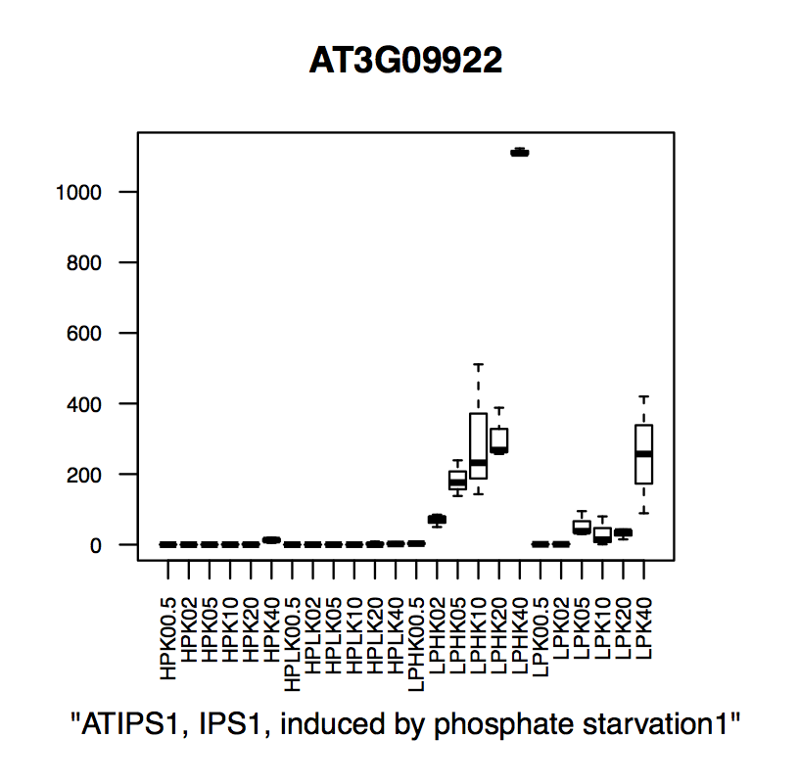
Gab insight
Notes:
Hence a better way is to look at fixed P and fixed K

Slide 31
Fixed PK Correlation – Number of genes – FDR cutoff 0.15
 | HK | HP | LK | LP
Root - Biomass | Pos: 70 Neg: 51 | Pos: 11 Neg: 3 | Pos: 2 Neg: 1 | Pos: 1 Neg: 0
Root - Nitrogen | Pos: 194 Neg: 144 | Pos: 133 Neg: 117 | Pos: 135 Neg: 147 | Pos: 270 Neg: 260
Shoot - Biomass | Pos: 932 Neg: 1,158 | Pos: 786 Neg: 683 | Pos: 43 Neg: 51 | Pos: 9 Neg: 12
Shoot - Nitrogen | Pos: 830 Neg: 1,169 | Pos: 718 Neg: 576 | Pos: 599 Neg: 651 | Pos: 244 Neg: 624
Notes:
Then We found genes that…
Root = ~11,405 - ~12,950 after filtering Shoot=~13,385 - ~14,978 after filtering

Slide 32
Jacopo: question
Jacopo: I don’t understand something. Your title says constant PK but the sungear anchors have labels like poscorrelation_nitrogenHK. I would have thought you’d want poscorrelation_nitrogenHKHP.

Slide 33
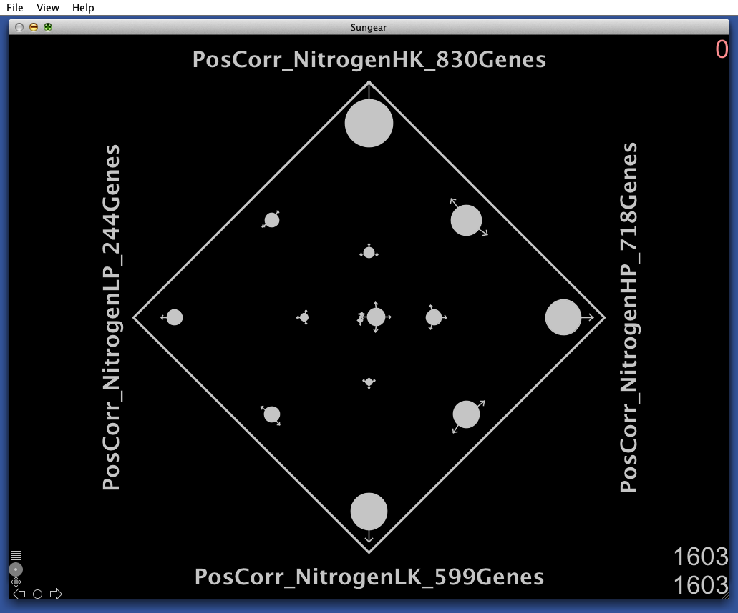
Shoots, Positive Correlated Genes w/ Nitrogen for constant PK – Sungear
458
37
188
22
249
15
44
48
61
11
141
48
274

Slide 34
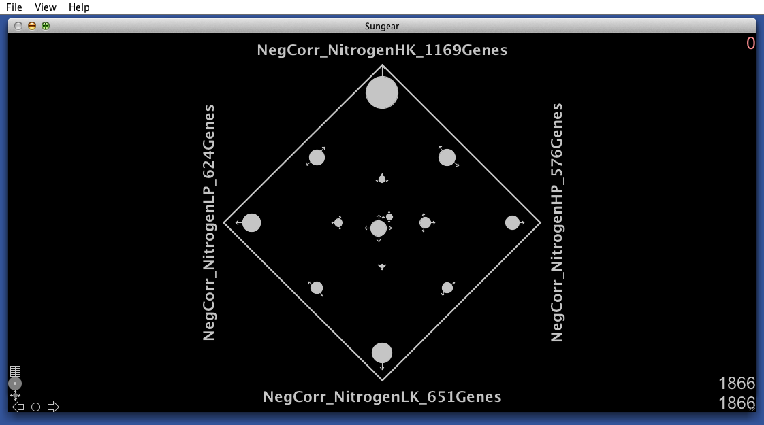
Shoots, Negative Correlated Genes w/ Nitrogen for constant PK – Sungear
458
586
37
188
136
22
157
26
249
15
23
44
112
48
35
61
67
197
139
11
11
141
79
63
48
274
234

Slide 35
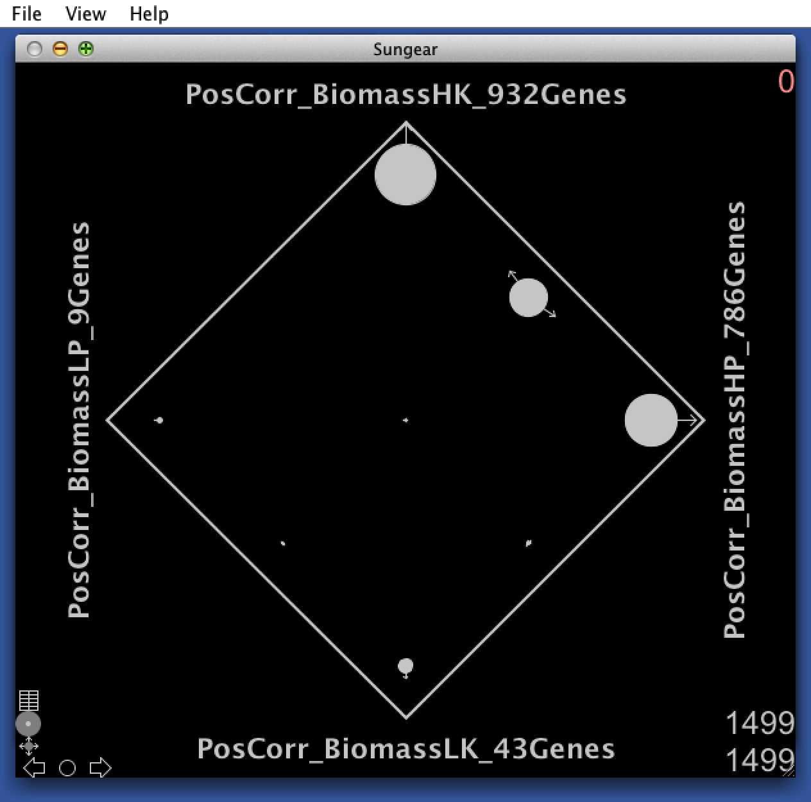
Shoots, Positive Correlated Genes w/ Biomass for constant PK – Sungear
666
266
516
7
1
1
3
39

Slide 36
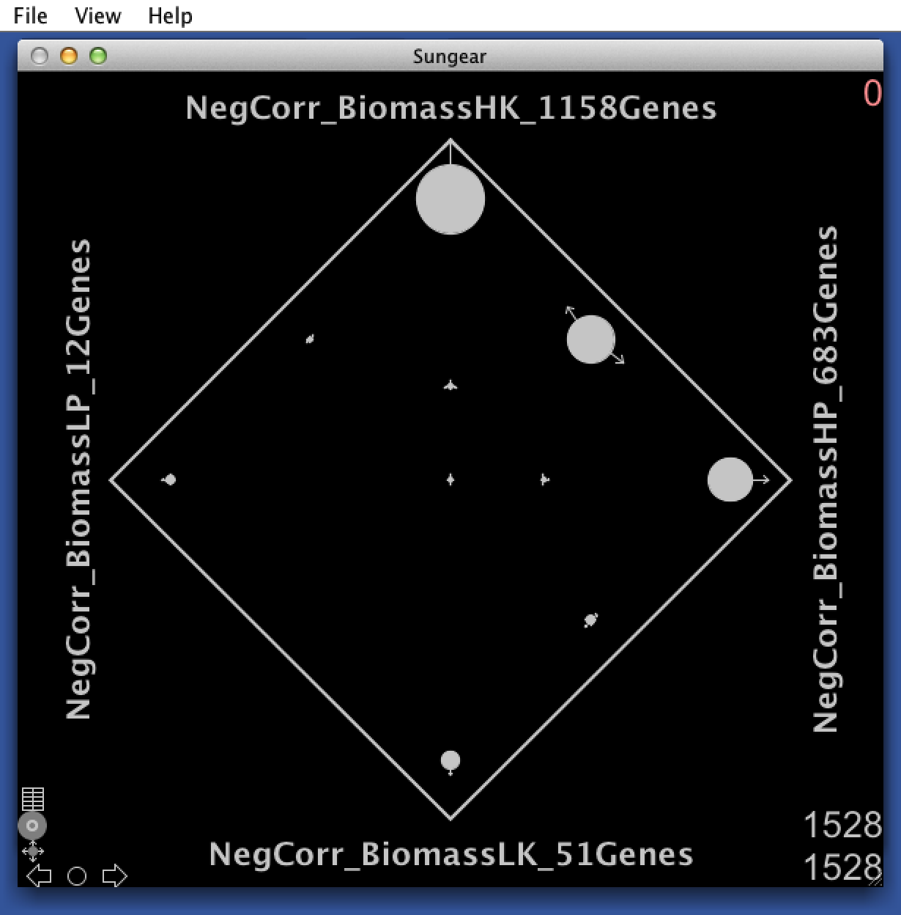
Shoots, Negative Correlated Genes w/ Biomass for constant PK – Sungear
666
794
266
359
516
7
1
312
9
1
3
9
40
39

Slide 37
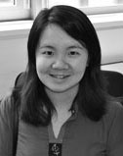
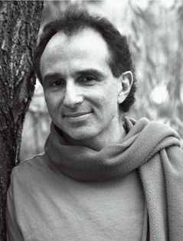
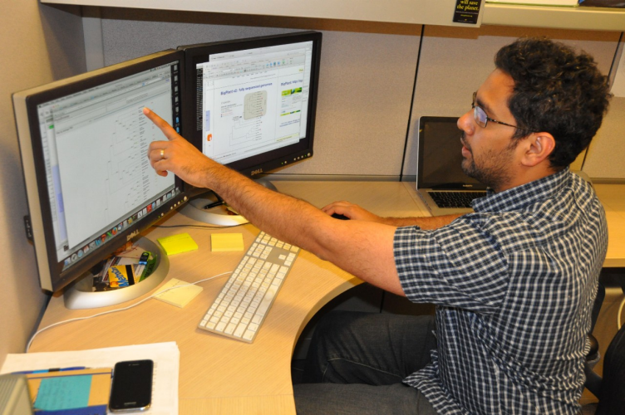
Acks
Notes:
People I have worked with

Slide 38
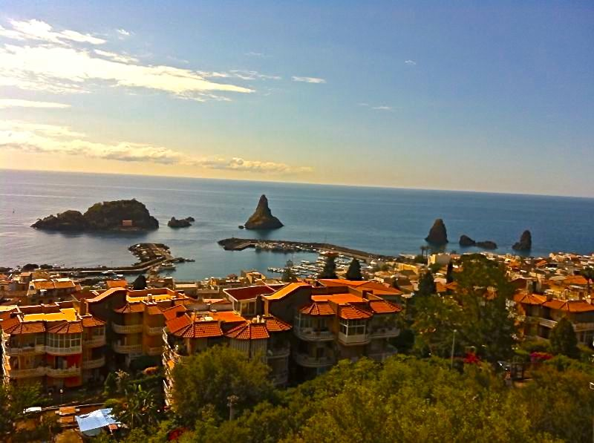
Thanks!
Questions?

