Slide 1
Learning using TF-families 2015-02-17

Slide 2
All N-resp relevant Families Together includes:
G2-LIKE TRANSCRIPTION FACTOR FAMILY (12 genes)
AP2-EREBP TRANSCRIPTION FACTOR FAMILY (16 genes)
NLP TRANSCRIPTION FACTOR FAMILY (7 genes)
BASIC REGION LEUCINE ZIPPER (BZIP) TRANSCRIPTION FACTOR (10 genes)
TGA3-LIKE (3 genes)
AS2 - LATERAL ORGAN BOUNDARIES (4 genes)
MYB (4 genes)
Rav fam (1 gene)

Slide 3
All 161 TFs as Predictors
TERM | Num | % Correct Signs using all 161 TFs as Predictors | Pvalue | Pvalue Trend Forecast | Pvalue Inv Trend Forecast
G2-LIKE TRANSCRIPTION FACTOR FAMILY | 12 | 0.66 | 0.001 | 0.11 | 0.004
NLP TRANSCRIPTION FACTOR FAMILY | 7 | 0.65 | 0.01 | 0.16 | 0.02
AP2-EREBP TRANSCRIPTION FACTOR FAMILY | 16 | 0.51 | 0.1 | 0.67 | 0.13
BASIC REGION LEUCINE ZIPPER (BZIP) TRANSCRIPTION FACTOR | 10 | 0.43 | 0.5 | 0.91 | 0.54
TGA3-LIKE | 3 | 0.59 | 0.1 | 0.36 | 0.15
AS2 - LATERAL ORGAN BOUNDARIES | 4 | 0.67 | 0.03 | 0.19 | 0.04
MYB | 4 | 0.25 | 0.8 | 0.97 | 0.88
All N-resp relevant Families Together (includes also 1 gene Rav fam) | 54 | 0.55 | 0.001 | 0.53 | 0.003
BHLH | 6 | 0.31 | 0.8 | 0.97 | 0.83
C2C2_CO | 5 | 0.33 | 0.8 | 0.95 | 0.81
C2C2_DOF | 5 | 0.44 | 0.5 | 0.81 | 0.51
C2C2_GATA | 6 | 0.31 | 0.8 | 0.97 | 0.83
C2H2 | 14 | 0.58 | 0.01 | 0.37 | 0.03
Homeobox | 10 | 0.57 | 0.05 | 0.40 | 0.07
NAC | 7 | 0.46 | 0.4 | 0.80 | 0.44
Notes:
This genes are about 100 in total
-- no Significant term found in Best Predicted Genes with 7 – 9 scores
The whole point is that, using all TFs as predictors and the entire universe, we don’t know get good percentage of correct prediction. Then what we want to see here is how we do using subests of TFs that work together as predictors of subsets of the entire universe. Further this subset of genes, we look at, are also families. Hence we are trying to figure it out which family predicts well which other family.
3 Kind of pvalue:
1st column - so by considering the predictions on the entire universe using these specific/given predictors, this is the probability of having a greater percentage of correct signs in a random set of genes just as big (12 for instance).
2nd column – here considering the predictions on the entire universe using trend forecast, this is the probability of having a greater percentage of correct signs (using trend forecast) in a random set of genes just as big (12 for instance)
3rd column – here considering the predictions on the entire universe using inverse trend forecast , this is the probability of having a greater percentage of correct signs (using inverse trend forecast) in a random set of genes just as big (12 for instance)

Slide 4
GO-Term Best predicted Genes (Scores 7-9) – 161 TFs as Predictors
No Significant term found in Best Predicted Genes (with 7 – 9 scores)
So, no particular pattern in which ones are well-predicted.

Slide 5
12 TFs of G2 Family as Predictors
TERM | Num | % Correct Signs using title Fam as Predictors | Pvalue G2 | Pvalue G2 no better than Trend | Pvalue G2 no better than Inv Trend
NAC | 7 | 0.73 | 0.01 | 0.05 | 0.004
AP2-EREBP TRANSCRIPTION FACTOR FAMILY | 16 | 0.54 | 0.22 | 0.52 | 0.06
NLP TRANSCRIPTION FACTOR FAMILY | 7 | 0.51 | 0.40 | 0.62 | 0.24
BASIC REGION LEUCINE ZIPPER (BZIP) TRANSCRIPTION FACTOR | 10 | 0.5 | 0.43 | 0.68 | 0.23
TGA3-LIKE | 3 | 0.67 | 0.12 | 0.21 | 0.07
AS2 - LATERAL ORGAN BOUNDARIES | 4 | 0.58 | 0.30 | 0.44 | 0.19
MYB | 4 | 0.22 | 0.97 | 0.99 | 0.94
All N-resp relevant Families Together (includes also 1 gene Rav fam) | 54 | 0.51 | 0.32 | 0.86 | 0.03
BHLH | 6 | 0.28 | 0.95 | 0.98 | 0.90
C2C2_CO | 5 | 0.53 | 0.40 | 0.58 | 0.26
C2C2_DOF | 5 | 0.42 | 0.72 | 0.85 | 0.58
C2C2_GATA | 6 | 0.54 | 0.38 | 0.57 | 0.23
C2H2 | 14 | 0.46 | 0.66 | 0.88 | 0.40
Homeobox | 10 | 0.53 | 0.34 | 0.59 | 0.16
G2-LIKE TRANSCRIPTION FACTOR FAMILY | 12 | 0.51 | 0.42 | 0.70 | 0.21
Notes:
This genes are about 100 in total

Slide 6
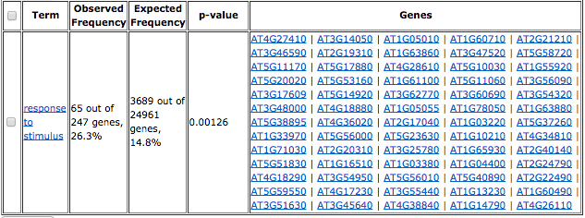
GO-Term Best predicted Genes (Scores 7-9) – G2 as Predictors

Slide 7
NAC BINDING SITES | BINDING SITES BEST PREDICTED GENES BY G2
ABRE-like binding site | SORLIP1
BoxII promoter | DPBF1&2 binding site
AGL2 binding site | SORLIP2
SBP-box promoter | ABRE-like binding site
CBF1 BS in cor15a | DRE-like promoter
Ibox promoter | ABRE binding site
SORLIP1 | G-box promoter
G-box promoter | MYB4 binding site
T-box promoter | JASE2 motif in OPR1
 | SORLREP1
(Top 10 known motifs in the promoters of best predicted genes)

Slide 8
16 TFs of AP2 Family as Predictors
TERM | Num | % Correct Signs using AP2as Predictors | Pvalue | Pvalue Trend Forecast | Pvalue Inv Trend Forecast
C2C2_DOF | 5 | 0.78 | 0.001 | 0.03 | 0.001
AP2-EREBP TRANSCRIPTION FACTOR FAMILY | 16 | 0.46 | 0.27 | 0.86 | 0.33
NLP TRANSCRIPTION FACTOR FAMILY | 7 | 0.44 | 0.45 | 0.85 | 0.50
BASIC REGION LEUCINE ZIPPER (BZIP) TRANSCRIPTION FACTOR | 10 | 0.42 | 0.52 | 0.93 | 0.60
TGA3-LIKE | 3 | 0.33 | 0.73 | 0.91 | 0.75
AS2 - LATERAL ORGAN BOUNDARIES | 4 | 0.14 | 0.97 | 0.99 | 0.98
MYB | 4 | 0.28 | 0.81 | 0.96 | 0.84
All N-resp relevant Families Together (includes also 1 gene Rav fam) | 54 | 0.39 | 0.79 | 0.99 | 0.88
BHLH | 6 | 0.33 | 0.79 | 0.97 | 0.83
C2C2_CO | 5 | 0.4 | 0.53 | 0.84 | 0.57
C2C2_GATA | 6 | 0.52 | 0.19 | 0.57 | 0.22
C2H2 | 14 | 0.56 | 0.03 | 0.41 | 0.04
Homeobox | 10 | 0.44 | 0.43 | 0.88 | 0.50
NAC | 7 | 0.44 | 0.45 | 0.85 | 0.49
G2-LIKE TRANSCRIPTION FACTOR FAMILY | 12 | 0.39 | 0.64 | 0.97 | 0.70
Notes:
--This genes are about 100 in total
-- no Significant term found in Best Predicted Genes with 7 – 9 scores

Slide 9
GO-Term Best predicted Genes (Scores 7-9) – 16 TFs of AP2 as Predictors
No Significant term found in Best Predicted Genes (with 7 – 9 scores)

Slide 10
BINDING SITES BEST PREDICTED GENES BY AP2
SORLIP1
SORLIP2
DPBF1&2 binding site
ABRE-like binding site
LTRE promoter
CArG Promoter
TELO-box promoter
G-box promoter
ATHB1 binding site
ABRE binding site
(Top 10 known motifs in the promoters of best predicted genes)

Slide 11
7 TFs of NLP Family as Predictors
TERM | Num | % Correct Signs using title Fam as Predictors | Pvalue | Pvalue Trend Forecast | Pvalue Inv Trend Forecast
NAC | 7 | 0.71 | 0.02 | 0.07 | 0.007
AP2-EREBP TRANSCRIPTION FACTOR FAMILY | 16 | 0.67 | 0.008 | 0.05 | 0.0008
C2H2 | 14 | 0.69 | 0.003 | 0.03 | 0.0003
C2C2_GATA | 6 | 0.70 | 0.03 | 0.08 | 0.007
TGA3-LIKE | 3 | 0.78 | 0.03 | 0.07 | 0.01
C2C2_DOF | 5 | 0.69 | 0.053 | 0.12 | 0.02
MYB | 4 | 0.56 | 0.29 | 0.44 | 0.17
All N-resp relevant Families Together (includes also 1 gene Rav fam) | 54 | 0.52 | 0.18 | 0.75 | 0.01
BHLH | 6 | 0.33 | 0.91 | 0.97 | 0.83
C2C2_CO | 5 | 0.44 | 0.66 | 0.80 | 0.51
AS2 - LATERAL ORGAN BOUNDARIES | 4 | 0.31 | 0.87 | 0.93 | 0.78
BASIC REGION LEUCINE ZIPPER (BZIP) TRANSCRIPTION FACTOR | 10 | 0.51 | 0.41 | 0.67 | 0.23
NLP TRANSCRIPTION FACTOR FAMILY | 7 | 0.32 | 0.94 | 0.98 | 0.88
Homeobox | 10 | 0.61 | 0.1 | 0.27 | 0.03
G2-LIKE TRANSCRIPTION FACTOR FAMILY | 12 | 0.5 | 0.43 | 0.70 | 0.22
Notes:
This genes are about 100 in total

Slide 12
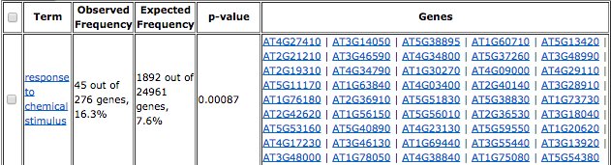
GO-Term Best predicted Genes (Scores 7-9) – NLP as Predictors

Slide 13
BINDING SITES BEST PREDICTED GENES BY NLP
DPBF1&2 binding site
E2F binding site
E2F/DP BS in AtCDC6
ABRE-like binding site
MYB4
SORLIP1
CArG promoter
MYB binding site promoter
ABRE binding site
(Top 10 known motifs in the promoters of best predicted genes)

Slide 14
10 TFs of basic BZIP Family as Predictors
TERM | Num | % Correct Signs using title Fam as Predictors | Pvalue | Pvalue Trend Forecast | Pvalue Inv Trend Forecast
C2C2_DOF | 5 | 0.76 | 0.01 | 0.04 | 0.004
AP2-EREBP TRANSCRIPTION FACTOR FAMILY | 16 | 0.62 | 0.02 | 0.17 | 0.004
NLP TRANSCRIPTION FACTOR FAMILY | 7 | 0.43 | 0.67 | 0.84 | 0.51
BASIC REGION LEUCINE ZIPPER (BZIP) TRANSCRIPTION FACTOR | 10 | 0.46 | 0.59 | 0.83 | 0.40
TGA3-LIKE | 3 | 0.48 | 0.55 | 0.69 | 0.43
AS2 - LATERAL ORGAN BOUNDARIES | 4 | 0.14 | 0.99 | 0.99 | 0.98
MYB | 4 | 0.64 | 0.11 | 0.24 | 0.06
All N-resp relevant Families Together (includes also 1 gene Rav fam) | 54 | 0.50 | 0.35 | 0.90 | 0.05
BHLH | 6 | 0.54 | 0.36 | 0.57 | 0.22
C2C2_CO | 5 | 0.38 | 0.77 | 0.89 | 0.65
C2C2_GATA | 6 | 0.54 | 0.35 | 0.57 | 0.22
C2H2 | 14 | 0.51 | 0.36 | 0.67 | 0.17
Homeobox | 10 | 0.47 | 0.55 | 0.80 | 0.35
NAC | 7 | 0.43 | 0.66 | 0.84 | 0.5
G2-LIKE TRANSCRIPTION FACTOR FAMILY | 12 | 0.46 | 0.58 | 0.83 | 0.36
Notes:
This genes are about 100 in total
-- no Significant term found in Best Predicted Genes with 7 – 9 scores

Slide 15
GO-Term Best predicted Genes (Scores 7-9) – 10 TFs of Bzip as Predictors
No Significant term found in Best Predicted Genes (with 7 – 9 scores)

Slide 16
BINDING SITES BEST PREDICTED GENES BY BZIP
SORLIP1
SORLIP2
DPBF1&2 binding site
G-box promoter
CArG promoter
ABRE-like binding site
ABRE binding site
E2F binding site
E2F/DP BS in AtCDC6
(Top 10 known motifs in the promoters of best predicted genes)

Slide 17
4 TFs of AS2 Family as Predictors
TERM | Num | % Correct Signs using AS2 Fam as Predictors | Pvalue | Pvalue Trend Forecast | Pvalue Inv Trend Forecast
C2C2_GATA | 6 | 0.80 | 0.002 | 0.02 | 0.001
NAC | 7 | 0.68 | 0.01 | 0.1 | 0.008
Homeobox | 10 | 0.63 | 0.03 | 0.19 | 0.02
BASIC REGION LEUCINE ZIPPER (BZIP) TRANSCRIPTION FACTOR | 10 | 0.63 | 0.04 | 0.19 | 0.01
AP2-EREBP TRANSCRIPTION FACTOR FAMILY | 16 | 0.61 | 0.02 | 0.21 | 0.008
C2H2 | 14 | 0.61 | 0.03 | 0.23 | 0.013
MYB | 4 | 0.56 | 0.25 | 0.44 | 0.18
All N-resp relevant Families Together (includes also 1 gene Rav fam) | 54 | 0.53 | 0.07 | 0.71 | 0.01
BHLH | 6 | 0.39 | 0.73 | 0.89 | 0.62
C2C2_CO | 5 | 0.38 | 0.73 | 0.89 | 0.64
C2C2_DOF | 5 | 0.53 | 0.34 | 0.58 | 0.26
G2-LIKE TRANSCRIPTION FACTOR FAMILY | 12 | 0.44 | 0.64 | 0.90 | 0.48
AS2 - LATERAL ORGAN BOUNDARIES | 4 | 0.5 | 0.39 | 0.60 | 0.30
NLP TRANSCRIPTION FACTOR FAMILY | 7 | 0.27 | 0.96 | 0.99 | 0.93
TGA3-LIKE | 3 | 0.70 | 0.06 | 0.15 | 0.04
Notes:
This genes are about 100 in total

Slide 18
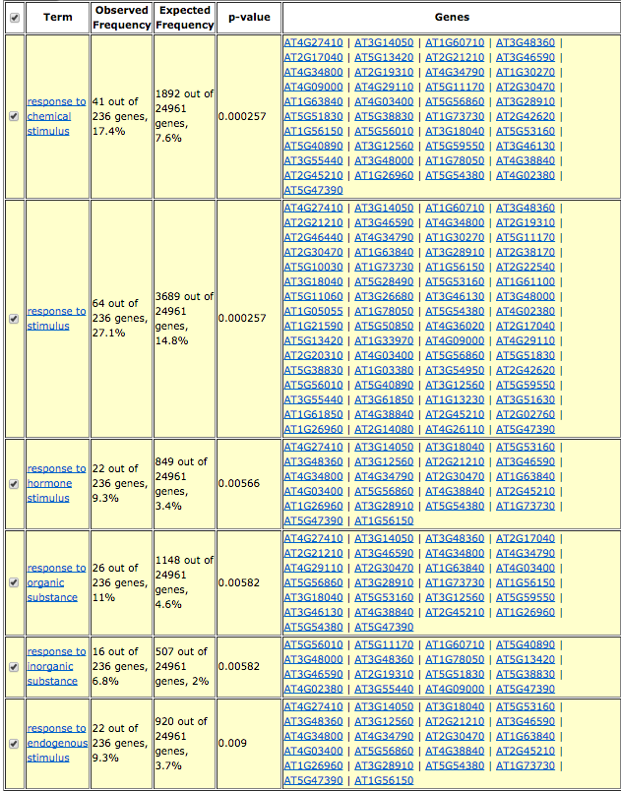
GO-Term Best predicted Genes (Scores 7-9) – AS2 as Predictors

Slide 19
BINDING SITES BEST PREDICTED GENES BY AS2
DPBF1&2 binding site
GATA promoter
ABRE-like binding site
G-box promoter
MYB4
SORLIP1
Ibox promoter
CArG
Octamer promoter
(Top 10 known motifs in the promoters of best predicted genes)

Slide 20
4 TFs of MYB Family as Predictors
TERM | Num | % Correct Signs using title Fam as Predictors | Pvalue | Pvalue Trend Forecast | Pvalue Inv Trend Forecast
Homeobox | 10 | 0.64 | 0.02 | 0.13 | 0.009
TGA3-LIKE | 3 | 0.81 | 0.01 | 0.04 | 0.006
NLP TRANSCRIPTION FACTOR FAMILY | 7 | 0.32 | 0.89 | 0.98 | 0.88
BASIC REGION LEUCINE ZIPPER (BZIP) TRANSCRIPTION FACTOR | 10 | 0.5 | 0.30 | 0.68 | 0.24
AP2-EREBP TRANSCRIPTION FACTOR FAMILY | 16 | 0.53 | 0.15 | 0.60 | 0.09
AS2 - LATERAL ORGAN BOUNDARIES | 4 | 0.14 | 0.97 | 0.99 | 0.97
MYB | 4 | 0.39 | 0.63 | 0.84 | 0.59
All N-resp relevant Families Together (includes also 1 gene Rav fam) | 54 | 0.44 | 0.60 | 0.99 | 0.45
BHLH | 6 | 0.56 | 0.18 | 0.45 | 0.14
C2C2_CO | 5 | 0.38 | 0.67 | 0.89 | 0.64
C2C2_DOF | 5 | 0.58 | 0.16 | 0.38 | 0.12
C2C2_GATA | 6 | 0.54 | 0.27 | 0.57 | 0.23
C2H2 | 14 | 0.53 | 0.19 | 0.62 | 0.12
G2-LIKE TRANSCRIPTION FACTOR FAMILY | 12 | 0.5 | 0.29 | 0.69 | 0.21
NAC | 7 | 0.38 | 0.71 | 0.92 | 0.68
Notes:
This genes are about 100 in total
-- no Significant term found in Best Predicted Genes with 7 – 9 scores

Slide 21
GO-Term Best predicted Genes (Scores 7-9) – 4 TFs of MYB as Predictors
No Significant term found in Best Predicted Genes (with 7 – 9 scores)

Slide 22
BINDING SITES BEST PREDICTED GENES BY MYB
SORLIP1
MYB4
SORLIP2
MYB binding site
GATA
DPBF1&2 binding site
ABRE-like binding site
E2F
E2F/DP BS in AtCDC6
ATHB1
(Top 10 known motifs in the promoters of best predicted genes)

Slide 23
All Important TFs Families as Predictors
TERM | Num | % Correct Signs using title Fam as Predictors | Pvalue | Pvalue Trend Forecast | Pvalue Inv Trend Forecast
AS2 - LATERAL ORGAN BOUNDARIES | 4 | 0.78 | 0.009 | 0.04 | 0.005
C2C2_GATA | 6 | 0.67 | 0.03 | 0.14 | 0.02
NAC | 7 | 0.65 | 0.03 | 0.16 | 0.02
BASIC REGION LEUCINE ZIPPER (BZIP) TRANSCRIPTION FACTOR | 10 | 0.6 | 0.05 | 0.27 | 0.03
Homeobox | 10 | 0.61 | 0.05 | 0.27 | 0.03
TGA3-LIKE | 3 | 0.44 | 0.58 | 0.75 | 0.52
MYB | 4 | 0.06 | 0.99 | 0.99 | 0.99
All N-resp relevant Families Together (includes also 1 gene Rav fam) | 54 | 0.5 | 0.15 | 0.90 | 0.05
BHLH | 6 | 0.56 | 0.19 | 0.45 | 0.15
C2C2_CO | 5 | 0.44 | 0.58 | 0.80 | 0.52
C2C2_DOF | 5 | 0.49 | 0.38 | 0.65 | 0.31
NLP TRANSCRIPTION FACTOR FAMILY | 7 | 0.32 | 0.92 | 0.98 | 0.87
C2H2 | 14 | 0.5 | 0.29 | 0.72 | 0.20
G2-LIKE TRANSCRIPTION FACTOR FAMILY | 12 | 0.57 | 0.09 | 0.40 | 0.05
AP2-EREBP TRANSCRIPTION FACTOR FAMILY | 16 | 0.49 | 0.37 | 0.82 | 0.27
Notes:
This genes are about 100 in total

Slide 24
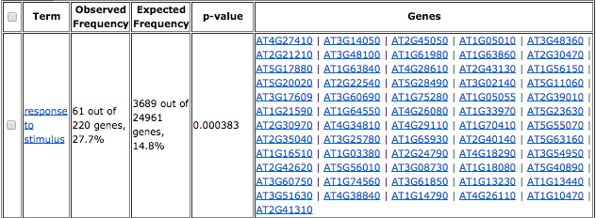
GO-Term Best predicted Genes (Scores 7-9) – All Important Fams as Predictors

Slide 25
BINDING SITES BEST PREDICTED GENES BY AllImpTFs
ABRE
DPBF1&2 binding site
G-box
ABRE
SORLIP1
ABFs binding site
SORLIP2
CBF2 binding site
GBF1/2/3 BS in ADH1
GATA
(Top 10 known motifs in the promoters of best predicted genes)

Slide 26
6 TFs of BHLH Family as Predictors
TERM | Num | % Correct Signs using title Fam as Predictors | Pvalue | Pvalue Trend Forecast | Pvalue Inv Trend Forecast
C2C2_GATA | 6 | 0.74 | 0.004 | 0.04 | 0.002
C2H2 | 14 | 0.66 | 0.001 | 0.06 | 0.001
BASIC REGION LEUCINE ZIPPER (BZIP) TRANSCRIPTION FACTOR | 10 | 0.63 | 0.01 | 0.20 | 0.01
C2C2_DOF | 5 | 0.69 | 0.01 | 0.12 | 0.02
G2-LIKE TRANSCRIPTION FACTOR FAMILY | 12 | 0.39 | 0.6 | 0.97 | 0.70
AS2 - LATERAL ORGAN BOUNDARIES | 4 | 0.31 | 0.72 | 0.94 | 0.79
MYB | 4 | 0.42 | 0.45 | 0.79 | 0.52
All N-resp relevant Families Together (includes also 1 gene Rav fam) | 54 | 0.47 | 0.09 | 0.97 | 0.20
BHLH | 6 | 0.44 | 0.43 | 0.82 | 0.51
C2C2_CO | 5 | 0.40 | 0.5 | 0.85 | 0.58
AP2-EREBP TRANSCRIPTION FACTOR FAMILY | 16 | 0.55 | 0.04 | 0.53 | 0.06
NLP TRANSCRIPTION FACTOR FAMILY | 7 | 0.27 | 0.88 | 0.99 | 0.93
TGA3-LIKE | 3 | 0.59 | 0.14 | 0.35 | 0.15
Homeobox | 10 | 0.57 | 0.05 | 0.40 | 0.07
NAC | 7 | 0.54 | 0.13 | 0.50 | 0.16
Notes:
This genes are about 100 in total
-- no Significant term found in Best Predicted Genes with 7 – 9 scores

Slide 27
GO-Term Best predicted Genes (Scores 7-9) – 6 TFs of BHLH as Predictors
No Significant term found in Best Predicted Genes (with 7 – 9 scores)

Slide 28
BINDING SITES BEST PREDICTED GENES BY BHLH
DPBF1&2 binding site
MYB4
G-box
ABRE
DRE
MYB
CArG
SORLIP1
SORLIP5
Boxll promoter
(Top 10 known motifs in the promoters of best predicted genes)

Slide 29
5 TFs of C2C2-CO Family as Predictors
TERM | Num | % Correct Signs using title Fam as Predictors | Pvalue | Pvalue Trend Forecast | Pvalue Inv Trend Forecast
BASIC REGION LEUCINE ZIPPER (BZIP) TRANSCRIPTION FACTOR | 10 | 0.80 | 0.0002 | 0.001 | 0.00001
Homeobox | 10 | 0.67 | 0.0097 | 0.09 | 0.004
C2C2_DOF | 5 | 0.71 | 0.03 | 0.12 | 0.02
C2C2_GATA | 6 | 0.68 | 0.03 | 0.14 | 0.02
TGA3-LIKE | 3 | 0.81 | 0.01 | 0.04 | 0.006
AS2 - LATERAL ORGAN BOUNDARIES | 4 | 0.67 | 0.06 | 0.18 | 0.04
MYB | 4 | 0.44 | 0.57 | 0.79 | 0.52
All N-resp relevant Families Together (includes also 1 gene Rav fam) | 54 | 0.51 | 0.07 | 0.82 | 0.02
BHLH | 6 | 0.46 | 0.44 | 0.74 | 0.39
C2C2_CO | 5 | 0.44 | 0.56 | 0.81 | 0.50
G2-LIKE TRANSCRIPTION FACTOR FAMILY | 12 | 0.43 | 0.61 | 0.92 | 0.54
AP2-EREBP TRANSCRIPTION FACTOR FAMILY | 16 | 0.46 | 0.51 | 0.90 | 0.41
C2H2 | 14 | 0.56 | 0.07 | 0.41 | 0.04
NLP TRANSCRIPTION FACTOR FAMILY | 7 | 0.38 | 0.72 | 0.93 | 0.67
NAC | 7 | 0.44 | 0.57 | 0.84 | 0.51
Notes:
This genes are about 100 in total
-- no Significant term found in Best Predicted Genes with 7 – 9 scores

Slide 30
GO-Term Best predicted Genes (Scores 7-9) – 5 TFs of C2C2-CO as Predictors
No Significant term found in Best Predicted Genes (with 7 – 9 scores)

Slide 31
BINDING SITES BEST PREDICTED GENES BY C2C2_CO
GATA promoter
DPBF1&2 binding site
E2F binding site
E2F/DP BS in AtCDC6
SORLIP2
MYB4
SORLIP1
G-box
ABRE-like
octamer
(Top 10 known motifs in the promoters of best predicted genes)

Slide 32
5 TFs of C2C2-DOF Family as Predictors
TERM | Num | % Correct Signs using title Fam as Predictors | Pvalue | Pvalue Trend Forecast | Pvalue Inv Trend Forecast
Homeobox | 10 | 0.72 | 0.01 | 0.03 | 0.0007
C2H2 | 14 | 0.66 | 0.01 | 0.06 | 0.002
C2C2_DOF | 5 | 0.73 | 0.04 | 0.09 | 0.01
BASIC REGION LEUCINE ZIPPER (BZIP) TRANSCRIPTION FACTOR | 10 | 0.56 | 0.27 | 0.45 | 0.08
TGA3-LIKE | 3 | 0.70 | 0.10 | 0.15 | 0.04
AS2 - LATERAL ORGAN BOUNDARIES | 4 | 0.67 | 0.11 | 0.18 | 0.04
MYB | 4 | 0.64 | 0.16 | 0.23 | 0.07
All N-resp relevant Families Together (includes also 1 gene Rav fam) | 54 | 0.54 | 0.22 | 0.63 | 0.004
BHLH | 6 | 0.52 | 0.43 | 0.57 | 0.22
C2C2_CO | 5 | 0.38 | 0.8 | 0.89 | 0.63
NLP TRANSCRIPTION FACTOR FAMILY | 7 | 0.49 | 0.57 | 0.72 | 0.33
C2C2_GATA | 6 | 0.68 | 0.07 | 0.14 | 0.02
G2-LIKE TRANSCRIPTION FACTOR FAMILY | 12 | 0.48 | 0.62 | 0.80 | 0.32
AP2-EREBP TRANSCRIPTION FACTOR FAMILY | 16 | 0.56 | 0.23 | 0.44 | 0.04
NAC | 7 | 0.46 | 0.6 | 0.81 | 0.44
Notes:
This genes are about 100 in total

Slide 33
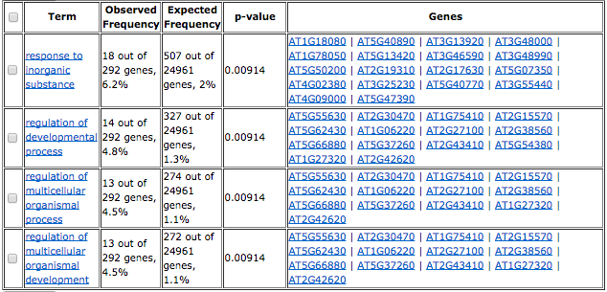
GO-Term Best predicted Genes (Scores 7-9) – C2C2-DOF as Predictors

Slide 34
BINDING SITES BEST PREDICTED GENES BY C2C2_DOF
SORLIP1
MYB4
CArG
DPBF1&2 binding site
EveningElement promoter
SORLIP2
W-box promoter
AG BS in SUP
AP1 BS in SUP
ABRE binding site
(Top 10 known motifs in the promoters of best predicted genes)

Slide 35
6 TFs of C2C2-GATA Family as Predictors
TERM | Num | % Correct Signs using title Fam as Predictors | Pvalue | Pvalue Trend Forecast | Pvalue Inv Trend Forecast
C2C2_GATA | 6 | 0.80 | 0.001 | 0.01 | 0.0007
Homeobox | 10 | 0.66 | 0.007 | 0.11 | 0.006
NLP TRANSCRIPTION FACTOR FAMILY | 7 | 0.27 | 0.92 | 0.99 | 0.93
BASIC REGION LEUCINE ZIPPER (BZIP) TRANSCRIPTION FACTOR | 10 | 0.5 | 0.24 | 0.68 | 0.23
TGA3-LIKE | 3 | 0.70 | 0.05 | 0.15 | 0.04
AS2 - LATERAL ORGAN BOUNDARIES | 4 | 0.31 | 0.78 | 0.94 | 0.79
MYB | 4 | 0.56 | 0.19 | 0.45 | 0.19
All N-resp relevant Families Together (includes also 1 gene Rav fam) | 54 | 0.48 | 0.12 | 0.95 | 0.11
BHLH | 6 | 0.28 | 0.89 | 0.98 | 0.89
C2C2_CO | 5 | 0.6 | 0.10 | 0.33 | 0.09
C2C2_DOF | 5 | 0.49 | 0.31 | 0.64 | 0.31
G2-LIKE TRANSCRIPTION FACTOR FAMILY | 12 | 0.45 | 0.41 | 0.86 | 0.40
C2H2 | 14 | 0.59 | 0.02 | 0.30 | 0.02
AP2-EREBP TRANSCRIPTION FACTOR FAMILY | 16 | 0.59 | 0.01 | 0.27 | 0.01
NAC | 7 | 0.54 | 0.16 | 0.50 | 0.15
Notes:
This genes are about 100 in total
-- no Significant term found in Best Predicted Genes with 7 – 9 scores

Slide 36
GO-Term Best predicted Genes (Scores 7-9) – 6 TFs of C2C2-GATA as Predictors
No Significant term found in Best Predicted Genes (with 7 – 9 scores)

Slide 37
BINDING SITES BEST PREDICTED GENES BY C2C2-GATA
GATA promoter
MYB4
SORLIP1
DPBF1&2 binding site
ABRE-like binding site
G-box
SORLIP2
MYB
lbox promoter
W-box promoter
(Top 10 known motifs in the promoters of best predicted genes)

Slide 38
14 TFs of C2H2 Family as Predictors
TERM | Num | % Correct Signs using title Fam as Predictors | Pvalue | Pvalue Trend Forecast | Pvalue Inv Trend Forecast
Homeobox | 10 | 0.74 | 0.002 | 0.01 | 0.0001
C2C2_GATA | 6 | 0.89 | 0.0001 | 0.0005 | 0.0001
NLP TRANSCRIPTION FACTOR FAMILY | 7 | 0.51 | 0.43 | 0.61 | 0.24
BASIC REGION LEUCINE ZIPPER (BZIP) TRANSCRIPTION FACTOR | 10 | 0.52 | 0.42 | 0.63 | 0.19
TGA3-LIKE | 3 | 0.59 | 0.26 | 0.36 | 0.16
AS2 - LATERAL ORGAN BOUNDARIES | 4 | 0.69 | 0.11 | 0.18 | 0.04
MYB | 4 | 0.56 | 0.32 | 0.44 | 0.18
All N-resp relevant Families Together (includes also 1 gene Rav fam) | 54 | 0.57 | 0.04 | 0.32 | 0.0004
BHLH | 6 | 0.39 | 0.78 | 0.89 | 0.63
C2C2_CO | 5 | 0.51 | 0.48 | 0.65 | 0.32
C2C2_DOF | 5 | 0.49 | 0.49 | 0.65 | 0.31
G2-LIKE TRANSCRIPTION FACTOR FAMILY | 12 | 0.53 | 0.34 | 0.58 | 0.13
C2H2 | 14 | 0.62 | 0.07 | 0.20 | 0.01
AP2-EREBP TRANSCRIPTION FACTOR FAMILY | 16 | 0.6 | 0.06 | 0.21 | 0.006
NAC | 7 | 0.67 | 0.06 | 0.12 | 0.01
Notes:
This genes are about 100 in total

Slide 39
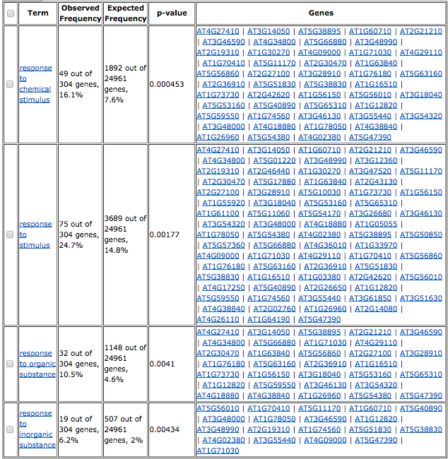
GO-Term Best predicted Genes (Scores 7-9) – C2H2 as Predictors

Slide 40
BINDING SITES BEST PREDICTED GENES BY C2H2
GATA promoter
MYB4
DPBF1&2 binding site
ABRE-like binding site
lbox promoter
MYB binding site
G-box promoter
SORLIP2
ABRE binding site
Octamer promoter
(Top 10 known motifs in the promoters of best predicted genes)

Slide 41
10 TFs of Homeobox Family as Predictors
TERM | Num | % Correct Signs using title Fam as Predictors | Pvalue | Pvalue Trend Forecast | Pvalue Inv Trend Forecast
C2H2 | 14 | 0.63 | 0.003 | 0.004 | 0.12
C2C2_GATA | 6 | 0.67 | 0.01 | 0.02 | 0.14
Homeobox | 10 | 0.62 | 0.01 | 0.02 | 0.23
BASIC REGION LEUCINE ZIPPER (BZIP) TRANSCRIPTION FACTOR | 10 | 0.56 | 0.06 | 0.09 | 0.45
TGA3-LIKE | 3 | 0.59 | 0.14 | 0.15 | 0.36
AS2 - LATERAL ORGAN BOUNDARIES | 4 | 0.33 | 0.76 | 0.79 | 0.94
MYB | 4 | 0.58 | 0.16 | 0.18 | 0.45
All N-resp relevant Families Together (includes also 1 gene Rav fam) | 54 | 0.46 | 0.14 | 0.25 | 0.98
BHLH | 6 | 0.52 | 0.19 | 0.22 | 0.57
C2C2_CO | 5 | 0.31 | 0.82 | 0.85 | 0.97
C2C2_DOF | 5 | 0.51 | 0.27 | 0.31 | 0.65
G2-LIKE TRANSCRIPTION FACTOR FAMILY | 12 | 0.43 | 0.46 | 0.53 | 0.92
AP2-EREBP TRANSCRIPTION FACTOR FAMILY | 16 | 0.51 | 0.10 | 0.13 | 0.67
NLP TRANSCRIPTION FACTOR FAMILY | 7 | 0.27 | 0.9 | 0.93 | 0.99
NAC | 7 | 0.29 | 0.88 | 0.90 | 0.98
Notes:
This genes are about 100 in total
-- no Significant term found in Best Predicted Genes with 7 – 9 scores

Slide 42
GO-Term Best predicted Genes (Scores 7-9) – 10 TFs of Homeobox as Predictors
No Significant term found in Best Predicted Genes (with 7 – 9 scores)

Slide 43
BINDING SITES BEST PREDICTED GENES BY Homeobox
GATA promoter
MYB4
SORLIP1
SORLIP2
DPBF1&2 binding site
G-box promoter
E2F binding site
E2F/DP BS in AtCDC6
HSEs binding site motif
ATHB5
(Top 10 known motifs in the promoters of best predicted genes)

Slide 44
7 TFs of NAC Family as Predictors
TERM | Num | % Correct Signs using title Fam as Predictors | Pvalue | Pvalue Trend Forecast | Pvalue Inv Trend Forecast
Homeobox | 10 | 0.76 | 0.0009 | 0.0002 | 0.009
C2H2 | 14 | 0.63 | 0.01 | 0.004 | 0.12
C2C2_GATA | 6 | 0.67 | 0.04 | 0.01 | 0.15
BASIC REGION LEUCINE ZIPPER (BZIP) TRANSCRIPTION FACTOR | 10 | 0.52 | 0.3 | 0.19 | 0.64
TGA3-LIKE | 3 | 0.56 | 0.27 | 0.21 | 0.44
AS2 - LATERAL ORGAN BOUNDARIES | 4 | 0.22 | 0.96 | 0.94 | 0.99
MYB | 4 | 0.47 | 0.51 | 0.44 | 0.73
All N-resp relevant Families Together (includes also 1 gene Rav fam) | 54 | 0.45 | 0.61 | 0.33 | 0.99
BHLH | 6 | 0.5 | 0.36 | 0.27 | 0.62
C2C2_CO | 5 | 0.44 | 0.6 | 0.51 | 0.81
C2C2_DOF | 5 | 0.58 | 0.18 | 0.12 | 0.38
G2-LIKE TRANSCRIPTION FACTOR FAMILY | 12 | 0.39 | 0.8 | 0.71 | 0.96
AP2-EREBP TRANSCRIPTION FACTOR FAMILY | 16 | 0.56 | 0.1 | 0.04 | 0.45
NLP TRANSCRIPTION FACTOR FAMILY | 7 | 0.36 | 0.83 | 0.77 | 0.96
NAC | 7 | 0.52 | 0.29 | 0.19 | 0.56
Notes:
This genes are about 100 in total

Slide 45
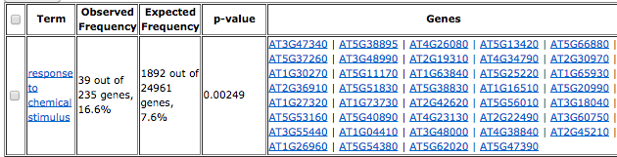
GO-Term Best predicted Genes (Scores 7-9) – NAC as Predictors

Slide 46
BINDING SITES BEST PREDICTED GENES BY NAC
GATA promoter
SORLIP2
MYB4
ABRE-like binding site
SORLIP1
DPBF1&2 binding site
E2F binding site
E2F/DP BS in AtCDc6
lbox promoter
CArG promoter
(Top 10 known motifs in the promoters of best predicted genes)

Slide 47
Motifs that are in common and from which family
Table showing Motif, families that predicted it.

Slide 48
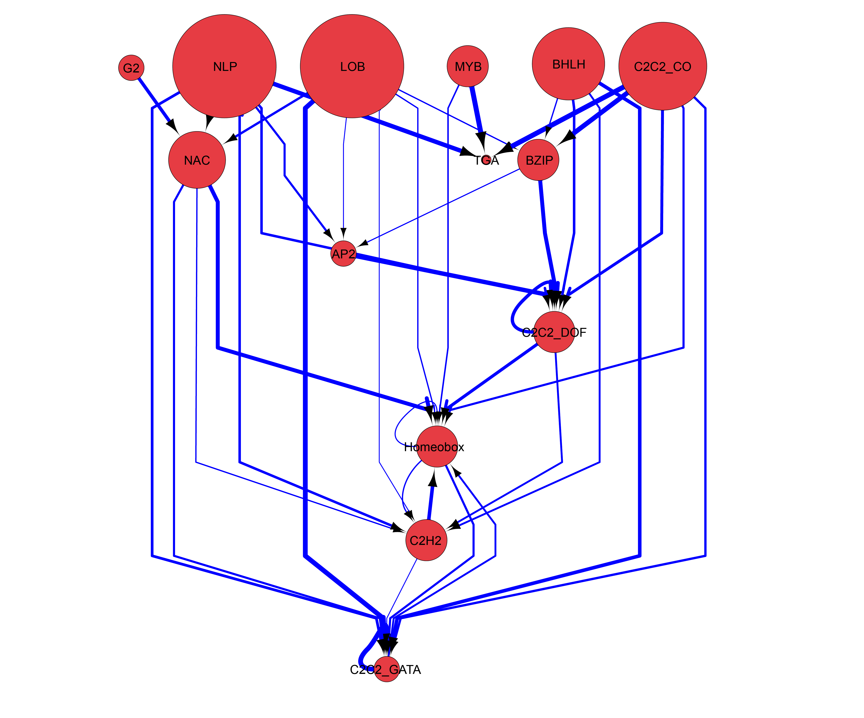
Summary

Slide 49
TERM | Num | Trend Forecast | Pvalue no better than Trend | Inv Trend Forecast | Pvalue no better than Inv Trend
G2-LIKE TRANSCRIPTION FACTOR FAMILY | 12 | 0.53 | 0.59 | 0.45 | 0.40
AP2-EREBP TRANSCRIPTION FACTOR FAMILY | 16 | 0.40 | 0.98 | 0.59 | 0.02
NLP TRANSCRIPTION FACTOR FAMILY | 7 | 0.73 | 0.04 | 0.27 | 0.93
BASIC REGION LEUCINE ZIPPER (BZIP) TRANSCRIPTION FACTOR | 10 | 0.42 | 0.91 | 0.57 | 0.07
TGA3-LIKE | 3 | 0.30 | 0.92 | 0.67 | 0.07
AS2 - LATERAL ORGAN BOUNDARIES | 4 | 0.81 | 0.03 | 0.19 | 0.95
MYB | 4 | 0.53 | 0.52 | 0.47 | 0.37
All N-resp relevant Families Together (includes also 1 gene Rav fam) | 54 | 0.51 | 0.86 | 0.48 | 0.13
BHLH | 6 | 0.50 | 0.64 | 0.50 | 0.27
C2C2_CO | 5 | 0.60 | 0.33 | 0.38 | 0.65
C2C2_DOF | 5 | 0.51 | 0.59 | 0.49 | 0.33
C2C2_GATA | 6 | 0.28 | 0.99 | 0.72 | 0.006
C2H2 | 14 | 0.32 | 0.99 | 0.67 | 0.0006
Homeobox | 10 | 0.31 | 0.99 | 0.69 | 0.002
NAC | 7 | 0.51 | 0.63 | 0.46 | 0.4

Slide 50
Conclusion
TrendForecasting is never better than families
All TFs as Predictors is never better than families

