Slide 1
NYU WIRELESS
World’s First Research Center with ECE, CS, and MEDICINE
For more information contact: Prof. Ted Rappaport - tsr@nyu.edu

Slide 2
NYU WIRELESS Mission and Expertise
EXCITING NEW START UP: 24 faculty and 100 students across NYU solving
problems for industry, creating research leaders, and developing fundamental knowledge and new applications using wireless technologies
  NYU-Poly (Electrical and Computer engineering)
  NYU Courant Institute (Computer Science)
  NYU School of Medicine (Radiology)
NYU WIRELESS faculty possess a diverse set of knowledge and expertise:
  Communications (DSP, Networks, RF/Microwave, Chips)
  Medical applications (RF coil design, MRI, Compressed sensing)
  Computing (Graphics, Data mining, Algorithms, Scientific computing)
Current in-force funding:
  ~ $9 Million/annually from NSF, NIH, and Companies

Slide 3
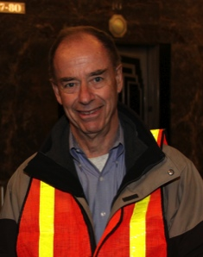
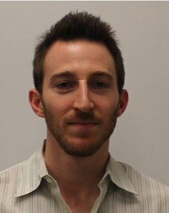
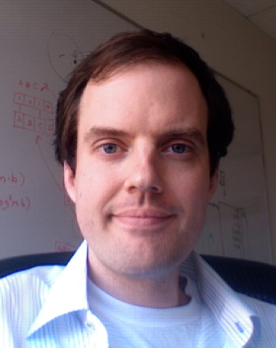
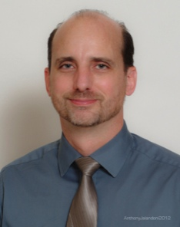
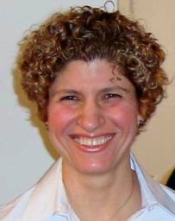
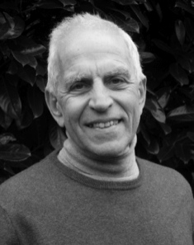
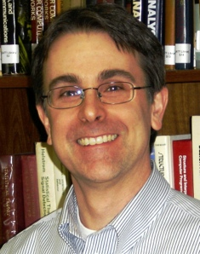
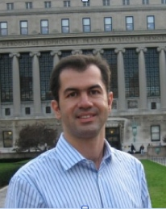
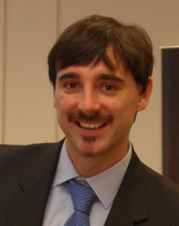
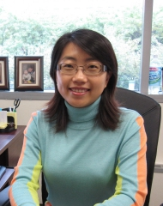
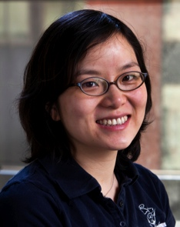
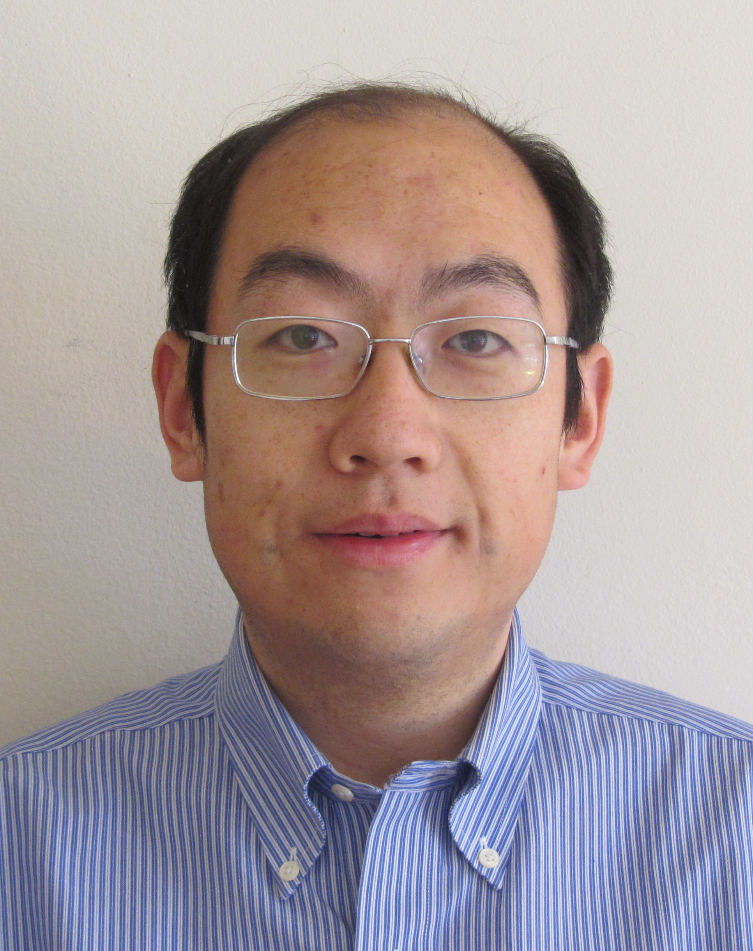
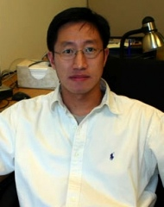
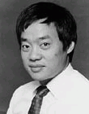
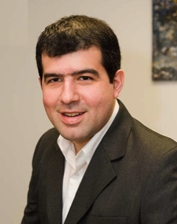
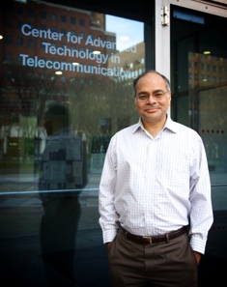
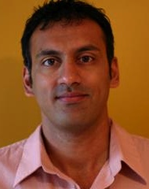
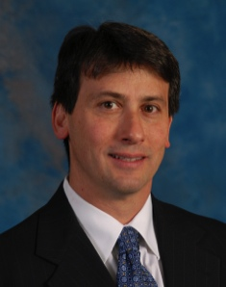
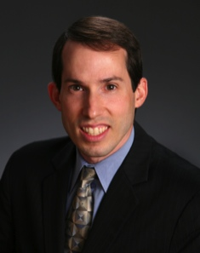
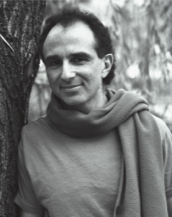
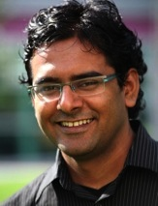
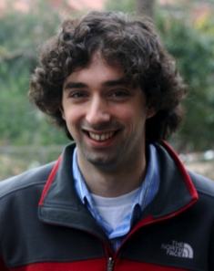
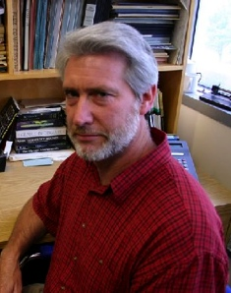
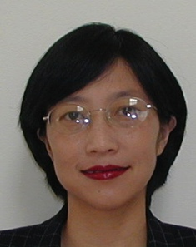
NYU WIRELESS Faculty
Henry Bertoni
Radio Channels
POLY
Ryan Brown
RF Coils/Imaging
NYUMC
Justin Cappos
Systems Security
POLY
Christopher Collins
MRI Imaging
NYUMC
Elza Erkip
Communications
POLY
David Goodman
Communications
POLY
Mike Knox
RF/Microwaves
POLY
Thanasis Korakis
Wireless Networks
POLY
Ricardo Lattanzi
MRI Optimization
NYUMC
Helen Li
Circuit Design
POLY
Jinyang Li
Networks
COURANT
Pei Liu
Wireless Networks
POLY
Yong Liu
Networks
POLY
I-Tai Lu
Electromagnetics
POLY
Ricardo Otazo
MRI Imaging
NYUMC
Shivendra Panwar
Cross-layer Design
POLY
Sundeep Rangan
Communications
POLY
Ted Rappaport
Communications
POLY
Dan Sodickson
RF/ MRI Design
NYUMC
Dennis Shasha
Algorithms/Data
COURANT
Lakshmi Subramanian
Computing
COURANT
Jonathan Viventi
Medical Electronic
POLY
Peter Voltz
DSP/Comms.
POLY
Yao Wang
Image/Video
POLY

Slide 4





NYU WIRELESS Industry Affiliates
Legacy WICAT Industry Sponsors:

Slide 5
About NYU
New York University
One of the largest and oldest private universities in the USA (1831)
Origins in Telecom: Samuel Morse (Morse Code) first faculty member
Pioneering the Global Network University w/campuses in Abu Dhabi, Shanghai, Toronto, Buenos Aires, and 18 other countries
Faculty have received 34 Nobel Prizes, 16 Pulitzer Prizes, 21 Academy Awards, 10 National of Science Medals
New focus in Engineering for the Urban, Telecom, Bio-Med future
NYU is ranked #33 in 2012 USNWR National University Ranking
    (GA Tech is 36, UT Austin is 45)

Slide 6
About NYU Poly
Polytechnic Institute of NYU
  2nd oldest private engineering university in the USA
  Lead Institution for NSF I/UCRC Wireless Internet Center for Advanced Technology (WICAT)
    Top-ranked I/UCRC center within NSF
    Other universities include UT Austin, VA Tech, UVA, Auburn
    Strong wireless faculty base: 14 faculty in ECE and CSE focusing on wireless and wireless applications
  NYU’s Electrical Engineering is moving up quickly in the ranks
  Students are hungry to work with industry, prove their worth

Slide 7
About NYU School of Medicine
NYU School of Medicine / NYU Langone Medical Center
  Top 10 in the US and #1 in New York for clinical research
  World-class patient-centered integrated academic medical center in Healthcare, biomedical research (http://www.med.nyu.edu/about-us)
  Approximately $250,000,000 /yr. in research grants (mainly NIH)
  Department of Radiology is global leader in RF engineering and technology development for biomedical imaging, MRI
  Department of Surgery desires wireless solutions

Slide 8
About NYU Courant
NYU Courant Institute of Mathematical Sciences
  The Courant Institute of Mathematical Sciences is ranked #1 in applied mathematical research, #5 in citation impact worldwide, and #12 in citation worldwide.
  Computer Science program has top-ranked computer graphics rendering, game development, video recognition programs.

Slide 9
SAMPLE RESEARCH PROJECTS AT NYU WIRELESS
Interdisciplinary across NYU
Creating a new kind of student
Vast opportunities for Industry
NYU is uniquely positioned to change the world – and we are!

Slide 10
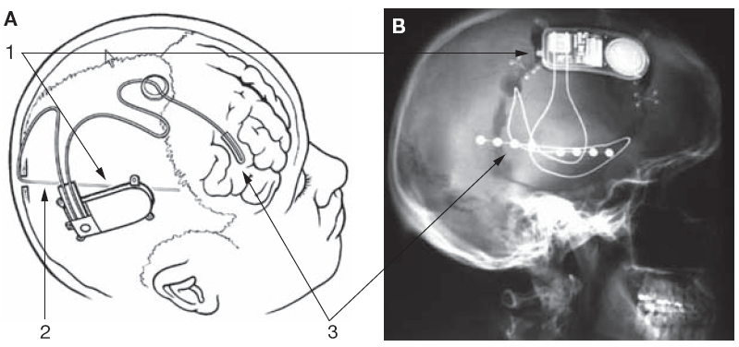
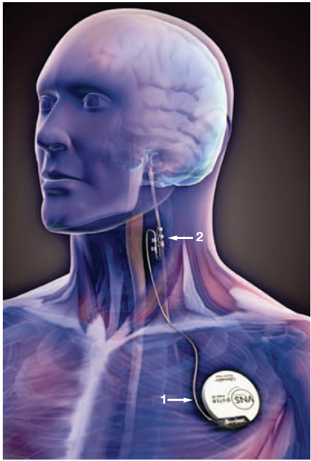
Implantable Devices for Medicine
Implantable devices have evolved
Electrodes have not improved
NeuroPace Responsive Neurostimulator (RNS®)
Vagus Nerve Stimulator
Cyberonics, Inc.
Notes:
Challenge
- more intelligent implantable devices,
better processors,
longer battery life,
better wireless
More storage
- algorithmic improvement
What hasn’t changed?
- electrode tissue interface
Despite developments in basic science that illustrate how flawed these interface devices are
Set out to develop a new generation of electrode tissue interface devices
Though about what kind of devices we need

Slide 11
“State of the Art” Clinical Electrode Arrays
Large contacts
Spaced 1 cm apart
1 Electrode interfaces with ~12M neurons!
Very poor spatial resolution
Need 1,000s of electrodes, but not 1,000s of wires
1 cm
12 Million Neurons → 1 Electrode
Notes:
One example,
- technology used for Evaluating patients prior to Epilepsy surgery
scalp EEG has poor spatial resolution
Electrodes are 3-4 mm in diameter, 1 cm apart, covering 8 cm x 8 cm
- however, 12 M neurons!
- helicopter analogy??
Need to measure from small groups of neurons, 1000s, 10s thousands
Transition to Utah array
Wiring!!!

Slide 12
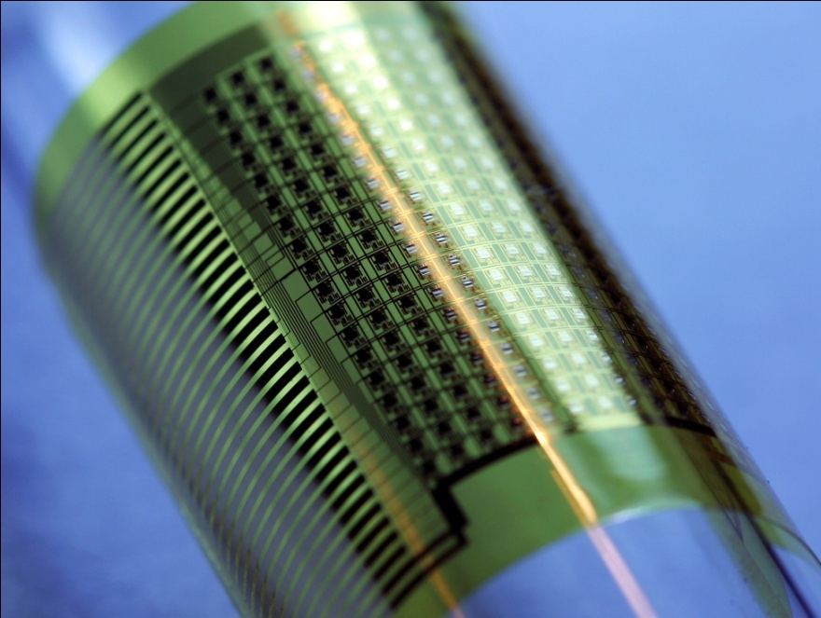
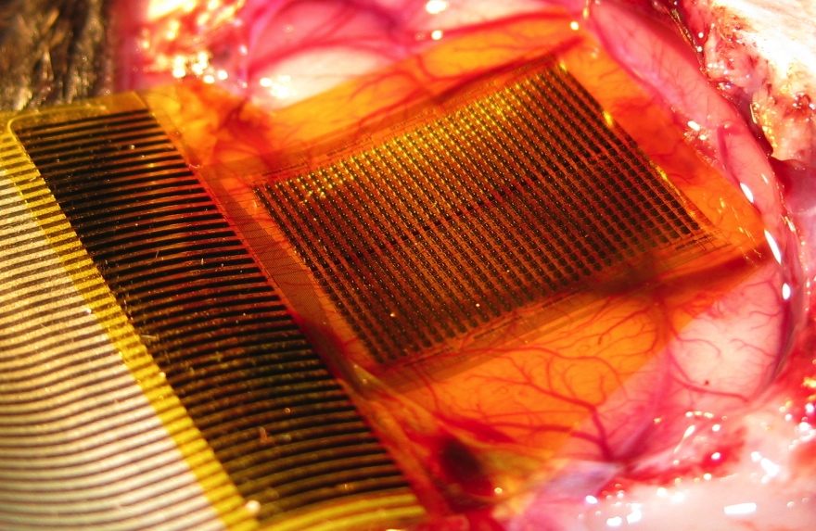
Flexible Silicon Electronics to Improve Electrode Arrays in the Body
Conformal to Brain
  25 µm thickness
  2.8 µm using biodegradable silk
High spatial resolution
  1024 Active Electrodes
  250 µm spacing
High temporal resolution
  Up to 12.5 kHz sampling
Multiplexing & Amplification
  ~40 wires
  Amplifier at each electrode
Scalable
  1000s of electrodes
  Fewer wires
288 (16×18) Sensor Array
1 mm
Viventi, J., Kim, D-H. et al. Science Translational Medicine 2, 24ra22 (2010).
Notes:
Want mm resolution over large areas of the brain, → requiring thousands of electrodes and thousands of wires
Very flexible sheets of electrodes, incorporating amplifiers and multplexing
Allows to pack a large number off electrodes into a small space, → 720 electrodes in ~ 1 sq cm

Slide 13
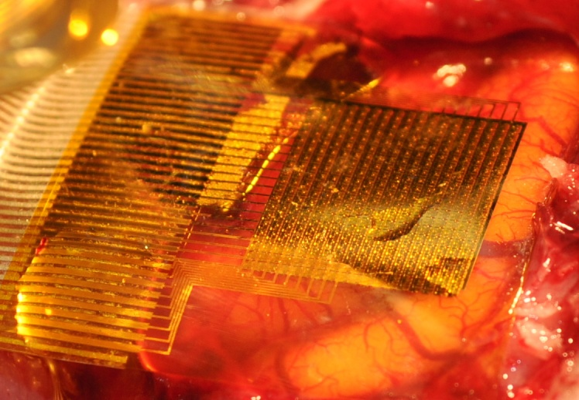
Electrode on Brain
2 mm
Viventi, J., Kim, D-H. et al. Nature Neuroscience, In Press
Notes:
tested electrode array by Placed on surface of feline visual cortex
Also flexible enough to insert into the interhemispheric fissure
- difficult to access
- similar to sulci
Recording visual evoked responses

Slide 14
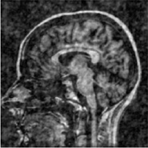
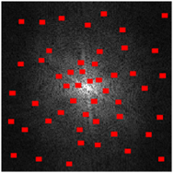
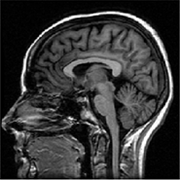
Compressed Sensing for Medicine
Exploit compressibility/sparsity of medical images to speed up MRI by pre-compressing data acquisition
Undersampled data
Conventional reconstruction
Compressed sensing reconstruction

Slide 15
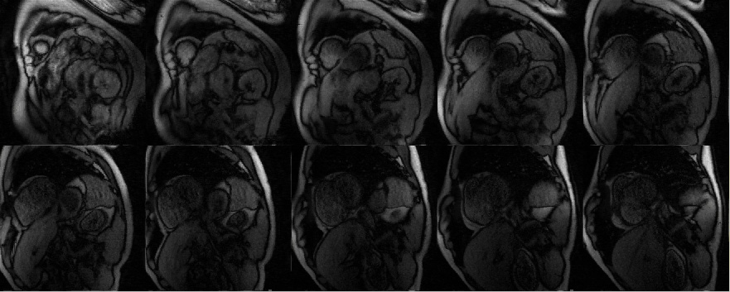
First-Pass Cardiac Perfusion MRI
8-fold acceleration
10 slices per heartbeat
Temporal resolution = 60ms/slice
Spatial resolution (in-plane) = 1.7 mm
Otazo et al. Magn Reson Med. 2010; 64:767-76

Slide 16
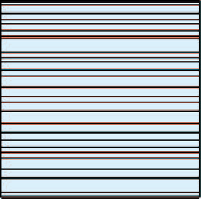

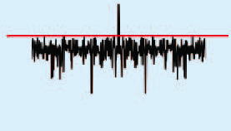
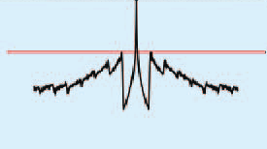
Non-Cartesian Compressed Sensing MRI
Non-Cartesian acquisition
trajectories (radial, spiral)
offer inherent incoherence
  No need for random
  undersampling
Continuous data acquisition and reconstruction with arbitrary temporal resolution (golden-angle)
Cartesian
Radial
k-space
PSF
3 frames
6 frames

Slide 17
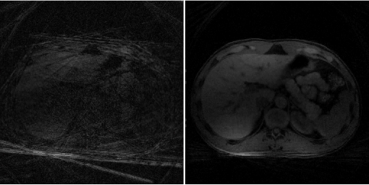
Dynamic Liver MRI
13 spokes/frame to reconstruct 400 spokes/frame
Conventional reconstruction
CS & PI
Feng L et al. Accepted for ISMRM 2012

Slide 18
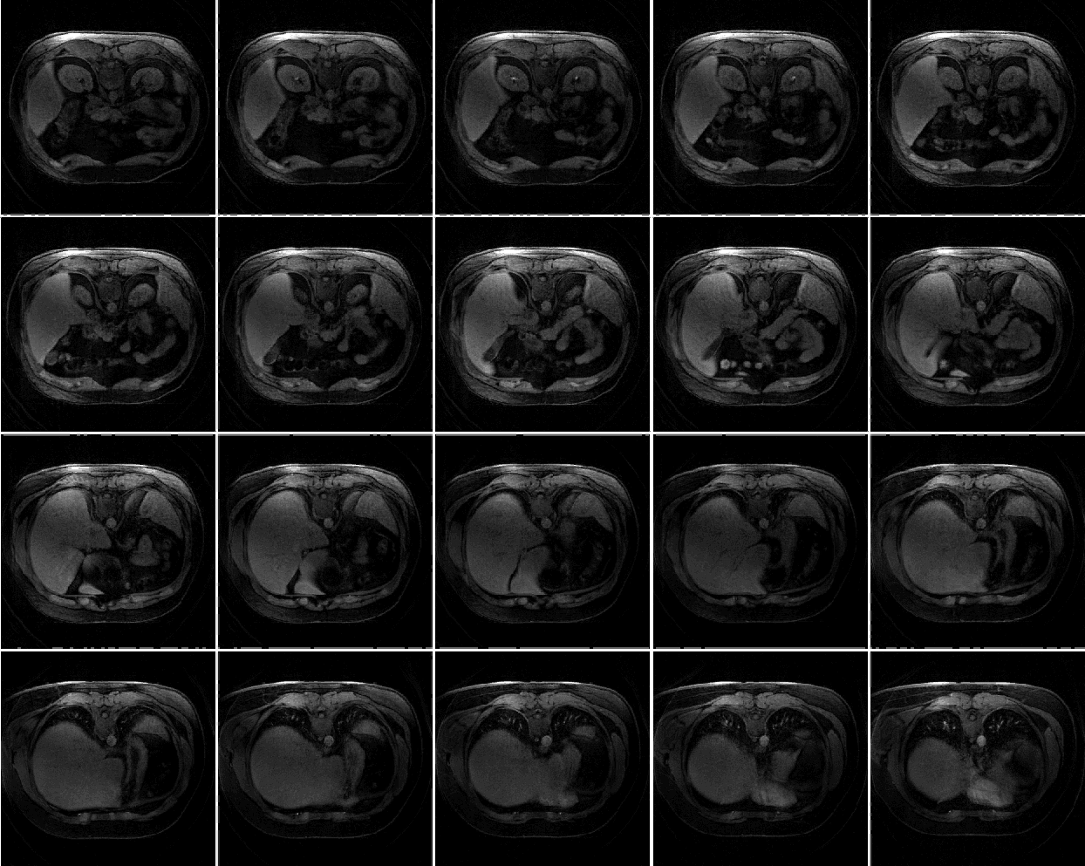
Free-Breathing Dynamic Contrast-Enhanced Liver MRI
20-fold acceleration
Whole-liver coverage (40 slices)
Temporal resolution = 2.8 sec / volume
Spatial resolution = 1x1x3mm³
Image matrix = 256x256x40
Feng L et al. Accepted for ISMRM 2012

Slide 19
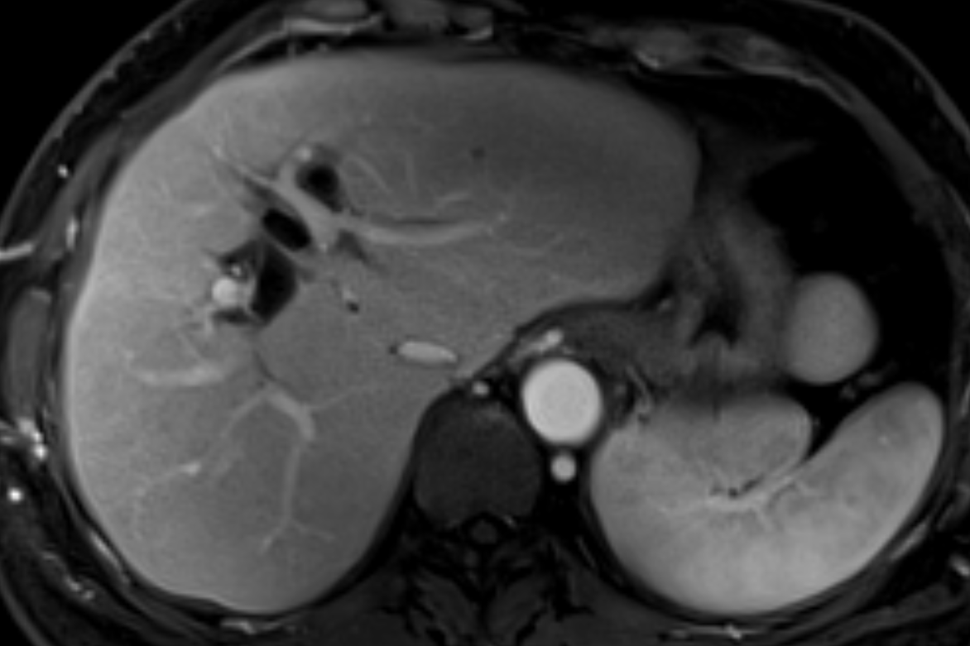
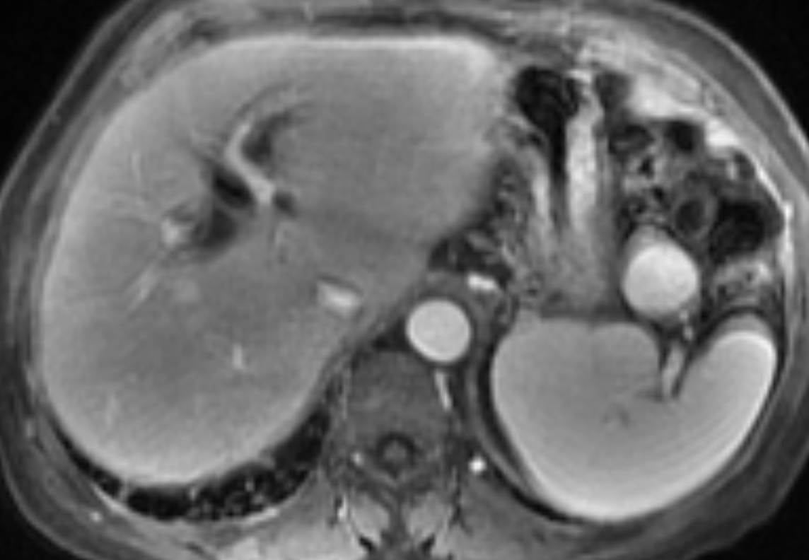
Free-Breathing High-Resolution Liver MRI
Accelerated free-breathing scan
(384x384 matrix)
Conventional breath-held scan
(256x256 matrix)
Chandarana H et al. Accepted for ISMRM 2012

Slide 20
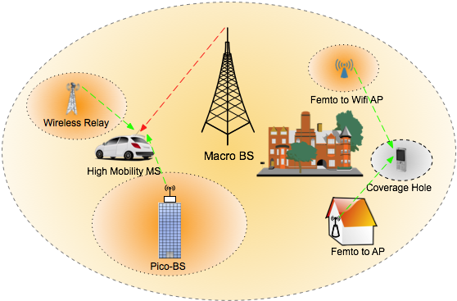
Cooperative MIMO for Het Nets
For high mobility MSs or MSs that have not been covered by any femtocell, cooperative MIMO
  enables fully opportunistic use of all available surrounding radios.
  increases network capacity and helps to reduce coverage holes.

Slide 21
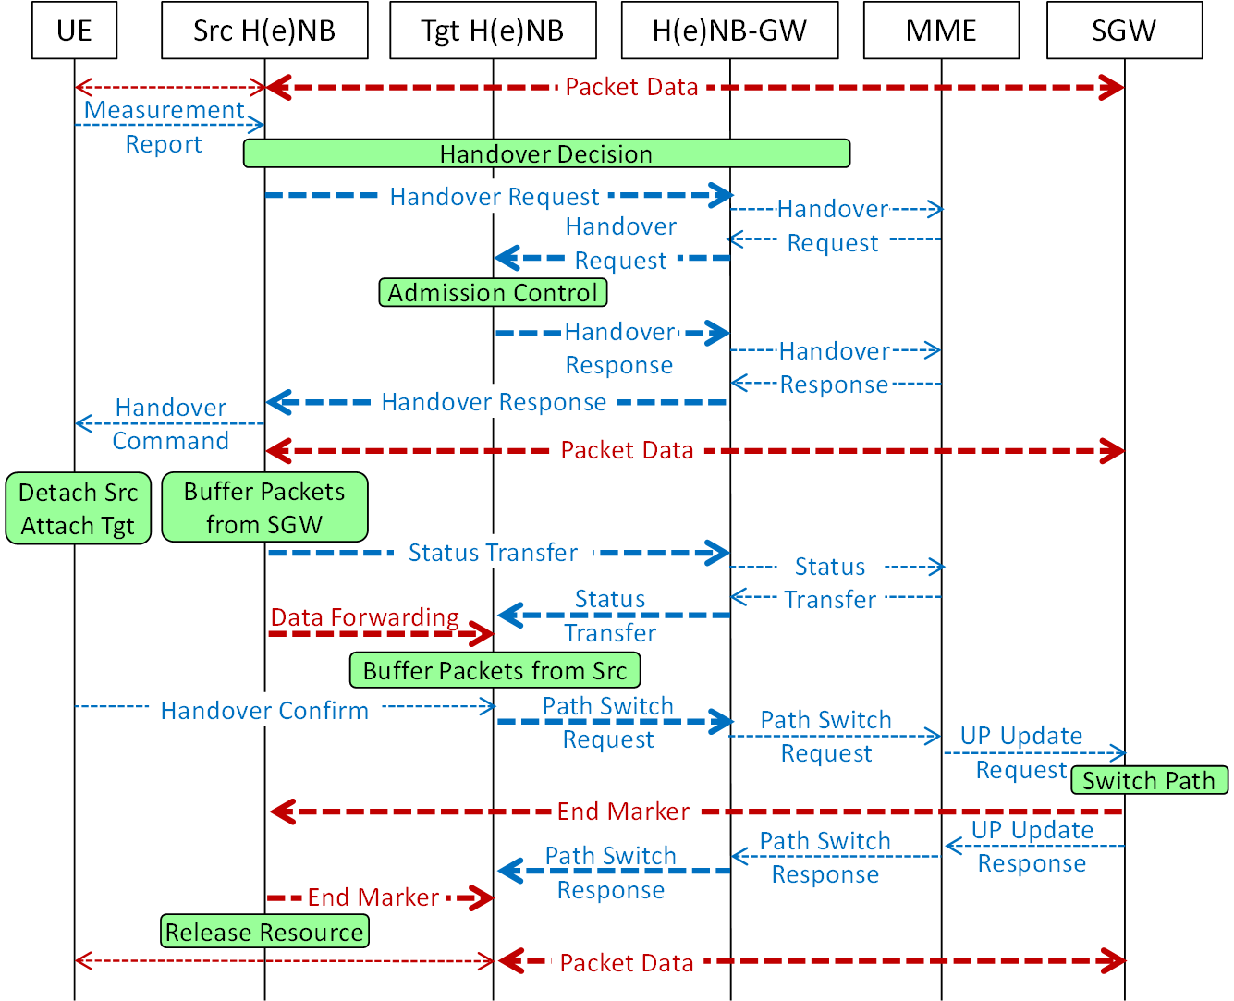
Fast Handover with Femtocells
Legacy Handover in Femtocells for Mobile Users:
  Smaller cell size – More Frequent Handover.
  Higher latency backhaul – Slower Handover.
  Longer and more frequent interruptions on App layer.
  Missed handover opportunities into passing Femtocells.
Issues with Legacy Handover procedure:
  Preparation for Handoff, the Handoff and Post-Handoff processes are tightly coupled.
  Long time gap between Handover Decision and actual Handoff.
  Forwarding of data over the internet from source to target Femtocell during Handover.

Slide 22
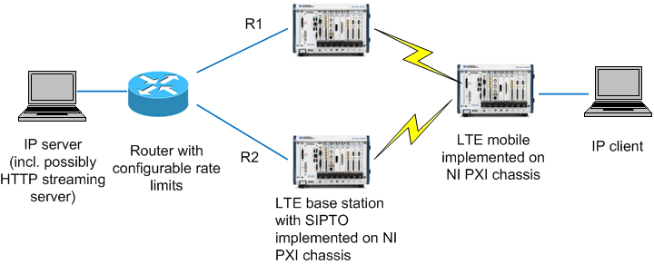
Current National Instruments Projects
Upper-layer algorithm experimentation for LTE-Advanced
  Intercell interference coordination, cell selection, multiflow, …
Benefits to NI:
  Validate NI platform for high-throughput cellular systems
  Develop complete LTE stack that can be given to customers

Slide 23
Partitioning on NI Platform
Host PC with LabView GUI
(logging?, scripting?)
NI PXI chassis
FPGAs
Corei7 with RT-Linux (?)
PHY HW i/f, front-end, channel emulation?
IP stack, GTP, PDCP, RLC, MAC, PHY control
RF unit
USB
Xilinx IP blocks
FFT, TDEC, Convolutional
GigE
Scatter-
gather DMA
IP test endpoint
Symbol, LLR memory, coding memory
IP packet memory

Slide 24
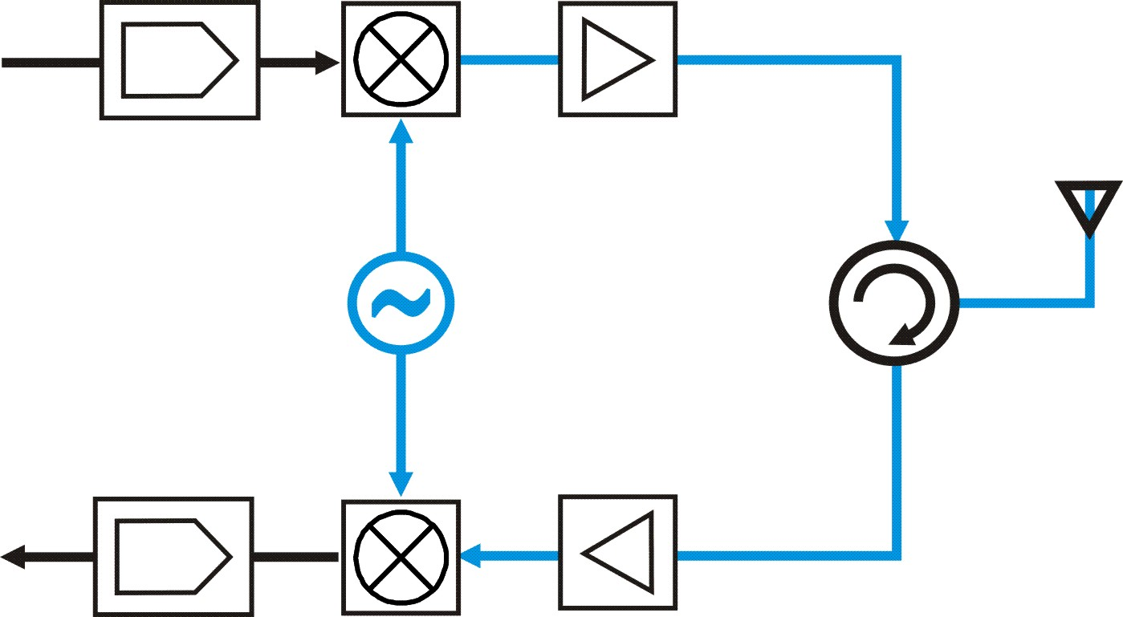
Full Duplex using Common Carrier
TX Data
Antenna
f1
TX
f1
Duplexer/
Circulator
f1
f1
RX
RX Data
Theoretically achieve 2x system capacity
Eliminate hidden terminal problem
Low Latency and Fairness
More efficient MAC designs

Slide 25
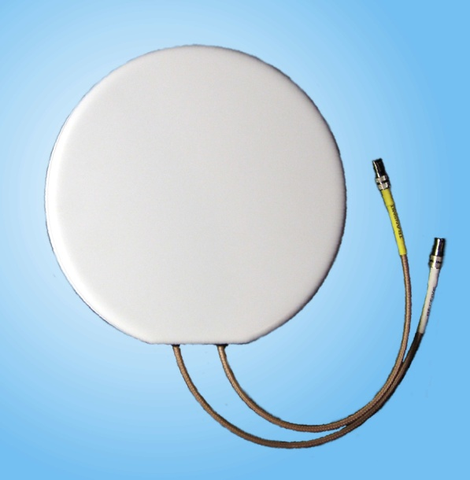
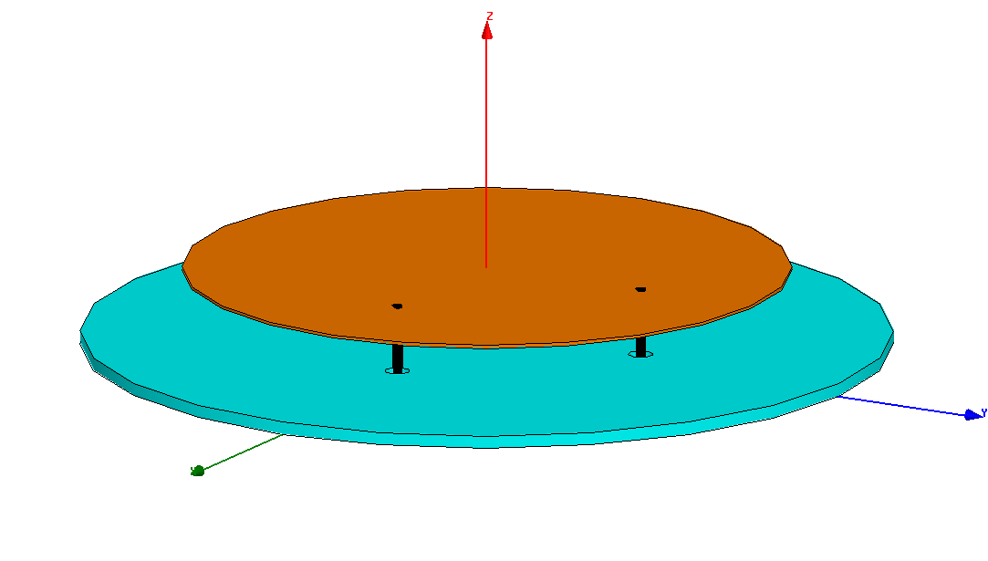
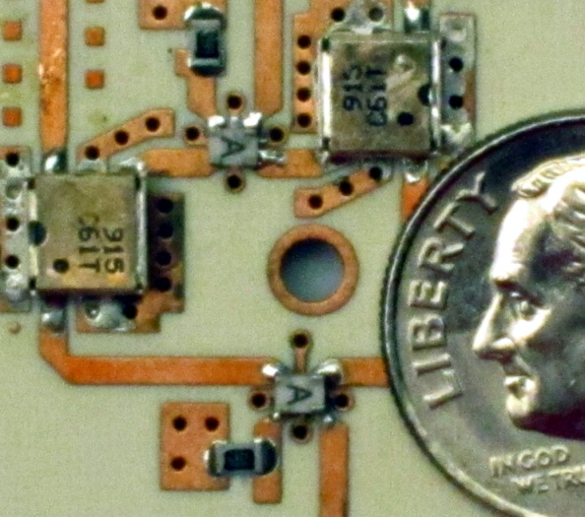
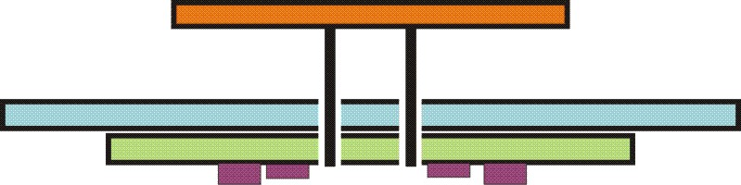
Single Antenna Prototype
Photo of complete antenna
Patch Antenna (CP)
Ground
Assembly Diagram
Photo of Cancellation Circuit
Patch Antenna
Ground
Cancellation Circuit
Patent pending

Slide 26
WiMAX Testbed Deployment
Overview
WiMAX Large-Scale Deployment Integration
6 Universities
  Polytechnic Institute of NYU Columbia University
  UCLA University of Colorado at Boulder
  UMass Amherst University of Wisconsin
  BBN Technologies
Developing WiMAX testbeds on several campuses
Created open-source management software to remotely use the infrastructure and run experiments

Slide 27
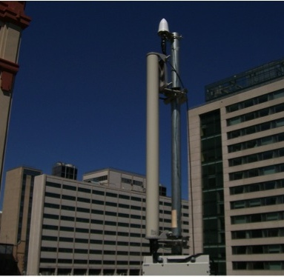
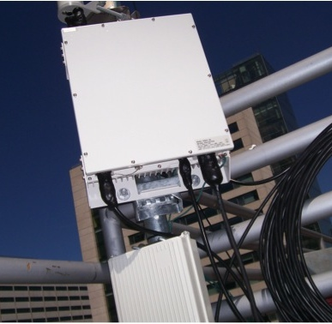
Base Station Installation
Sector antenna and GPS antenna installation
ODU installation

Slide 28

Base Station Installation
Poly’s location (Downtown Brooklyn)

Slide 29


Slide 30
Spectrum Allocations
The case for higher carrier frequencies
Current Cellular Bands ~200 MHz
LMDS – 1.3GHz
30/40 GHz bands – 3.4GHz
60 GHz unlicensed – 7GHz

Slide 31

mmWave On-Chip Die Photos
    Close relationship with fabrication company (TSMC CMOS)
    Several chips fabricated in ’08-’11
    Collaborative die among several UT-ECE faculty/students
    mmWave on-chip antennas
      Yagi
      Dipole
    mmWave transmission lines/ inductors
    PN Correlators for channel sounding

Slide 32

Office of the future

Slide 33

Cellular and Wireless Backhaul
Trends:
Higher data usage
Increase in base station density
(femto/pico cells)
Greater frequency reuse
Problem: fiber optic backhaul is expensive and difficult to install.
Solution: Cheap CMOS-based wireless backhaul with beam steering capability.
Base station to base station Link
Antenna array
Base station to mobile link

Slide 34

5G Cellular Measurements
38 GHz and 60 GHz
Move the transmitter to various building rooftop locations (e.g. TX1 and TX2)
For each transmitter location, move the receiver to various locations, (e.g. RX 1 – 10) and measure the channel w/varying antenna angles.
Use the collected results to generate statistical channel models

Slide 35


Initial 60 GHz AOA P2P Measurements
Observation: Links exist at only few angles
Thus, full AOA is not needed to characterize channel
Only angles that have a signal are measured

Slide 36


Millimeter Wave Channel Sparsity
Nyquist-rate sampling
Compressed sampling
CDFs of (a) channel sparsity and (b) RMS delay spread for 60 GHz outdoor peer-to-peer measurements
95% signal power in first peaks

Slide 37

Future Work using Compressed Sensing for Channel Sounding
Incorporate angle of arrival (adaptive beam forming)
Build Massively Broadband Channel Sounding Xampler

Slide 38



Shims
Semantically consistent method for adding network functionality
  Works with legacy applications!
Often improve latency, bandwidth, loss rate, etc. by a factor of two!
Easy to code
Low overhead
Without FEC
With FEC shim

Slide 39

Seattle Testbed summary
Seattle testbed
Real system deployed on about 10K computers
  Geographic diversity, network diversity, device diversity...
  Laptops, desktops, tablets, phones
Battle tested educational platform!
  Used in 24 classes
  Networking, security, OS
Interesting research problems
  Write-Once Run Anywhere
  Network Heterogeneity
  Legacy cloud containers (SFI meets Seattle VM)
Open for public use
      https://seattle.cs.washington.edu/

Slide 40
WHAT WE ASK FROM YOU
Join the NYU WIRELESS Industrial Affiliates Program
Gain Access to World-Class Faculty
Hire World-Class students (full-time, interns)
Gain private/advanced access to all of our publications
Visit and Interact with our center, on-site at NYU
Gain Access to Medical Device and Equipment vendors
Gain insights from Doctors, Bio-Engineers, Nueroscience
Gain insights into Wireless Systems and Devices
Introduce your company to NYU’s Global Network University
Introduce your executives to the New York media engine
Please commit $100K/yr. for 3 year commitment
Join the most exciting research movement in the USA

Slide 41

World-Class Research Space - coming December 2012

