Slide 1
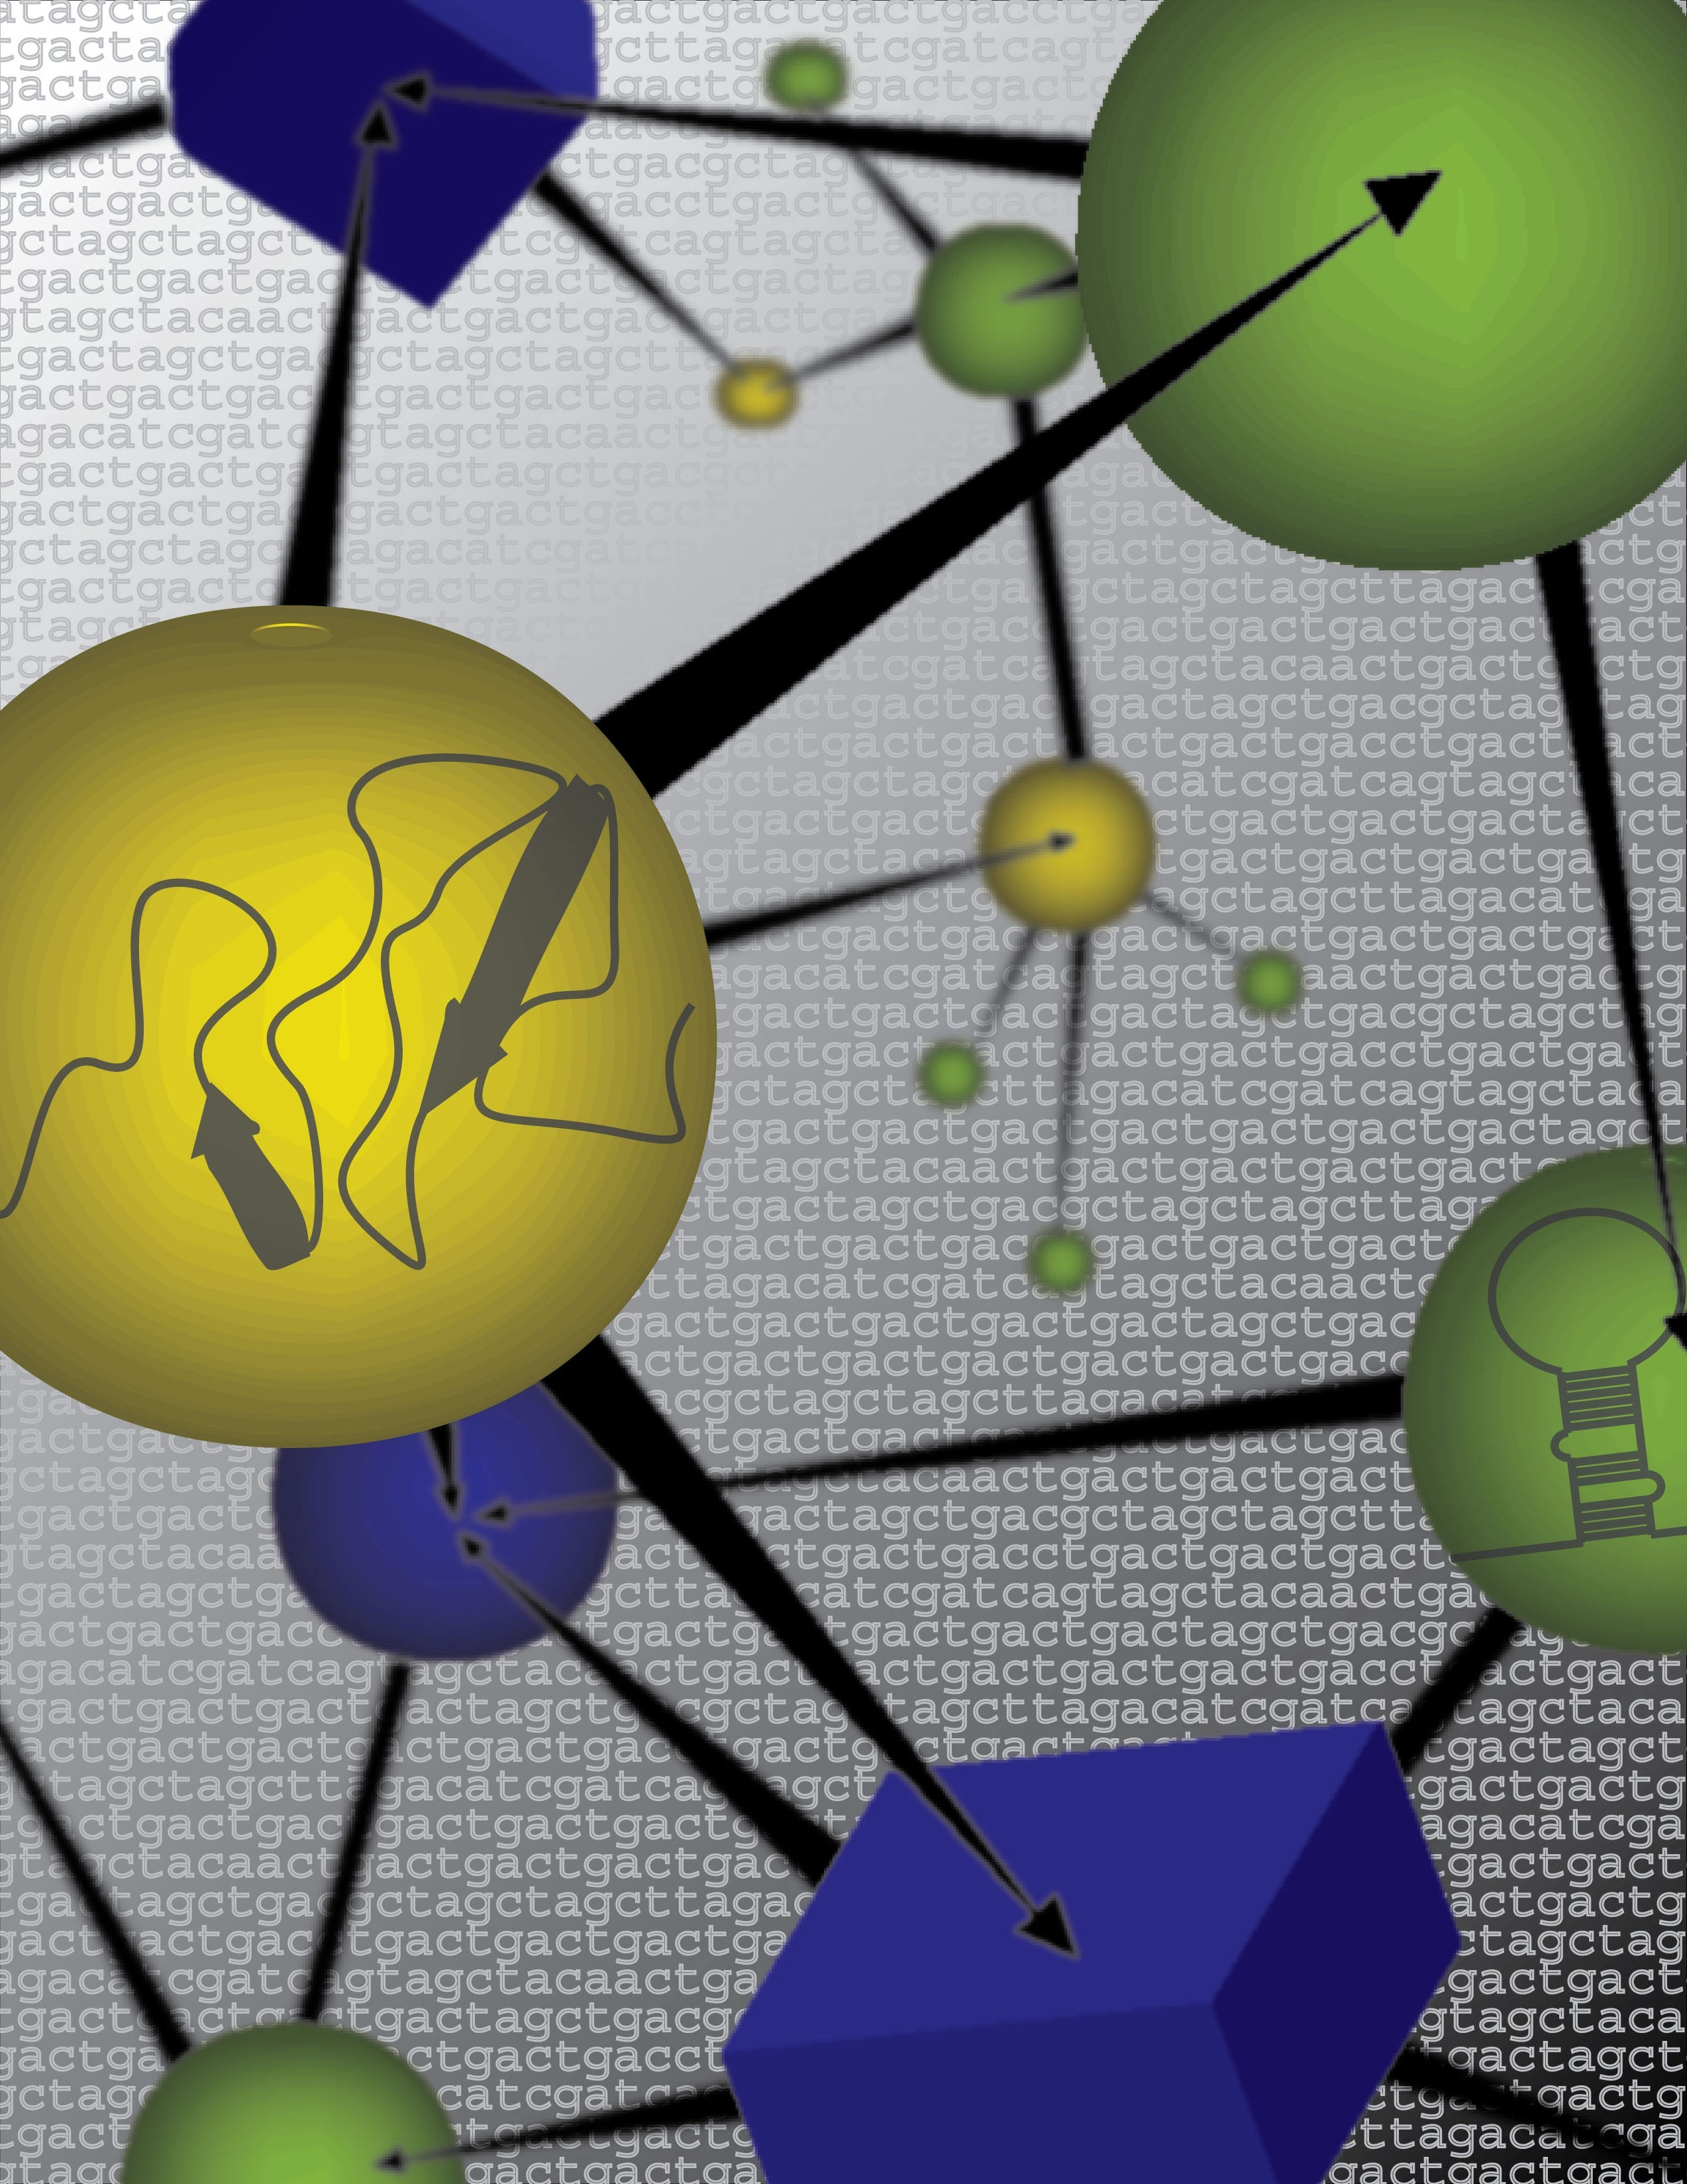

Plant Systems Biology
From Predictive Network Modeling to Trait Evolution
Art by Suzan Runko,
NYU Center for Digital Image Design
Gloria M. Coruzzi
New York University
Center for Genomics & Systems Biology

Slide 2



Plant Systems Biology
NYU Biology – Coruzzi lab
NYU Courant
Math & Computer Science
Networks
Dennis Shasha
Yann LeCun/Piotr Mirowski
Tamara Tershakovec
Statistical Genomics
Dan Tranchina
Genomics
Amy Marshall-Colon
Joan Doidy
Nancy Francoeur
Ying Li
Tara Moran
Daniela Ristova
Informatics
Manpreet Katari
Stuti Srivastav
Kranthi Varala
NY Plant Genomics Consortium
NYU: Coruzzi/Shasha
NYBG: Stevenson
AMNH: DeSalle, Lee
CSHL: McCombie, Martienssen
DOE
Alumni/Collaborators
Gabriel Krouk & Sandrine Ruffel (CNR/INRA-Montpellier, FR)
Miriam Gifford (U Warwick, UK)
Rodrigo Gutierrez (Universidad Catolica de Chile)
Collaborators
Ken Birnbaum & Michael Purugganan (NYU), Rob McClung (Darmouth); S. Moose, Illinois
Notes:
2

Slide 3
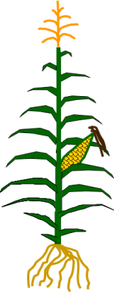
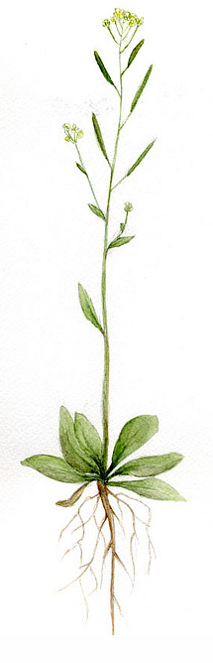
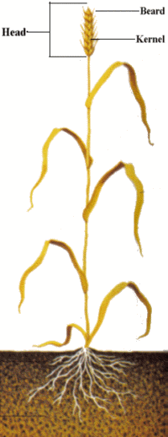

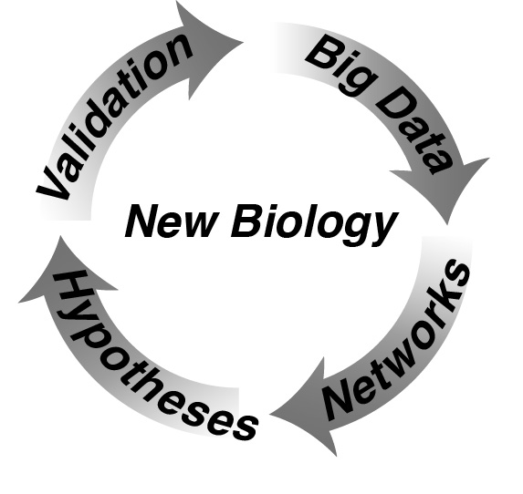
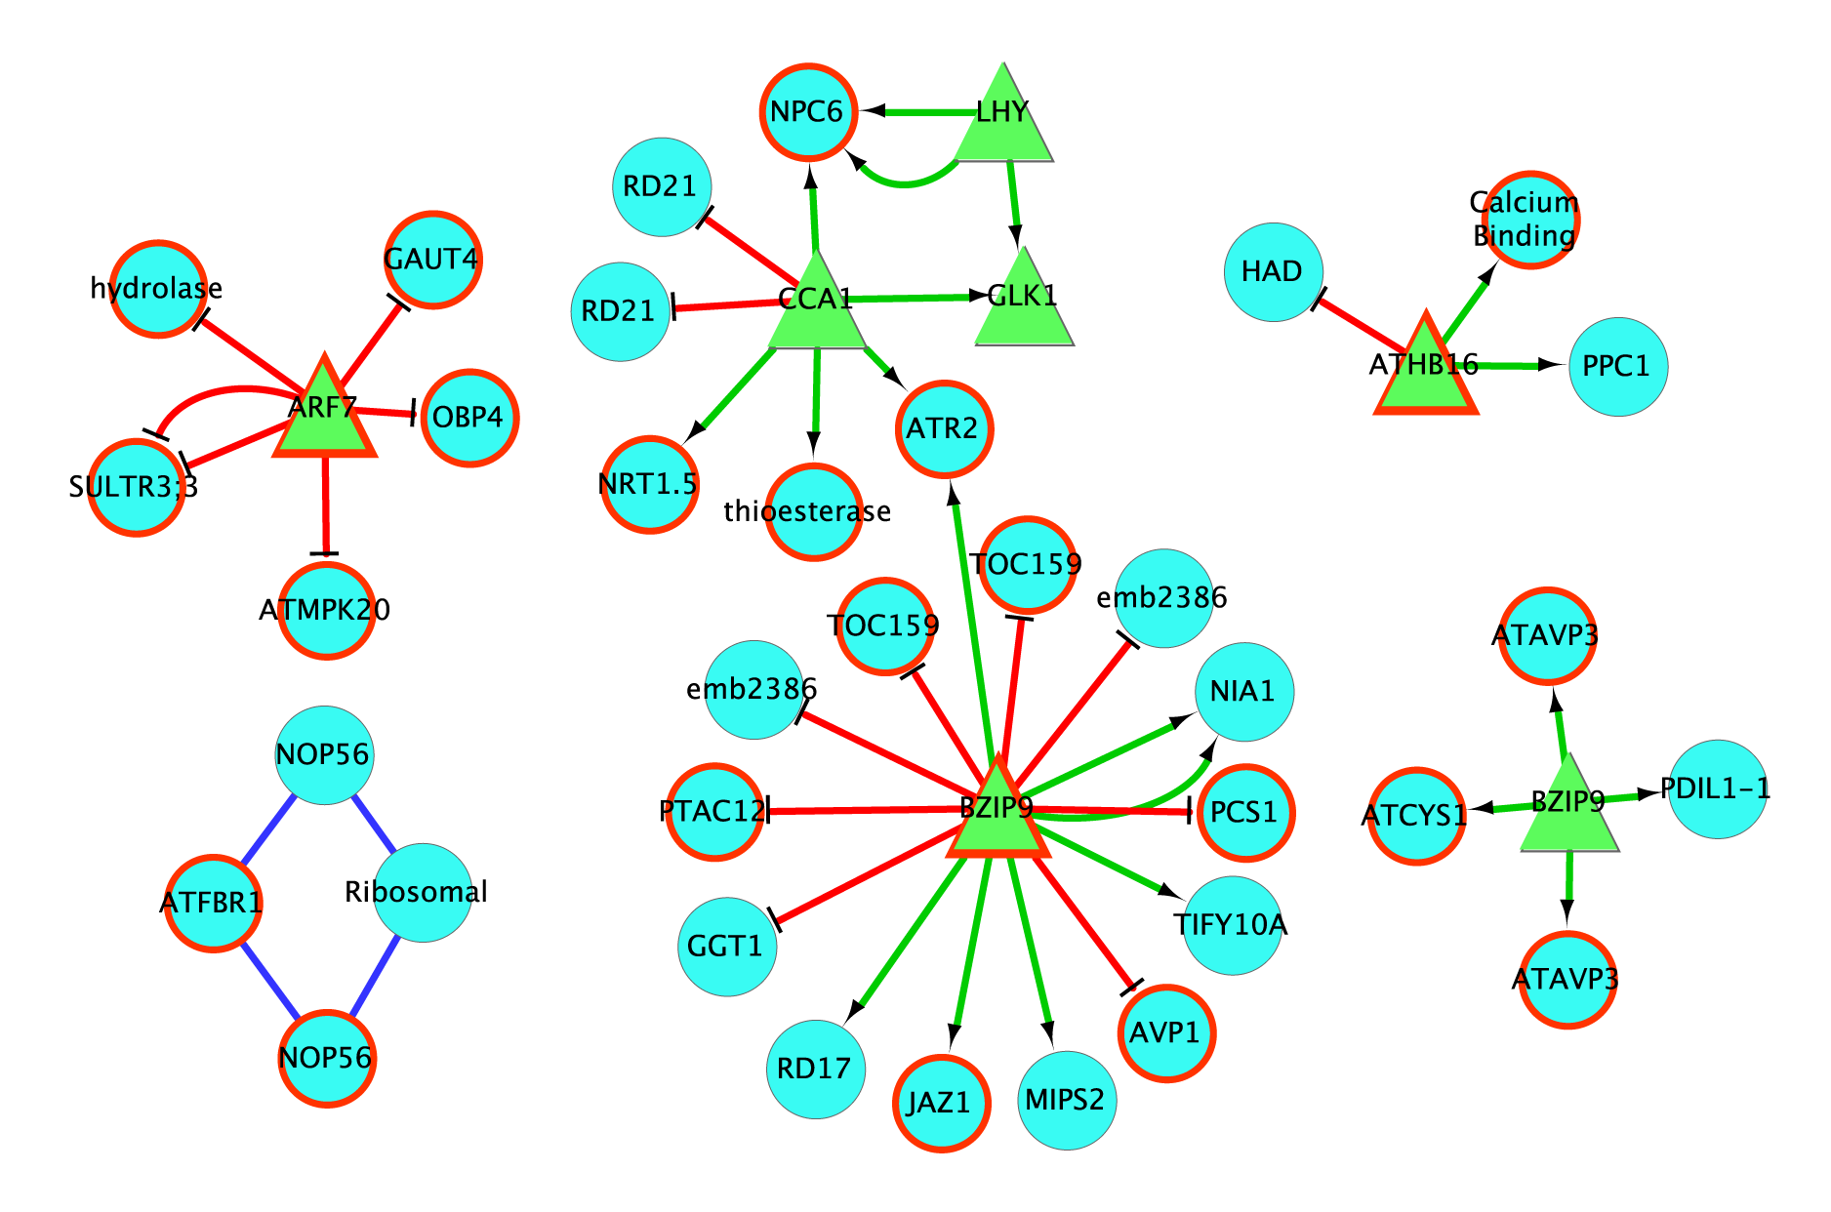
Arabidopsis
Data-rich model
Transcriptome, Proteome, etc
www.virtualplant.org
Multinetwork
Agricultural Traits
Data-Poor Crops
Network Knowledge
NUE Variation
Translational Studies
Identify
genes underlying
NUE

Slide 4
Big and Diverse
Data
Networks
Multinetworks
Machine Learning
Apply to Problems in Agriculture

Slide 5
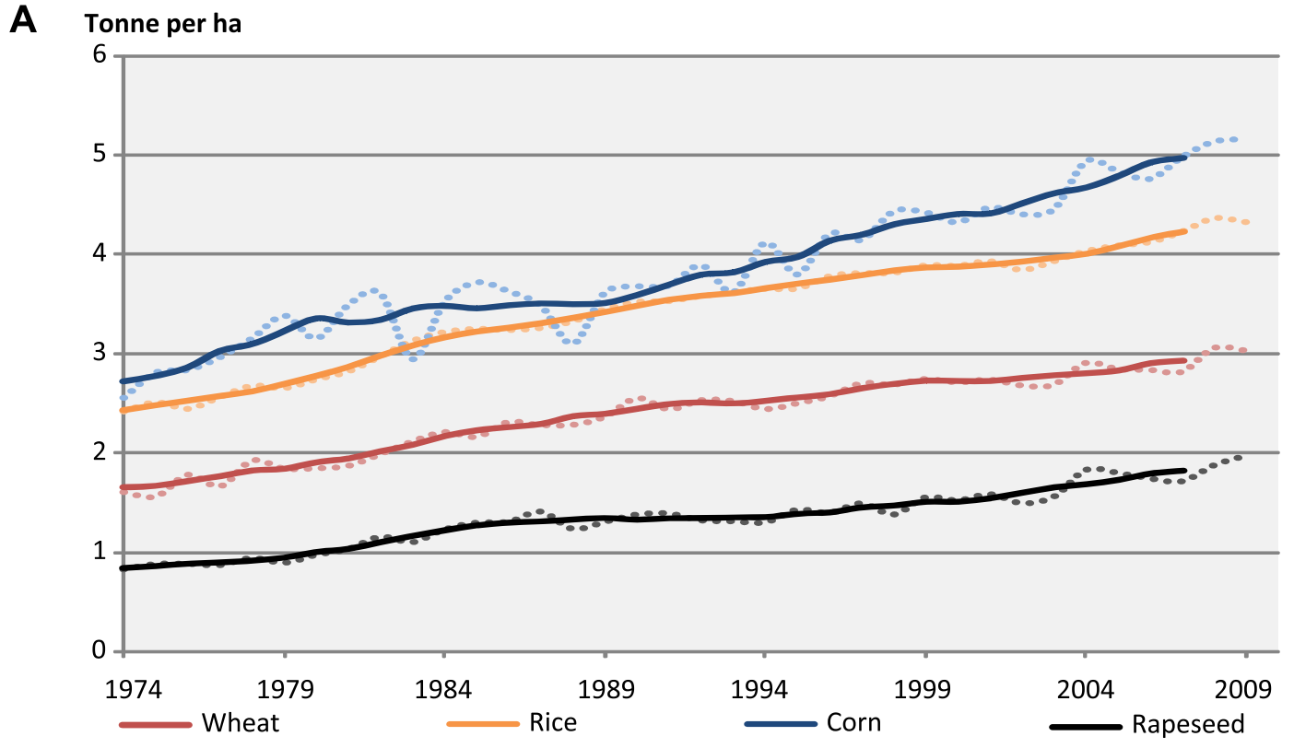
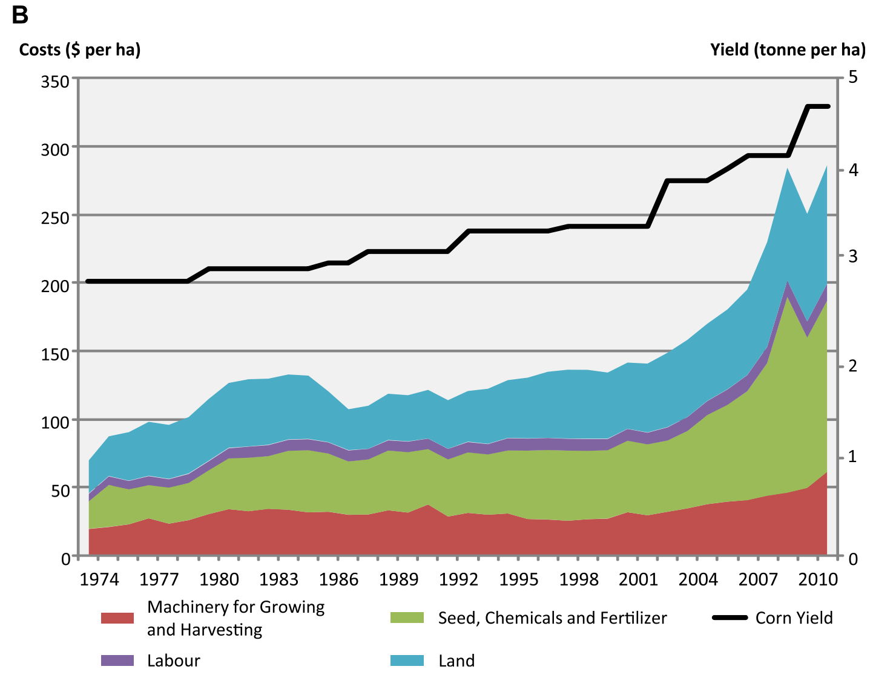
Nitrogen Use and the Environment
Nitrogen is the rate limiting element for plant growth
  Cost of N-fertilizers in crops
  Detrimental effect of N on environment
    Nitrate Leaching, erosion, runoff
    N fertilizer recovery efficiency < 50%
Goal: Improve Nitrogen Use Efficiency
  Increase in grain size or biomass per unit using available N in soil and fertilizers and/or less N.
*FAO Statistics
Notes:
N fertilizer recovery efficiency = applied N / amount taken up by fertililzed plant. Based on several cropping systems including corn-based
Cassman et al, 2002, Ambio 31:132-140
NUE = Chardon et al, 2012, Journal of Experimental Botany, 63(9):3401-12

Slide 6
A Systems Biology View of Nitrogen Use Efficiency
N-storage
Asn
N-assimilation
ENERGY COST
~ 12 ATP per NO3→AA₃
NO₃
Gln
N-foraging
Plants are 1-2% N/dry weight, yet spend 25% energy on NO₃ assimilation
(Bloom 2010, Cousins & Bloom 2004)

Slide 7
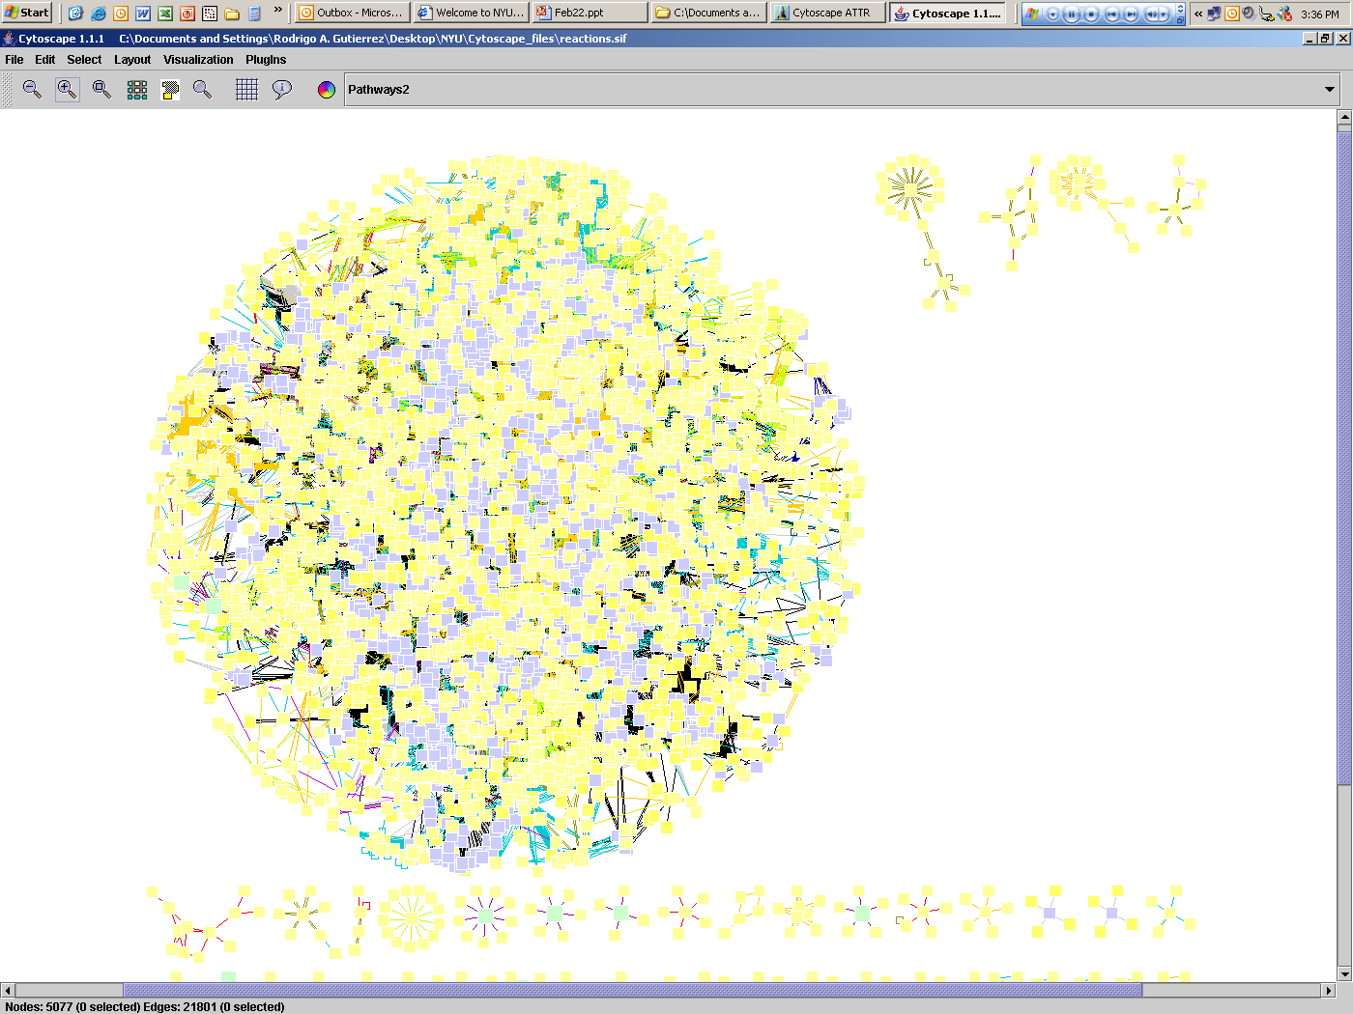
Query Multinetwork with Transcriptome Data
DNA:protein interactions
AGRIS & Predicted
Transcriptome
Query multinetwork with list of 834 N - regulated genes
Metabolic Rx
KEGG, ARACYC
Query multinetwork
For gene connections
Protein:Protein
Interactome
(Ecker/Vidal)
Multi-Network
“GeneWays”
Literature
based
Interactions
A. Rzhetsky
(U. Chicago
activate
bind
interact
miRNA:RNA
mirBASE
ASRP
Multi-Network
19,690 genes
182,592 interactions
www.virtualplant.org
Katari et al (2010) Plant Physiol.

Slide 8
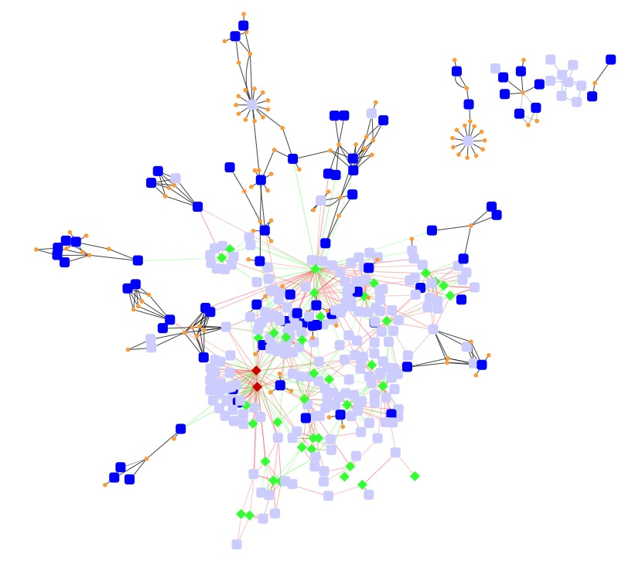
Multinetwork Analysis Identifies a N-regulated Network
CCA1 (myb TF)
Master regulator clock
A TOP HUB
N-regulatory Network
Gutierrez et al (2008) PNAS vol 105, 4939-4944
Notes:
8

Slide 9
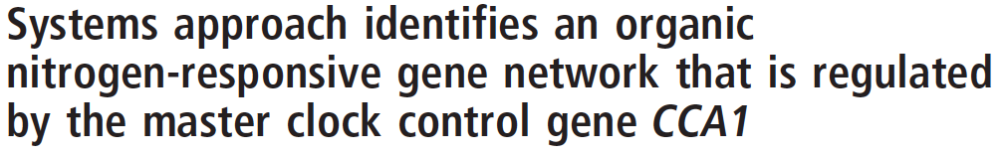
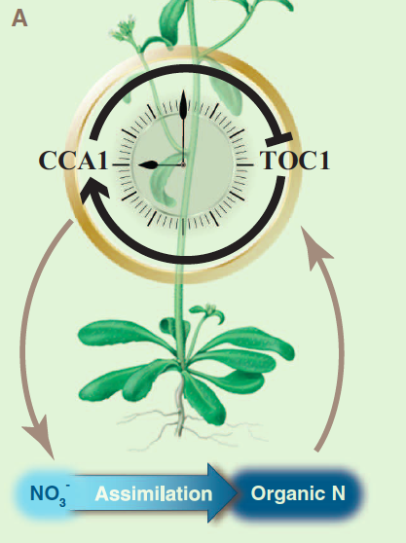
New Biology
Nutrient Control of the Clock
Gutierrez et al (2008) PNAS vol 105, 4939-4944
Review: Gutierrez (2012) Science

Slide 10
Arabidopsis
Data-rich model
Transcriptome, Proteome, etc
www.virtualplant.org
Multinetwork
Agricultural Traits
Data-Poor Crops
Network Knowledge
NUE Variation
Identify
genes underlying
NUE

Slide 11
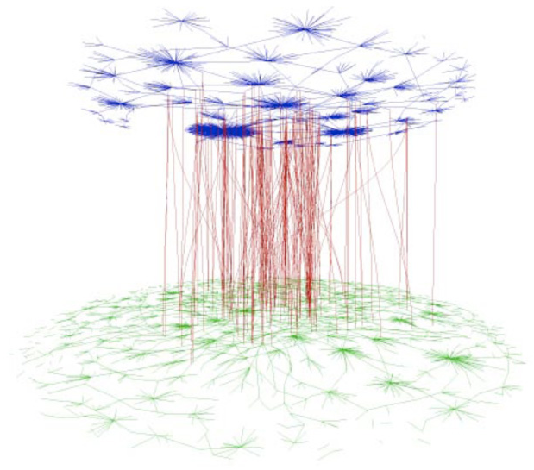
VirtualPlant v1.3: Cross-Species Networks
Arabidopsis Networks
(data rich)
Translating “network-knowledge” across species
Maize: Data Poor
N-regulated correlation network
5,000 genes
2,483/5,000 no annotation
Crop Networks
(data poor)

Slide 12


Transfer of Arabidopsis Network Knowledge to Maize: Conserved N-regulated Network Module
Interactions
Edges
BioModule
Overrepresented GO terms
Photoperiodism, p-value 0.001
Nitrogen metabolic processes, p-value 0.002
protein:protein
protein:DNA (+ correlation)
protein:DNA (- correlation)
Nodes
Maize TF (Maize annotation)
Maize TF (Arabidopsis annotation)
Maize target gene (Maize annotation)
Maize target gene (Arabidopsis annotation)

Slide 13
Arabidopsis
Data-rich model
Transcriptome, Proteome, etc
www.virtualplant.org
Multinetwork
Agricultural Traits
Data-Poor Crops
Network Knowledge
NUE Variation
Translational Studies
Identify
genes underlying
Nitrogen Use Eff

Slide 14
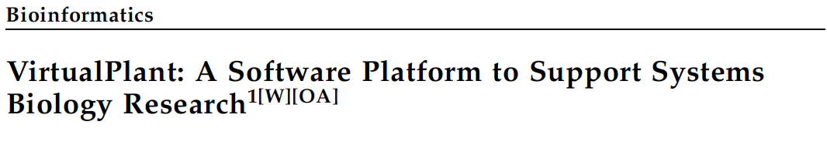



NSF Database Activities: DBI-0445666
ARABIDOPSIS
﻿
RICE
MAIZE

Slide 15
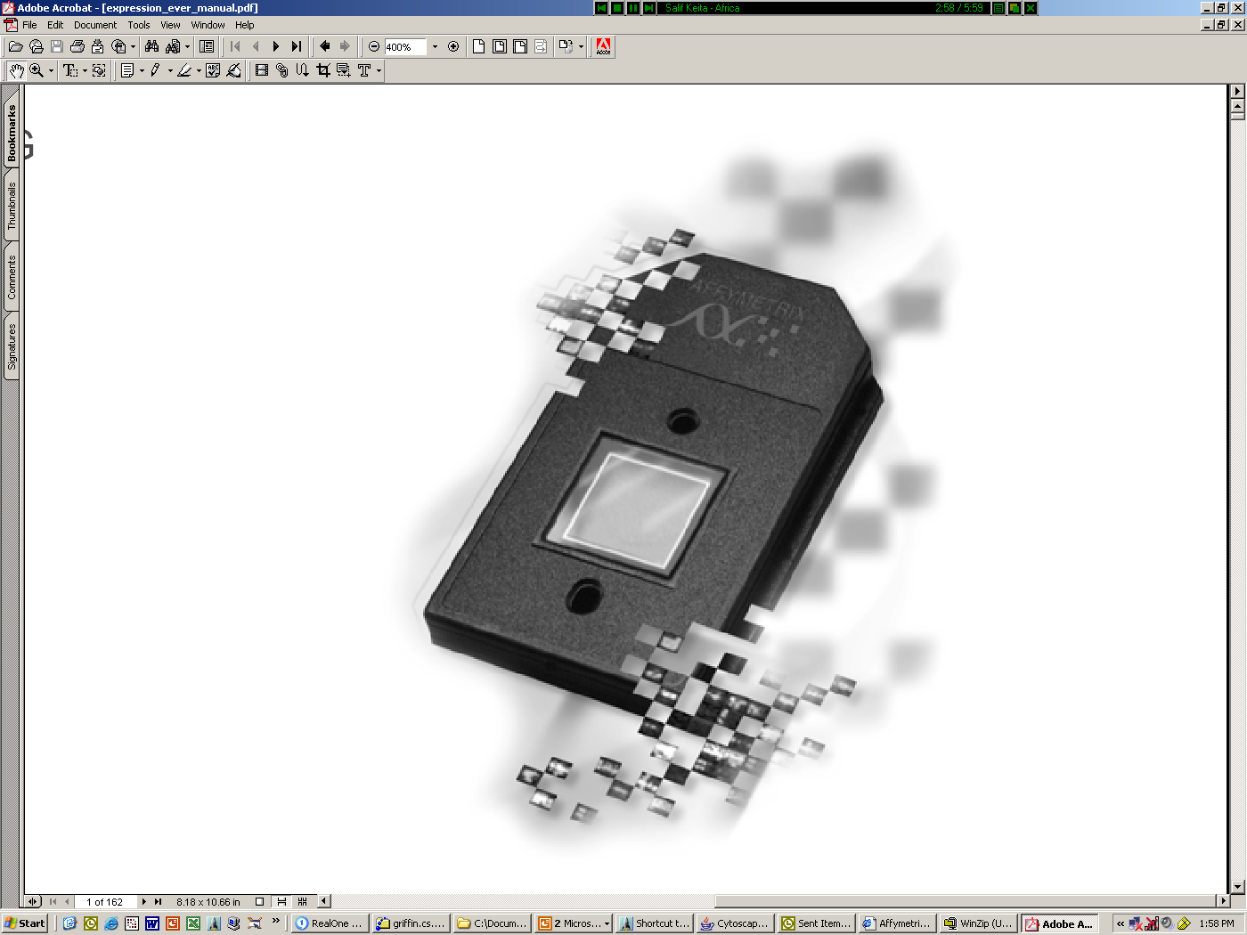
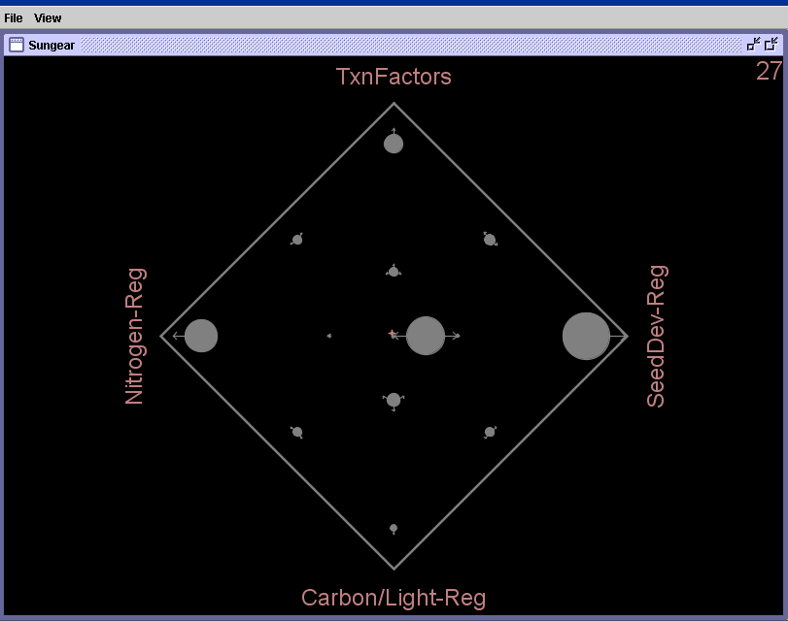
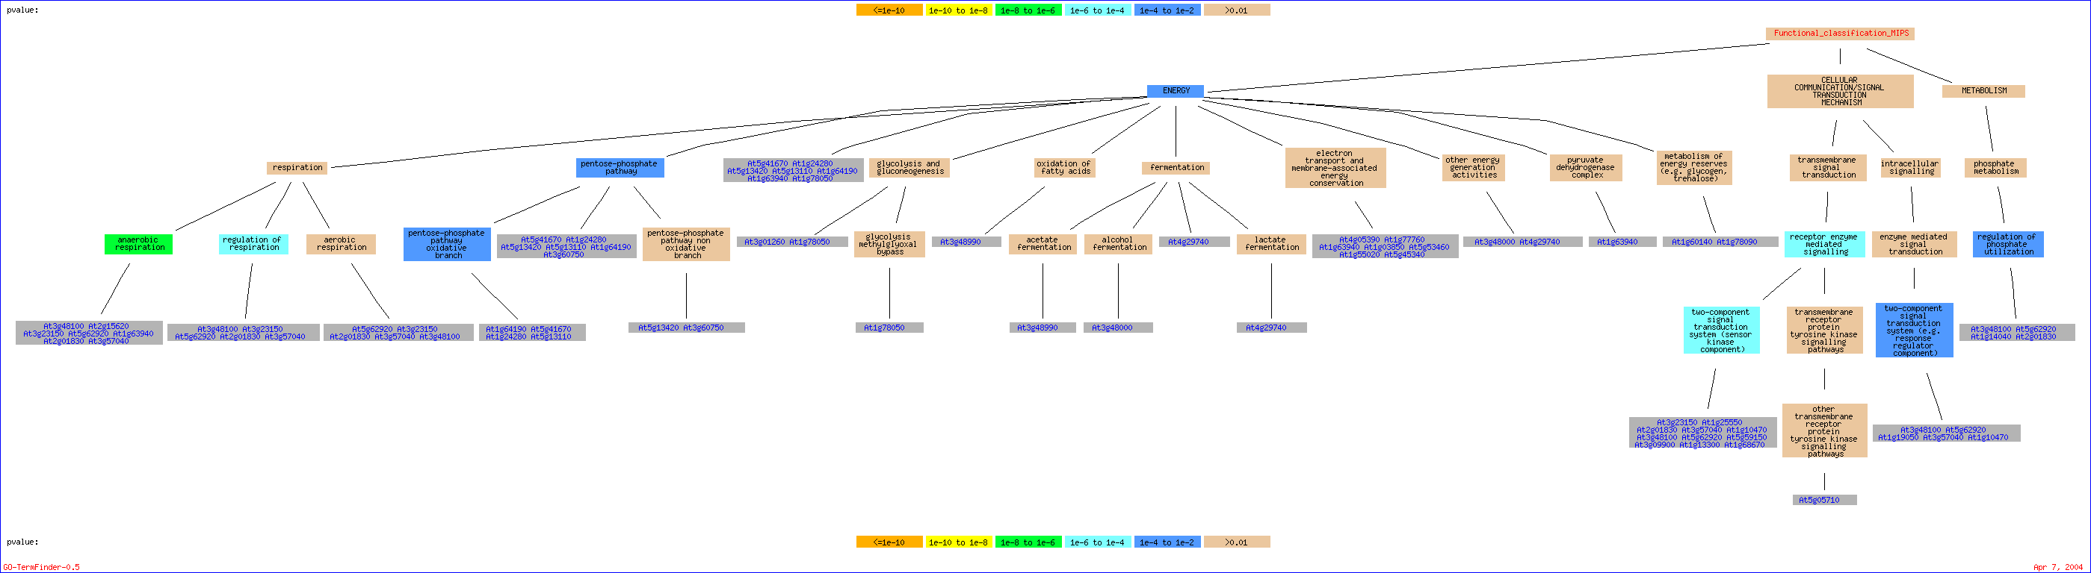
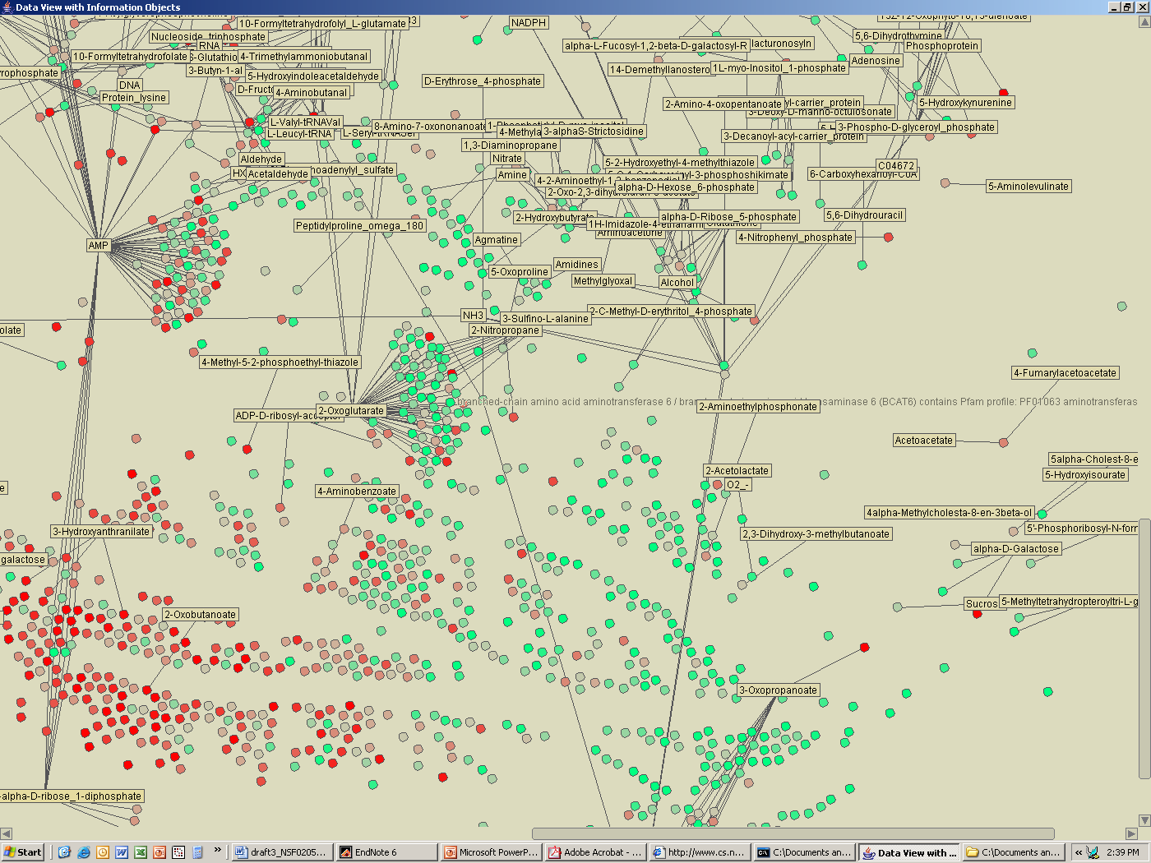
NSF Database Activities: DBI-0445666
1
2
3
Data Integration
Dynamic Visualization
Analysis & Synthesis
Derived Biological
Hypotheses
Metabolic
pathways
Multiple experiments
Regulatory
Interactions
Protein-protein
interactions
Biological processes
Molecular interactions in
the literature
.
.
Molecular Pathways
.
www.virtualplant.org
Katari et al (2010) Plant Physiol. 152(2): 500-15.
Katari et al (2010) Plant Physiol. 152(2): 500-15.
Notes:
Flexible

Slide 16


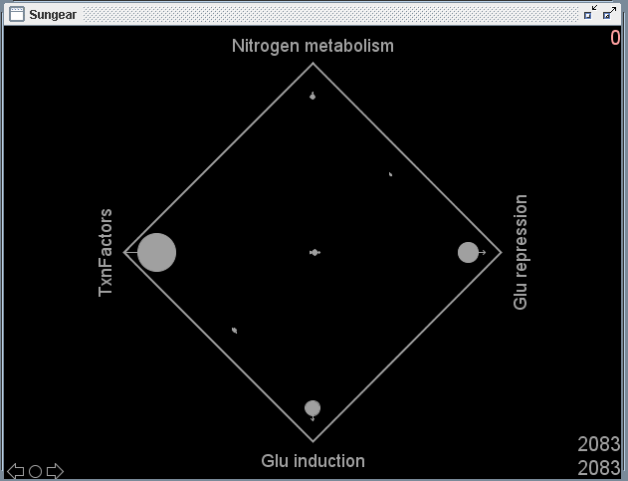
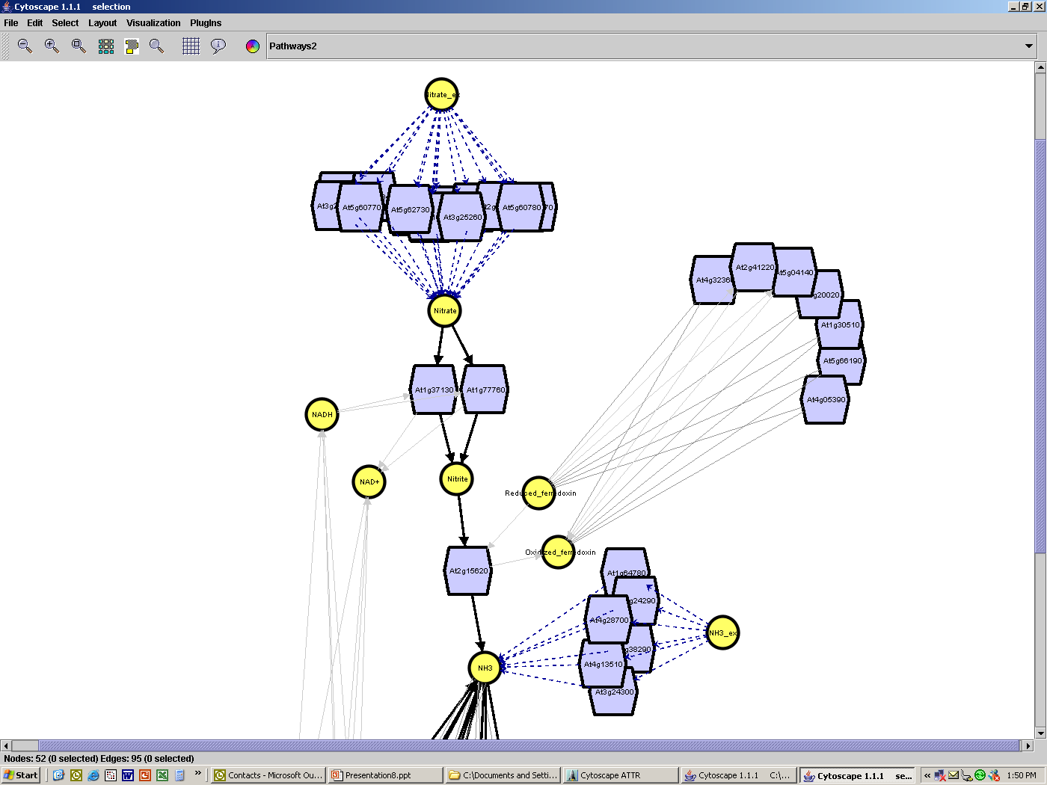
VirtualPlant v1.3
E-commerce site
At1g00100
At3g47340
Biologists
At4g01400
Customers
At2g34560
At3g47340
MyGeneList
Microarray Data
Browse
Query
Upload
Browse
Query
VirtualPlant Database
Product Inventory
Iterative cycles of data analysis
store
store
Product Delivery (one way)
Gene & Experiment
Cart
Shopping
Cart
Check out
Check out
Analysis &
Visualization
Reports
Purchase
Text file
Excel file
Tables
Graphs
Sungear Analysis
Set operations
Sungear
Gene Networks
SuperNode Analysis
BioMaps
Vicogenta
OrthologID
Network Analysis
www.virtualplant.org
Katari et al (2010) Plant Physiol. 152(2): 500-15.
Katari et al (2010) Plant Physiol. 152(2): 500-15.

Slide 17
Systems Approach Uncovers New Biology

Slide 18
Plant Systems Biology
NYU Biology – Coruzzi lab
NYU Courant
Math & Computer Science
Networks
Dennis Shasha
Yann LeCun/Piotr Mirowski
Tamara Tershakovec
Statistical Genomics
Dan Tranchina
Genomics
Amy Marshall-Colon
Joan Doidy
Nancy Francoeur
Ying Li
Tara Moran
Daniela Ristova
Informatics
Manpreet Katari
Stuti Srivastav
Kranthi Varala
NY Plant Genomics Consortium
NYU: Coruzzi/Shasha
NYBG: Stevenson
AMNH: DeSalle, Lee
CSHL: McCombie, Martienssen
DOE
Alumni/Collaborators
Gabriel Krouk & Sandrine Ruffel (CNR/INRA-Montpellier, FR)
Miriam Gifford (U Warwick, UK)
Rodrigo Gutierrez (Universidad Catolica de Chile)
Collaborators
Ken Birnbaum & Michael Purugganan (NYU), Rob McClung (Darmouth); S. Moose, Illinois
Notes:
18

