Slide 1
Codons
1. Relationship between DNA and amino acids 2. Using less frequent codons.
Anjali Aggarwal

Slide 2
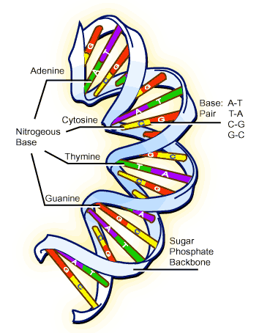
While they seem to be unrelated entities, DNA actually plays a crucial role in protein production. When a cell wants to manufacture a certain protein, it has to go find the recipe for that protein. The recipe is stored in the form of DNA.
Relationship between amino acid & DNA

Slide 3
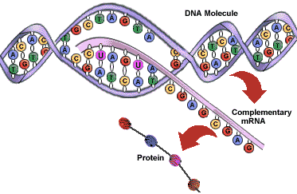
They are made by a 2 step translation process :
A string of DNA is copied (“transcribed”) to RNA

Slide 4
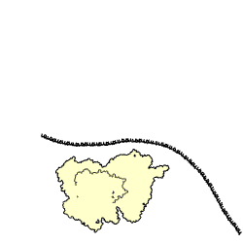
2. The RNA is “translated” into a protein
In this step, a protein is assembled by reading 3 letters of RNA and fetching the corresponding amino acid.

Slide 5
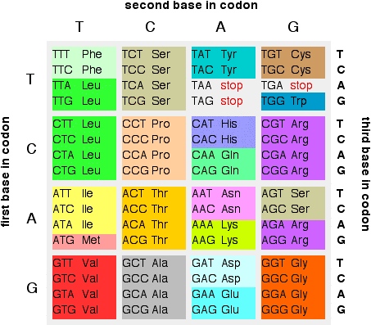
Codons
DNA sequences act as templates for building proteins according to the triplet code.
There are possible sequences or codons defined by three consecutive nucleotide bases. The triplet code maps each of these 64 sequences to one of the 20 different amino acids or the stop symbol. Each of the 20 amino acids has as few as or as many as corresponding codons.

Slide 6
Nature allows multiple ways of coding for the same amino acid
Certain codons for a specific amino acid are preferred over others. These preferences are organism-specific. The more popular codons translate to amino acids faster than the less frequent ones. Why?

Slide 7
Evidence
An experiment was conducted by Skiena on over 27,000 sequences from 34 microbial species with 36 genomic structures . It provided evidence that in all genomic structures highly stable (minimum energy) sequences are disproportionately abundant. This evidences nature’s clear bias for stability. So nature chose those codons to occur frquently which were more stable, having less energy and were easier to translate.

Slide 8
Minimum energy experimental results
Minimum energy algorithm was applied to 200 short microbial RNA sequences and compared the energy of the minimized sequences to the energy of the corresponding wildtype sequences. The average energy density (energy/nucleotide) of wildtype sequences is 0.241 kcal/mol; for the mini- mum energy sequences it is ¡0.626. A minimized sequence has, on average, a minimum free energy 2.657 times as great as the naturally occurring sequence.

Slide 9
Poliovirus
Skiena and his team designed and synthesized a virus from scratch that was less efficient at reproducing. They used their synthesizing method with computer software to systematically re-code the poliovirus genome. This type of vaccine is created by mutating the virus so it cannot cause disease.

Slide 10
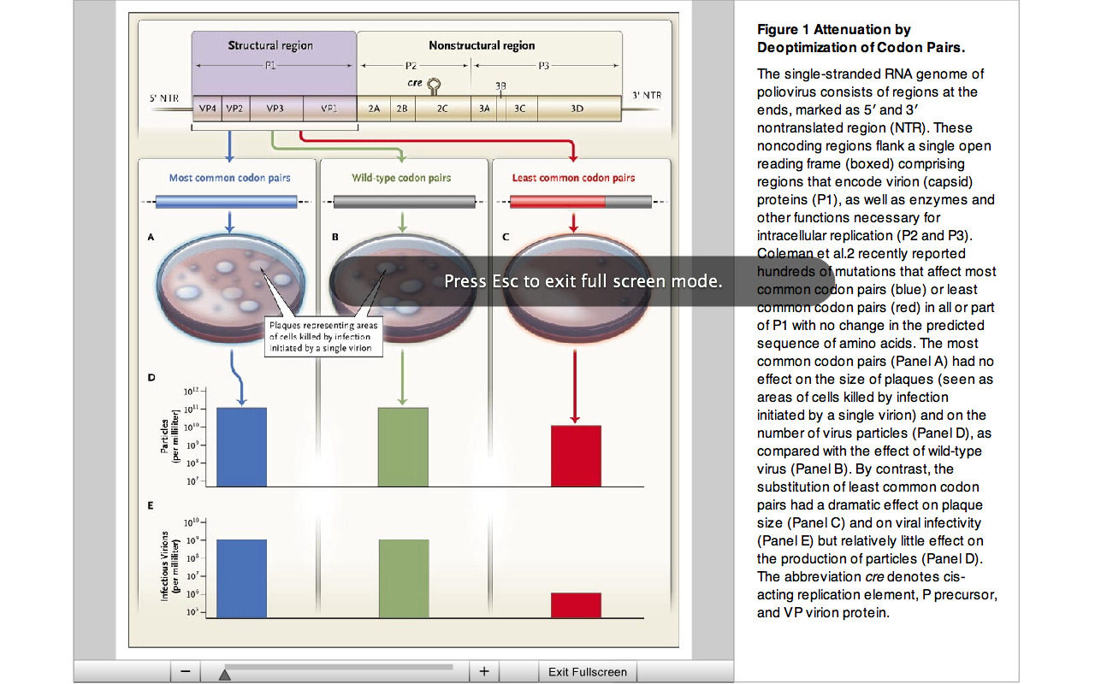
These viruses were tested for their ability to replicate in cell culture, as measured by the number of virus particles and of total infectious virions. The results were striking: replacement of most common codon pairs with those that were least common had little effect on total particle production, and yet the infectivity of these particles was reduced to about 0.001 times that of wild-type. So, codon-deoptimized viruses were marked by a reduction in virus-particle-specific infectivity up to 1,000-fold.

Slide 11

June 16, 2010 – A team of molecular biologists and computer scientists at Stony Brook University have used this novel method to weaken (attenuate) influenza virus by way of designing hundreds of mutations to its genetic code to create an effective vaccine.
Members of the SBU research team.
Influenza

Slide 12
Bibliography
1. Live attenuated influenza virus vaccines by computer-aided rational design- Steffen Mueller, J Robert Coleman, Dimitris Papamichail, Charles B Ward, Anjaruwee Nimnual, Bruce Furcher, Steven Skiena & Eckard Wimmer
2. http://ghr.nlm.nih.gov/handbook/basics/dna
3. Exploiting Redundancy in the Genetic Code - Steven Skiena
http://www.cs.sunysb.edu/~skiena/talks/talk-bio.pdf
4. ‘Natural Selection and Algorithmic Design of mRNA’ - BARRY COHEN and STEVEN SKIENA, JOURNAL OF COMPUTATIONAL BIOLOGY Volume 10, Numbers 3–4, 2003
5. “Reduction of the Rate of Poliovirus Protein Synthesis through Large-Scale Codon Deoptimization Causes Attenuation of Viral Virulence by Lowering Specific Infectivity” - Steffen Mueller,¹* Dimitris Papamichail,² J. Robert Coleman,¹ Steven Skiena,² and Eckard Wimmer¹

