Slide 1
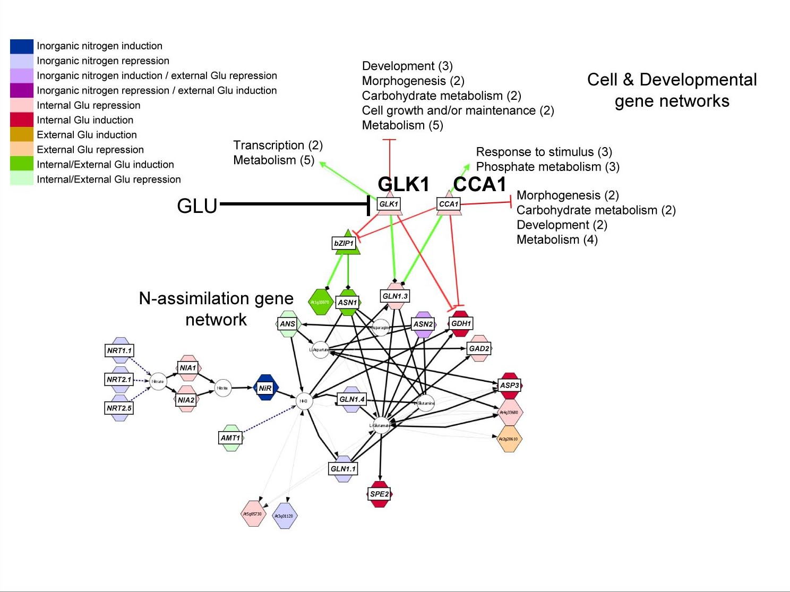
(A)
(C)
Development (3)
Morphogenesis (2)
Carbohydrate metabolism (2)
Cell growth and/or maintenance (2)
Metabolism (5)
Edge
Node
Node
(B)
Functional Relationships
Transcription (2)
Metabolism (5)
Response to stimulus (3)
Phosphate metabolism (3)
Metabolic Reaction
KEGG
Metabolic
Gene
Morphogenesis (2)
Development (2)
Metabolism (4)
Carbohydrate metabolism (2)
Metabolite
Regulatory
Protein
Protein:DNA
Transfac
Target
Gene
Protein
Protein:Protein
‘Interologs’
Protein
miRNA
microRNA:RNA
Target
RNA
Text mining
Geneways
Gene
Gene
Arabidopsis Multi-Network
16,562 nodes
97,423 interactions
Gutierrez et al 2007 [10]
Katari et al 2009 [1]
Notes:
Figure 3

Slide 2
Interaction | Source | # of Interactions | Reference
Biochemical Pathways | KEGG | 11,197 | Kanehisa et al., 2004 [21]
 | ARACYC | 17,498 | Mueller et al., 2003 [?]
Regulatory Interactions | AGRIS | 343 | Davuluri et al., 2003 [39]
Protein Interactions | INTERACTOME | 39,317 | Geisler-Lee et al., 2007 [30]
 | AtPID | 24,418 | Cui et al., 2008 [?]
 | BIND | 949 | Bader et al., 2002 [31]
 | MADS BOX | 263 | De Folter et al., 2005 [25]
 | Calmodulin | 755 | Popescu et al., 2007 [26]
microRNA:mRNA Interactions | Collated by Dr. Pam Green’s lab (mirBASE & ASRP) | 582 | Gustafson et al., 2005 [41] Lu et al., 2005 [42] Griffiths-Jones et al., 2006 [40]
Literature based interactions | GENEWAYS | 107 | Rzhetsky et al., 2004 [?]
Katari et al 2009 [1]

Slide 3
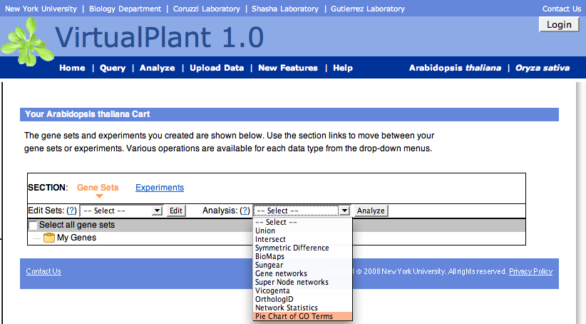
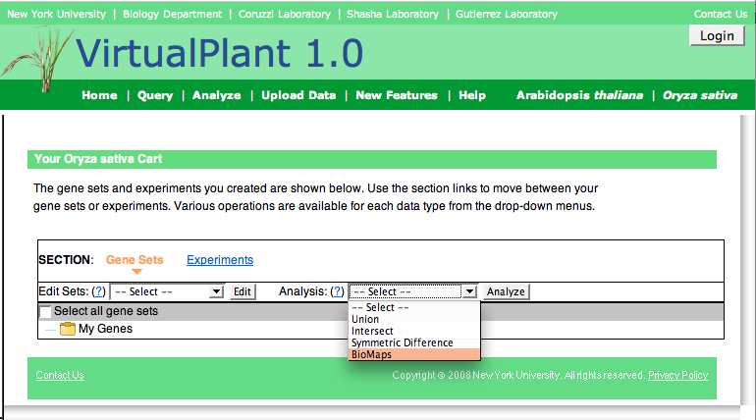
Arabidopsis
www.virtualplant.org
Arabidopsis Features:
Union
Intersect
Symmetric Difference
BioMaps
Sungear
Gene Networks
Super-Node Networks
Vicogenta
OrthologID
Network Statistics
Pie Chart of GO Terms
Rice
Rice Features:
Union
Intersect
Symmetric Difference
BioMaps
Katari et al 2009 [1]

Slide 4
(A) PIPELINE – AIM 3 (generalizes Aim 1)
(B) TIME SERIES DATA – AIM 2
Experimental Data
time series data about Target
Target species genome
Reference species genome
Experimental Data (expression/RNA-seq) about target species
Infer & validate Target regulatory network inferred from time series experiments by analyzing the effect of ignoring data
Aim 2, step 6
Analyze target data via correlation & machine learning
Aim 2, step 5
Homology algorithm & parameters Ai
Determine homologous genes between reference & target genomes
Homology algorithm & parameters Aim4, step 1
Analyze target data via correlation & other methods
Aim 1, step 3
Predicted edges in target genome’s network
(C) VALIDATION
Inference rules
Rice genome
Validated
network in
reference species (protein:protein, metabolic and/or validated
regulatory edges)
Aim 1, step 1
Validated
network in Target (protein-protein, metabolic and /or validated
regulatory edges)
Aim 1, step 5
Generate topologically isomorphic random
Target networks
Aim 1, step 6
Infer gene network in target species by combining predicted edges with edges supported by homology from “ground truth” network in
reference species
Aim 1, step 4
Homologs
Inferred network in target species
Compare
inferred, “ground truth” & topologically matched random Target networks with “NetSect”
Aim 1, step 6
Expand to Multinetwork
Aim 1, step 7
Nodes:
Analytic process
Biological data
Edges:
predicted
experimental
Configuration
input
Final
Output
validation
parameters

Slide 5
REMOVE
Metabolic Interactions |  | Homology
 |  | Reciprocal Best Hit |  | Blast e-value < 1e-20
 |  | Inferred | Validated | Inferred | Validated
 |  | 3594 | 1883 (52.4%) | 1,268,094 | 7045 (0.56%)
Correlation | > 0.5 | 850 | 547* (64.4%) | 23,686 | 1464* (6.2%)
 | > 0.7 | 387 | 275* (71.1%) | 8,745 | 649* (7.4%)

Slide 6
Interaction network | Best CSNI methodology | Recall | Precision
Protein-protein | Homology by reverse top BLAST hits | 4% | 56%
Metabolic | Homology by InParanoid | 18% | 95%

Slide 7







State Space Modeling of Transcriptome Time Series Data
Time
t
t + 1
t + 2
t + 3
t + 4
gene zk
Gene expression
gene zi
f
f
f
f
TFs t
Red Squares represent a
transition function f to be learned
TFs t+3
TFs + targets t+1
TFs + targets t+4
Explain target gene expression as function of up to 4 input TFs
Krouk et al 2010 submitted [18]

Slide 8
(A) Transcriptome Data Set – time series
0
3
6
9
12
15
20 min
(B) State Space
observation model g
Y(t)
Y(t+1)
Y(t+2)
Y(t+3)
Y(t+4)
Y(t+5)
Predict 20 min?
dynamic model f
Z(t)
Z(t+1)
Z(t+2)
Z(t+3)
Z(t+4)
Z(t+5)
0
3
6
9
12
15
71% correct
Training set
0
3
6
9
12
15 min
“Leave-out-last” test:
Predict direction of change of each gene @ 20 min
(C) Naive
51% correct
Training set
12
15 min
“Trend-forecast” test:
Predict direction of change of each gene @ 20 min
Krouk et al 2010 submitted [18]

Slide 9
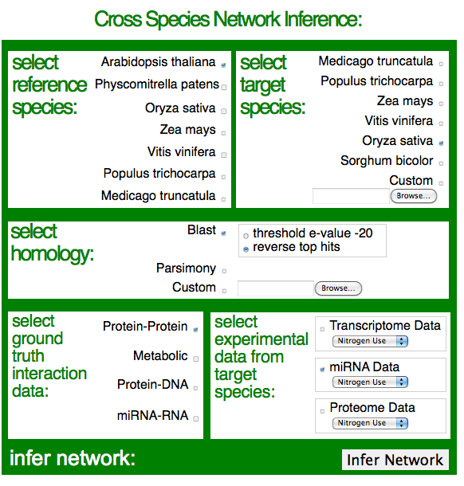
www.CrossSpecies.org

