Slide 1
Lecture 13 – Optical Flow
With slides from R. Szeliski, S. Lazebnik, S. Seitz, A. Efros, C. Liu & F. Durand

Slide 2
Admin
Assignment 3 due
Assignment 4 out
Deadline: Thursday 11th Dec
THIS IS A HARD DEADLINE (I have to hand in grades on 12th)
Course assessment forms

Slide 3
Overview
Segmentation in Video
Optical flow
Motion Magnification

Slide 4
Video
A video is a sequence of frames captured over time
Now our image data is a function of space (x, y) and time (t)

Slide 5
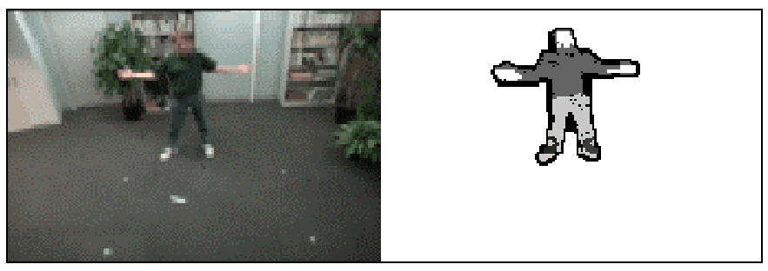
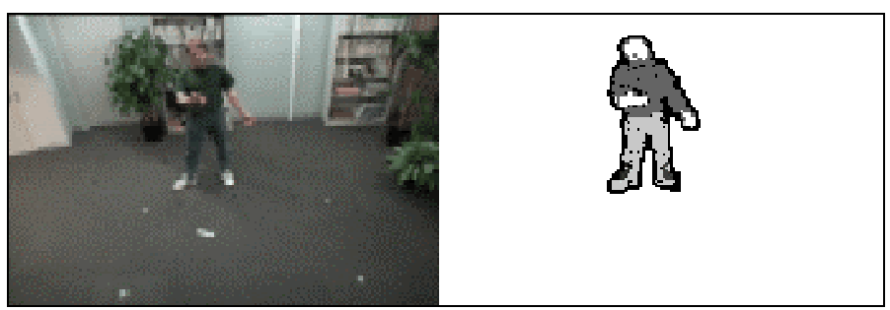
Applications of segmentation to video
Background subtraction
A static camera is observing a scene
Goal: separate the static background from the moving foreground

Slide 6
Applications of segmentation to video
Background subtraction
Form an initial background estimate
For each frame:
Update estimate using a moving average
Subtract the background estimate from the frame
Label as foreground each pixel where the magnitude of the difference is greater than some threshold
Use median filtering to “clean up” the results

Slide 7
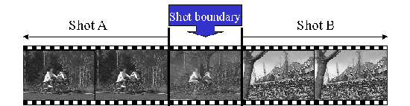
Applications of segmentation to video
Background subtraction
Shot boundary detection
Commercial video is usually composed of shots or sequences showing the same objects or scene
Goal: segment video into shots for summarization and browsing (each shot can be represented by a single keyframe in a user interface)
Difference from background subtraction: the camera is not necessarily stationary

Slide 8
Applications of segmentation to video
Background subtraction
Shot boundary detection
For each frame
Compute the distance between the current frame and the previous one
Pixel-by-pixel differences
Differences of color histograms
Block comparison
If the distance is greater than some threshold, classify the frame as a shot boundary

Slide 9
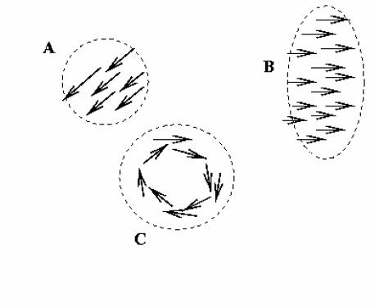
Applications of segmentation to video
Background subtraction
Shot boundary detection
Motion segmentation
Segment the video into multiple coherently moving objects

Slide 10
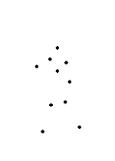
Motion and perceptual organization
Even “impoverished” motion data can evoke a strong percept

Slide 11
Motion and perceptual organization
Even “impoverished” motion data can evoke a strong percept

Slide 12
Uses of motion
Estimating 3D structure
Segmenting objects based on motion cues
Learning dynamical models
Recognizing events and activities
Improving video quality (motion stabilization)

Slide 13
Motion estimation techniques
Direct methods
Directly recover image motion at each pixel from spatio-temporal image brightness variations
Dense motion fields, but sensitive to appearance variations
Suitable for video and when image motion is small
Feature-based methods
Extract visual features (corners, textured areas) and track them over multiple frames
Sparse motion fields, but more robust tracking
Suitable when image motion is large (10s of pixels)

Slide 14
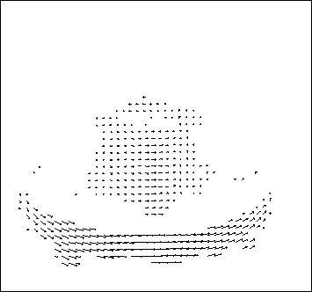
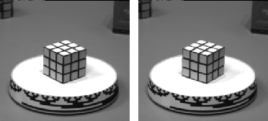
Motion field
The motion field is the projection of the 3D scene motion into the image

Slide 15
Motion field and parallax
P(t) is a moving 3D point
Velocity of scene point: V = dP/dt
p(t) = (x(t),y(t)) is the projection of P in the image
Apparent velocity v in the image: given by components v_{x} = dx/dt and v_{y} = dy/dt
These components are known as the motion field of the image
P(t+dt)
P(t)
V
v
p(t+dt)
p(t)

Slide 16
Motion field and parallax
P(t+dt)
P(t)
V
To find image velocity v, differentiate p with respect to t (using quotient rule):
v
p(t+dt)
p(t)
Image motion is a function of both the 3D motion (V) and the depth of the 3D point (Z)
Notes:
Quotient rule for differentiation: D(f/g) = (g f’ – g’ f)/g^2

Slide 17
Motion field and parallax
Pure translation: V is constant everywhere

Slide 18
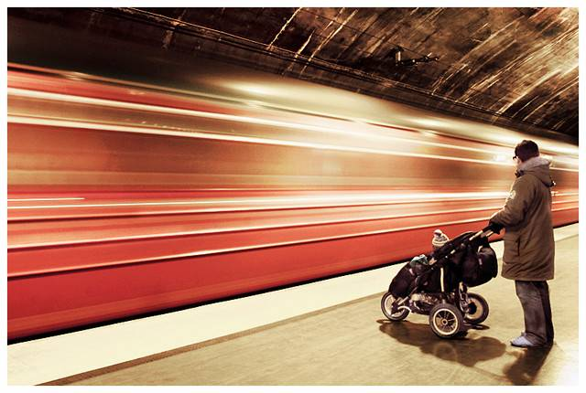
Motion field and parallax
Pure translation: V is constant everywhere
V_{z} is nonzero:
Every motion vector points toward (or away from) v₀, the vanishing point of the translation direction

Slide 19
Motion field and parallax
Pure translation: V is constant everywhere
V_{z} is nonzero:
Every motion vector points toward (or away from) v₀, the vanishing point of the translation direction
V_{z} is zero:
Motion is parallel to the image plane, all the motion vectors are parallel
The length of the motion vectors is inversely proportional to the depth Z

Slide 20
Overview
Segmentation in Video
Optical flow
Motion Magnification

Slide 21
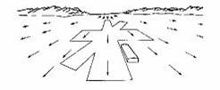
Optical flow
Combination of slides from Rick Szeliski, Steve Seitz, Alyosha Efros and Bill Freeman and Fredo Durand

Slide 22
Motion estimation: Optical flow
Will start by estimating motion of each pixel separately
Then will consider motion of entire image

Slide 23
Why estimate motion?
Lots of uses
Track object behavior
Correct for camera jitter (stabilization)
Align images (mosaics)
3D shape reconstruction
Special effects

Slide 24


Problem definition: optical flow
How to estimate pixel motion from image H to image I?
Solve pixel correspondence problem
given a pixel in H, look for nearby pixels of the same color in I
Key assumptions
color constancy: a point in H looks the same in I
For grayscale images, this is brightness constancy
small motion: points do not move very far
This is called the optical flow problem

Slide 25


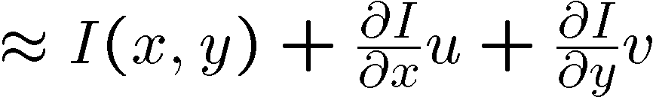
Optical flow constraints (grayscale images)
Let’s look at these constraints more closely
brightness constancy: Q: what’s the equation?
H(x,y)=I(x+u, y+v)
small motion: (u and v are less than 1 pixel)
suppose we take the Taylor series expansion of I:
Notes:
A: H(x,y) = I(x+u, y+v)

Slide 26



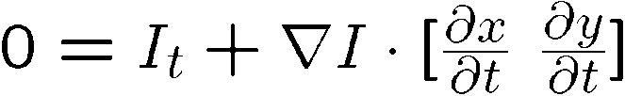
Optical flow equation
Combining these two equations
In the limit as u and v go to zero, this becomes exact

Slide 27

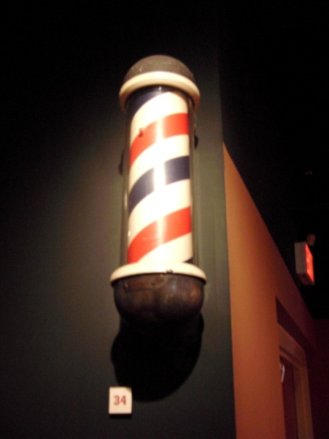
Optical flow equation
Q: how many unknowns and equations per pixel?
2 unknowns, one equation
Intuitively, what does this constraint mean?
The component of the flow in the gradient direction is determined
The component of the flow parallel to an edge is unknown
This explains the Barber Pole illusion
http://www.sandlotscience.com/Ambiguous/Barberpole_Illusion.htm
http://www.liv.ac.uk/~marcob/Trieste/barberpole.html
http://en.wikipedia.org/wiki/Barber's_pole
Notes:
A: u and v are unknown, 1 equation

Slide 28
Aperture problem

Slide 29
Aperture problem

Slide 30
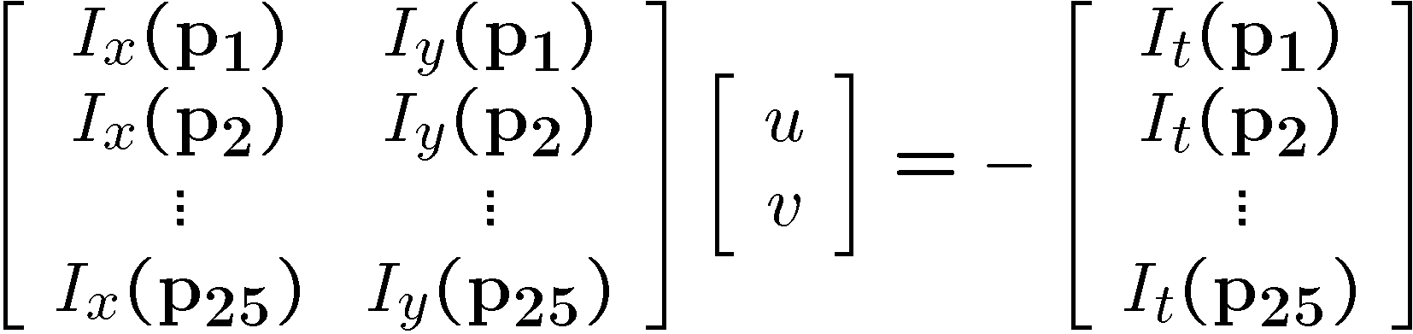



Solving the aperture problem
How to get more equations for a pixel?
Basic idea: impose additional constraints
most common is to assume that the flow field is smooth locally
one method: pretend the pixel’s neighbors have the same (u,v)
If we use a 5x5 window, that gives us 25 equations per pixel!

Slide 31
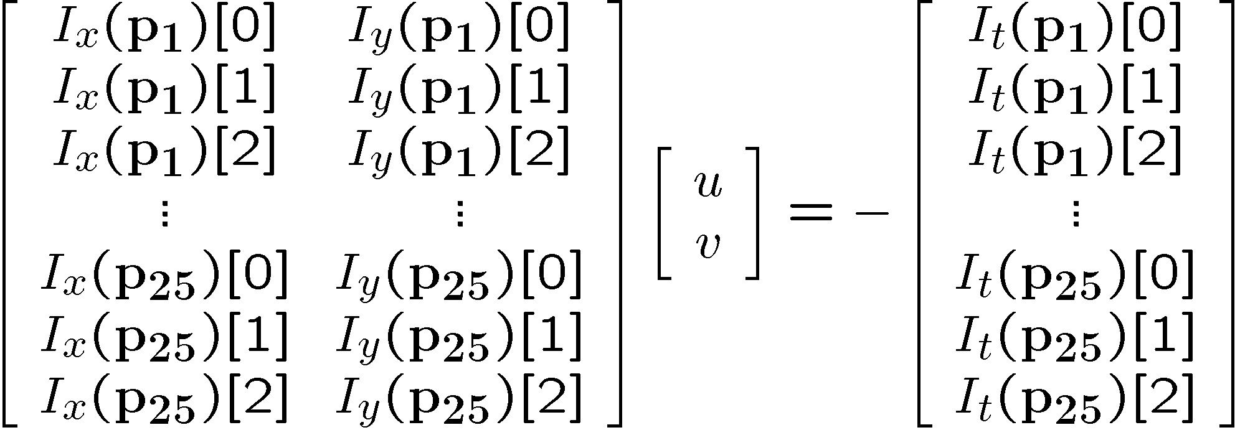


RGB version
How to get more equations for a pixel?
Basic idea: impose additional constraints
most common is to assume that the flow field is smooth locally
one method: pretend the pixel’s neighbors have the same (u,v)
If we use a 5x5 window, that gives us 25*3 equations per pixel!
Note that RGB is not enough to disambiguate because R, G & B are correlated Just provides better gradient

Slide 32






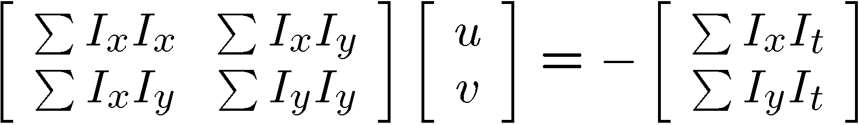


Lukas-Kanade flow
Prob: we have more equations than unknowns
Solution: solve least squares problem
minimum least squares solution given by solution (in d) of:
The summations are over all pixels in the K x K window
This technique was first proposed by Lukas & Kanade (1981)

Slide 33
Aperture Problem and Normal Flow
The gradient constraint:
Defines a line in the (u,v) space
v
Normal Flow:
u

Slide 34
Combining Local Constraints
v
u
etc.

Slide 35
Conditions for solvability
Optimal (u, v) satisfies Lucas-Kanade equation
When is This Solvable?
A^{T}A should be invertible
A^{T}A should not be too small due to noise
eigenvalues λ₁ and λ₂ of A^{T}A should not be too small
A^{T}A should be well-conditioned
λ₁/ λ₂ should not be too large (λ₁ = larger eigenvalue)
A^{T}A is solvable when there is no aperture problem

Slide 36
Eigenvectors of A^{T}A
Recall the Harris corner detector: M = A^{T}A is the second moment matrix
The eigenvectors and eigenvalues of M relate to edge direction and magnitude
The eigenvector associated with the larger eigenvalue points in the direction of fastest intensity change
The other eigenvector is orthogonal to it
Notes:
Suppose M = vv^T . What are the eigenvectors and eigenvalues? Start by considering Mv

Slide 37
Interpreting the eigenvalues
Classification of image points using eigenvalues of the second moment matrix:
λ₂
“Edge” λ₂ >> λ₁
“Corner” λ₁ and λ₂ are large, λ₁ ~ λ₂
λ₁ and λ₂ are small
“Flat” region
“Edge” λ₁ >> λ₂
λ₁

Slide 38
Local Patch Analysis

Slide 39
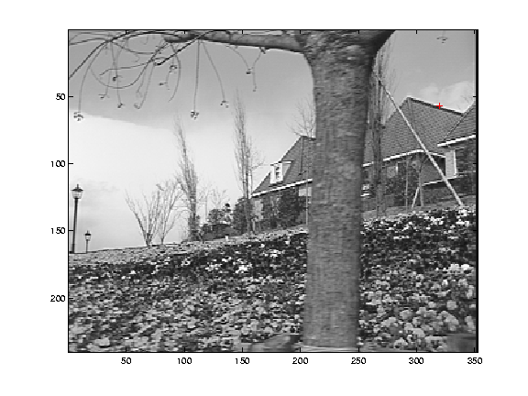
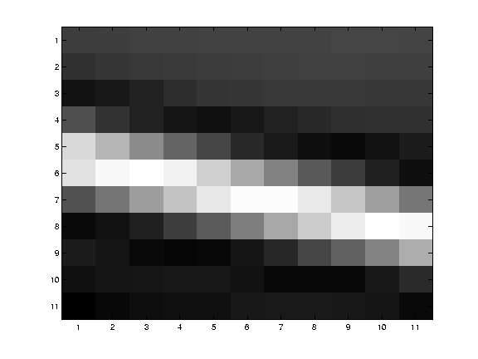
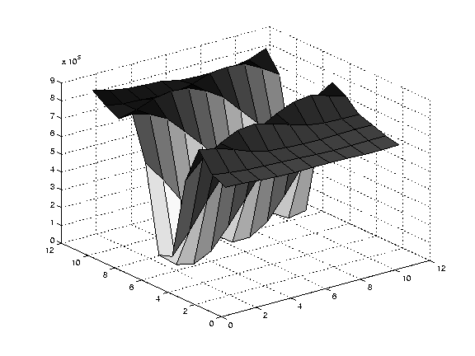
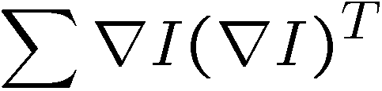
Edge
large gradients, all the same
large λ₁, small λ₂

Slide 40
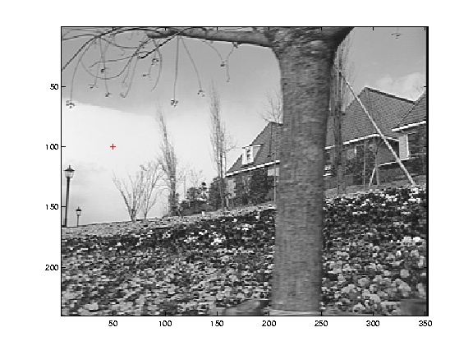
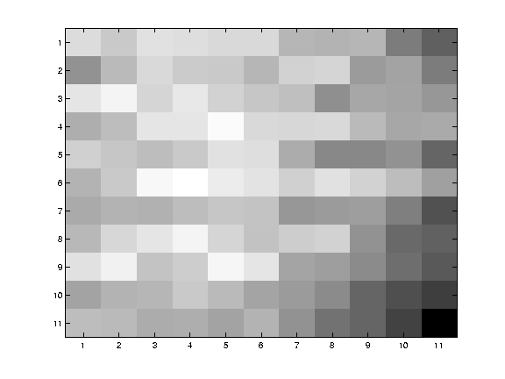
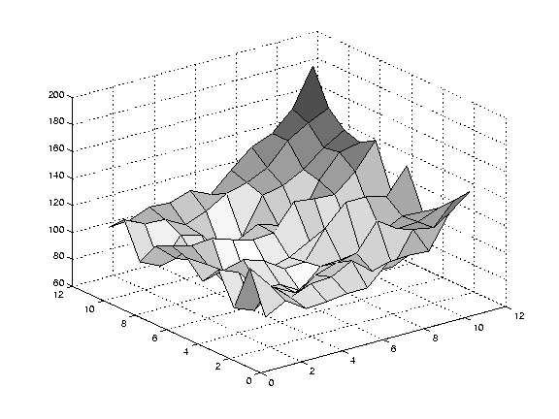
Low texture region
gradients have small magnitude
small λ₁, small λ₂

Slide 41
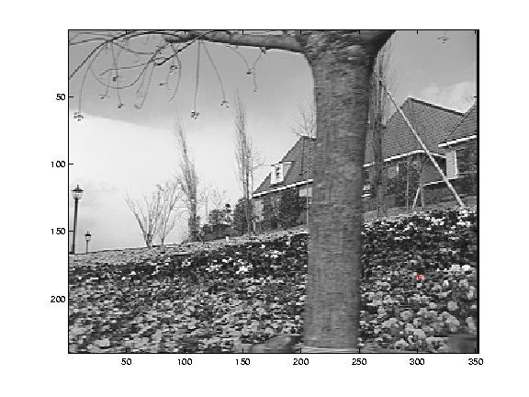
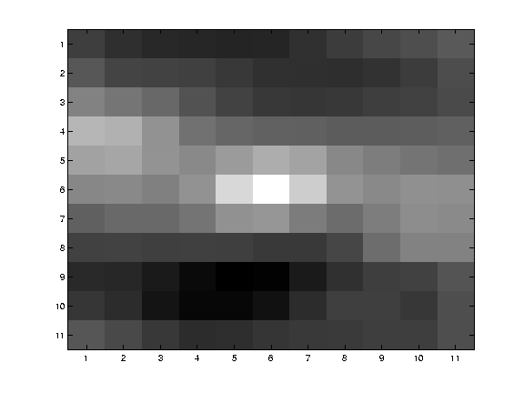
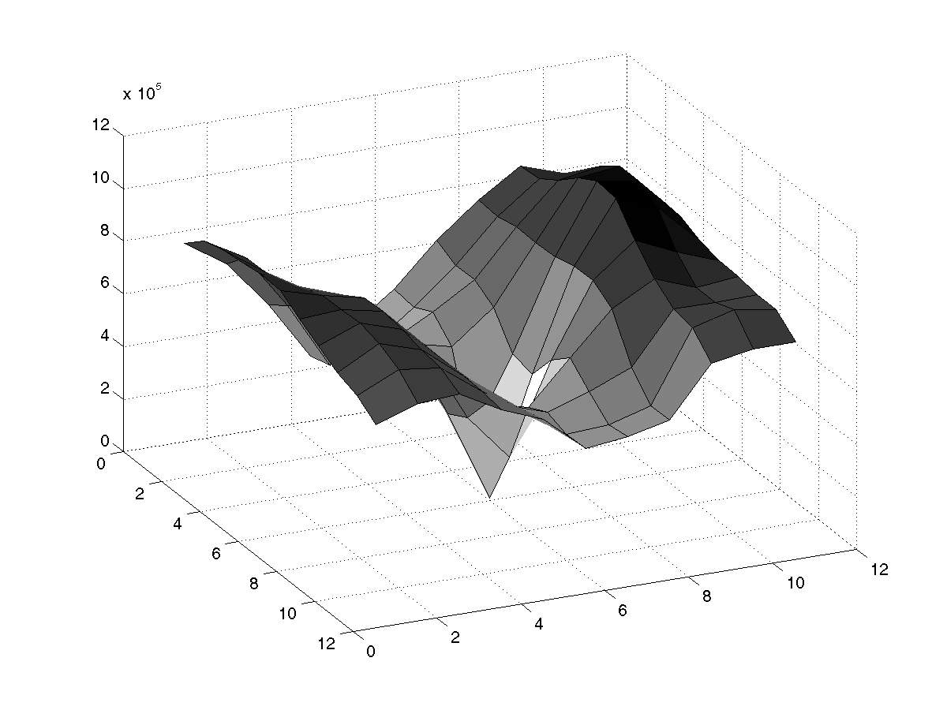
High textured region
gradients are different, large magnitudes
large λ₁, large λ₂

Slide 42
Observation
This is a two image problem BUT
Can measure sensitivity by just looking at one of the images!
This tells us which pixels are easy to track, which are hard
very useful later on when we do feature tracking...

Slide 43
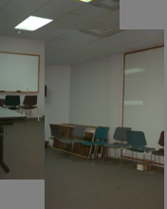
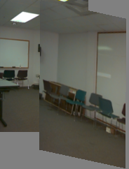
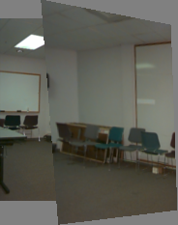
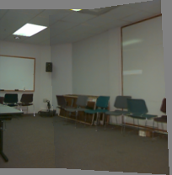
Motion models
Translation
Affine
Perspective
3D rotation
2 unknowns
6 unknowns
8 unknowns
3 unknowns

Slide 44
Affine motion
Substituting into the brightness constancy equation:

Slide 45
Affine motion
Substituting into the brightness constancy equation:
Each pixel provides 1 linear constraint in 6 unknowns
Least squares minimization:

Slide 46
Errors in Lukas-Kanade
What are the potential causes of errors in this procedure?
Suppose A^{T}A is easily invertible
Suppose there is not much noise in the image
When our assumptions are violated
Brightness constancy is not satisfied
The motion is not small
A point does not move like its neighbors
window size is too large
what is the ideal window size?

Slide 47
Iterative Refinement
Iterative Lukas-Kanade Algorithm
Estimate velocity at each pixel by solving Lucas-Kanade equations
Warp H towards I using the estimated flow field
- use image warping techniques
Repeat until convergence

Slide 48
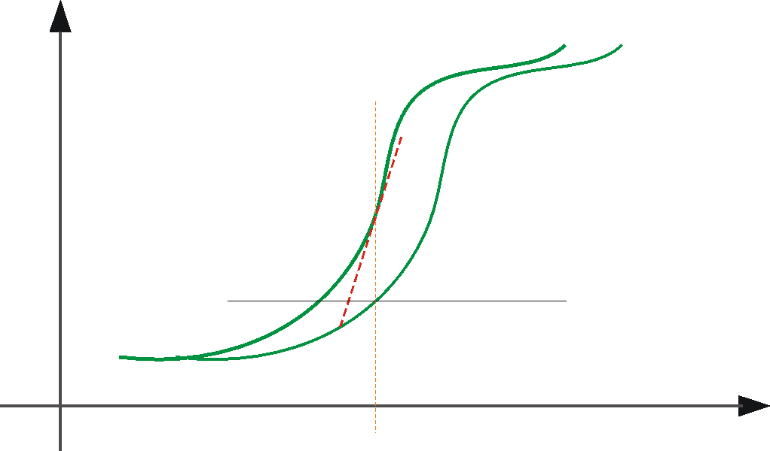
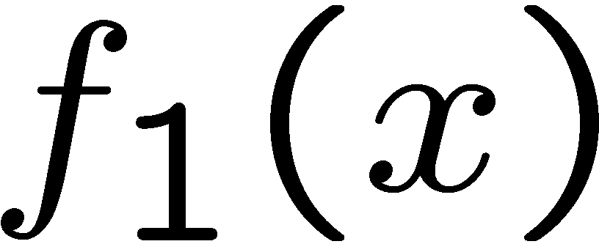
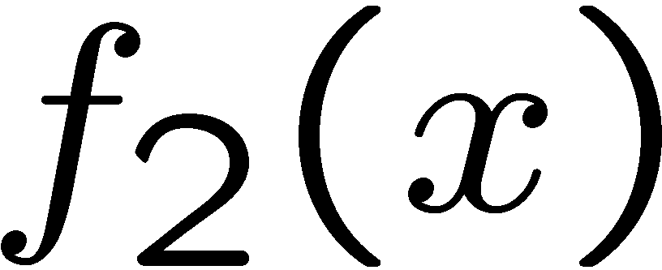

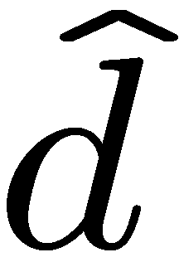
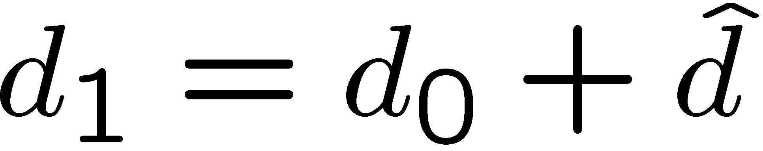
Optical Flow: Iterative Estimation
estimate update
Initial guess:
Estimate:
x₀
x
(using d for displacement here instead of u)

Slide 49
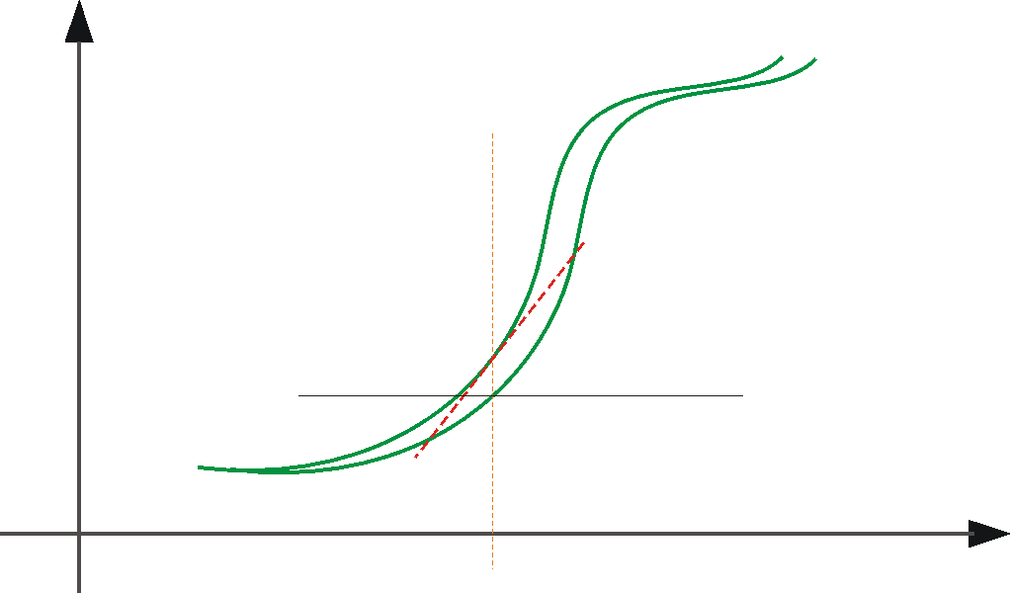
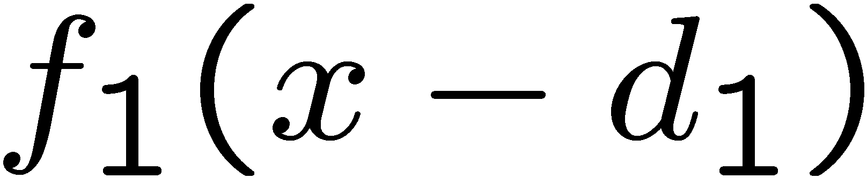
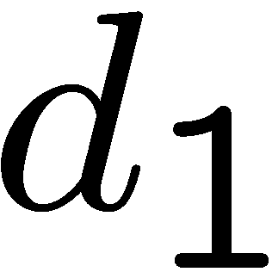
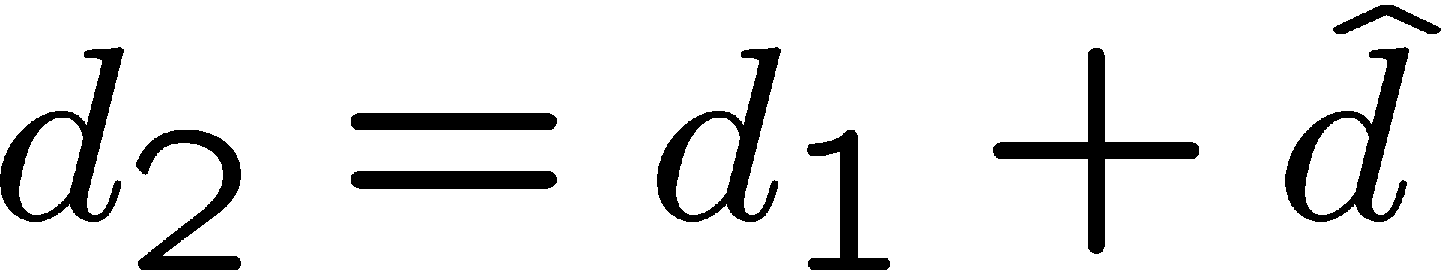
Optical Flow: Iterative Estimation
estimate update
Initial guess:
Estimate:
x₀
x

Slide 50
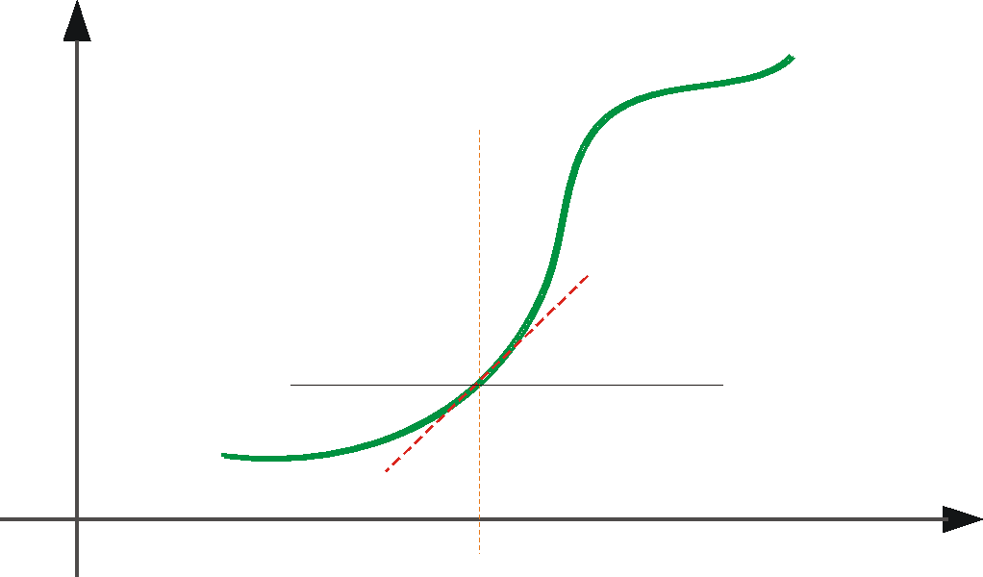
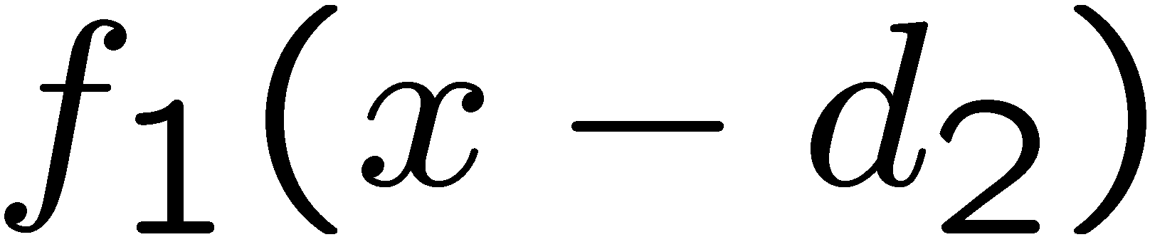
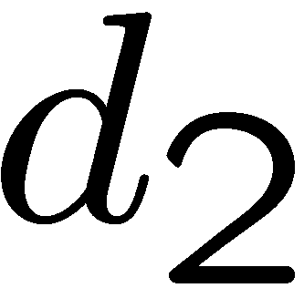
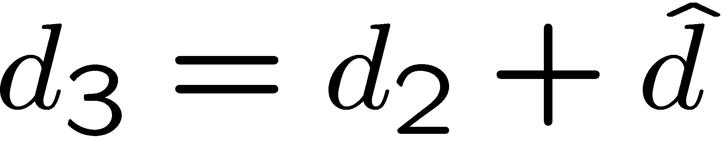
Optical Flow: Iterative Estimation
estimate update
Initial guess:
Estimate:
Initial guess:
Estimate:
x₀
x

Slide 51
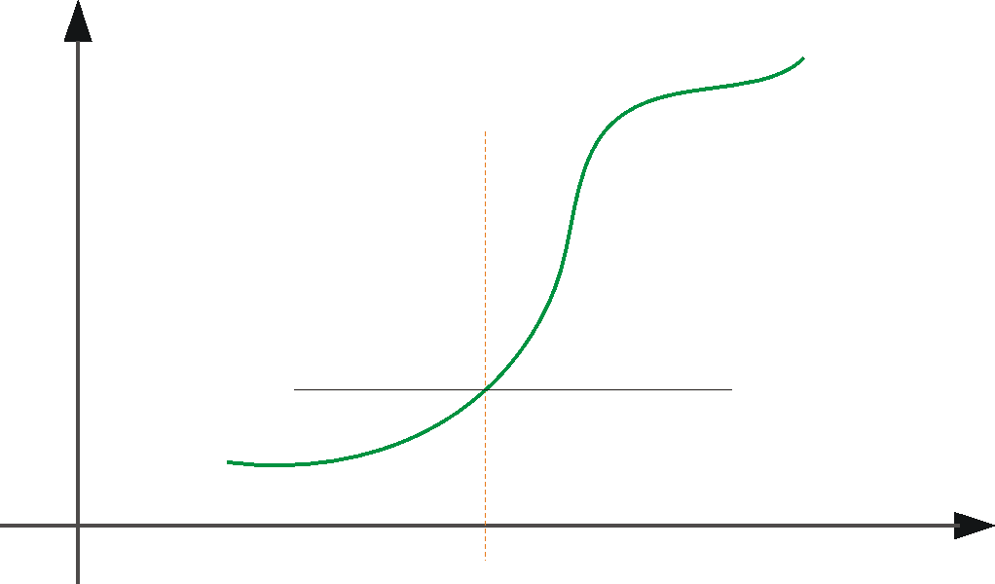
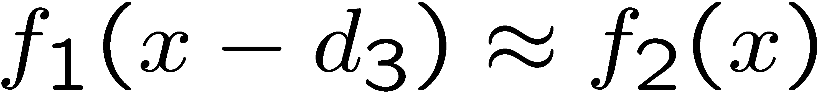
Optical Flow: Iterative Estimation
x₀
x

Slide 52
Optical Flow: Iterative Estimation
Some Implementation Issues:
Warping is not easy (ensure that errors in warping are smaller than the estimate refinement)
Warp one image, take derivatives of the other so you don’t need to re-compute the gradient after each iteration.
Often useful to low-pass filter the images before motion estimation (for better derivative estimation, and linear approximations to image intensity)

Slide 53
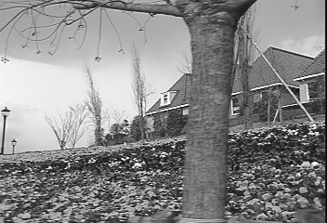
Revisiting the small motion assumption
Is this motion small enough?
Probably not—it’s much larger than one pixel (2nd order terms dominate)
How might we solve this problem?

Slide 54

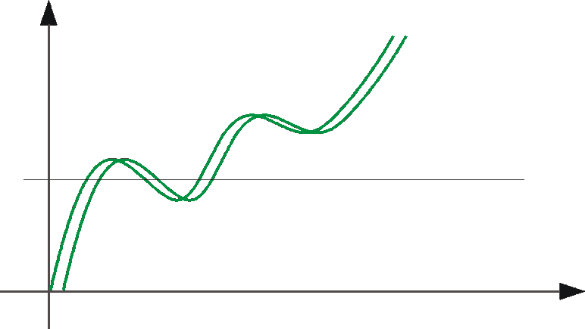
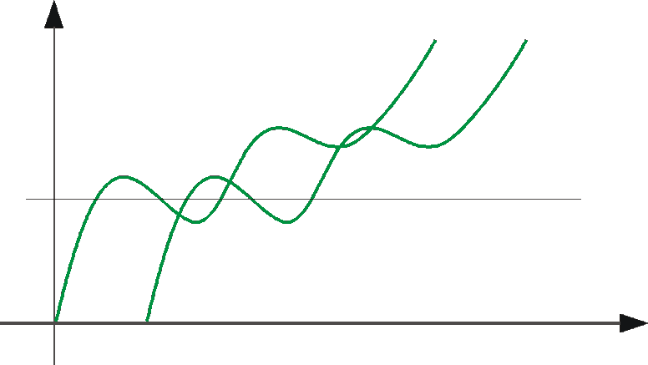
Optical Flow: Aliasing
Temporal aliasing causes ambiguities in optical flow because images can have many pixels with the same intensity.
I.e., how do we know which ‘correspondence’ is correct?
actual shift
estimated shift
nearest match is correct (no aliasing)
nearest match is incorrect (aliasing)
To overcome aliasing: coarse-to-fine estimation.

Slide 55
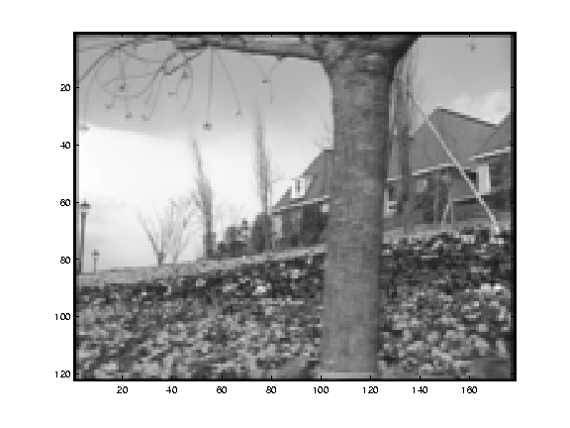
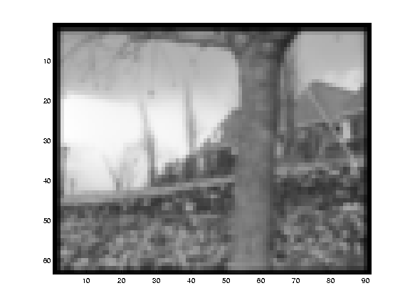
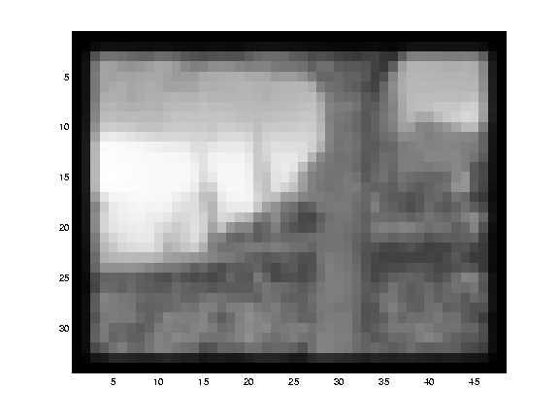

Reduce the resolution!

Slide 56
Coarse-to-fine optical flow estimation
u=1.25 pixels
u=2.5 pixels
u=5 pixels
image H
u=10 pixels
image I
image H
image I
Gaussian pyramid of image H
Gaussian pyramid of image I

Slide 57
Coarse-to-fine optical flow estimation
run iterative L-K
warp & upsample
run iterative L-K
.
.
.
image J
image I
image H
image I
Gaussian pyramid of image H
Gaussian pyramid of image I

Slide 58
Beyond Translation
So far, our patch can only translate in (u,v)
What about other motion models?
rotation, affine, perspective
Same thing but need to add an appropriate Jacobian
See Szeliski’s survey of Panorama stitching

Slide 59
Recap: Classes of Techniques
Feature-based methods (e.g. SIFT+Ransac+regression)
Extract visual features (corners, textured areas) and track them over multiple frames
Sparse motion fields, but possibly robust tracking
Suitable especially when image motion is large (10-s of pixels)
Direct-methods (e.g. optical flow)
Directly recover image motion from spatio-temporal image brightness variations
Global motion parameters directly recovered without an intermediate feature motion calculation
Dense motion fields, but more sensitive to appearance variations
Suitable for video and when image motion is small (< 10 pixels)

Slide 60

Block-based motion prediction
Break image up into square blocks
Estimate translation for each block
Use this to predict next frame, code difference (MPEG-2)

Slide 61

Retiming
http://www.realviz.com/retiming.htm

Slide 62



Layered motion
Break image sequence into “layers” each of which has a coherent motion
J. Wang and E. Adelson. Layered Representation for Motion Analysis. CVPR 1993.

Slide 63
What are layers?
Each layer is defined by an alpha mask and an affine motion model
J. Wang and E. Adelson. Layered Representation for Motion Analysis. CVPR 1993.

Slide 64
Motion segmentation with an affine model
Local flow estimates
J. Wang and E. Adelson. Layered Representation for Motion Analysis. CVPR 1993.

Slide 65
Motion segmentation with an affine model
Equation of a plane (parameters a₁, a₂, a₃ can be found by least squares)
J. Wang and E. Adelson. Layered Representation for Motion Analysis. CVPR 1993.

Slide 66
Motion segmentation with an affine model
Equation of a plane (parameters a₁, a₂, a₃ can be found by least squares)
1D example
u(x,y)
True flow
Local flow estimate
“Foreground”
“Background”
Segmented estimate
Line fitting
Occlusion
J. Wang and E. Adelson. Layered Representation for Motion Analysis. CVPR 1993.

Slide 67
How do we estimate the layers?
Compute local flow in a coarse-to-fine fashion
Obtain a set of initial affine motion hypotheses
Divide the image into blocks and estimate affine motion parameters in each block by least squares
Eliminate hypotheses with high residual error
Perform k-means clustering on affine motion parameters
Merge clusters that are close and retain the largest clusters to obtain a smaller set of hypotheses to describe all the motions in the scene
Iterate until convergence:
Assign each pixel to best hypothesis
Pixels with high residual error remain unassigned
Perform region filtering to enforce spatial constraints
Re-estimate affine motions in each region
J. Wang and E. Adelson. Layered Representation for Motion Analysis. CVPR 1993.

Slide 68



Example result
J. Wang and E. Adelson. Layered Representation for Motion Analysis. CVPR 1993.

Slide 69
Overview
Segmentation in Video
Optical flow
Motion Magnification

Slide 70

Motion Magnification
Ce Liu Antonio Torralba William T. Freeman
Frédo Durand Edward H. Adelson
Computer Science and Artificial Intelligence Laboratory
Massachusetts Institute of Technology

Slide 71


Motion Microscopy
How can we see all the subtle motions in a video sequence?
Original sequence
Magnified sequence

Slide 72


Naïve Approach
Magnify the estimated optical flow field
Rendering by warping
Original sequence
Magnified by naïve approach

Slide 73
Layer-based Motion Magnification Processing Pipeline
Input raw video
sequence
Video
Registration
Feature point
tracking
Trajectory
clustering
Output magnified
video sequence
Magnification,
texture fill-in,
rendering
Layer
segmentation
Dense optical
flow interpolation
User
interaction
Layer-based motion analysis
Stationary camera, stationary background

Slide 74
Layer-based Motion Magnification Video Registration
Input raw video
sequence
Video
Registration
Feature point
tracking
Trajectory
clustering
Output magnified
video sequence
Magnification,
texture fill-in,
rendering
Layer
segmentation
Dense optical
flow interpolation
User
interaction
Layer-based motion analysis
Stationary camera, stationary background

Slide 75
Robust Video Registration
Find feature points with Harris corner detector on the reference frame
Brute force tracking feature points
Select a set of robust feature points with inlier and outlier estimation (most from the rigid background)
Warp each frame to the reference frame with a global affine transform

Slide 76
Motion Magnification Pipeline Feature Point Tracking
Input raw video
sequence
Video
Registration
Feature point
tracking
Trajectory
clustering
Output magnified
video sequence
Magnification,
texture fill-in,
rendering
Layer
segmentation
Dense optical
flow interpolation
User
interaction
Layer-based motion analysis

Slide 77


Challenges (1)

Slide 78





Adaptive Region of Support
Confused by occlusion !
Brute force search
Learn adaptive region of support using expectation-maximization (EM) algorithm
time
region of support
time

Slide 79

Challenges (2)

Slide 80




Trajectory Pruning
Tracking with adaptive region of support
Outlier detection and removal by interpolation
Nonsense at full occlusion!
inlier probability
Outliers
time

Slide 81


Comparison
Without adaptive region of support and trajectory pruning
With adaptive region of support and trajectory pruning

Slide 82
Motion Magnification Pipeline Trajectory Clustering
Input raw video
sequence
Video
Registration
Feature point
tracking
Trajectory
clustering
Output magnified
video sequence
Magnification,
texture fill-in,
rendering
Layer
segmentation
Dense optical
flow interpolation
User
interaction
Layer-based motion analysis

Slide 83

Normalized Complex Correlation
The similarity metric should be independent of phase and magnitude
Normalized complex correlation

Slide 84




Spectral Clustering
Trajectory
Two clusters
Trajectory
Affinity matrix
Clustering
Reordering of affinity matrix

Slide 85

Clustering Results

Slide 86
Motion Magnification Pipeline Dense Optical Flow Field
Input raw video
sequence
Video
Registration
Feature point
tracking
Trajectory
clustering
Output magnified
video sequence
Magnification,
texture fill-in,
rendering
Layer
segmentation
Dense optical
flow interpolation
User
interaction
Layer-based motion analysis

Slide 87



From Sparse Feature Points to Dense Optical Flow Field
Interpolate dense optical flow field using locally weighted linear regression
Flow vectors of clustered sparse feature points
Dense optical flow field of cluster 1 (leaves)
Dense optical flow field of cluster 2 (swing)
Cluster 1: leaves
Cluster 2: swing

Slide 88
Motion Magnification Pipeline Layer Segmentation
Input raw video
sequence
Video
Registration
Feature point
tracking
Trajectory
clustering
Output magnified
video sequence
Magnification,
texture fill-in,
rendering
Layer
segmentation
Dense optical
flow interpolation
User
interaction
Layer-based motion analysis

Slide 89
Motion Layer Assignment
Assign each pixel to a motion cluster layer, using four cues:
Motion likelihood—consistency of pixel’s intensity if it moves with the motion of a given layer (dense optical flow field)
Color likelihood—consistency of the color in a layer
Spatial connectivity—adjacent pixels favored to belong the same group
Temporal coherence—label assignment stays constant over time
Energy minimization using graph cuts

Slide 90

Segmentation Results
Two additional layers: static background and outlier

Slide 91
Motion Magnification Pipeline Editing and Rendering
Input raw video
sequence
Video
Registration
Feature point
tracking
Trajectory
clustering
Output magnified
video sequence
Magnification,
texture fill-in,
rendering
Layer
segmentation
Dense optical
flow interpolation
User
interaction
Layer-based motion analysis

Slide 92








Layered Motion Representation for Motion Processing
Background
Layer 1
Layer 2
Layer mask
Occluding layers
Appearance for each layer before texture filling-in
Appearance for each layer after texture filling-in
Appearance for each layer after user editing

Slide 93
Video
Motion Magnification

Slide 94

Is the Baby Breathing?

Slide 95

Are the Motions Real?
Original
Magnified
y
y
x
x
t
t

Slide 96





Are the Motions Real?
Original
Magnified
Original
Magnified
time
time

Slide 97
Applications
Education
Entertainment
Mechanical engineering
Medical diagnosis

Slide 98
Conclusion
Motion magnification
A motion microscopy technique
Layer-based motion processing system
Robust feature point tracking
Reliable trajectory clustering
Dense optical flow field interpolation
Layer segmentation combining multiple cues

Slide 99

Thank you!
Motion Magnification
Ce Liu Antonio Torralba William T. Freeman Frédo Durand Edward H. Adelson
Computer Science and Artificial Intelligence Laboratory
Massachusetts Institute of Technology

